Slide 1
Updates
President Saúl
November 13, 2023

Slide 2
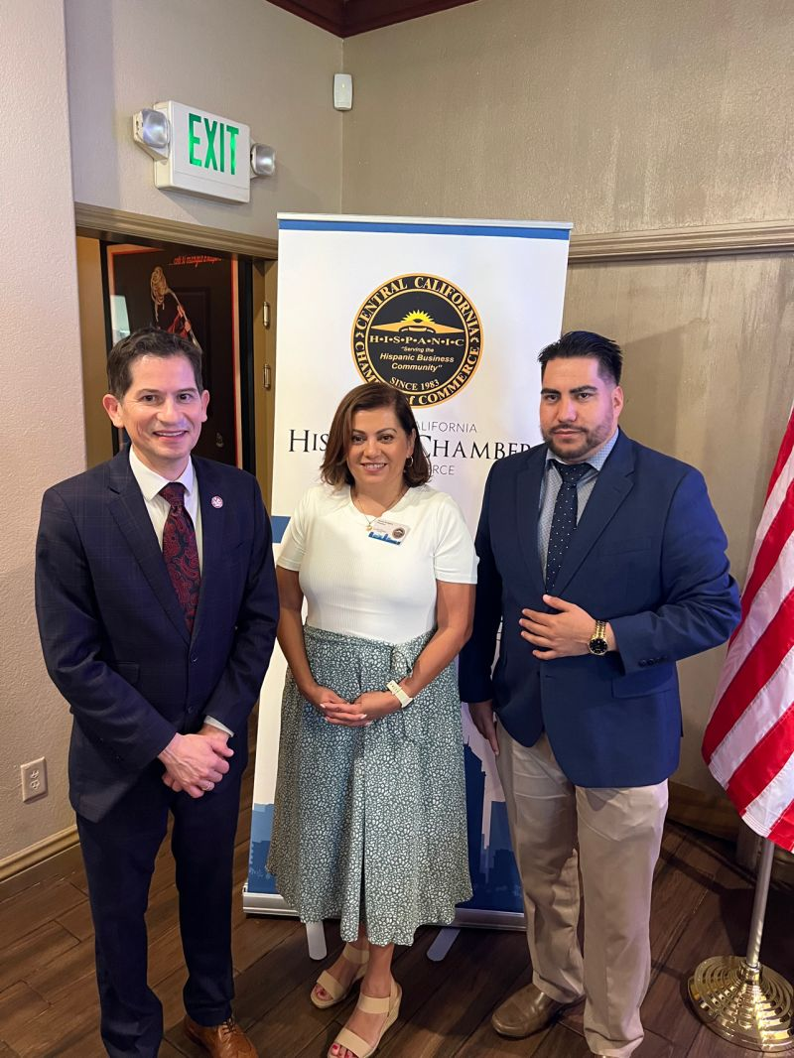
Central California Hispanic Chamber of Commerce

Slide 3
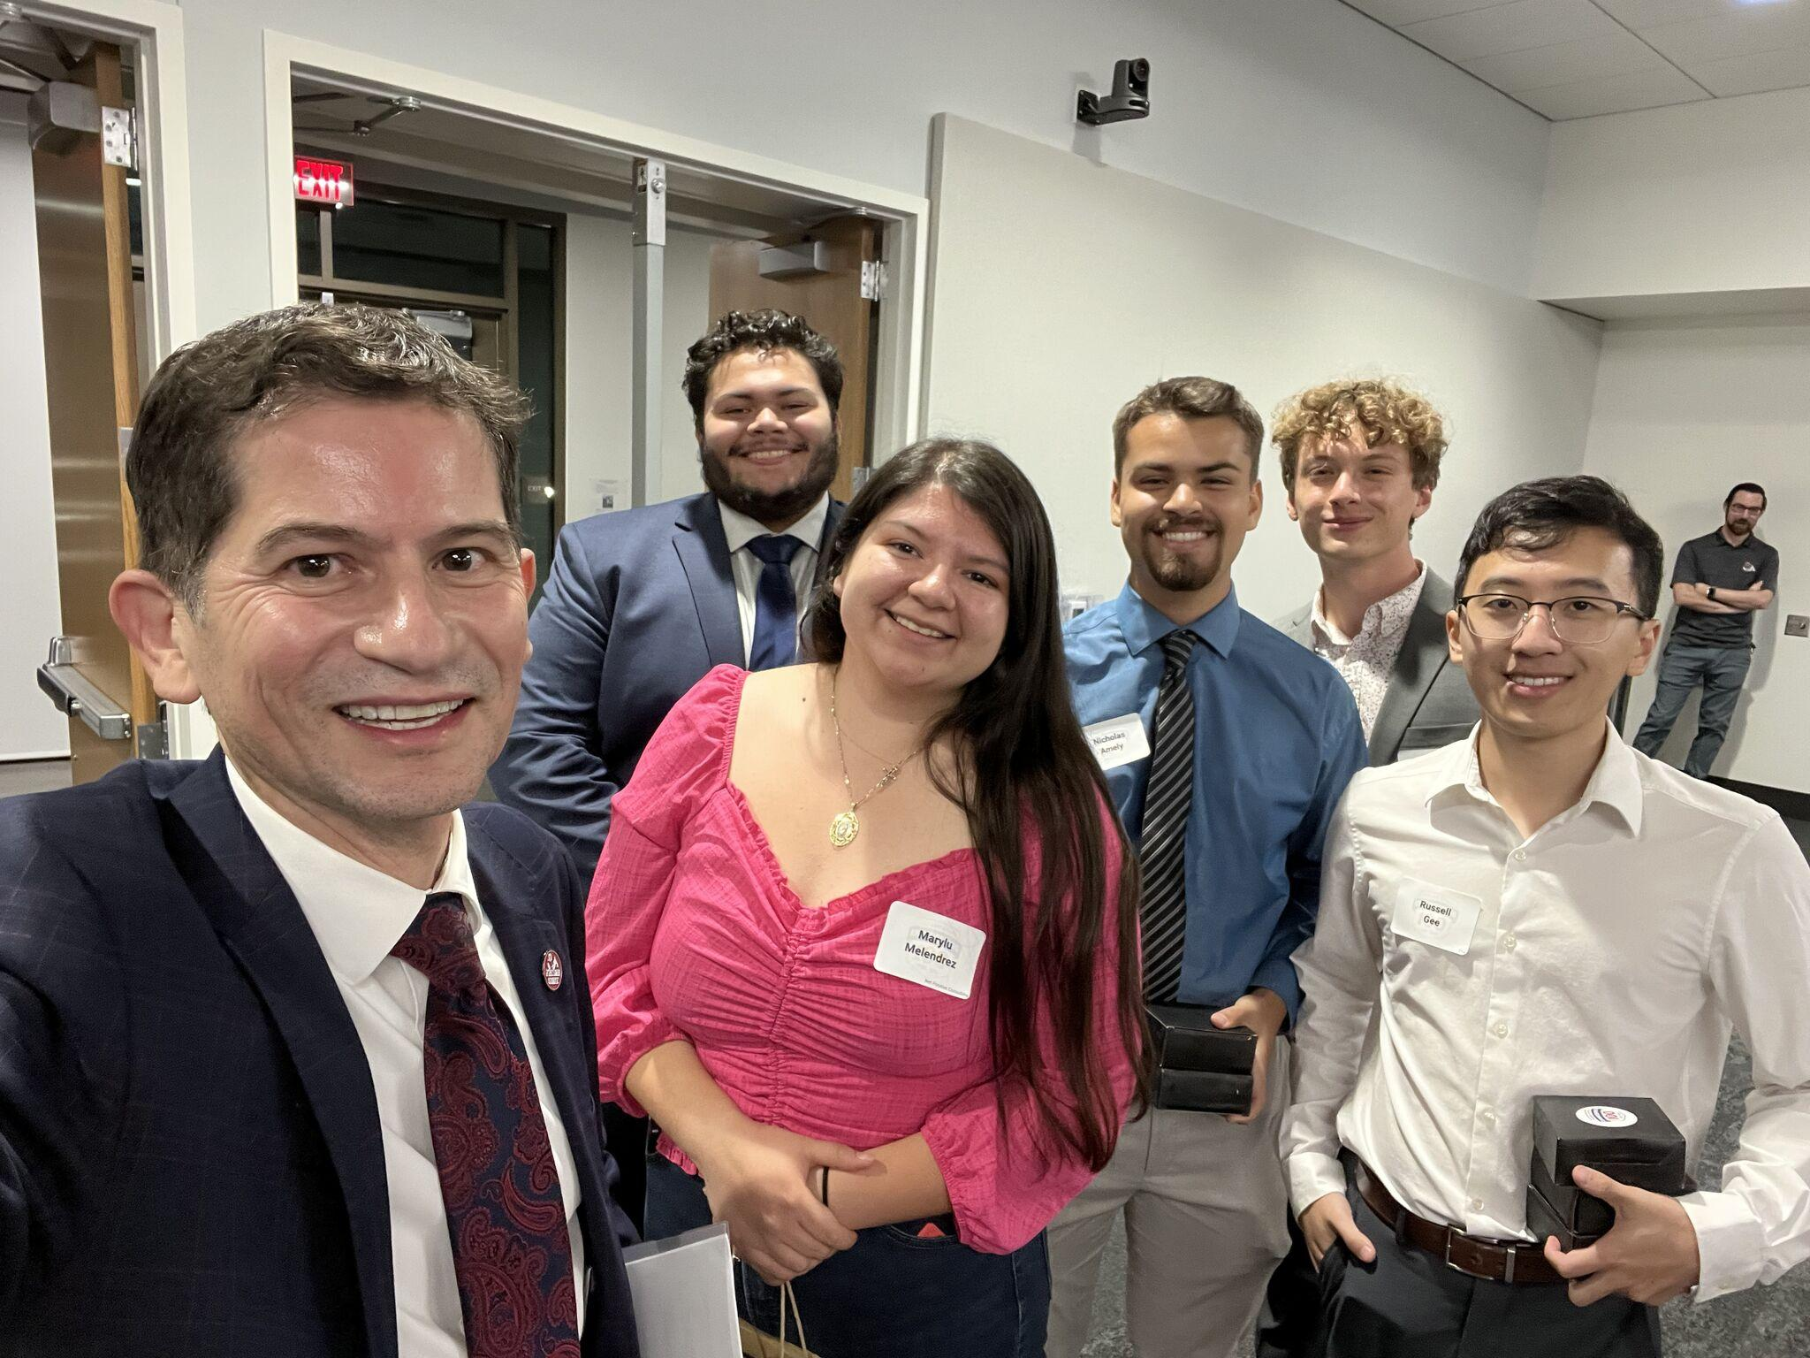
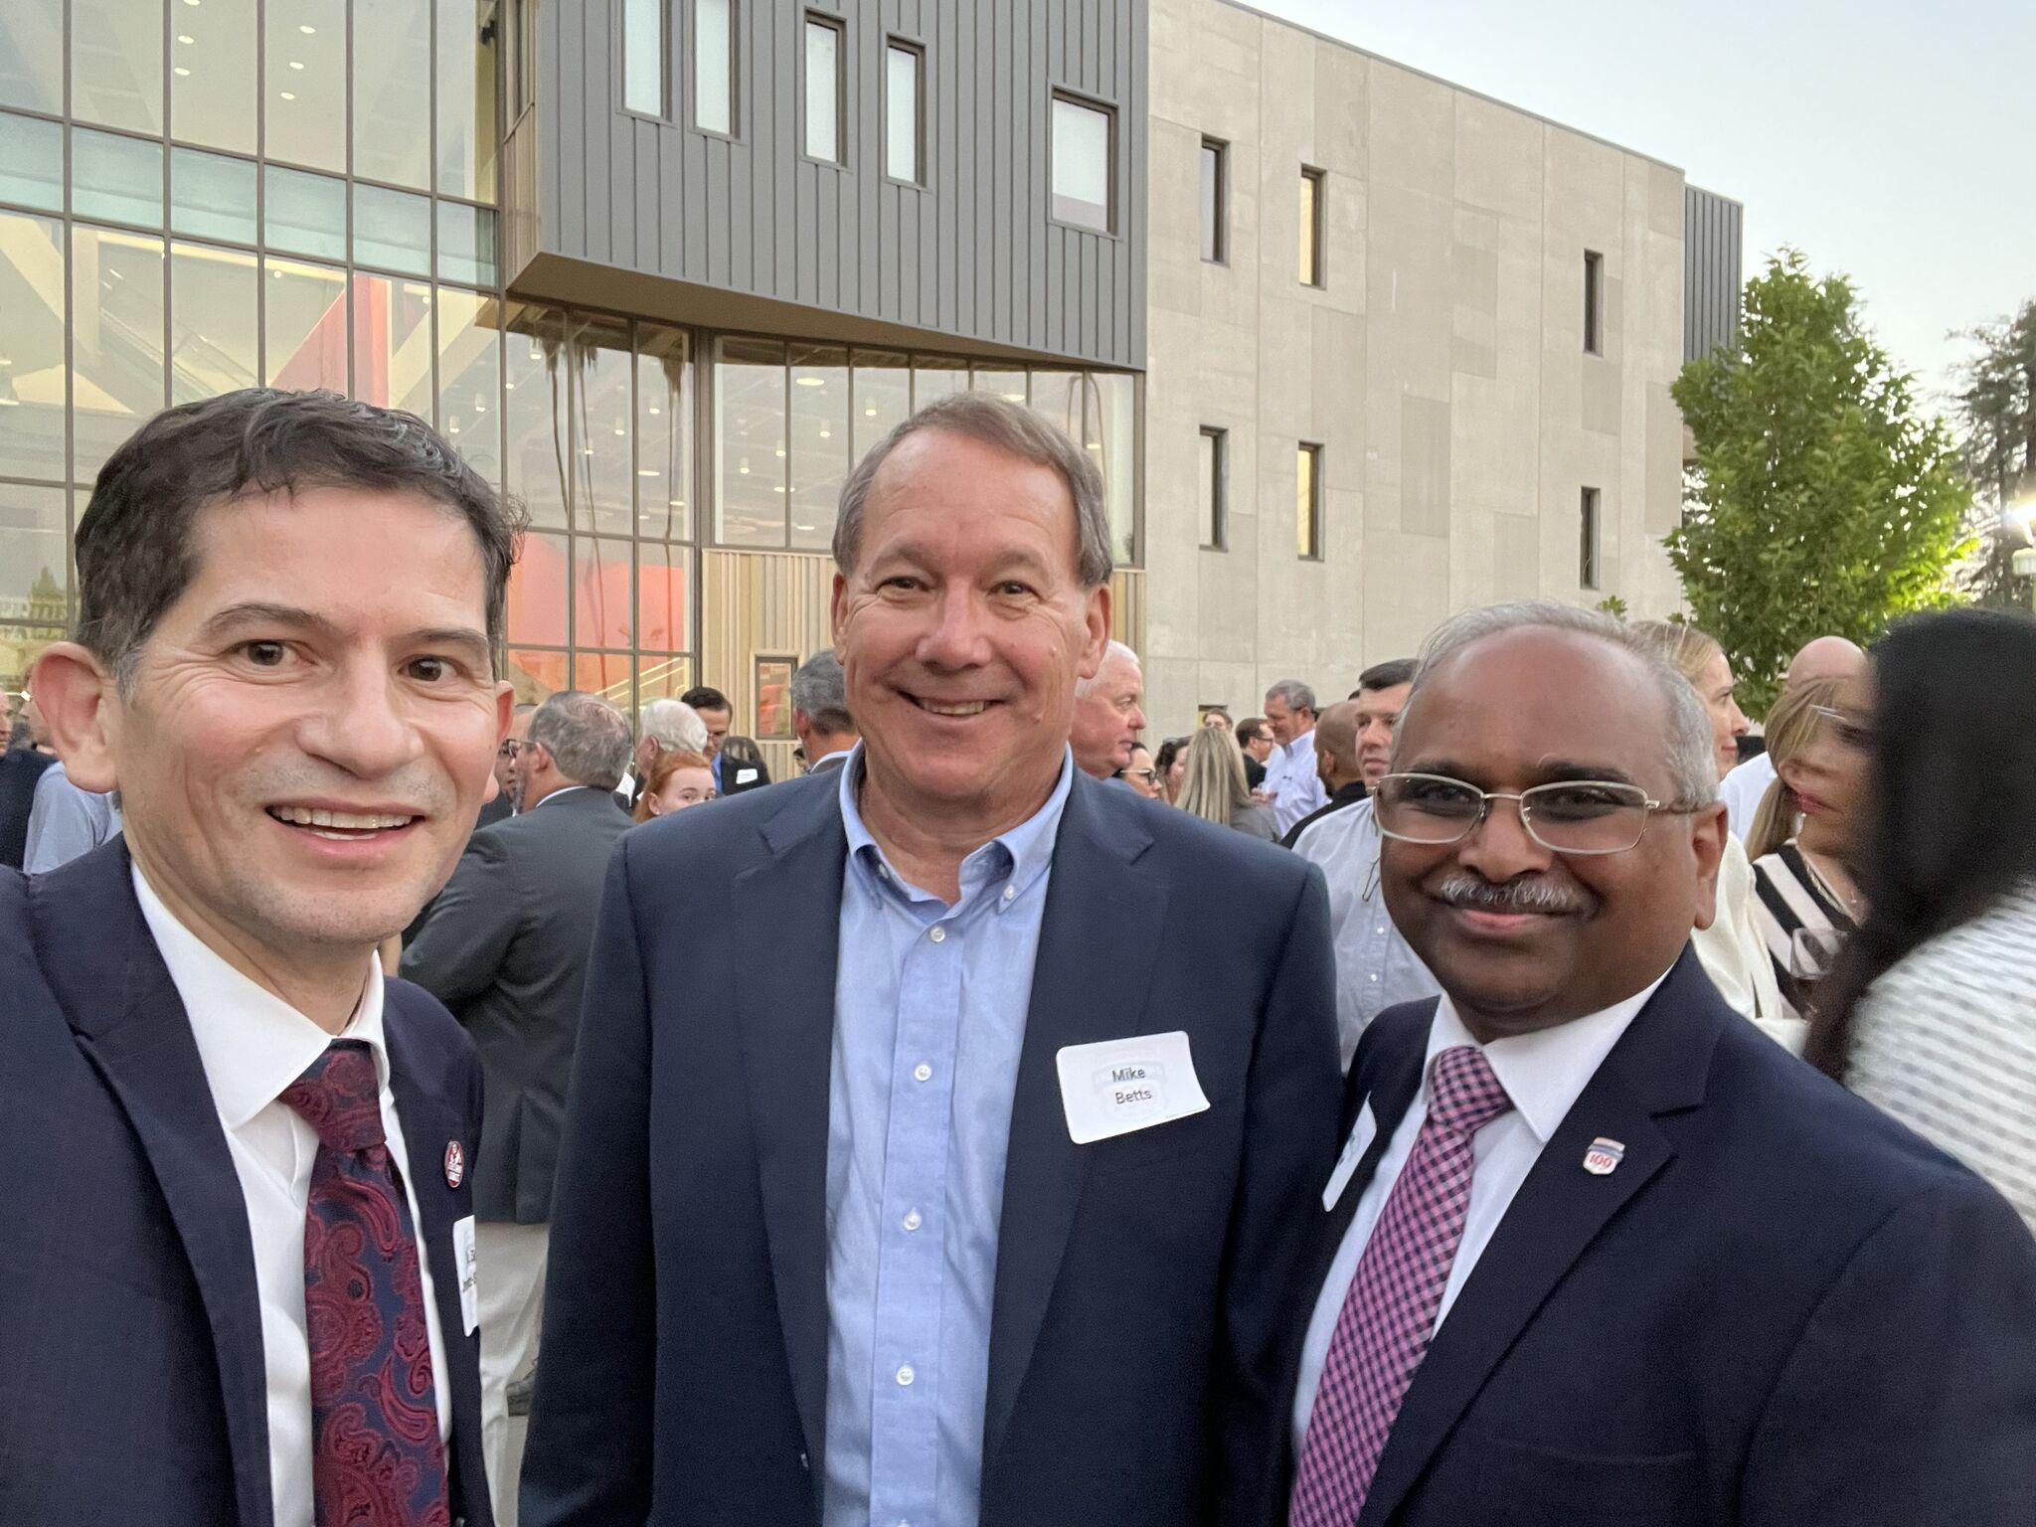
Celebrated 100 years of
Engineering at Fresno State

Slide 4
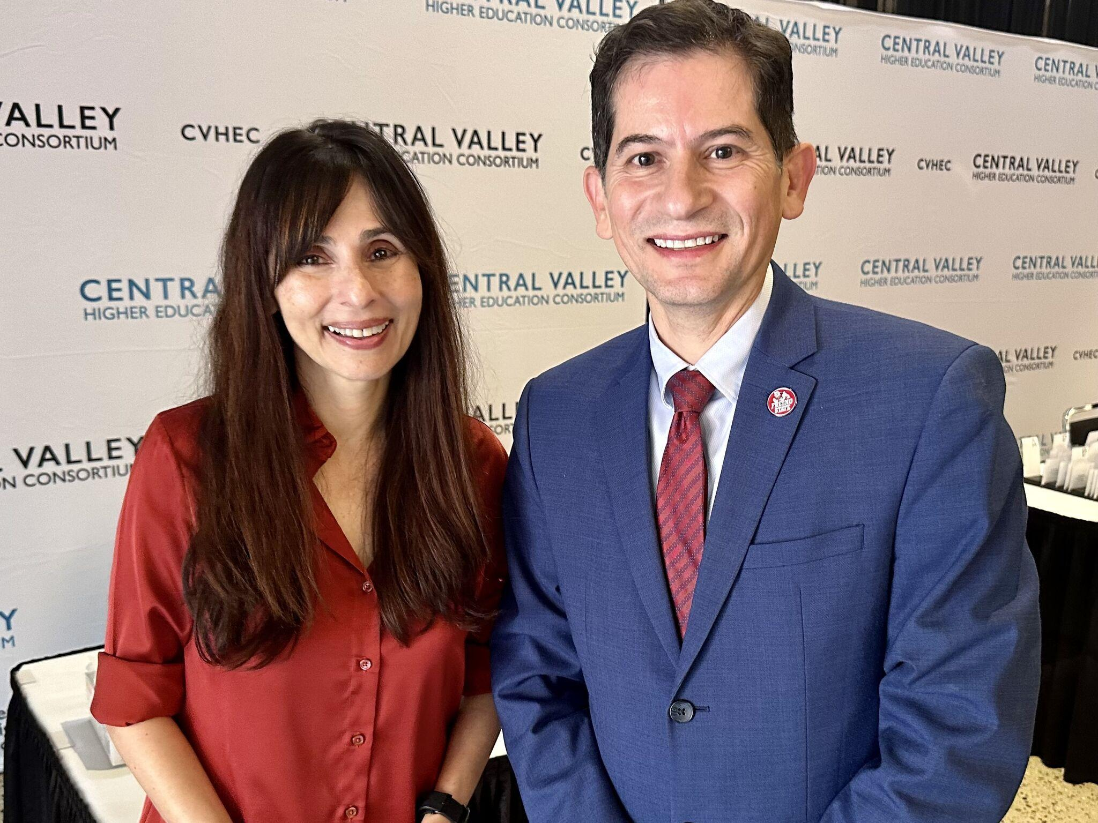
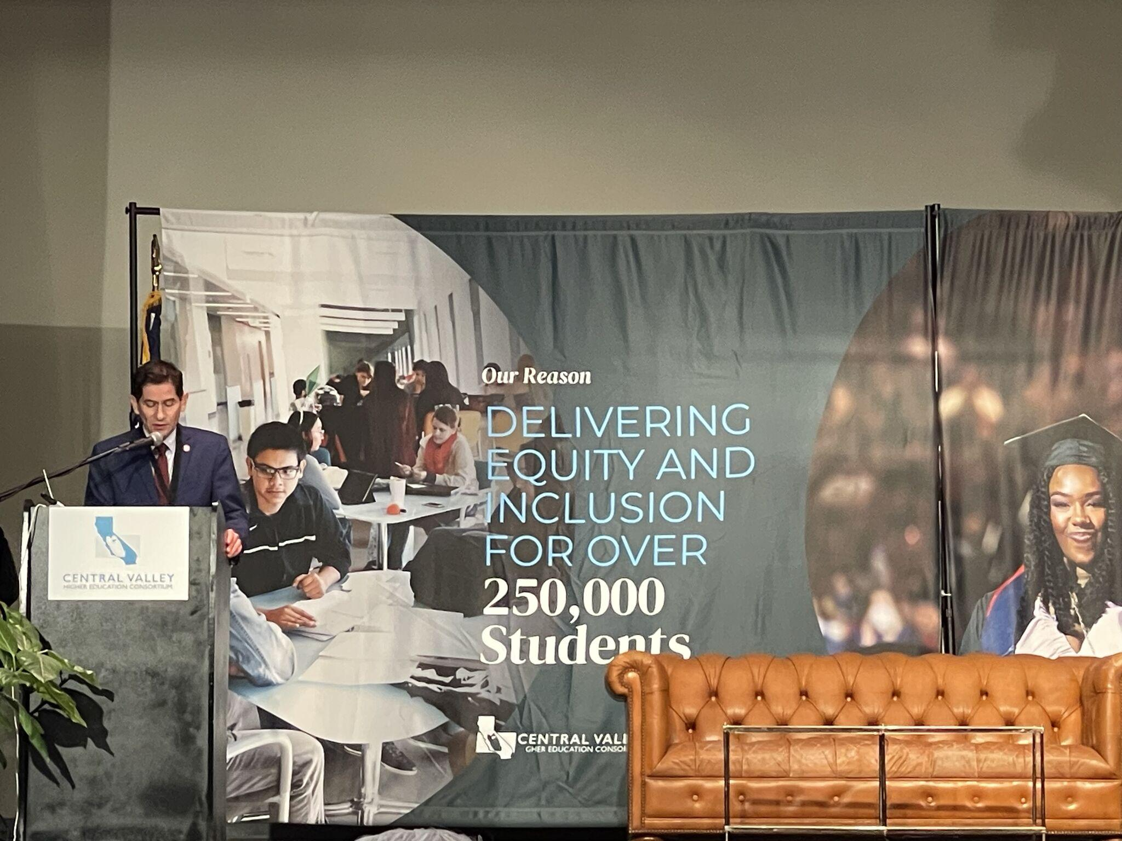
Central Valley Higher Education Consortium

Slide 5
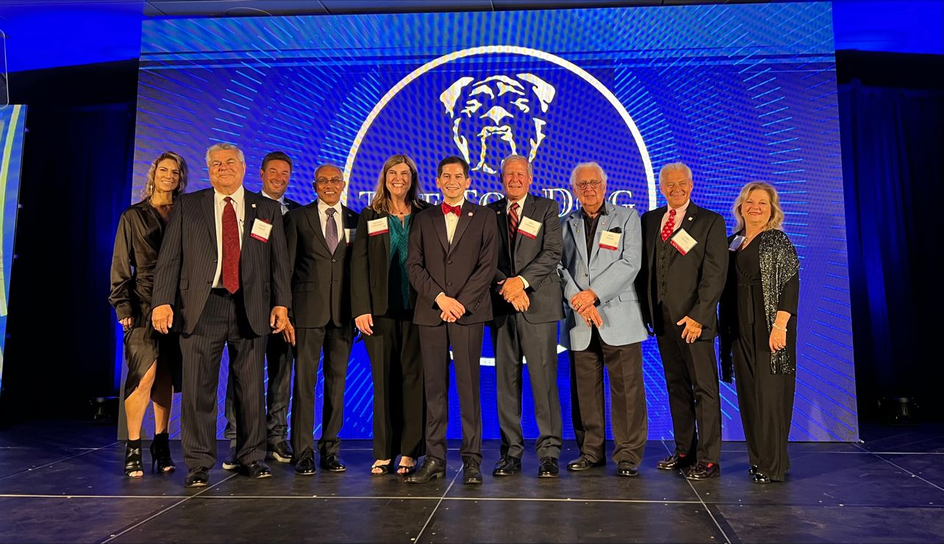
Top Dog Encore!

Slide 6
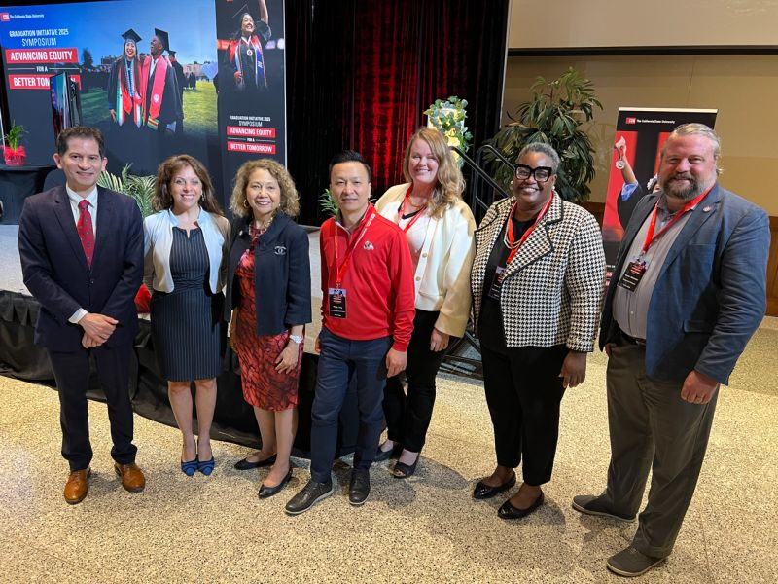
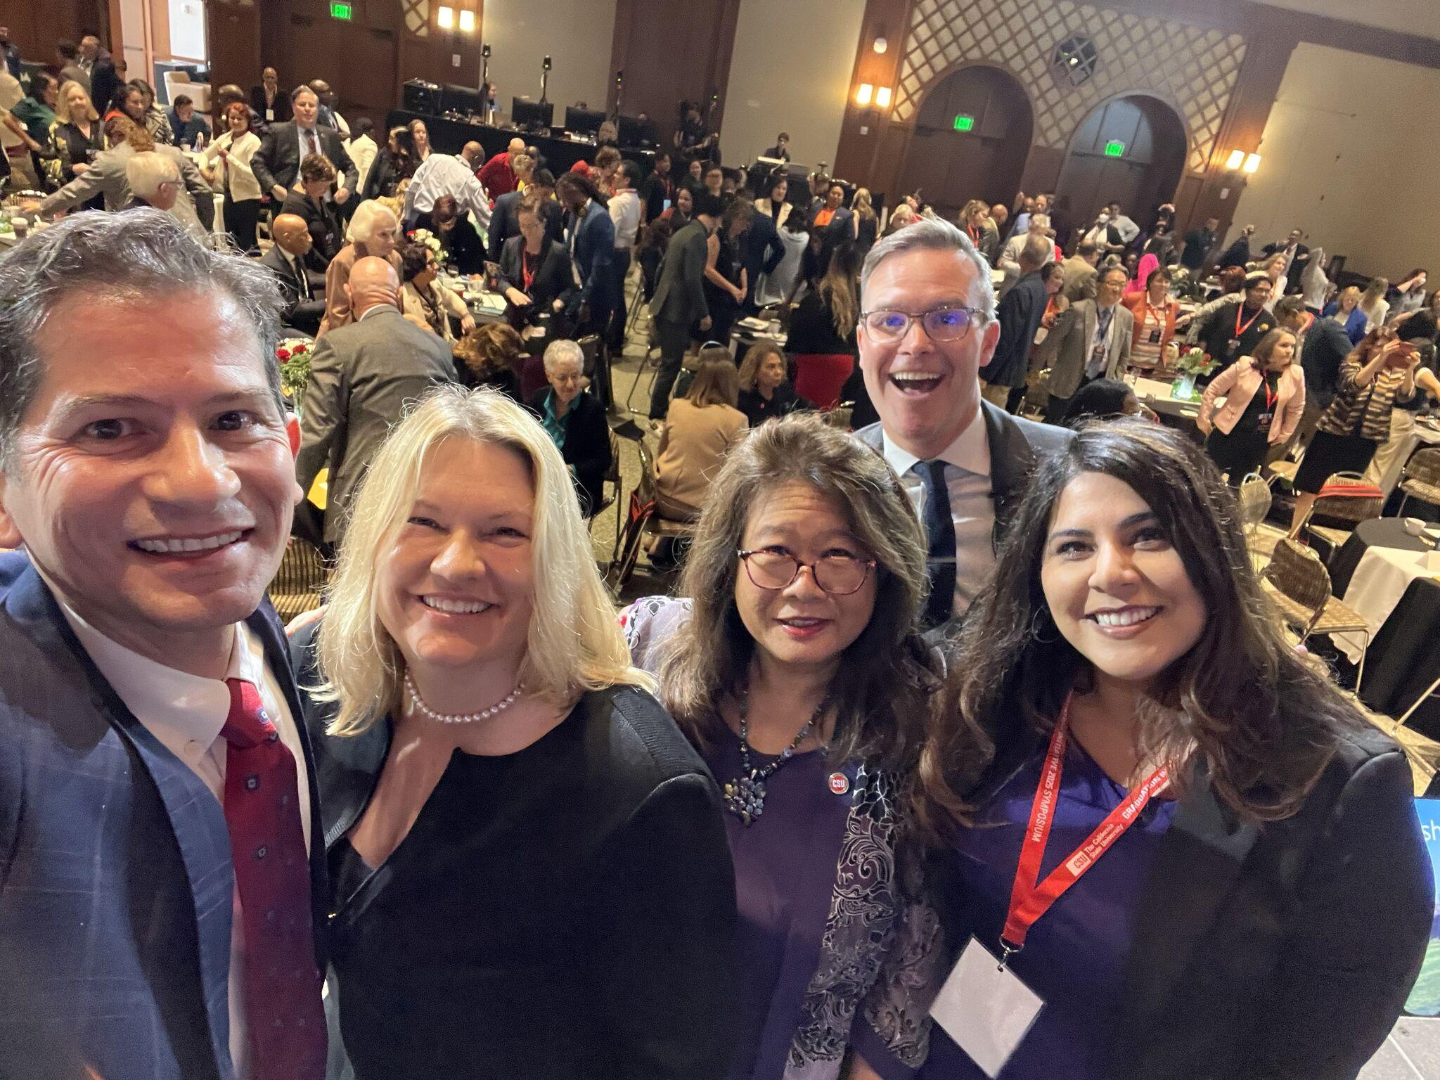
GI 2025 Symposium

Slide 7
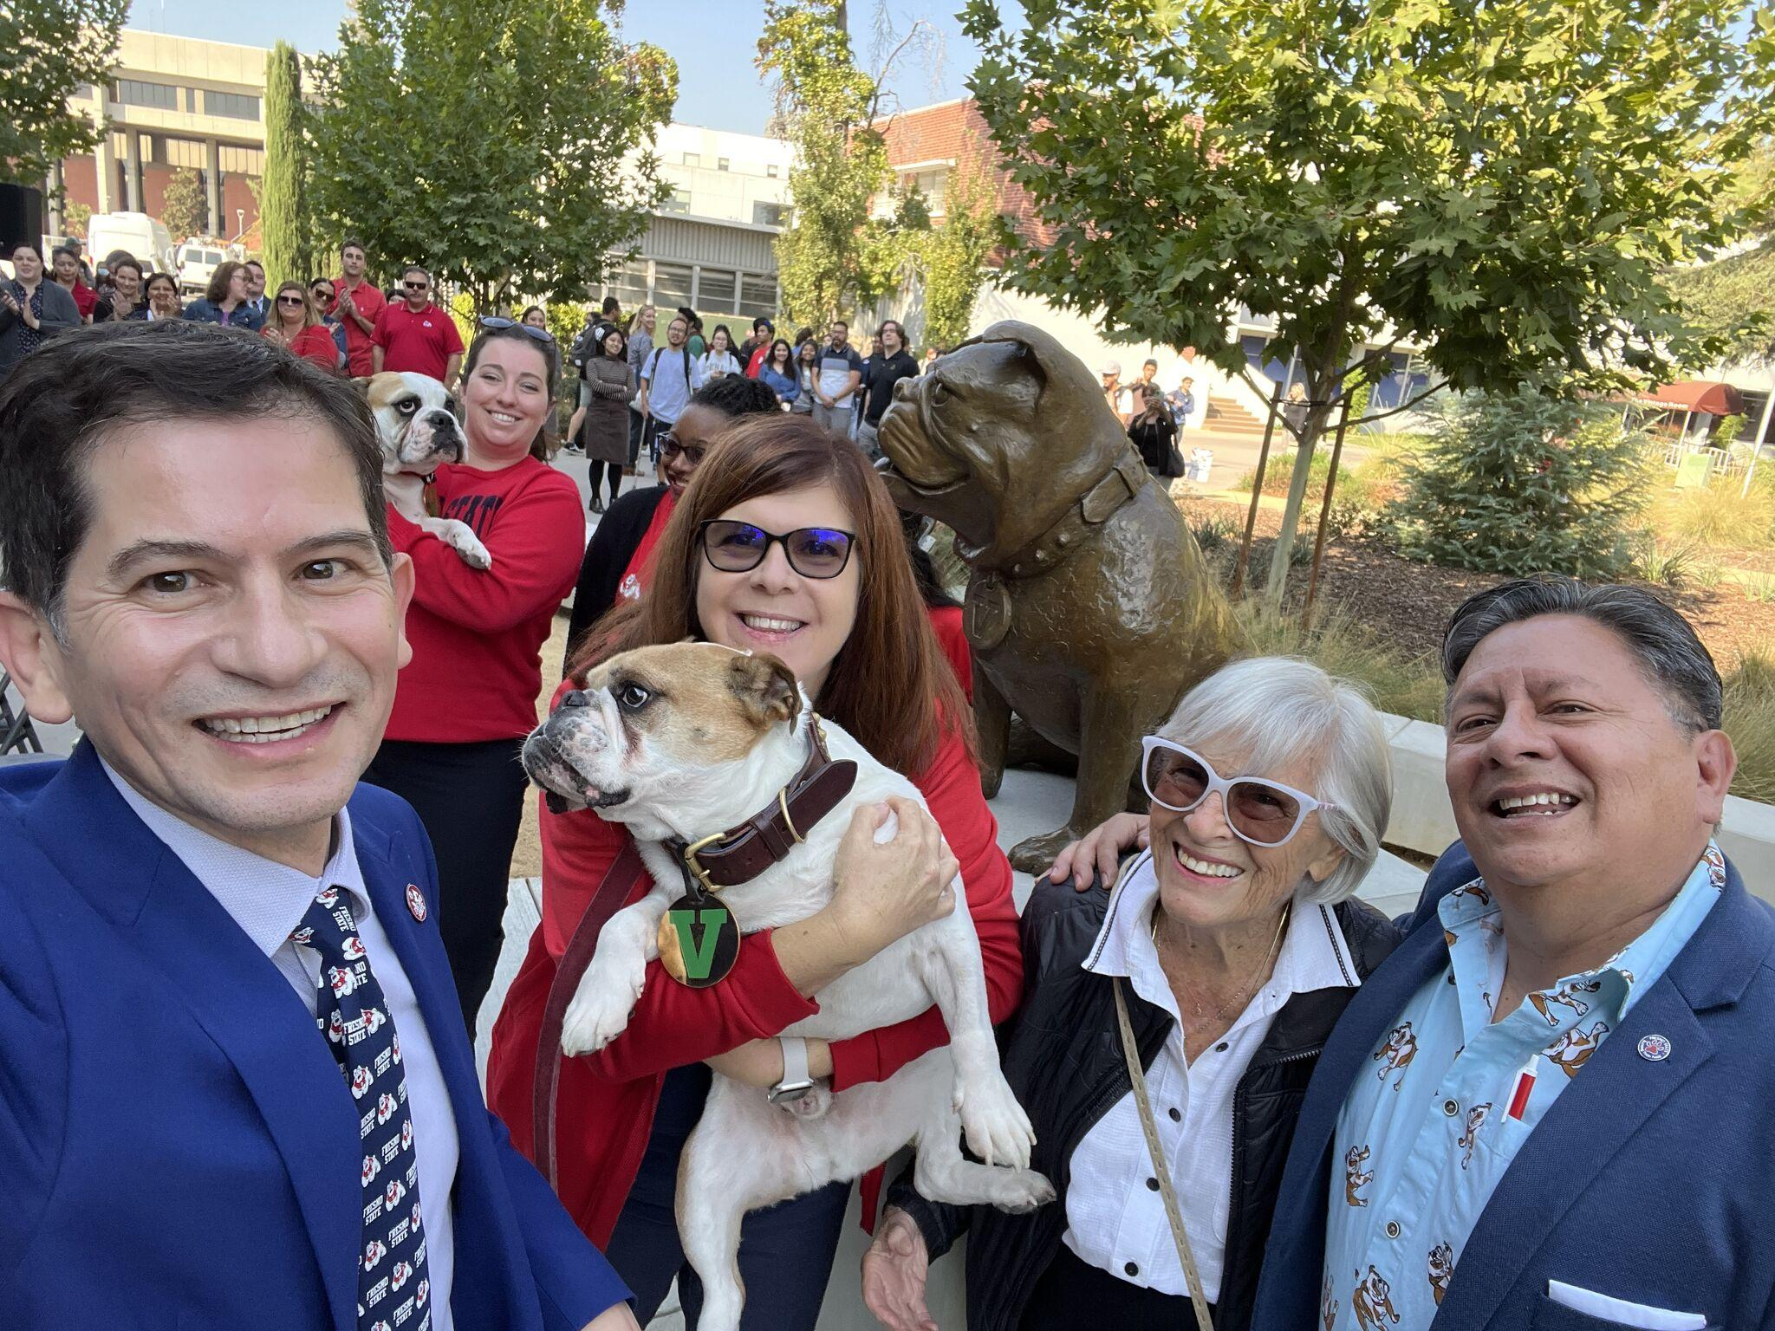
Unveiling of Victor E Bulldog III Statue

Slide 8
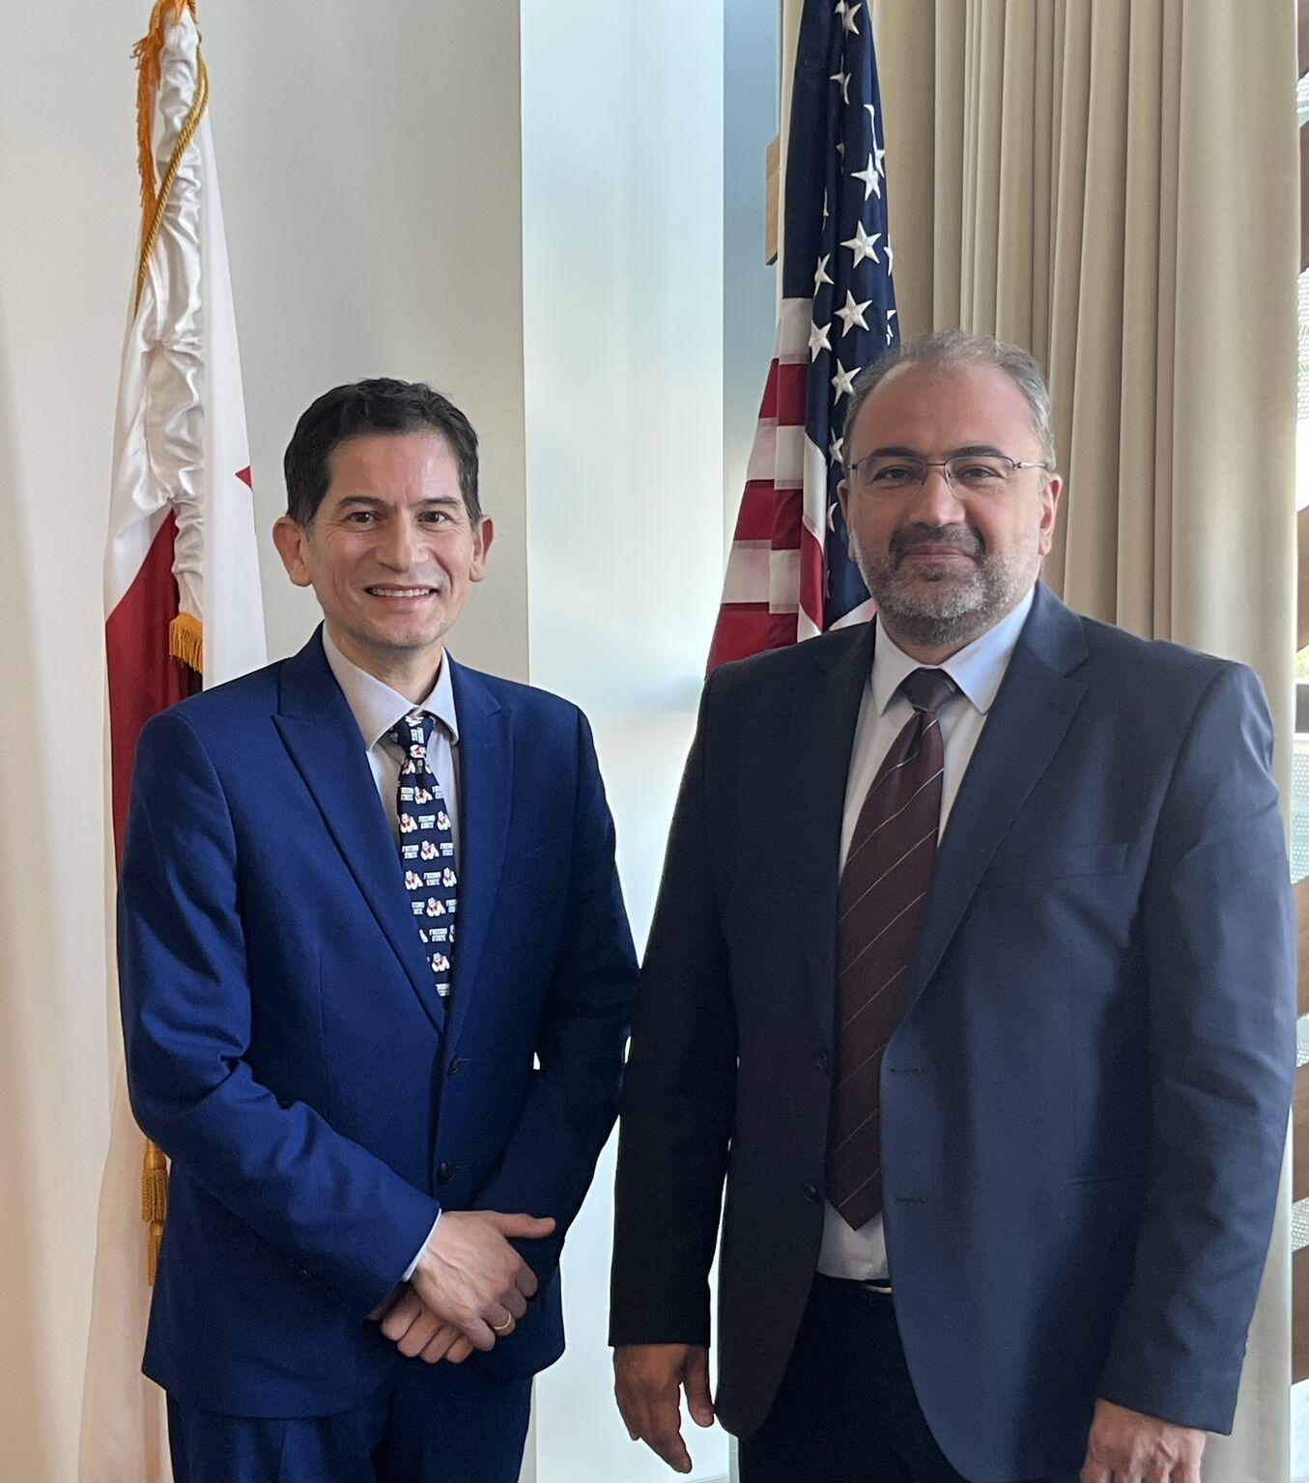
Dr. Vardan Urutyan,
Rector of the Armenian National Agrarian University

Slide 9
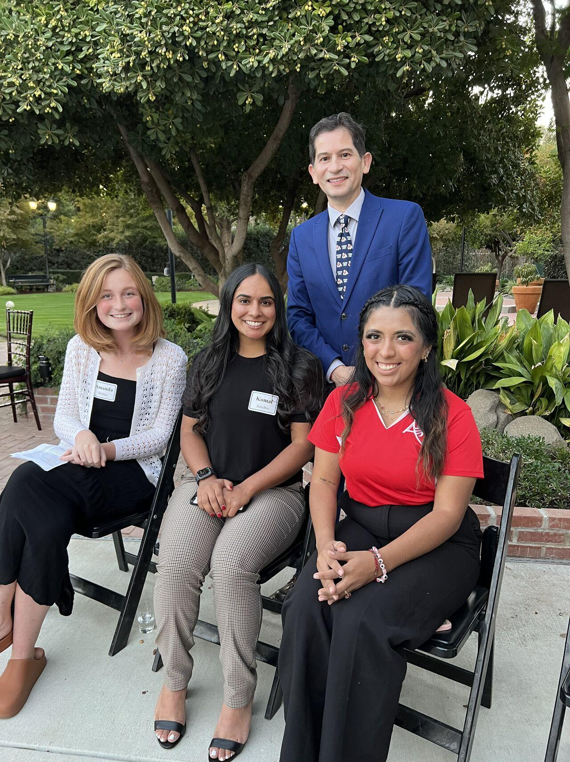
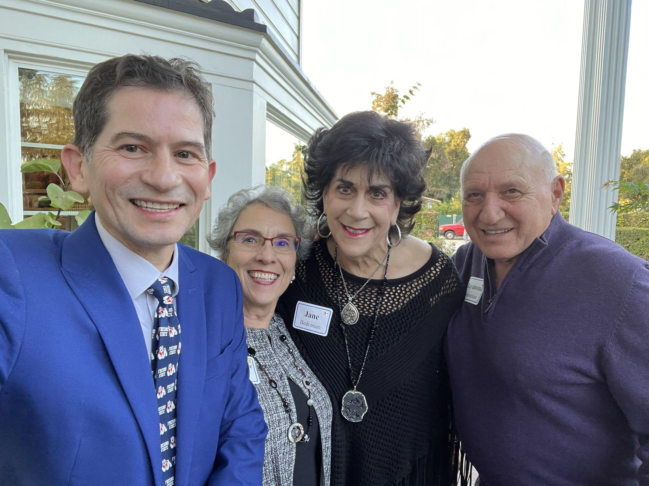
President’s Circle of Excellence

Slide 10
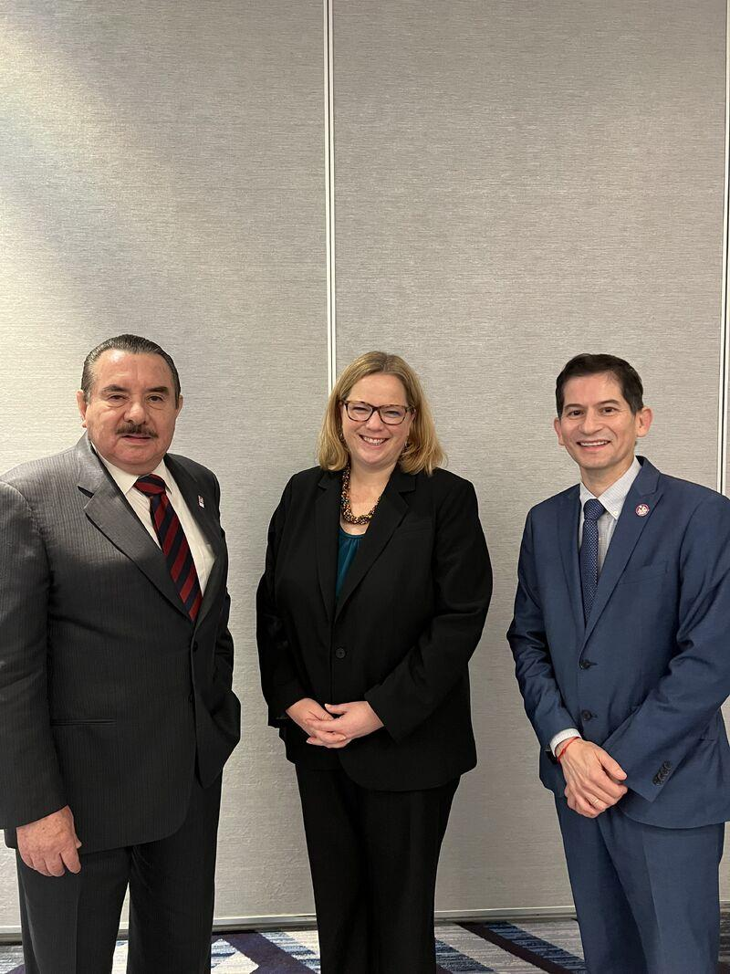
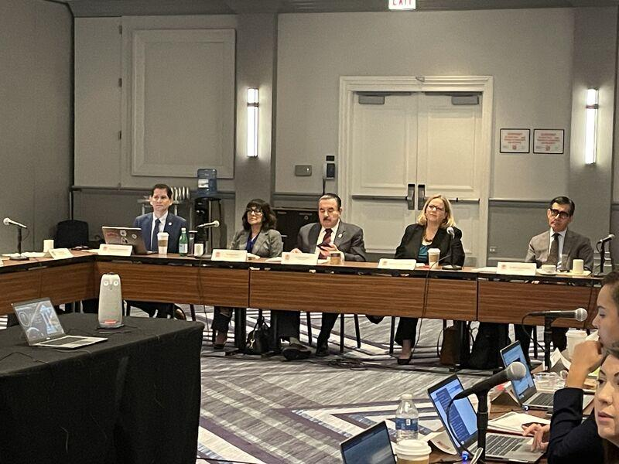
HACU: Meeting with
Under Secretary Jenny Lester Moffitt, USDA

Slide 11
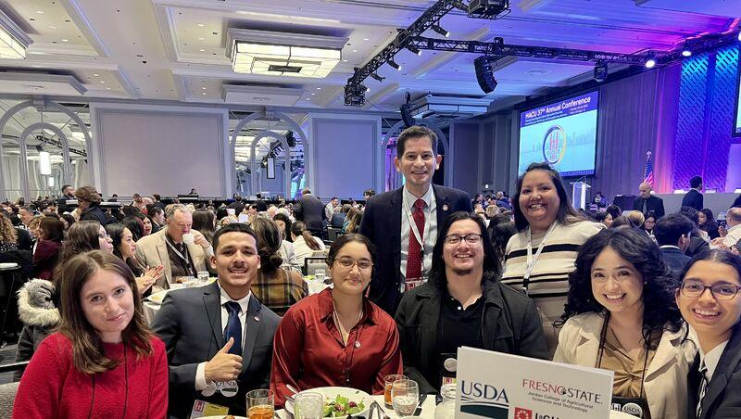
HACU: Fresno State
Student & Staff Participation

Slide 12
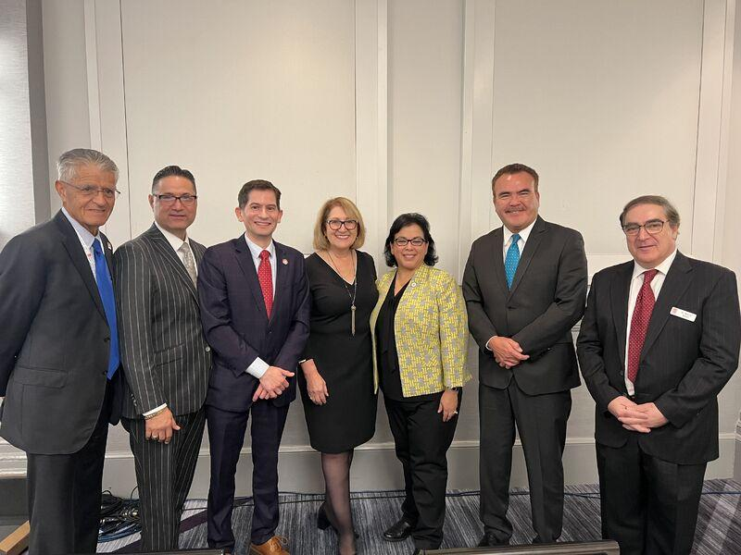
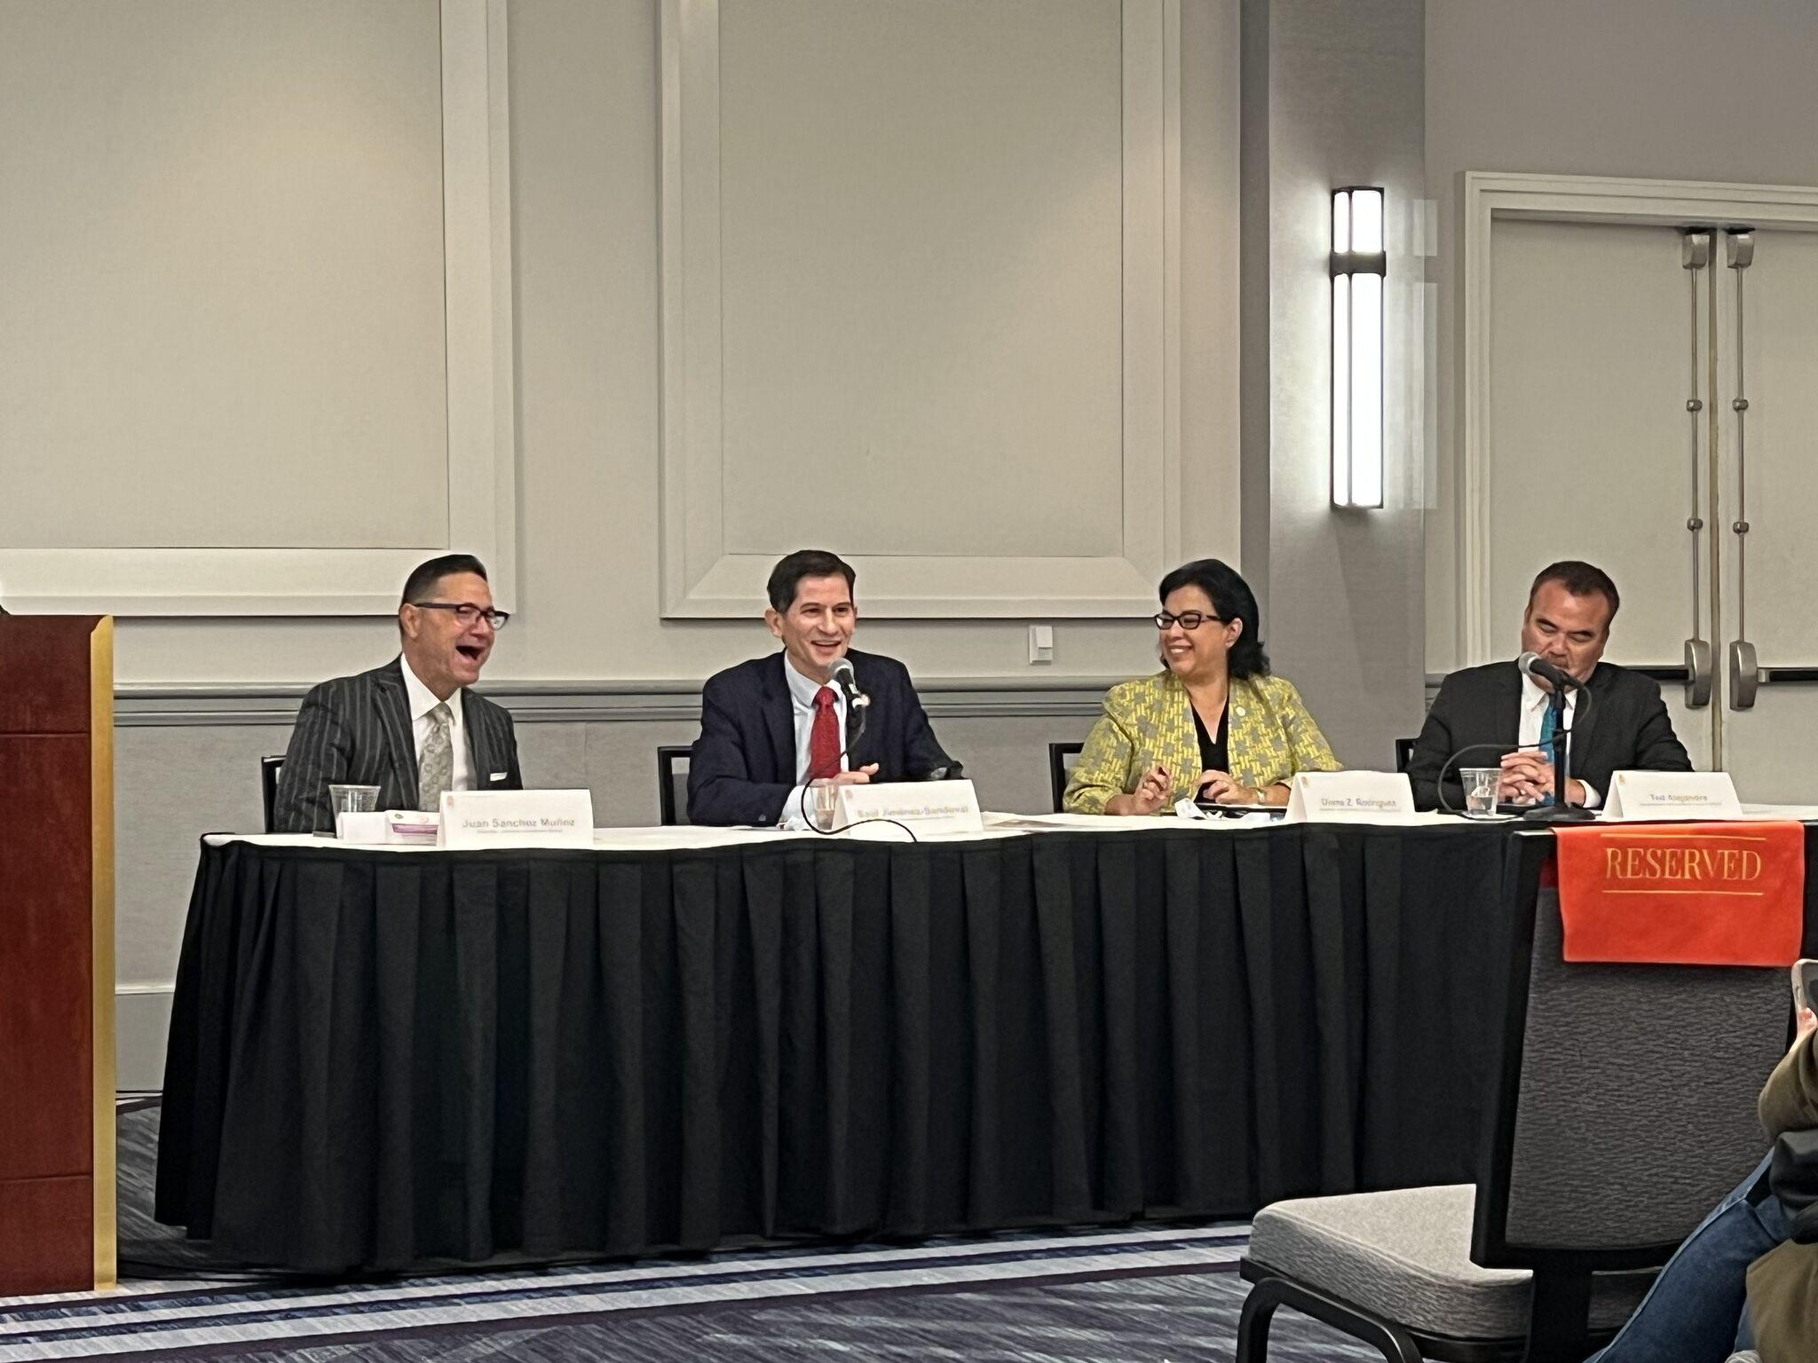
HACU: Annual Conference Panel
for the California HSI Summit

Slide 13
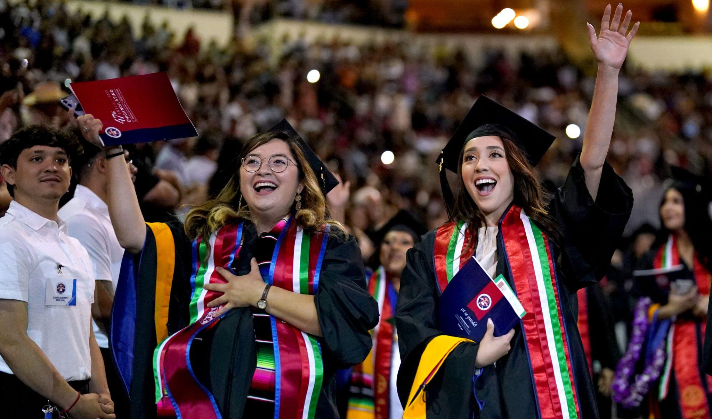
State Department designated
Fresno State as a Fulbright HSI leader

Slide 14
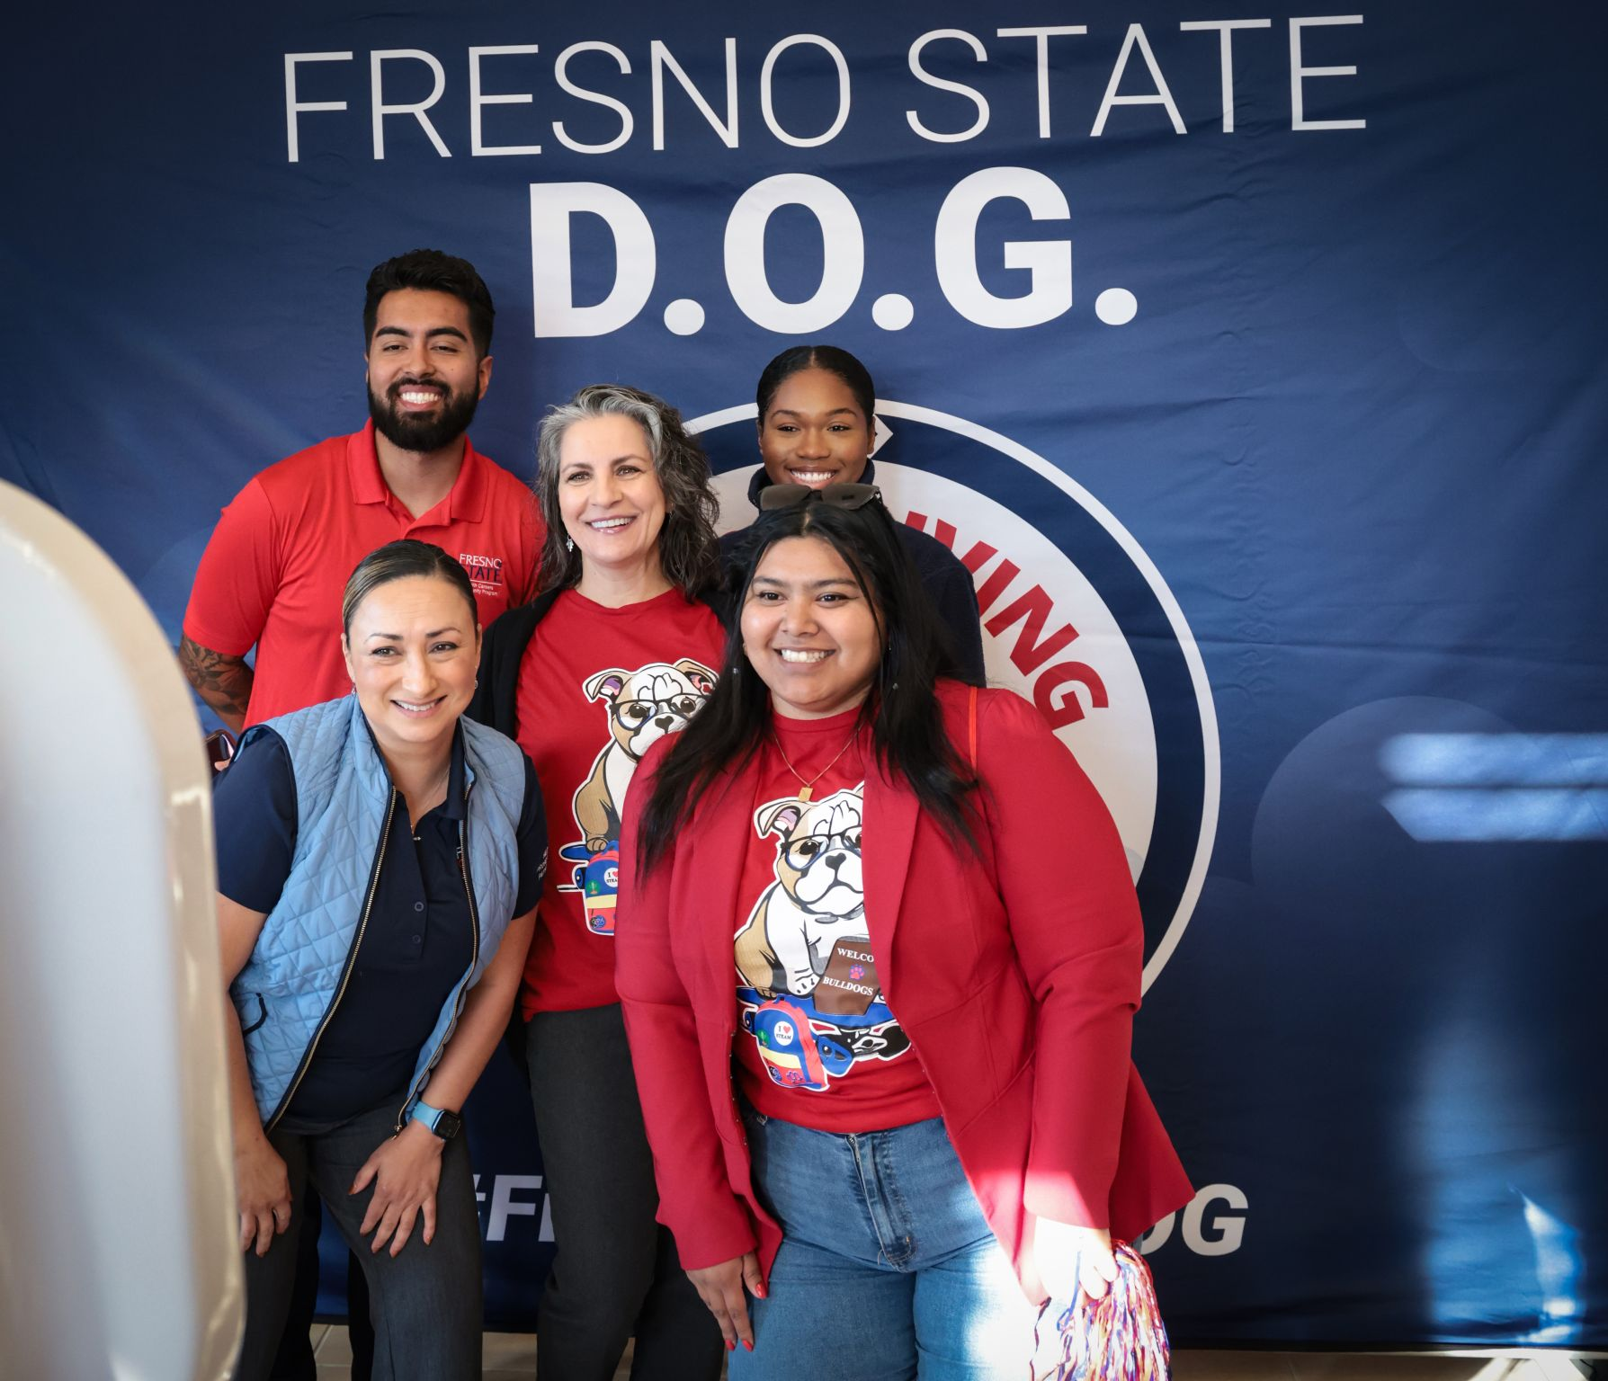
Day of Giving
1,852 unique donors
Raised $470,736

Slide 15
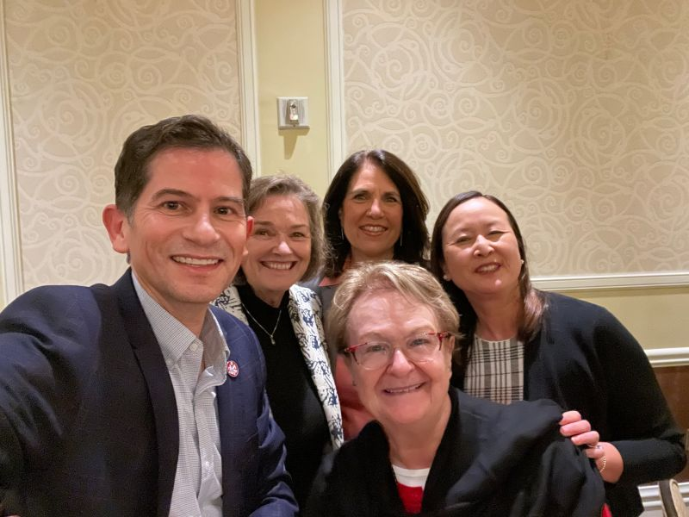
WASC Commissioner Retreat

Slide 16
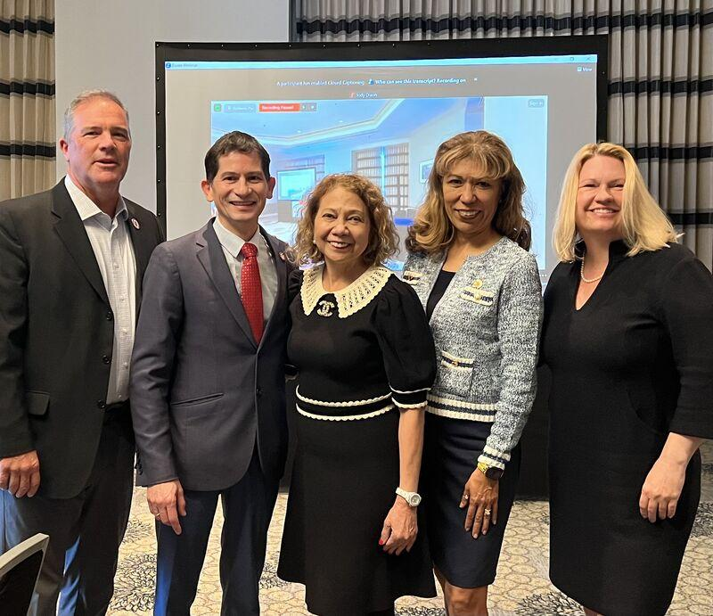
AASCU Annual Conference

Slide 17
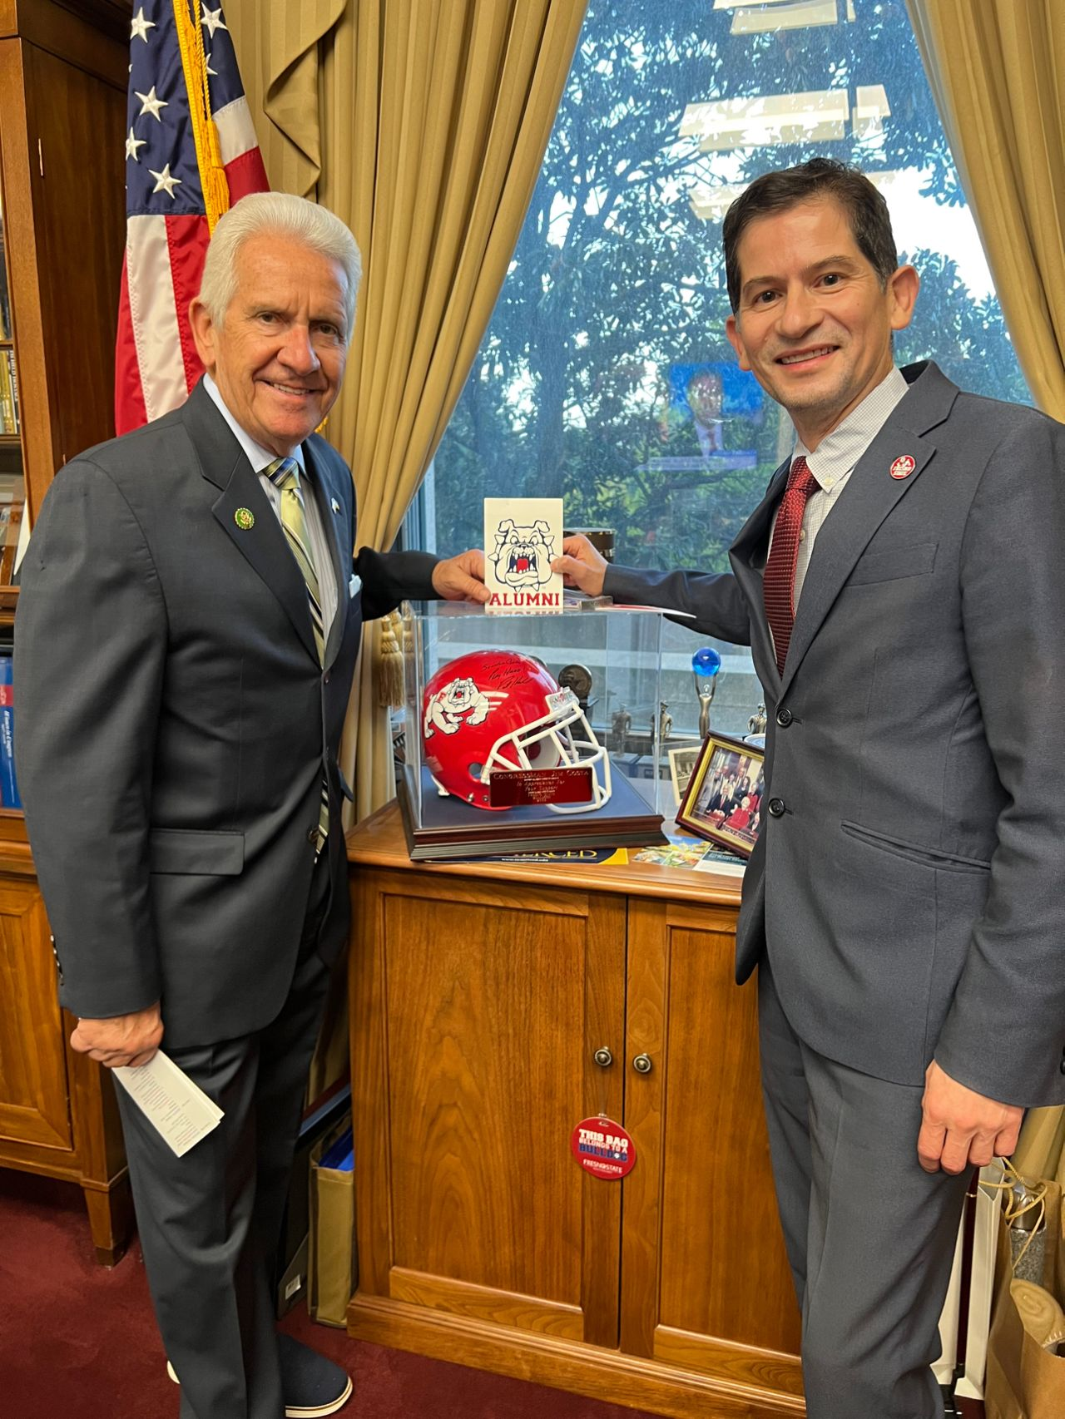
Washington, DC Advocacy

Slide 18
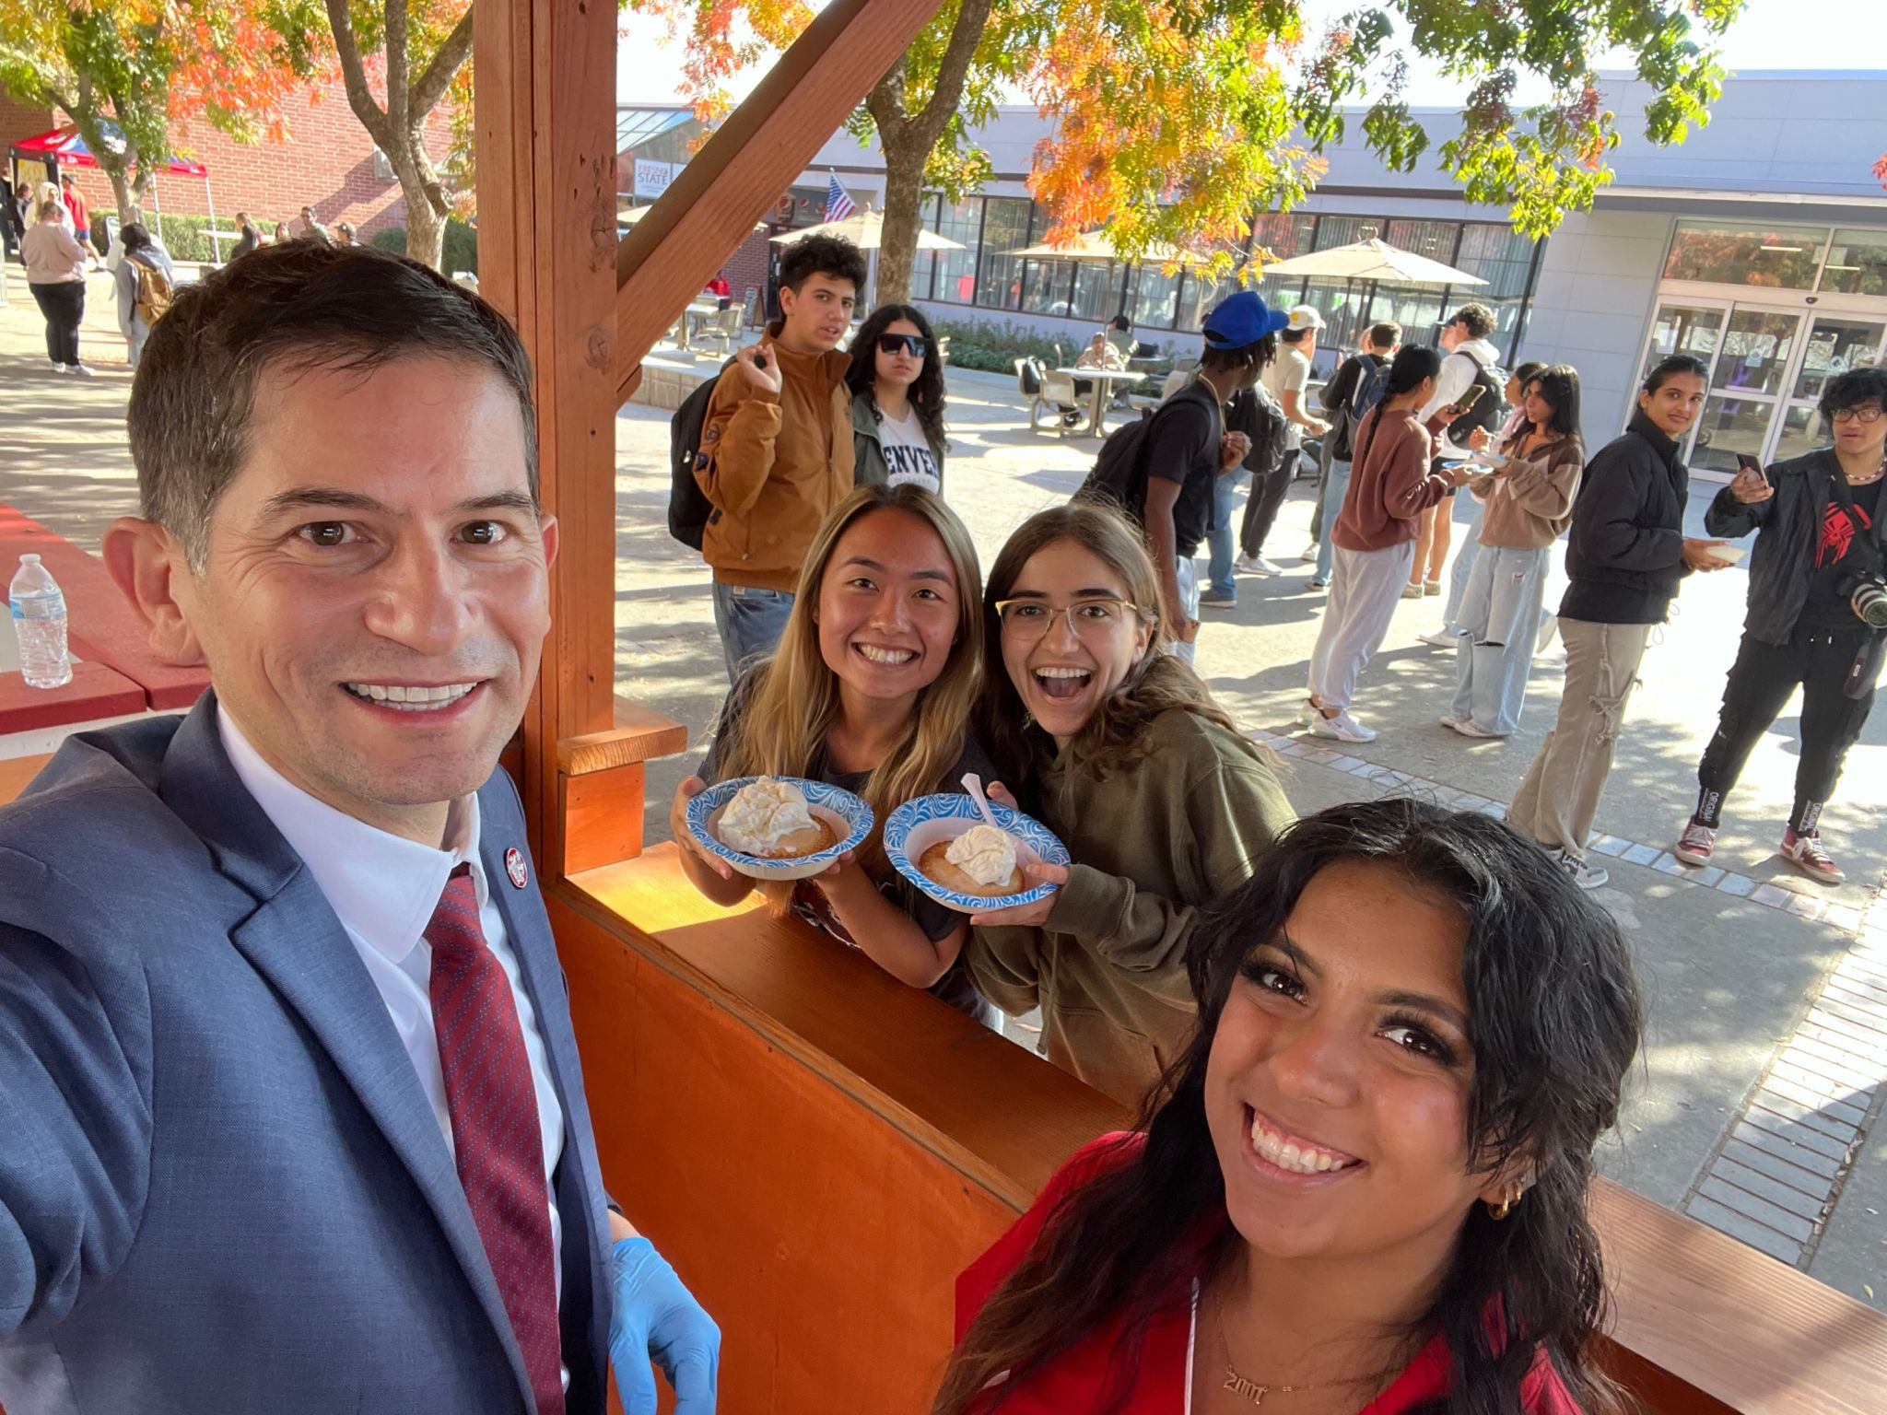
Pie with the Presidents

Slide 19
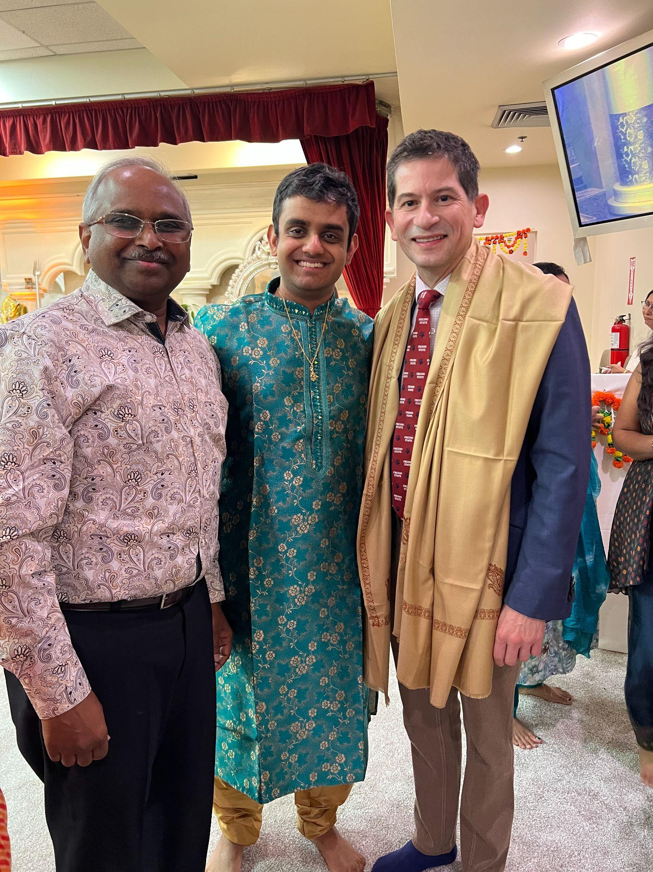
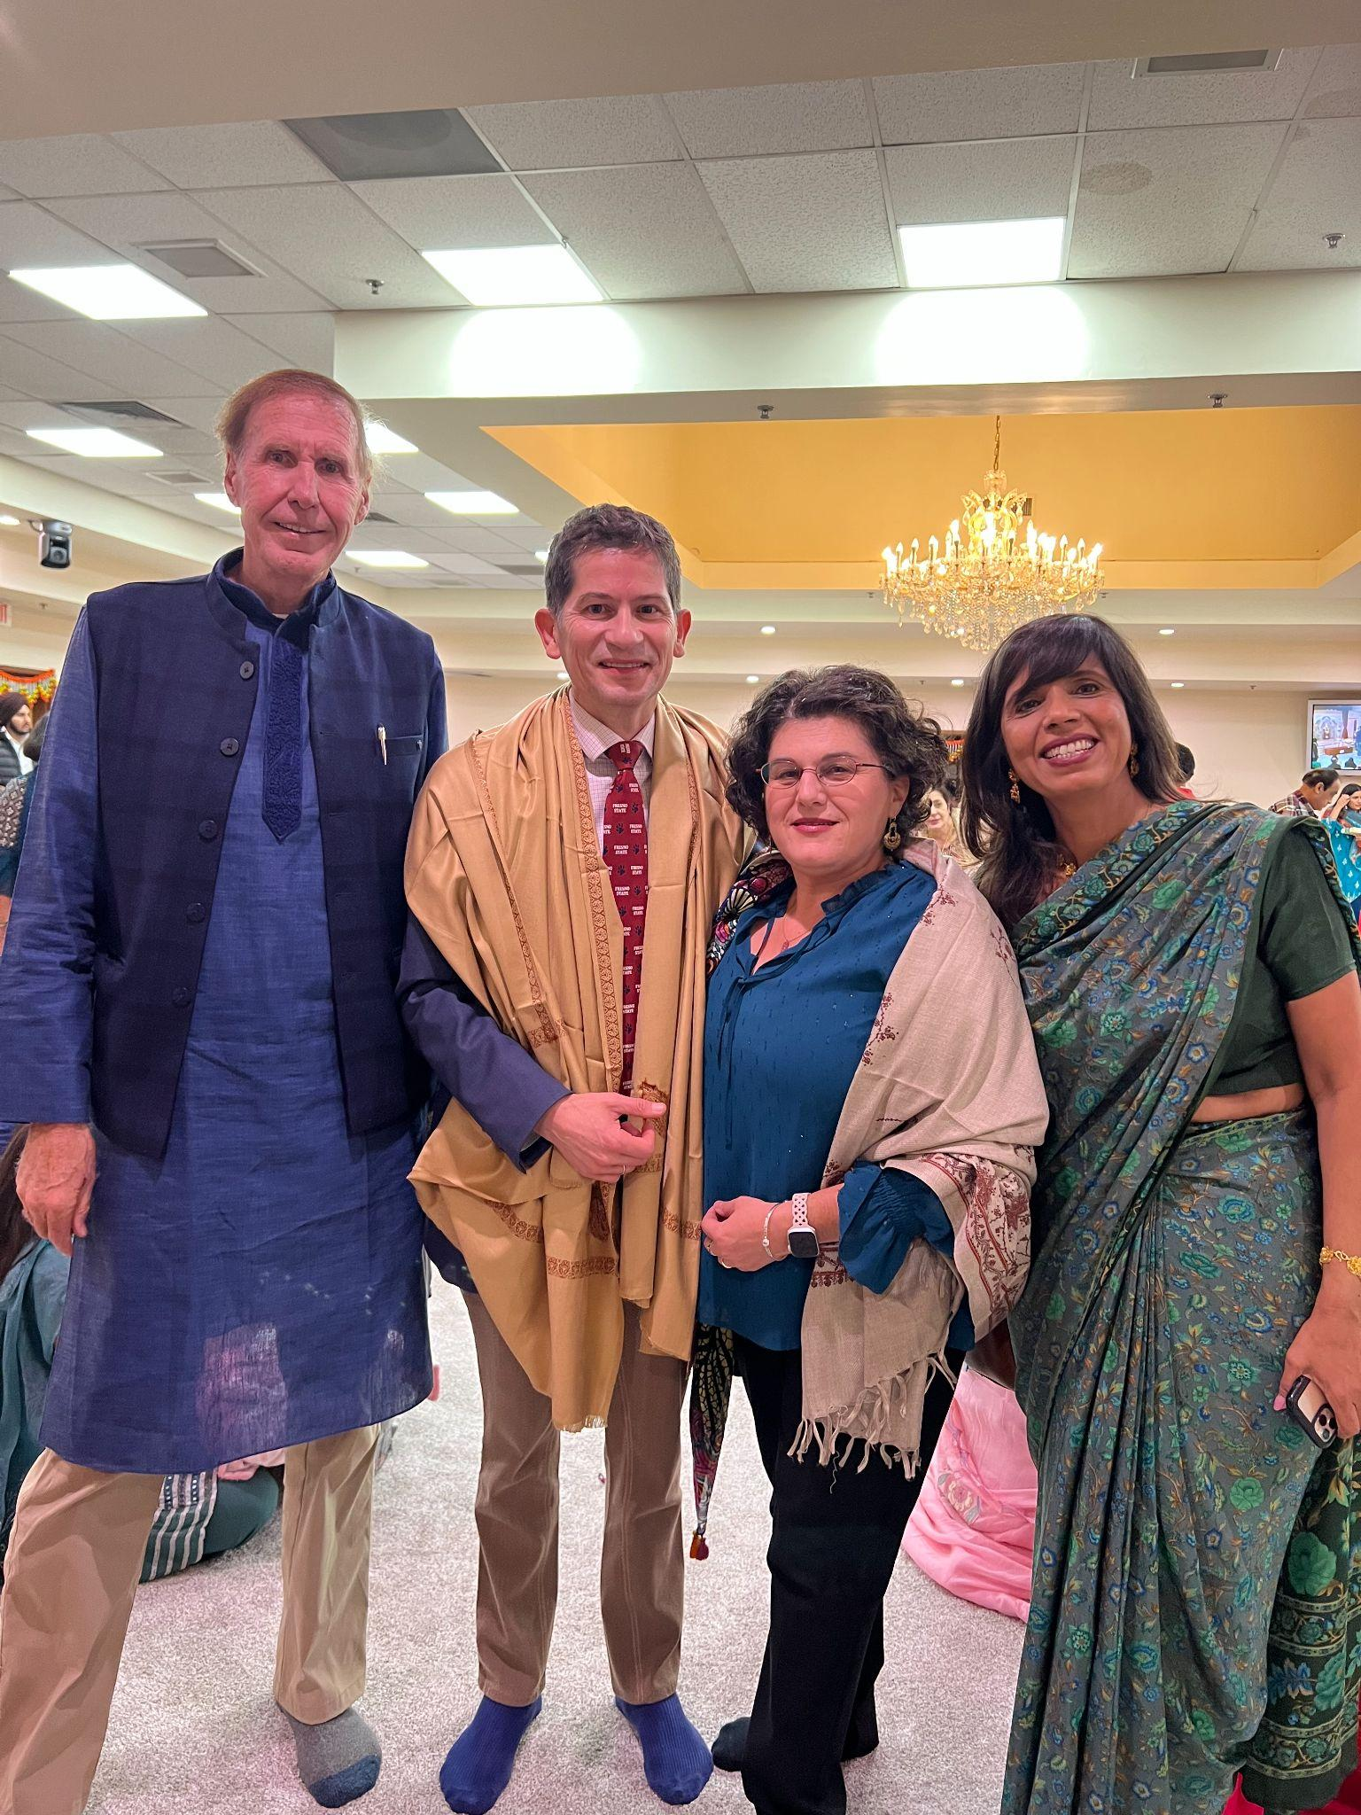
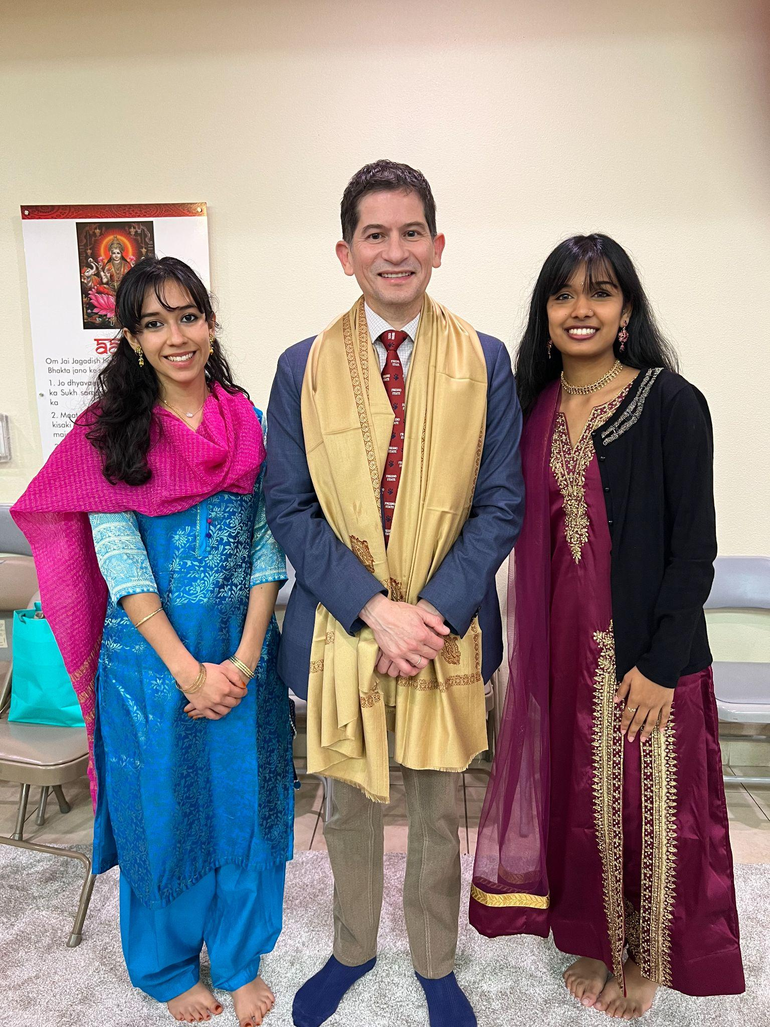
Happy Diwali 🪔

Slide 20
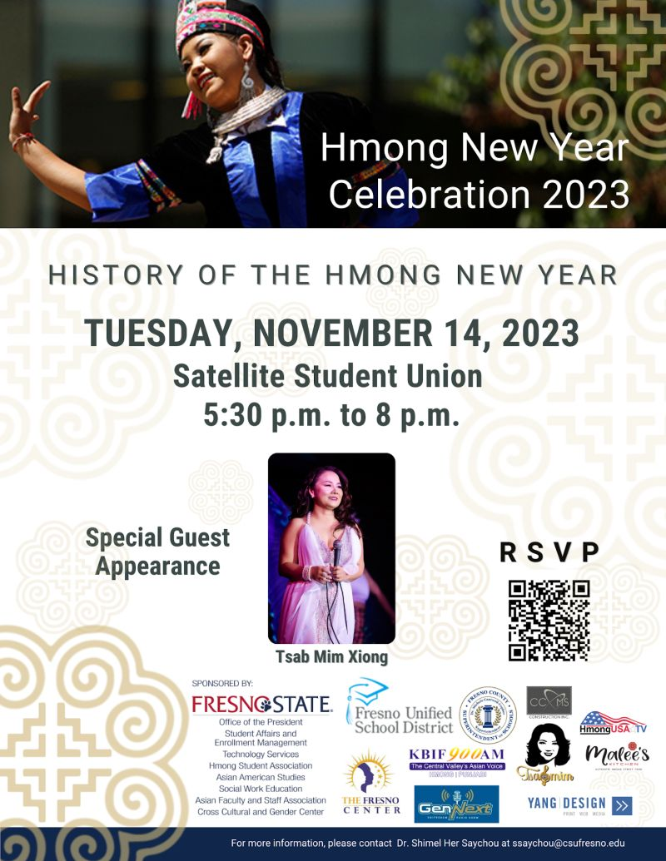

Slide 21
Title IX Updates
•Campus Title IX iTeam convened and has been meeting this semester
•The CO has assigned a liaison to each campus; Laura Anson (CSU Title IX) is providing assessment on progress and recommendations
•The CO: Campus implementation plan by December 8th based on recommendations from both the Task Force and Cozen
•One of the key Cozen recommendations: Restructure and recruit for an AVP for Compliance and Civil Rights who will oversee Title IX and DHR (DHR is being moved from HR)

Slide 22
•The CO is recruiting for an Associate Vice Chancellor for Civil Rights Programming and Services
•Fresno Bee story pertains to a pending third-party external investigation; supportive measures have been provided to the MPP impacted throughout the process
•Student Affairs has been involved in regards to any potential related student conduct matters
•Campus counsel has been involved

Slide 23
Title IX / DHR Hires
•Deputy Title IX and deputy DHR; second survivor advocate
•In the process of hiring a second Deputy Title IX Coordinator
•AVP position that will oversee combined unit of title IX/DHR will be launched soon with search committee
•We have an intake/program analyst position programmed for hire
•Faculty Affairs will post a position for a faculty relations hire
•We have plans to hire a Title IX/DHR prevention education coordinator

Slide 24
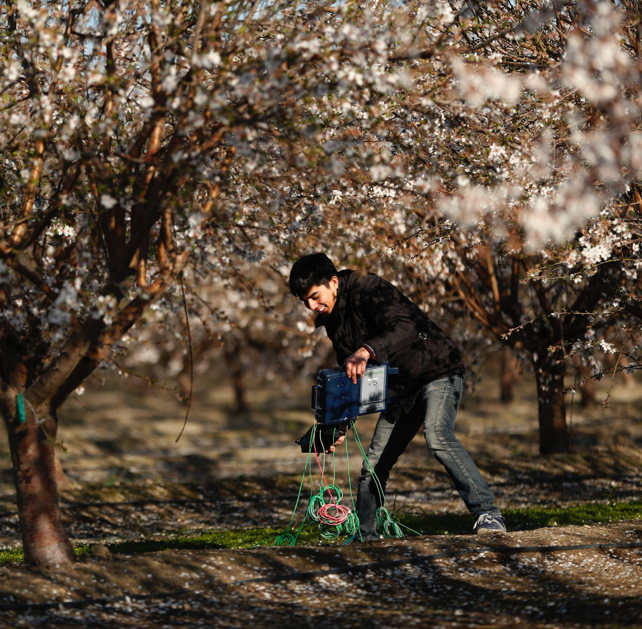
Measure E Endorsement by Board of Trustees
Background:
Ballot measure circulated by civic leaders
Secured 30,000+ signatures
Quarter of a cent sales tax (one cent for every $4 purchased)
Estimated to raise $56 million annually and $1.4 billion over 25 yrs.

Slide 25
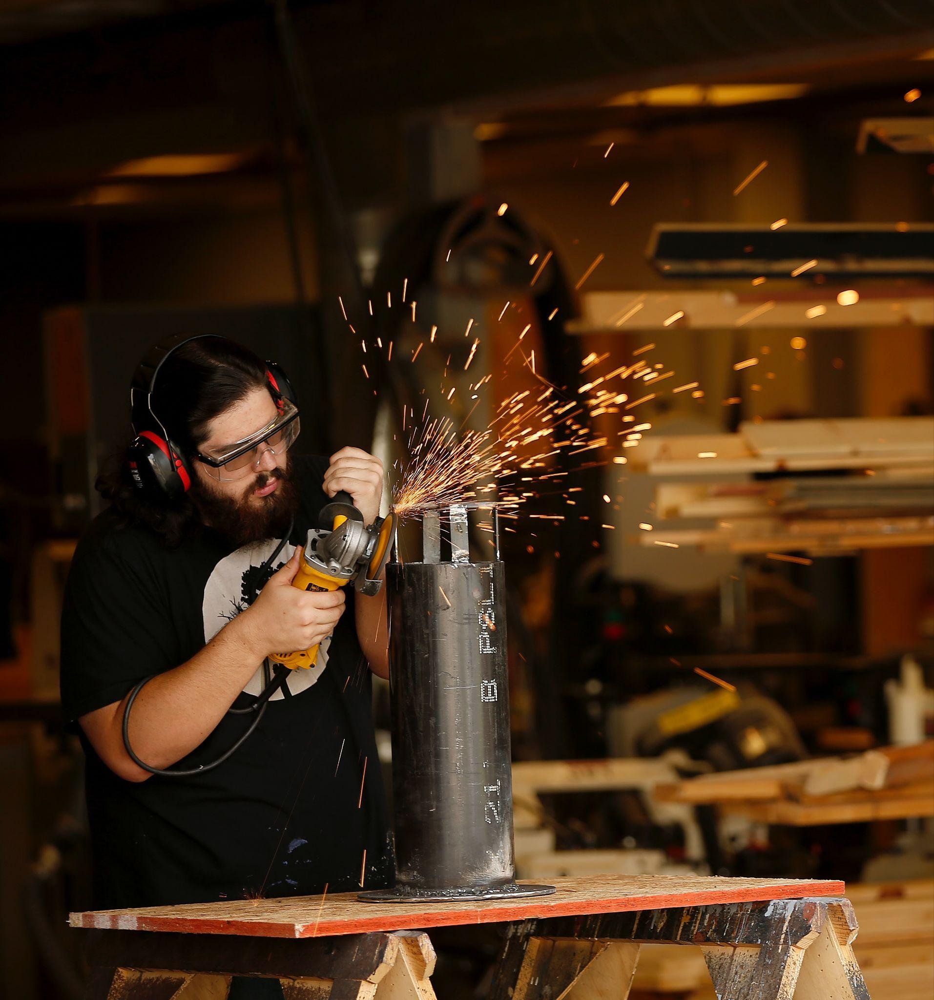
Measure E Details
Fresno State Improvement Zone
Citizens’ Oversight Committee
Capital Projects
Scholarship Endowment
Research, Internship funding
Board Approval Needed for Major Capital Projects

Slide 26
Palestine / Israel: Next Steps
(Dr. Booker to lead, support from Dr. Willis) Supporting academic conversations and dialogue that promote student learning, engender respect for diverse communities within the institution, and foster a healthy exchange of ideas and perspectives.
(Lauren to lead) Developing a protocol for when and how our campus publicly responds to issues of war, crisis, and turmoil internationally, nationally, and locally.
(Provost to lead, with support from Dr. Booker) Implementing professional learning for students, faculty, staff and other stakeholders on islamophobia and antisemitism.

Slide 27
(Provost to lead) Revisiting campus policies to provide reasonable flexibility on academic matters (e.g., assignments, attendance, deadlines) for students experiencing emotional strain.
Debbie to lead) Exploring the offering and/or expansion of inclusive food options (e.g., kosher, halal) for students at campus eateries and through third-party agreements.
(Dr. Willis to lead) A). Creating international and domestic recruitment/retention plans for students; to intentionally support students of Palestinian and Jewish descent, as well as other populations impacted by this war. B). Reach out to specific student groups impacted by the war (Jewish and Muslim/Palestinian/Middle Eastern student groups).

Slide 28
Goal
Promote a safe and healthy exchange of ideas that provide support for students, faculty, and staff.

