Slide 1
Library Collection Budget
Kimberley Smith, Collection Strategist
Dolly Lopez, Electronic Resources Librarian
Notes:
Over the last two years, the Henry Madden Library has undertaken several projects to address significant reductions in our collections budget. Several criteria were used to evaluate what resources to cancel including costs, frequency of use, alternative access, and relevance to curriculum needs. However, those cancellations are not enough to address the continued deficit. This may jeopardize the libraries' ability to support all of the programs offered at Fresno State as well as any emerging needs from new and existing programs. Therefore, we are introducing Resolution in support of stable budgetary support for library collections.

Slide 2
Standards for Libraries in Higher Education
The Association of College and Research Libraries (ACRL), the largest division of the American Library Association, establishes criteria for standards and guidelines for academic librarianship along with frameworks for information literacy.
“Collections: Libraries provide access to collections sufficient in quality, depth, diversity, format, and currency to support the research and teaching missions of the institution.
Educational Role: Libraries partner in the educational mission of the institution to develop and support information-literate learners who can discover, access, and use information effectively for academic success, research, and lifelong learning.
Discovery: Libraries enable users to discover information in all formats through effective use of technology and organization of knowledge”
Source: http://www.ala.org/acrl/standards/standardslibraries

Slide 3
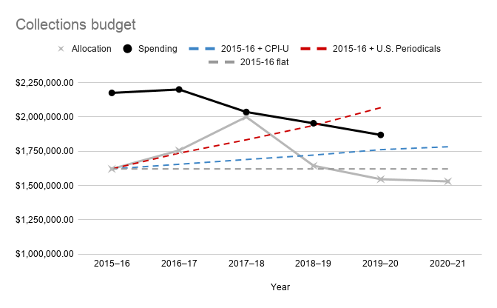
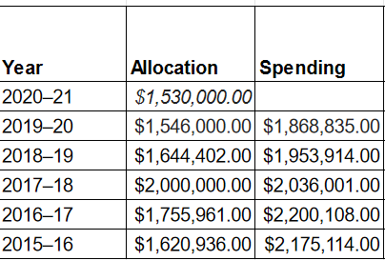
Fluctuating collections budget
Source: https://www2.calstate.edu/csu-system/administration/sdlc/Pages/library-statistics-reports.aspx
Source: http://www.ala.org/alcts/resources/collect/serials/spi
Notes:
Our allocations have been steadily decreasing over the last few years. The decrease in funding in conjunction with increased costs in e-resources has necessitated the cancellation of multiple journals, databases, and more over the last two years.

Slide 4
Previous cancellations
First wave of cancellations (2019-2020):
90 journals; 11 journal packages/databases
Cut near $200,000
Low hanging fruit: low usage; high cost
Second wave of cancellations (2020-2021):
A committee was formed to address a $423,666 projected cut.
49 journals; 25 journal packages/databases; 21 standing orders (amounting to about $182,000+)
Fell short of goal but provided a series of recommendations.
Notes:
In 2019-2020, we cancelled... The resources left were all considered by liaisons and collections librarians as essential. Our recommendation included engaging with campus stakeholders on cancellations and advocacy.Unless we can increase our collections budget, we are cutting into core resources.

Slide 5
Data and resolution
Collections Review site
Collections review report
Additional information available:
resources by college, costs over three years, and frequency use.
Resolution
Notes:
Again, those cancellations are not enough to address the continued deficit. This may jeopardize the libraries' ability to support all of the programs offered at Fresno State as well as any emerging needs from new and existing programs. Therefore, we are introducing Resolution in support of stable budgetary support for library collections.

Slide 6
Questions?
Contact us:
Kimberley Smith: kimberleys@csufresno.edu
Dolly Lopez: balopez@csufresno.edu

