Slide 1





PIF - Grant Application Routing and Approval

Slide 2

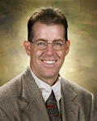

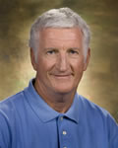
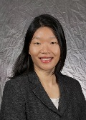

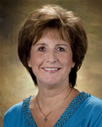
ORSP
GRANT MANAGER (GM) TEAM
Doug Carey
Grant Mgr.
College of Social Sciences
HHS
Arts & Hum
Education
Dr. Daniel Griffin
Associate Director
Administration
Business
Engineering
(Except NSF or SCORE)
Library
Student Serv.
Grace I. Liu
Grant Mgr.
JCAST
IP
Nancy Myers Sims
Grants and Contracts Development Specialist
Science and Math
Engineering
(only NSF or SCORE)

Slide 3
The PIF Process
The University currently utilizes a Project Information Form (PIF) for its review and
approval process. Proposals for sponsored programs shall not be submitted to a
potential sponsor on behalf of the University and/or Foundation without prior official
approval obtained through the PIF routing process. (APM Policy 501)
The PIF form is process through the Grant Application Routing and Approval Form (GRAF) through the Biz Flow system. The GRAF form can only be initiated by a grant manager (GM) through the Office of Research and Sponsored Programs.
Please contact your assigned GM at least two weeks in advance to start the GRAF routing process.
This approval process is for both proposals and contracts. In the proposal stage, the approvals are allowing us to submit the proposal whereas in a contract, it is allowing us to start negotiating with the funding agency. You must get these approvals before you submit a proposal or start negotiating a contract.
You can login to Bizflow by going through my.fresnostate.edu ; using your email username and password

Slide 4

Transitioning from an OLD to a NEW
PIF routing system
GM and PI meet to discuss available grants/set deadlines/gather documents
PI starts PIF routing process.
PIF is sent to Department Chair for signatures.
PIF is routed to the appropriate Dean.
PIF is then routed to ORSP via campus mail or walked over.

Slide 5





Transitioning from an OLD to a NEW
PIF routing system
Grant Manager and PI will discuss future proposals or grants/set a deadline/gather documents/…..
Grant Manager will initiate PIF routing process through Bizflow.
PI will receive an email notification, will approve/deny through Bizflow.
Department Chair will approve/deny PIF, then Dean will approve/deny.
PIF will be routed to Director of Sponsored Programs then to AVP of Research /VP of Admin via Bizflow.
PIF notification to GM/Analyst
PIF will be entered in to our system (SAR).

Slide 6
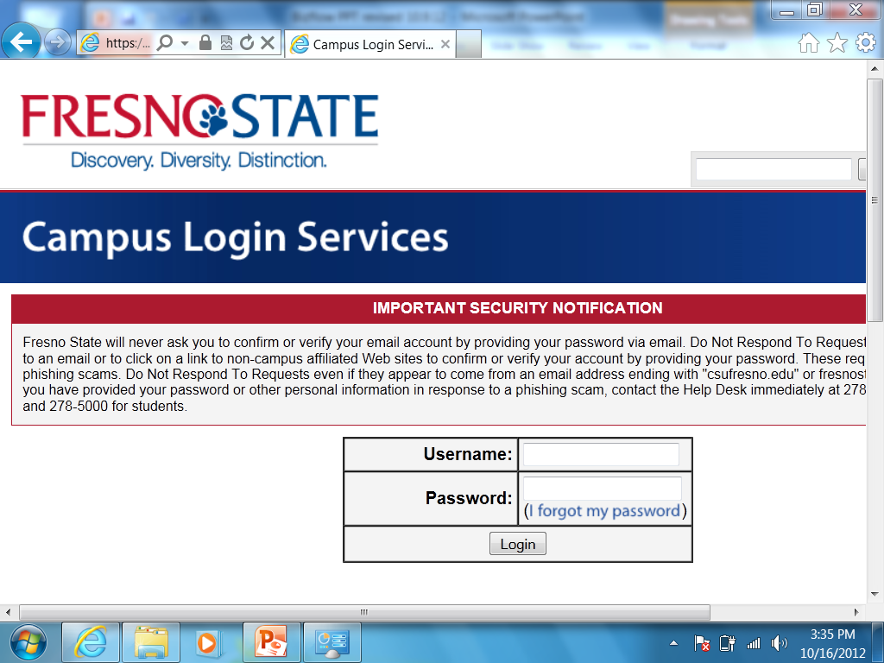

Slide 7
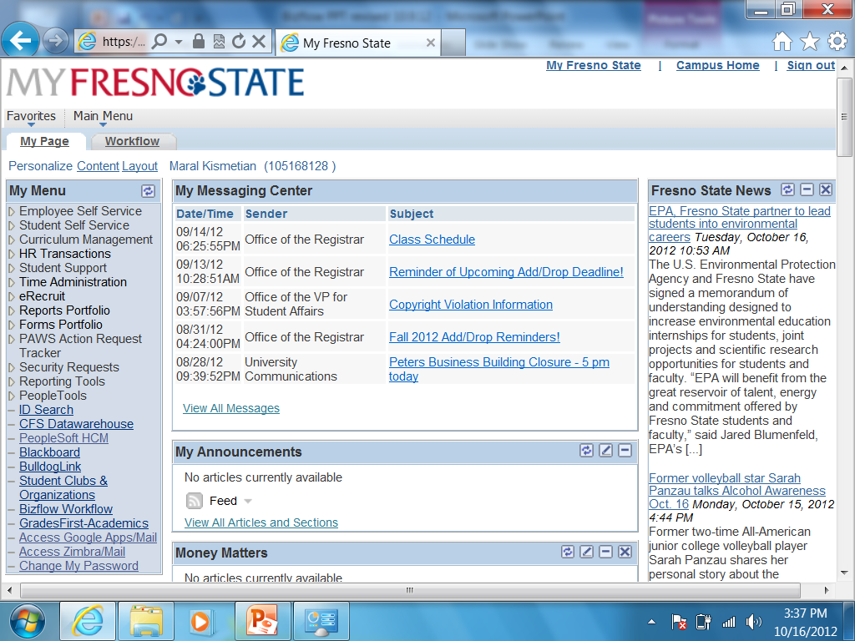

Slide 8
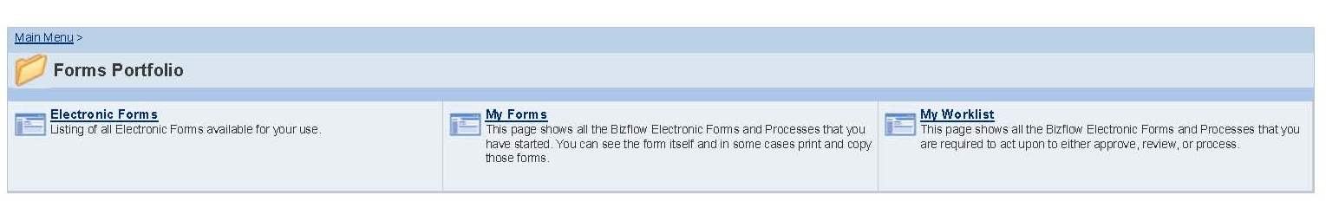
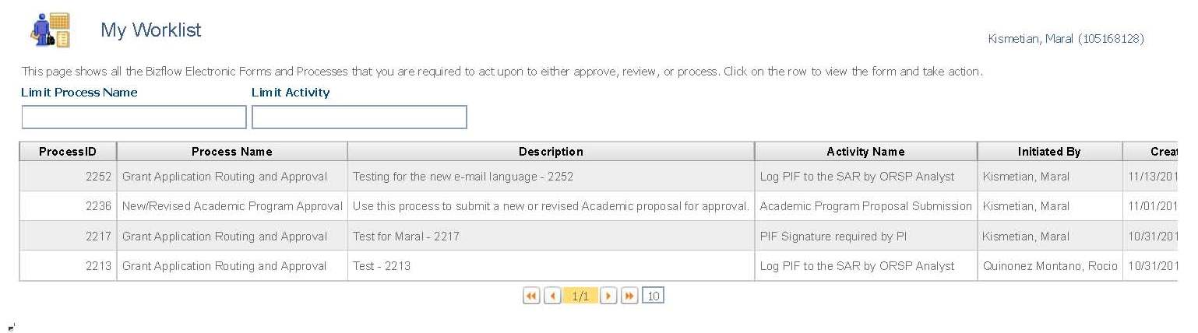
WHERE YOU FIND YOUR WORK
WHERE YOU ENTER TO APPROVE

Slide 9
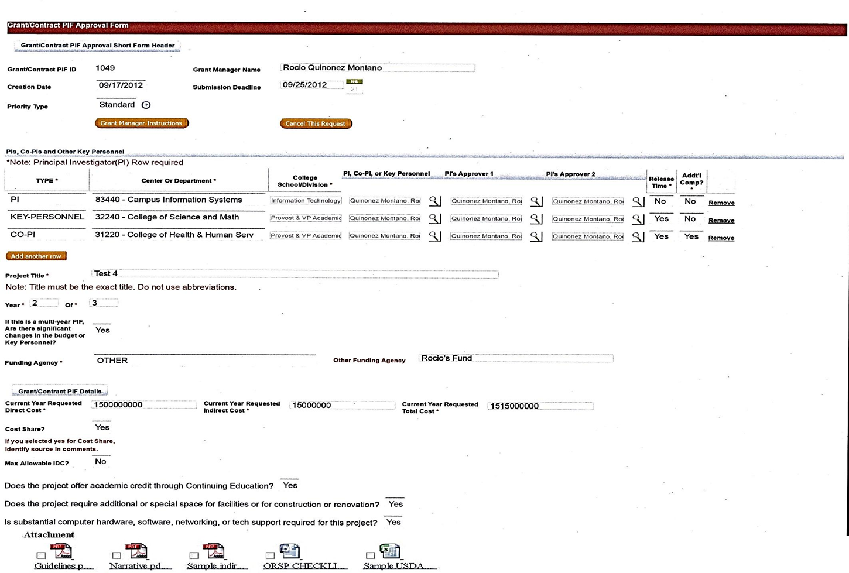
GRANT MANAGER – INFO ENTERED

Slide 10
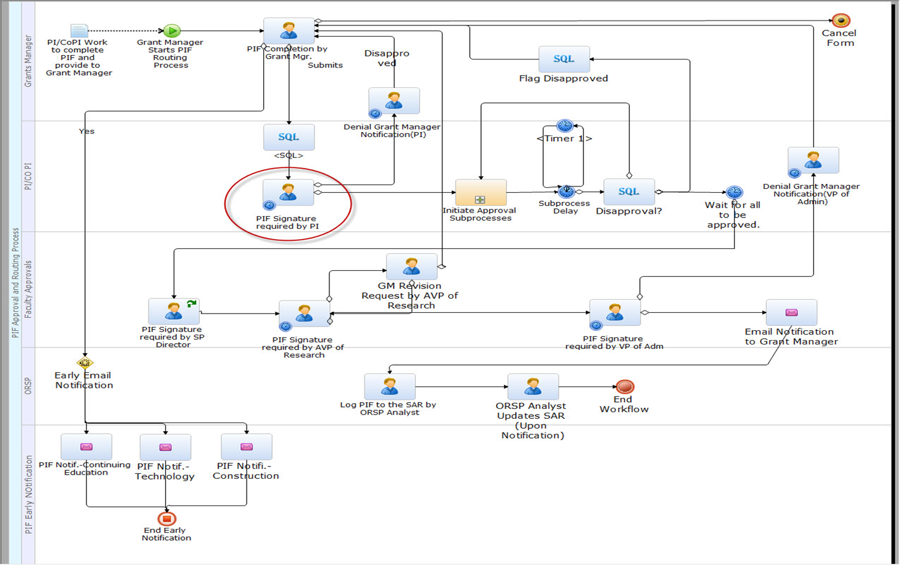
PIF MAIN PROCESS

Slide 11


PIF FLOW PROCESS “SIMPLIFIED”
SUBPROCESS
EMAIL NOTIFICATION
GM
KEY PERSONNEL
CO-PI
PI
CO-PI
CHAIR
EMAIL NOTIFICATIONS
PI-CHAIR
KP-CHAIR
Cont. Ed
Tech
Const.
PI-DEAN
KP-DEAN
CO-PI
DEAN
EMAIL NOTIFICATION
Director of Sp. Prog.
AVP RESEARCH
ENTRY INTO THE SAR
VP ADM
GM & PI

Slide 12
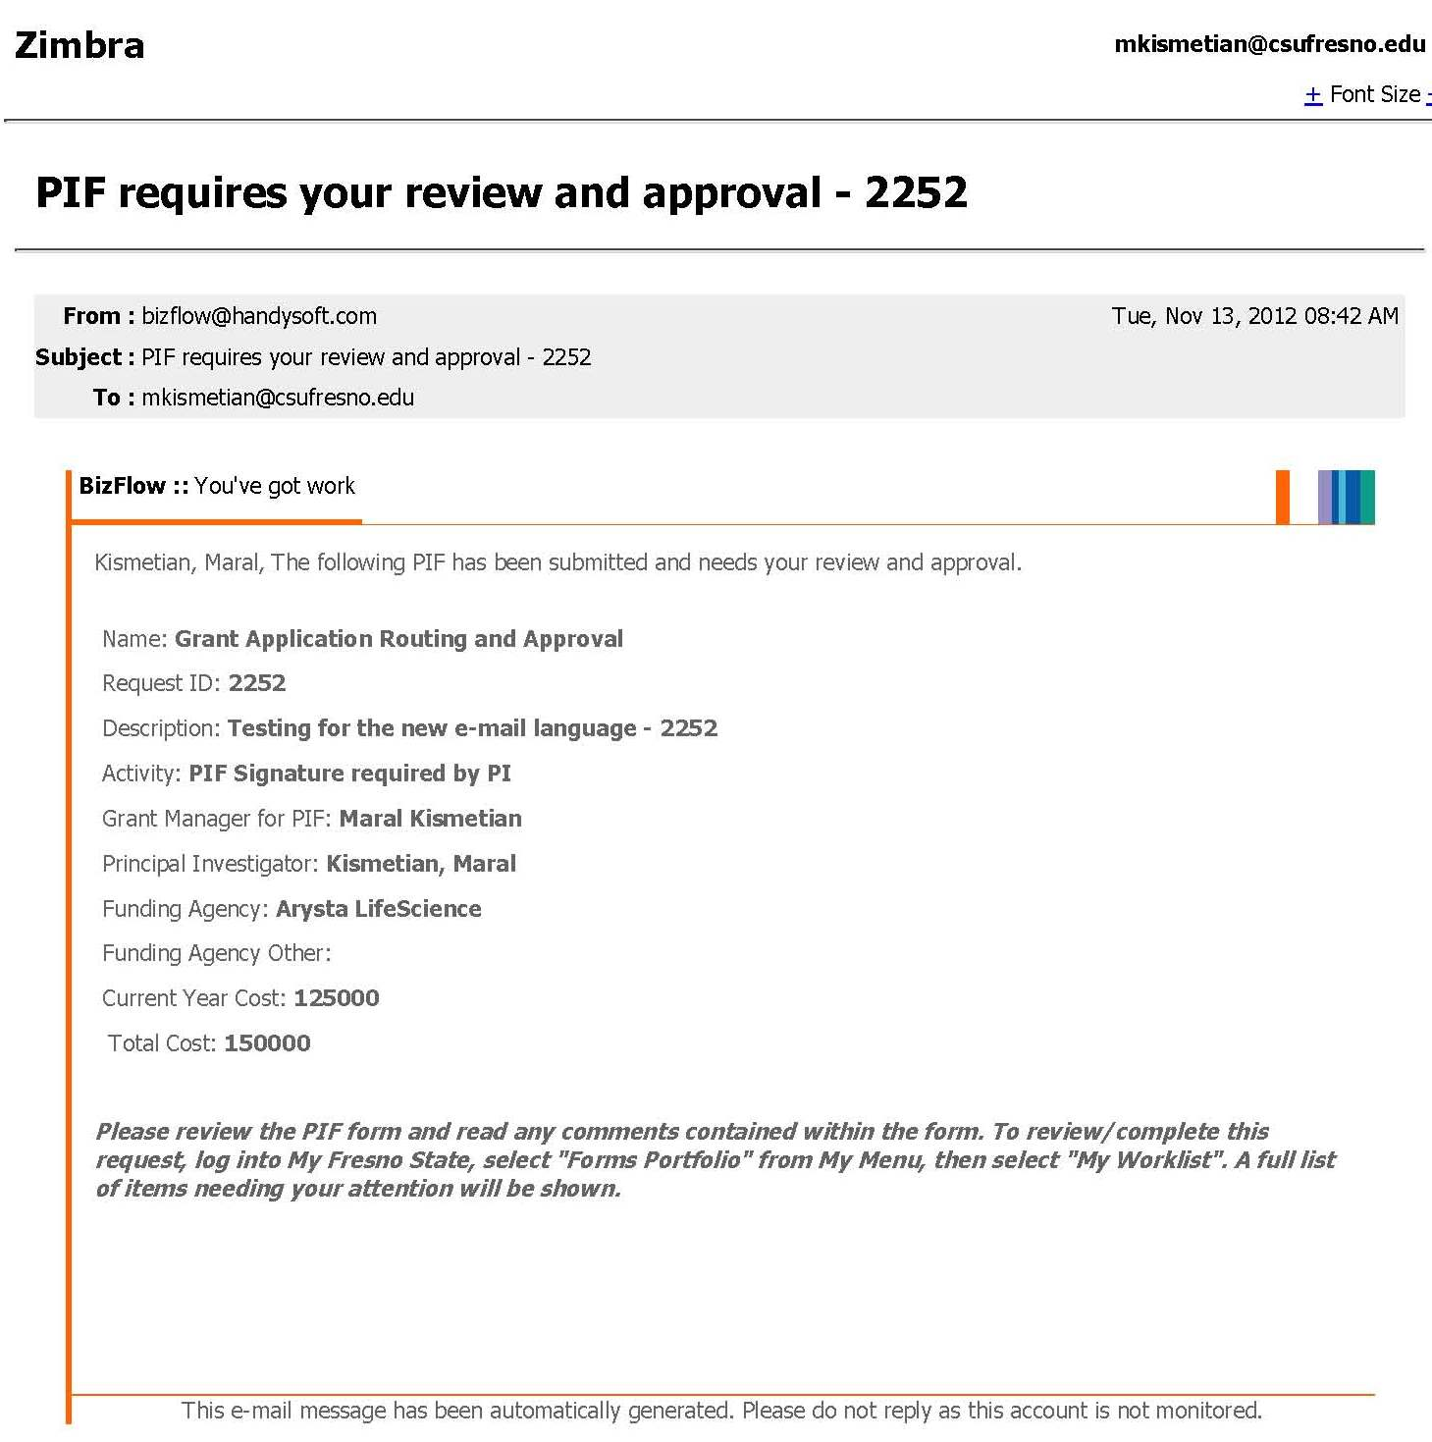
PI – EMAIL NOTIFICATION
PARENT ID
ACTIVITY LEVEL
INSTRUCTIONS

Slide 13
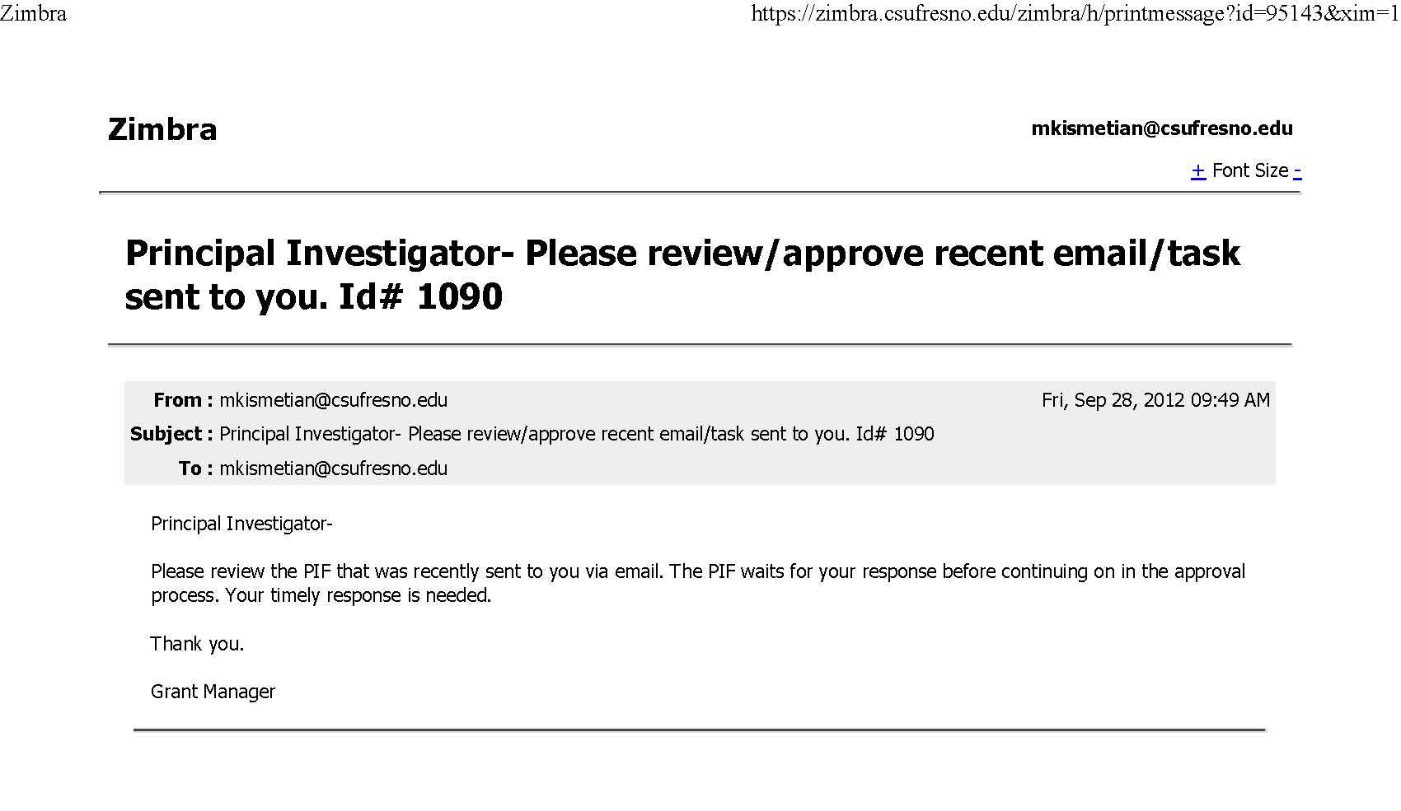
PI- EMAIL REMINDER
PARENT ID
FROM THE GRANT MANAGER

Slide 14
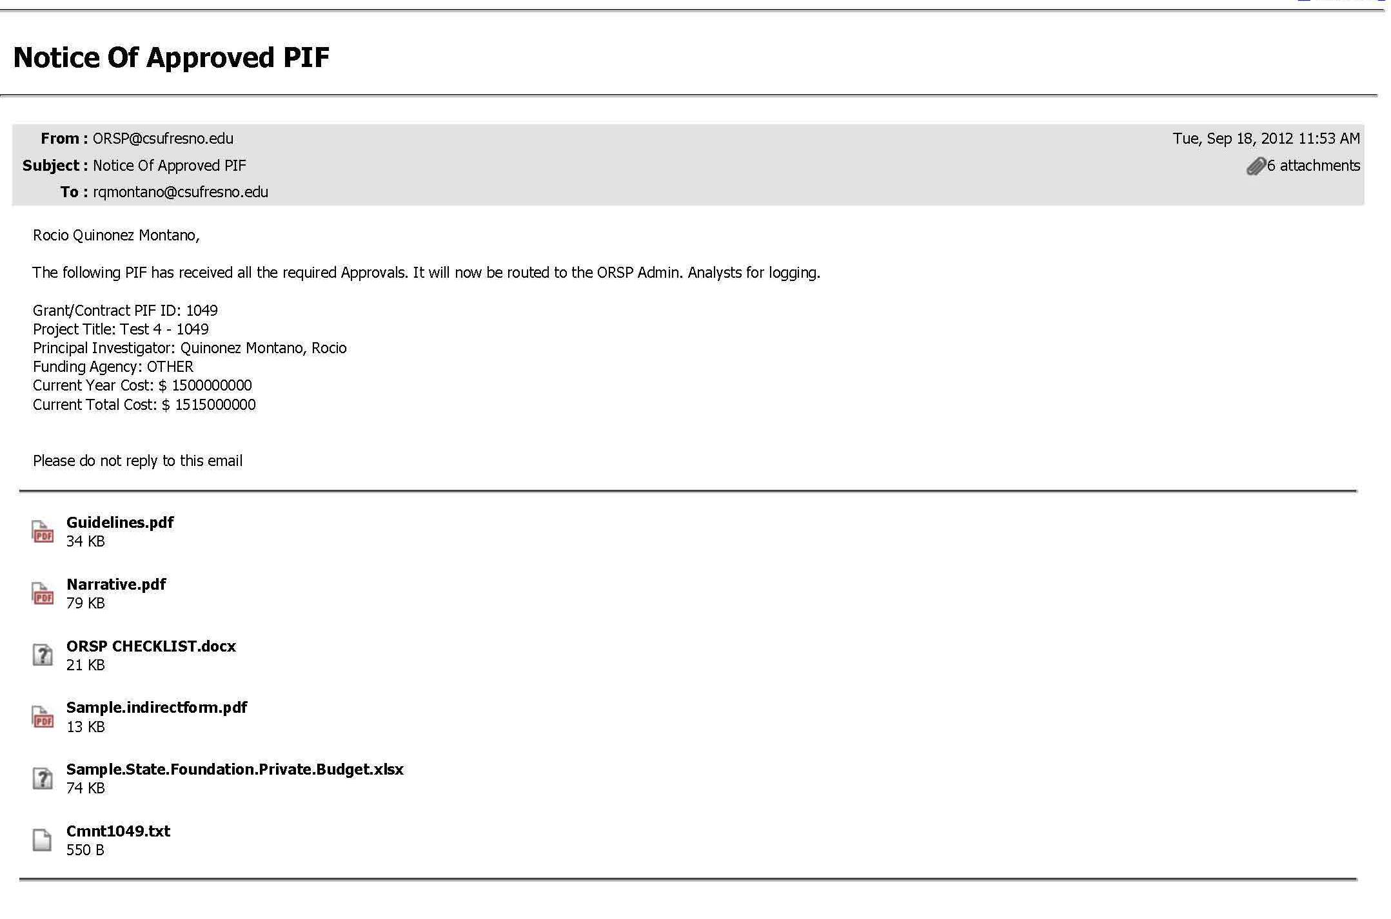
GM and PI - EMAIL NOTIFICATION
SUMMARY
ATTACHMENTS

Slide 15
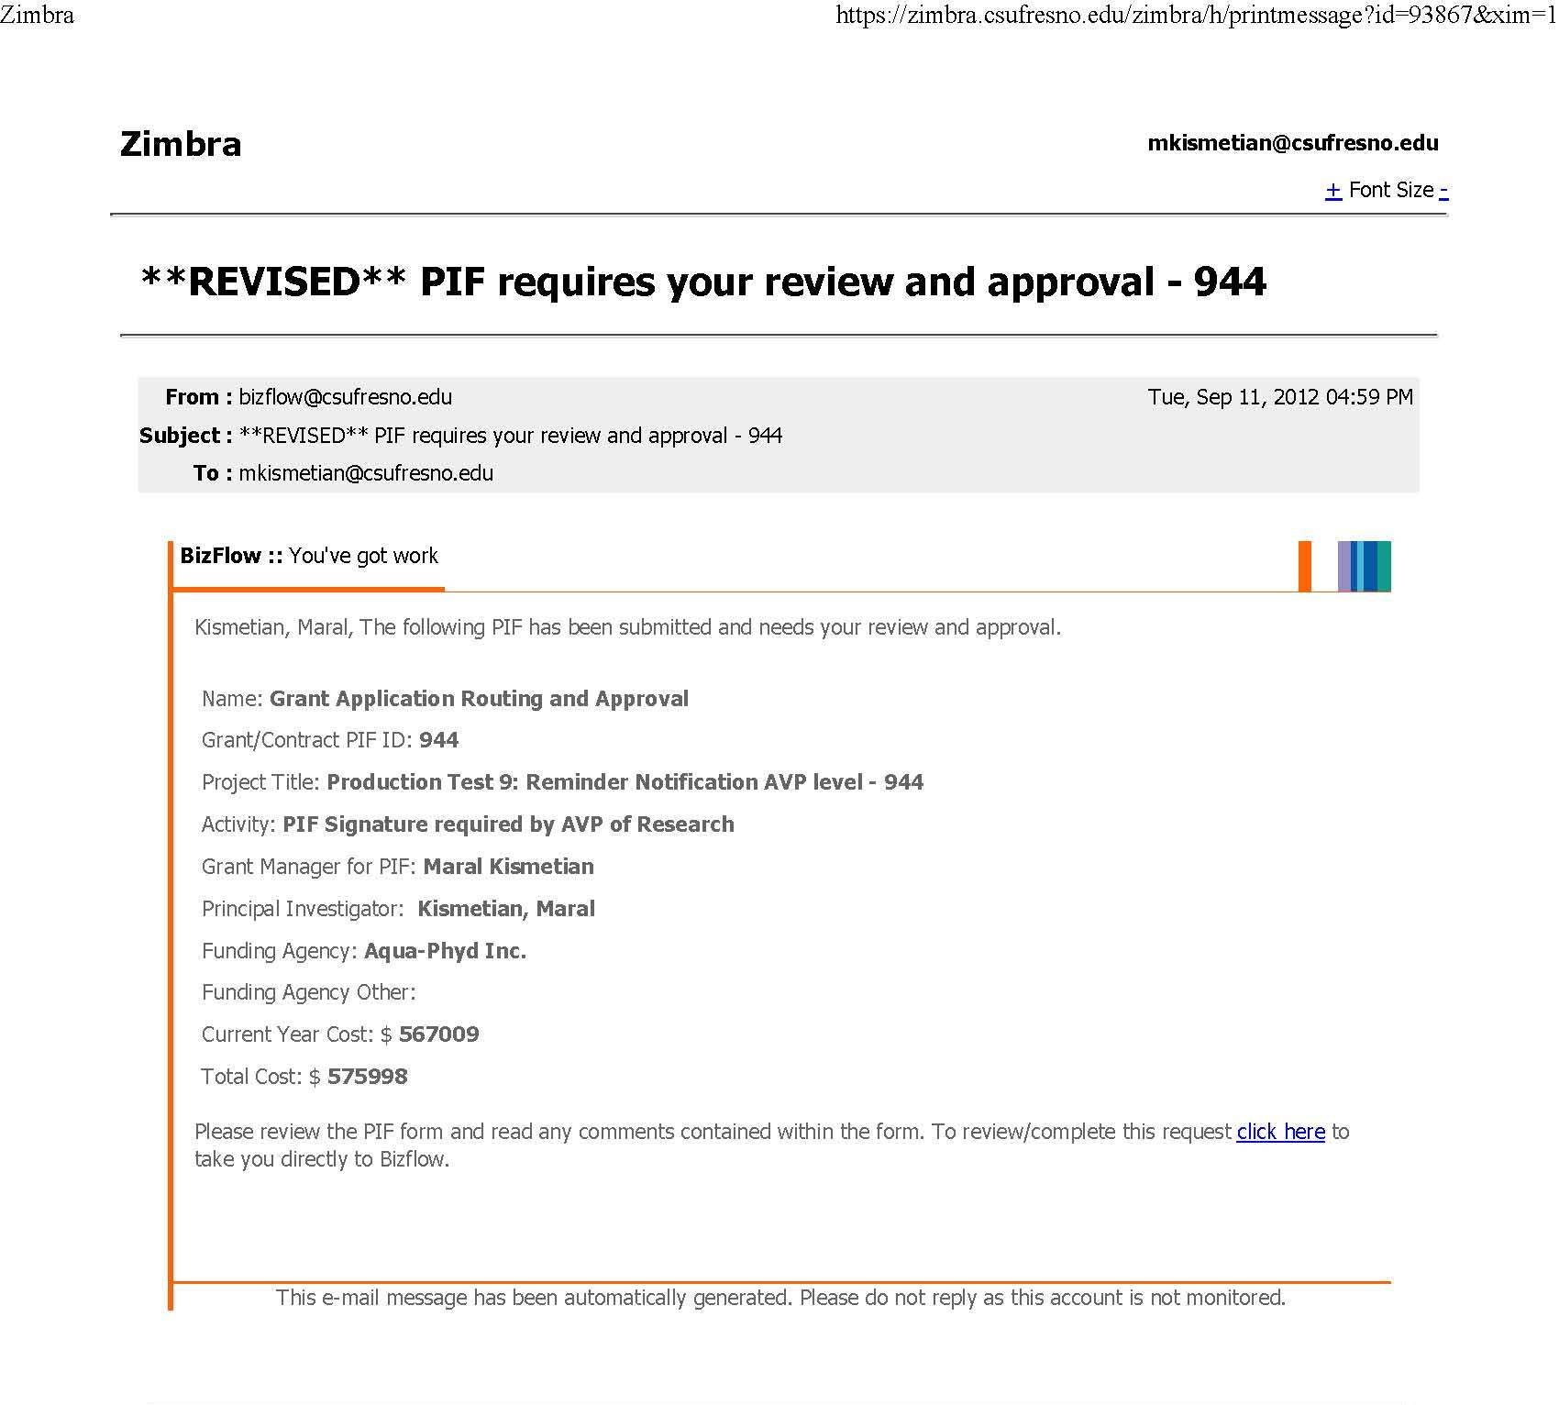
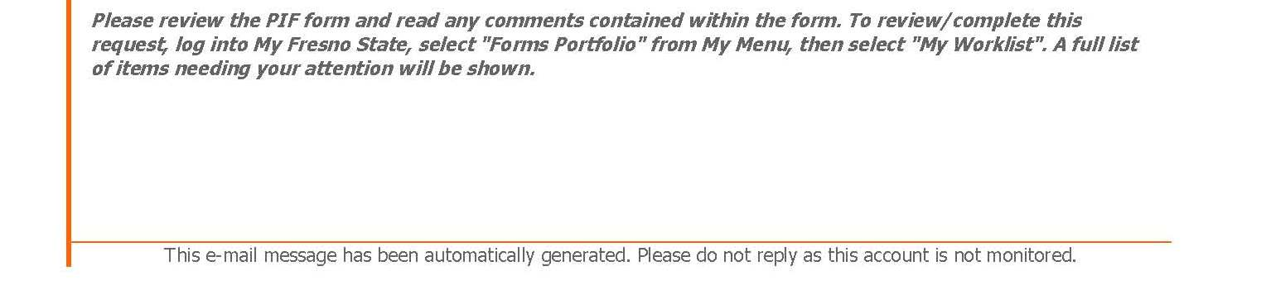
REVISED – E-MAIL NOTIFICATION
PARENT ID
ACTIVITY LEVEL
INSTRUCTIONS

Slide 16
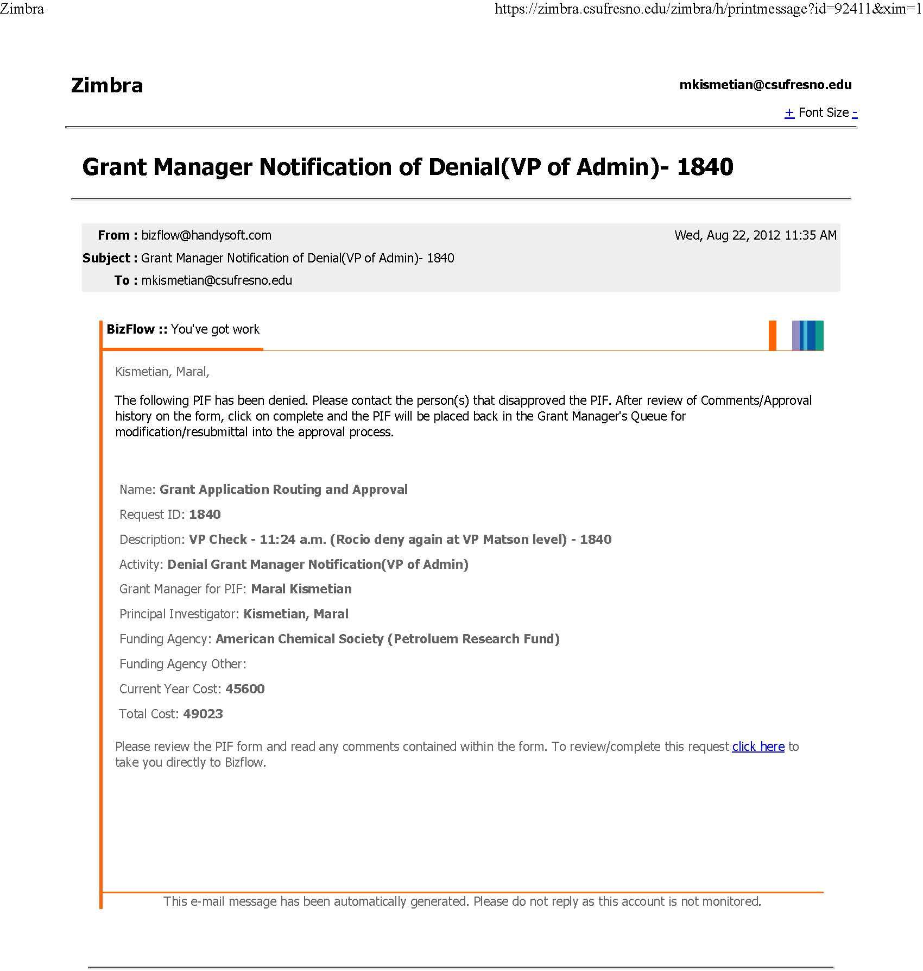
DENIAL NOTIFICATION
PARENT ID
INSTRUCTIONS

Slide 17
Contact information
ORSP
ext. 8-0840
IT- Help Desk
ext. 8-5000
Grant Routing and Approval Form (GRAF) Status/Completion
Issues with viewing the Grant Routing and Approval Form (GRAF) or Attachments
Problems writing Comments
Recommendations
Issues with browser
Login problems
Grant Manager @ ORSP
Questions regarding Grant Routing and Approval Form (GRAF) budget, Cost share, IDC, etc.
New Approvers (Dean/Chair)
PI, CO-PI, Deans/Chairs out of Office (more than 3 days)

Slide 18
QUESTIONS

