Slide 1
Pre-medical Studies at Fresno State
Larry G. Riley, MSc, PhD
Professor – Comparative Endocrinology
Pre-Med Advisor
Biology Department
California State University, Fresno
Science 1, room 212
lriley@csufresno.edu
Appointments are made with the Biology department @ 278-2001

Slide 2
The Journey Towards a Medical Doctor (MD) & Doctor of Osteopathy (DO) Financial (Application Fees & Cost Medical School)

Slide 3
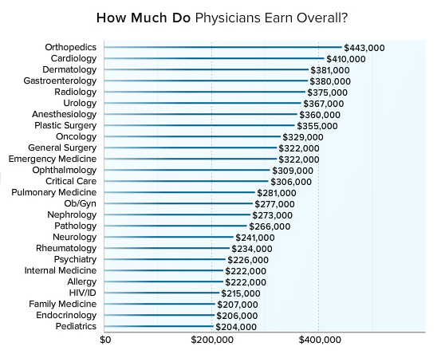
2016 data
Healthcareworkout.com

Slide 4
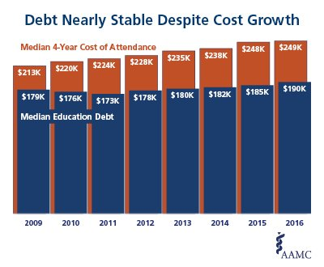

Slide 5
Lost wages while attending medical school & residency
Interest on your loan(s)
$400,000 more in the hole compared to average college graduate
Remember you need a good credit score to qualify for many loans.
So, get a credit card now, but use it sparingly and pay it off every month.

Slide 6
Average Cost of Education
2017-2018 average cost of medical school/year (Tuition, fees, & health insurance):
Public:
resident: $35,704
nonresident: $60,141
Private:
Resident: $57,194
Nonresident: $58,709
Remember you need a good credit score to qualify for many loans.

Slide 7
American Medical Student Association estimates that over 85% of graduates in the medical field carry education debt.
In 2016, average medical student debt was $190,000 before interest.
Education debt should not play a determining role in specialty choice.
Expect to take 15-20 years to pay off your loan. There are strategies to help decrease your debt.

Slide 8
In addition to paying off your school loans, possibly a home mortgage, and basic living expenses, you will need to have malpractice insurance (annually).
Malpractice Insurance
Cost depends on the State & Specialty
Costs can range from ~$5,000 - >$50,000 annually
Can be as high as >$100,000 annually

