Slide 1
Navigating the Dissertation Template: Basics
Chuck Radke
The Graduate Writing Studio

Slide 2
Topics
Where to find the template
Colored text
Approval page
Styles window
Show/Hide
Formatting text in the template
Populating the Table of Contents, List of Tables, and List of Figures

Slide 3
Where to find the template
DPELFS Web site, Student Corner:
https://www.csufresno.edu/dpelfs/students/index.shtml
Select “Dissertation Template” in the navigation bar to the right

Slide 4
What does the colored text mean?
Black text – Do not delete. Everything in black stays in the document.
Red text – Model text. Replace with your own text, then change the ink color to black.
Blue text – Delete. The blue text is instructional, providing general guidance for what goes into a particular chapter or section.

Slide 5
Approval page
Special instructions:
No academic titles (e.g., Dr., Ph.D.) before or after committee member names, per university guidelines.
Type only the name of the department; do not include “Department of…” preceding the department name.

Slide 6
Sample

Slide 7
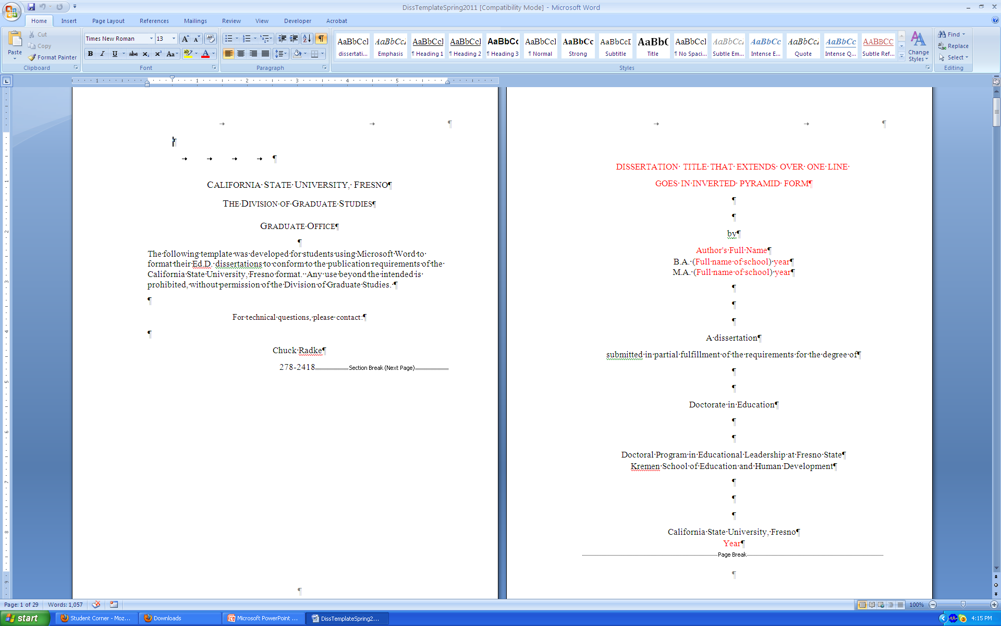
Open template

Slide 8
Styles window
Show the Styles window:
(Alt+Ctrl+Shift+S)

Slide 9
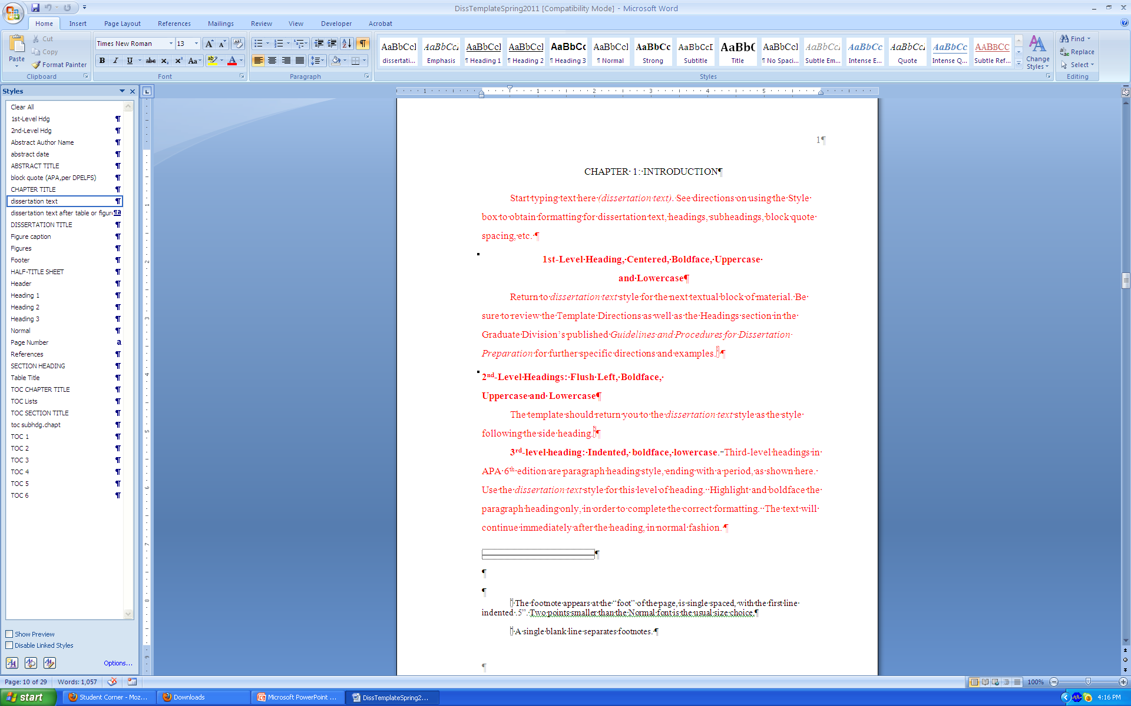
Styles window showing

Slide 10

Activate Show/Hide ¶

Slide 11
Show/Hide ¶
Show/Hide ¶ shows the paragraph marks and other hidden formatting symbols.
The individual paragraph’s/line’s “DNA” is contained within the ¶.
Making the ¶s visible will help you format.
Click the ¶ icon to reveal the symbols.

Slide 12
Pasting text into the template
1-2-3
Select and copy (Ctrl+C) text from the “home” document (your original)
Paste (Ctrl+V) into the “destination” document (the template)
Select paragraph(s) and apply “dissertation text” style

Slide 13
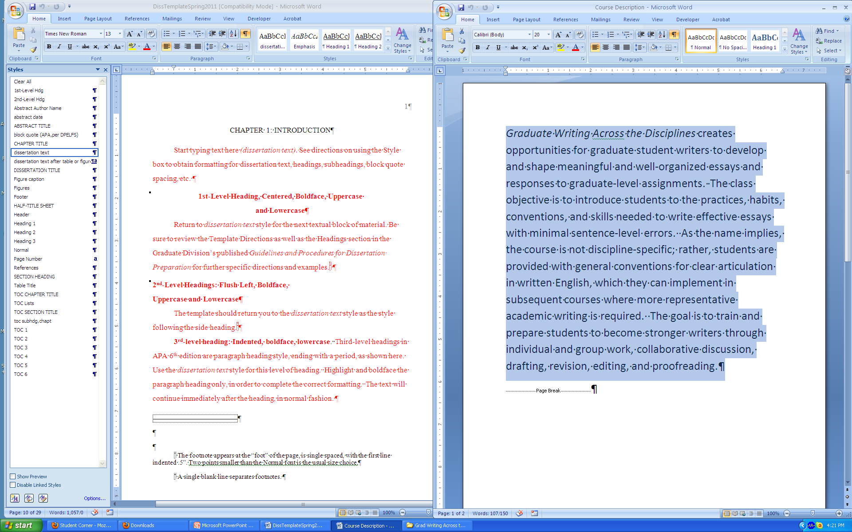
Text selected/copied (Ctrl+C) from original

Slide 14
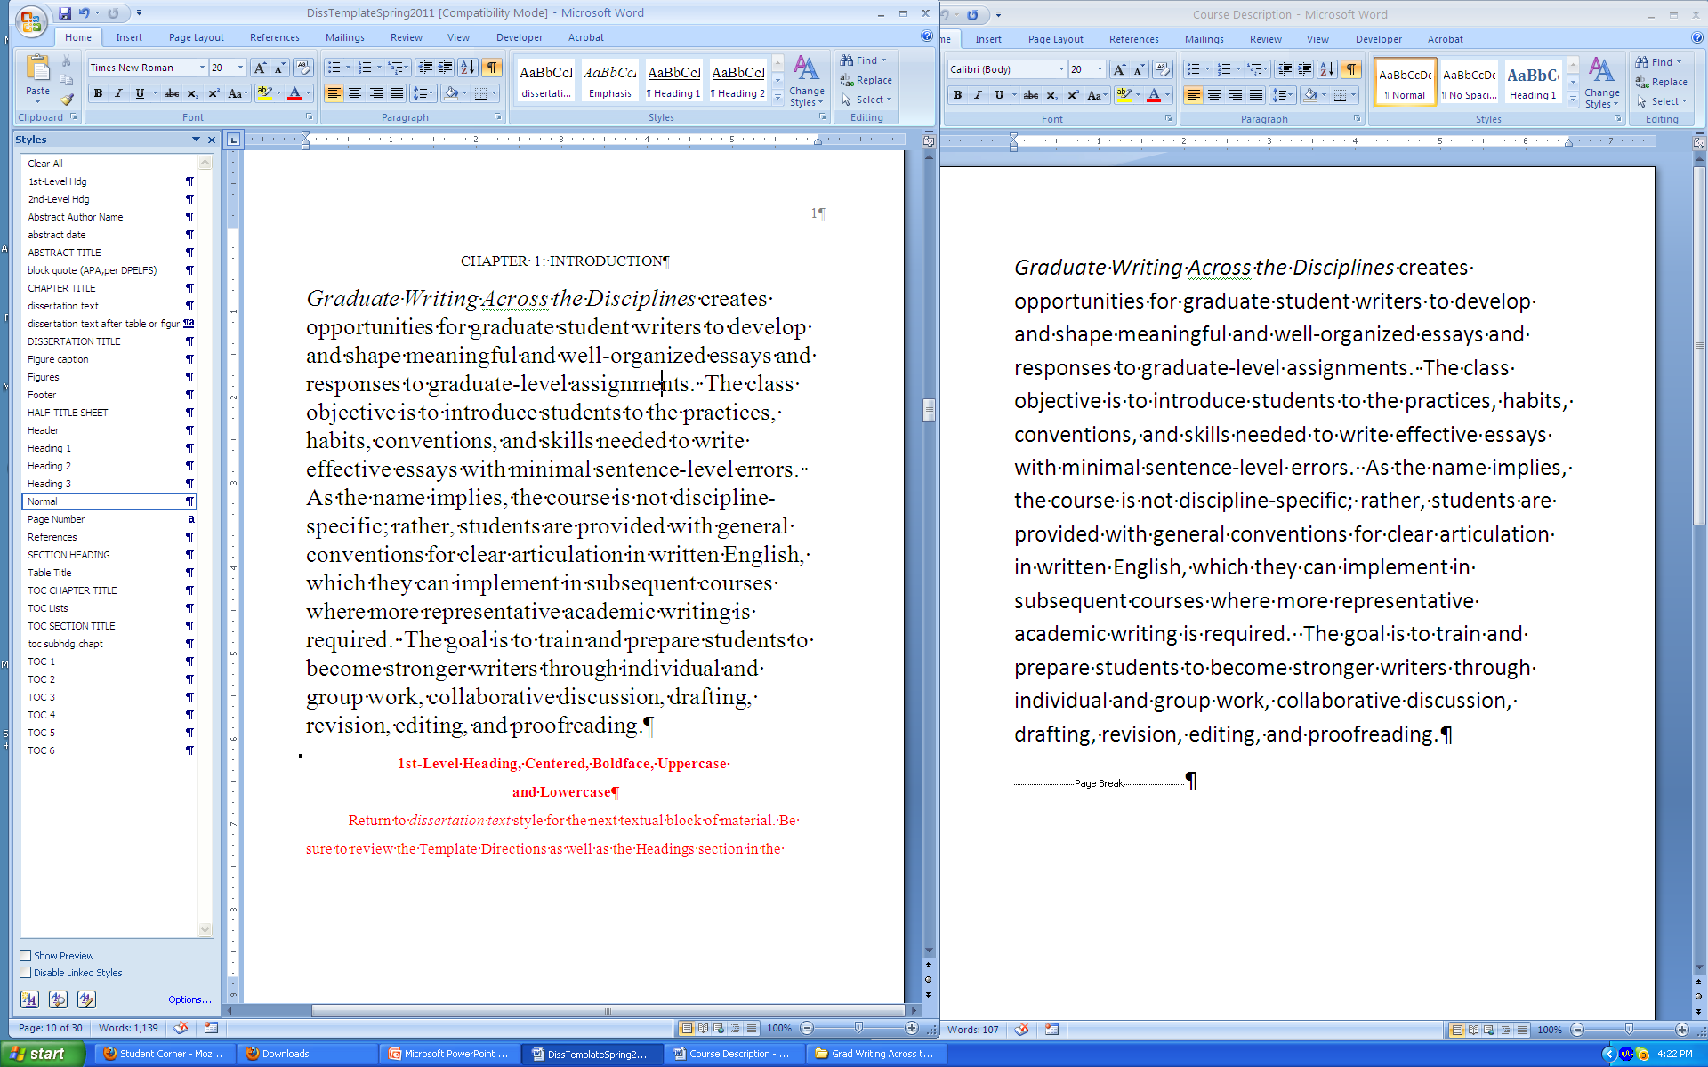
Text pasted (Ctrl+V) in template

Slide 15
Cursor anywhere in paragraph

Slide 16
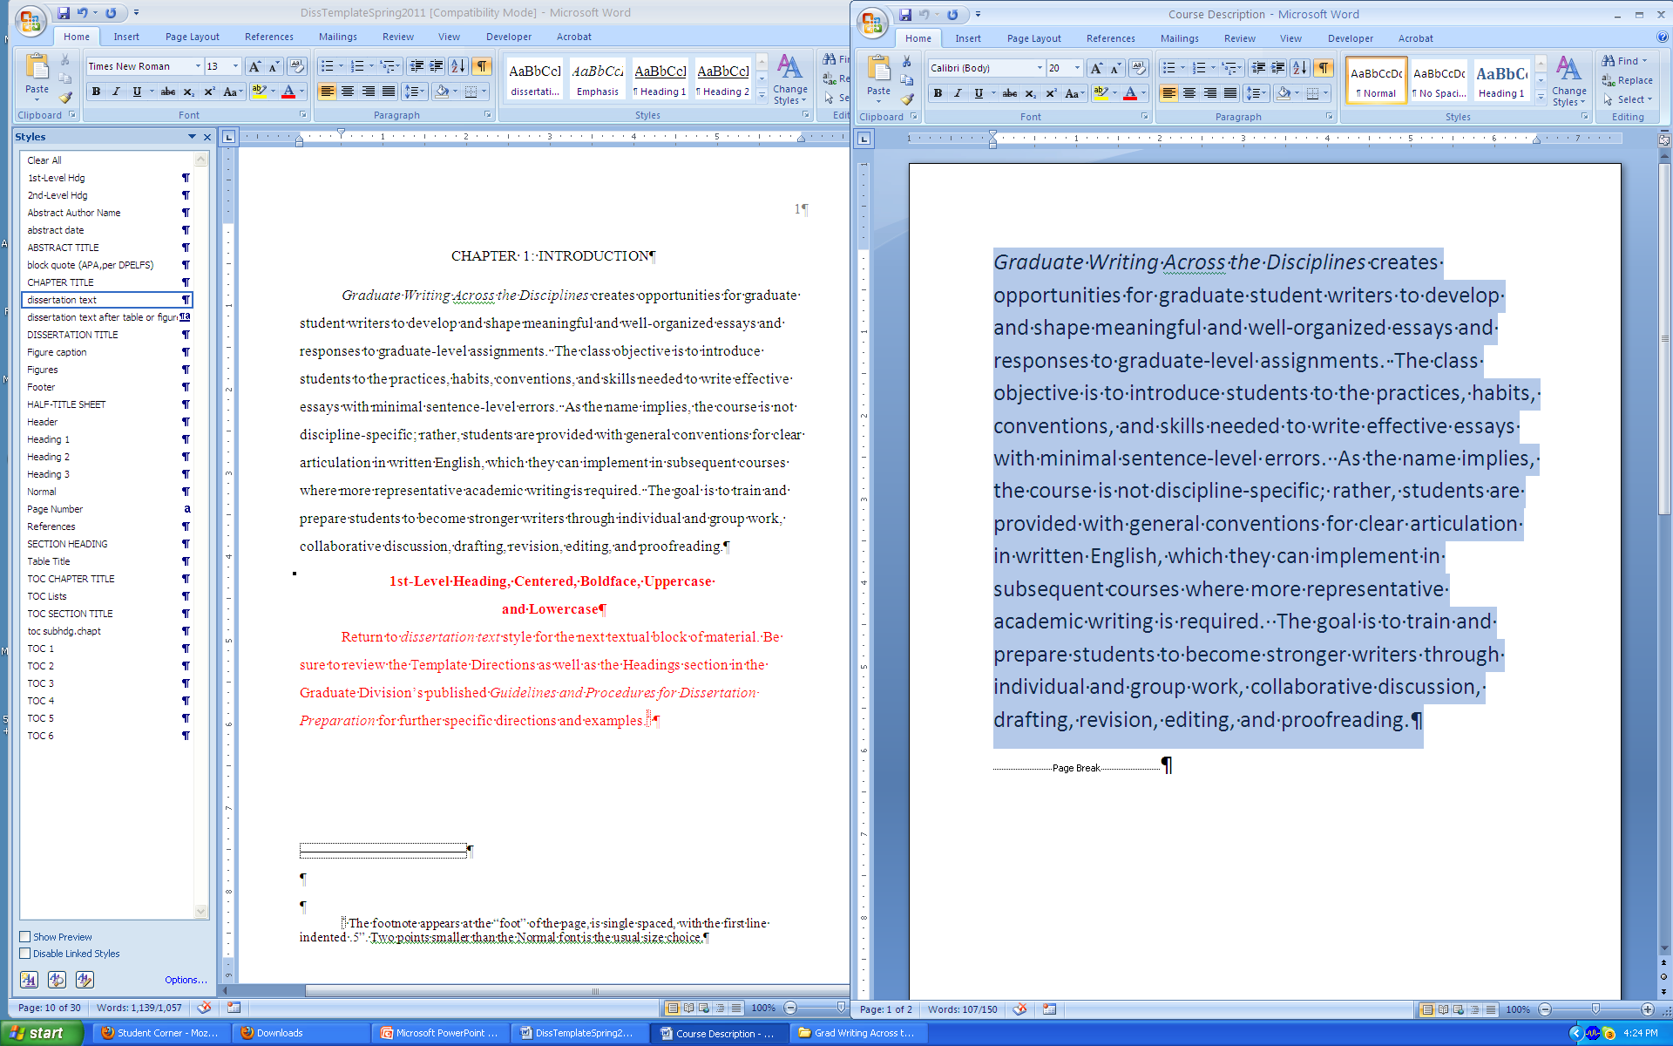
Select “dissertation text”

Slide 17
Headings, table titles, figure captions
Format headings, table titles, and figure captions using the Styles window.
1st-Level Hdg
2nd-Level Hdg
Table Title
Figure caption

Slide 18
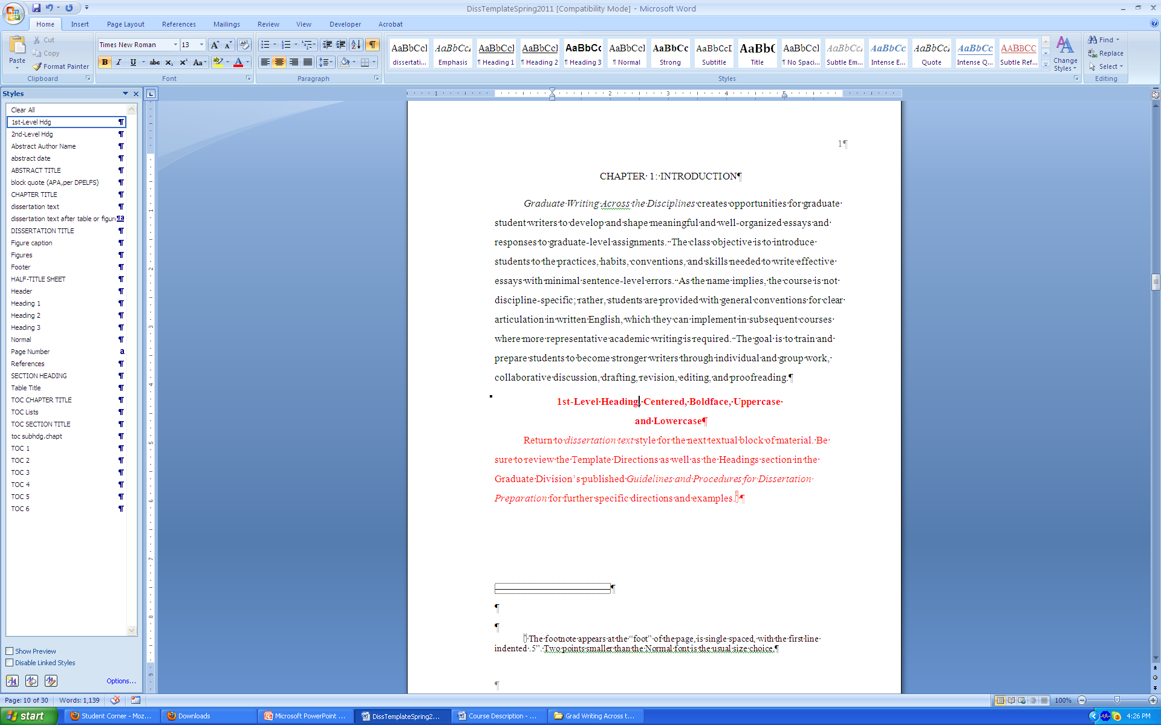
Place cursor, select style, format line

Slide 19
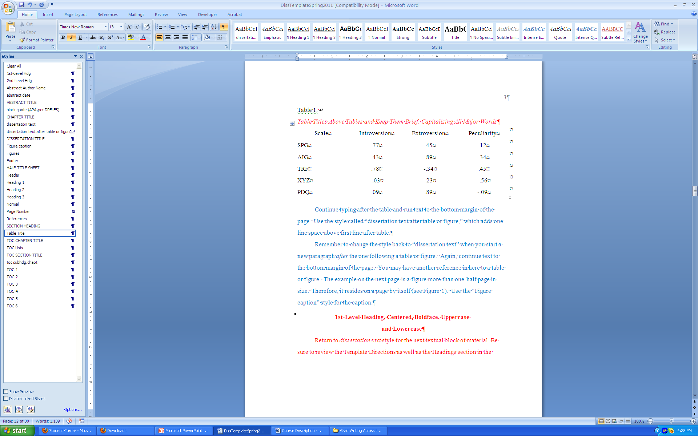
Table titles

Slide 20
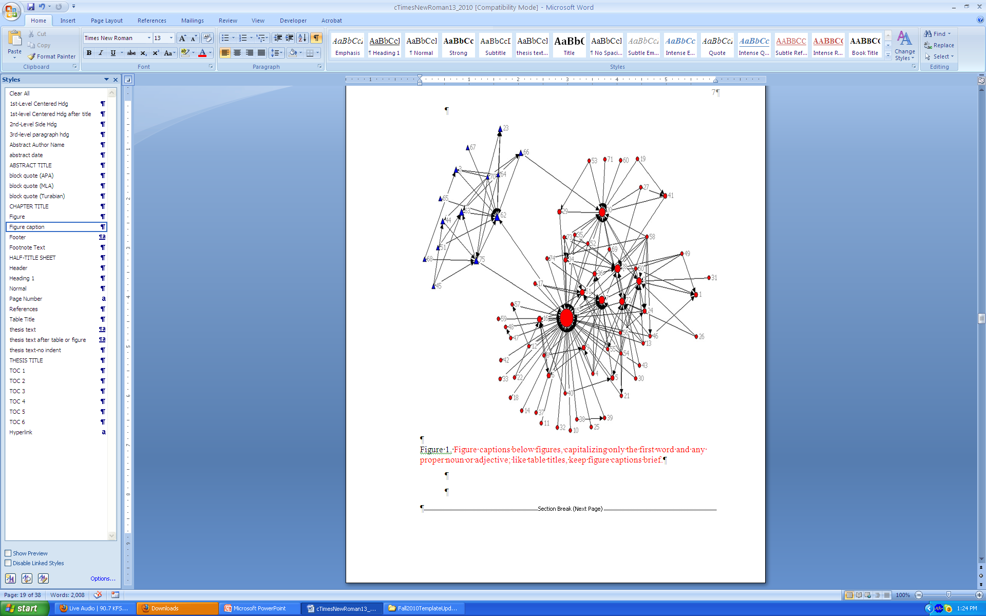
Figure captions

Slide 21
Populate the Table of Contents…
the List of Tables, and the List of Figures.
When text is in the template
When styles have been applied (e.g., CHAPTER TITLE, 1st-Level Hdg, Table Title)
Left click<Right click<Update field (Update entire table)

Slide 22
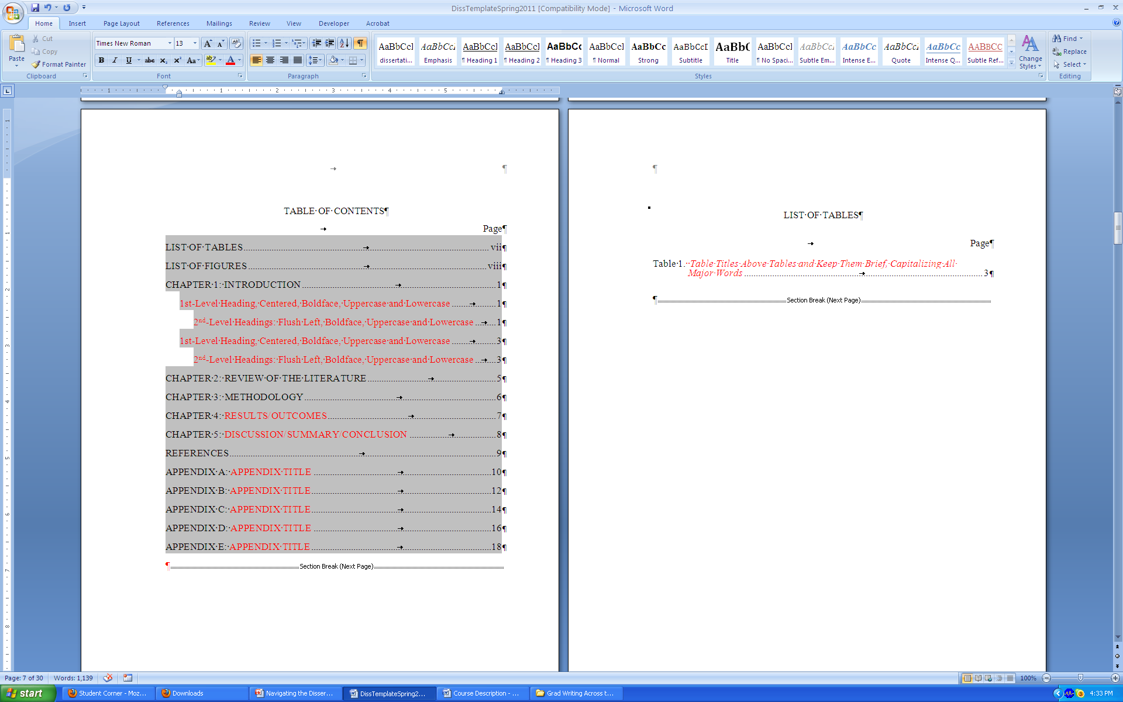
Left click
(table elements turn gray)

Slide 23
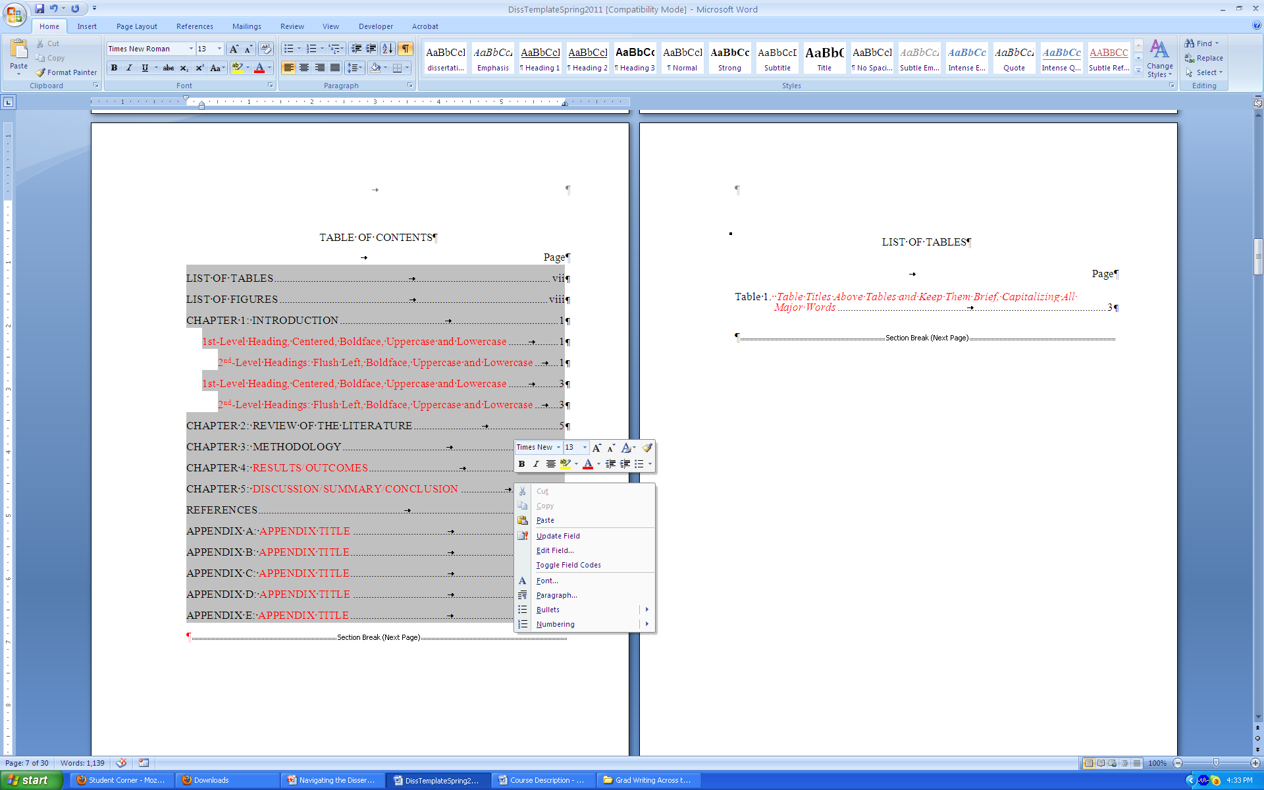
Right click (brings up menu)

Slide 24
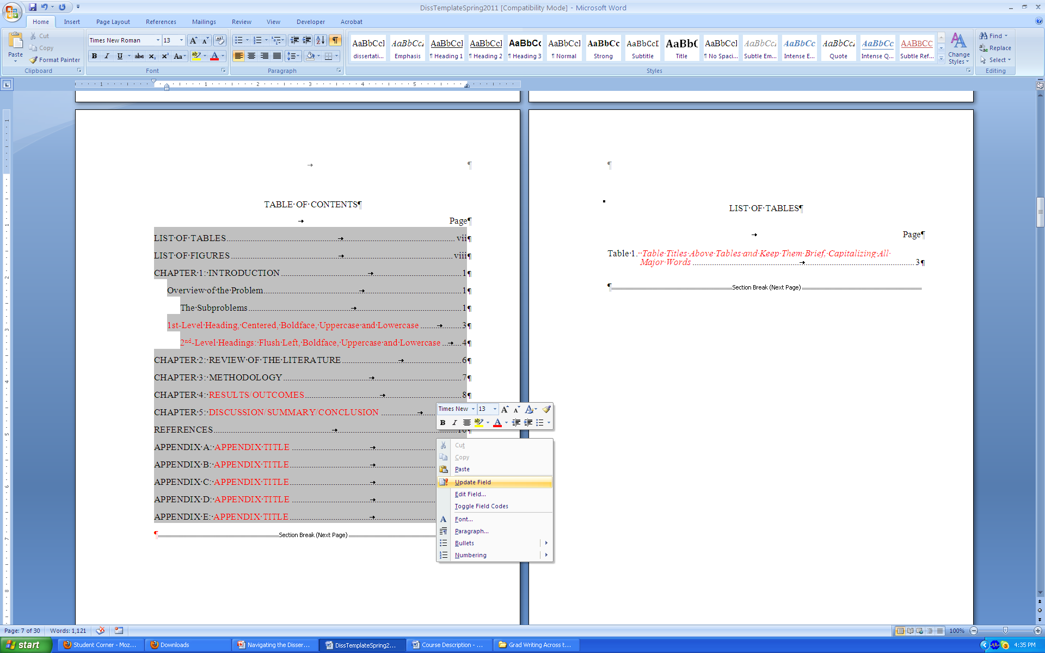
“Update Field” populates

Slide 25
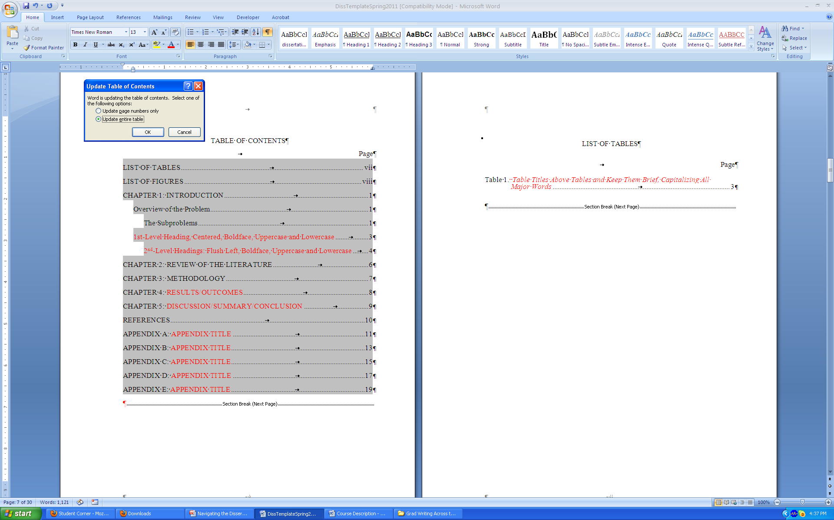
Select “Update entire table”<OK

Slide 26
Updating
Chapter titles, 1st-Level headings, 2nd-level headings, and section headings (e.g., Appendix titles) will populate the Table of Contents.
“Table Title” will populate the List of Tables, using the same “left click<right click<update field” sequence.
“Figure caption” will populate the List of Figures, using the same “left click<right click<update field” sequence.
Update as often as you wish!

