Slide 1
NEW MDP FEATURES
My degree plan

Slide 2
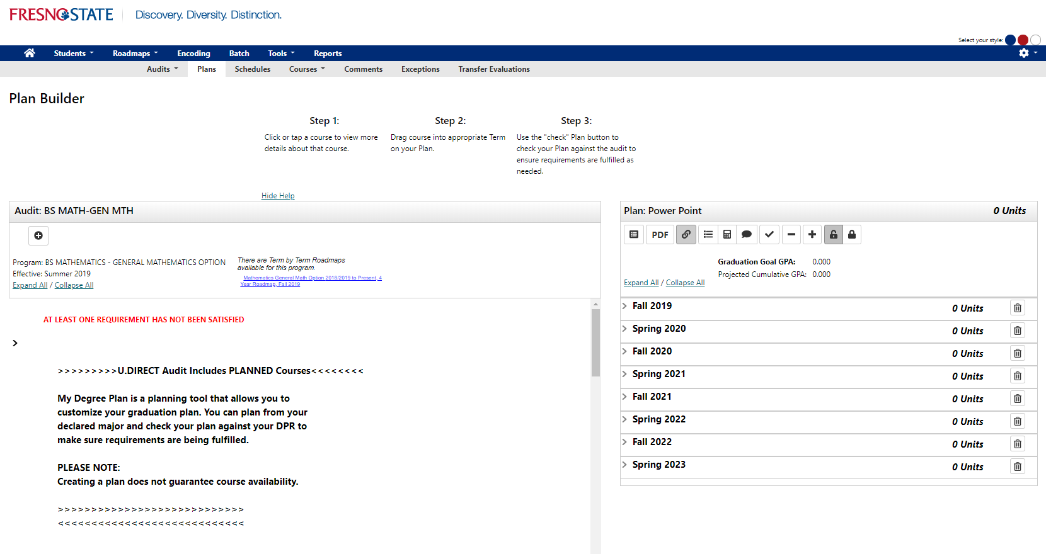
Create a Plan from Roadmaps
Roadmaps will be available by clicking hyperlink. This will allow you to create your plan from the roadmap.

Slide 3
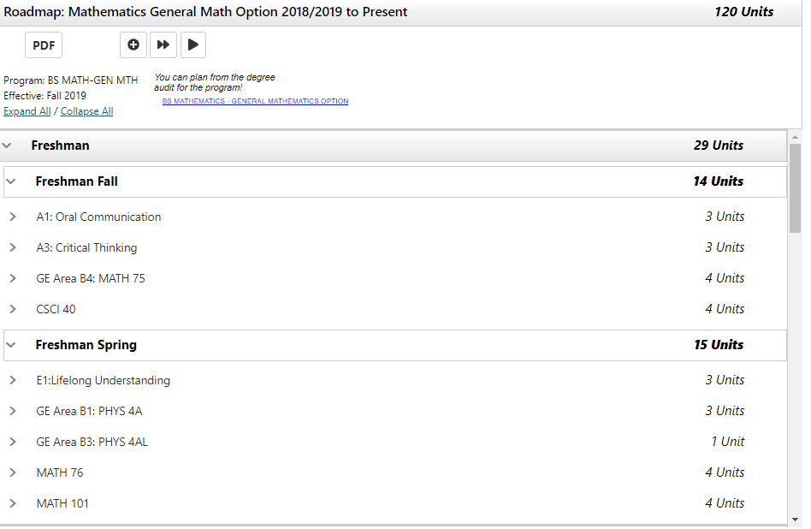
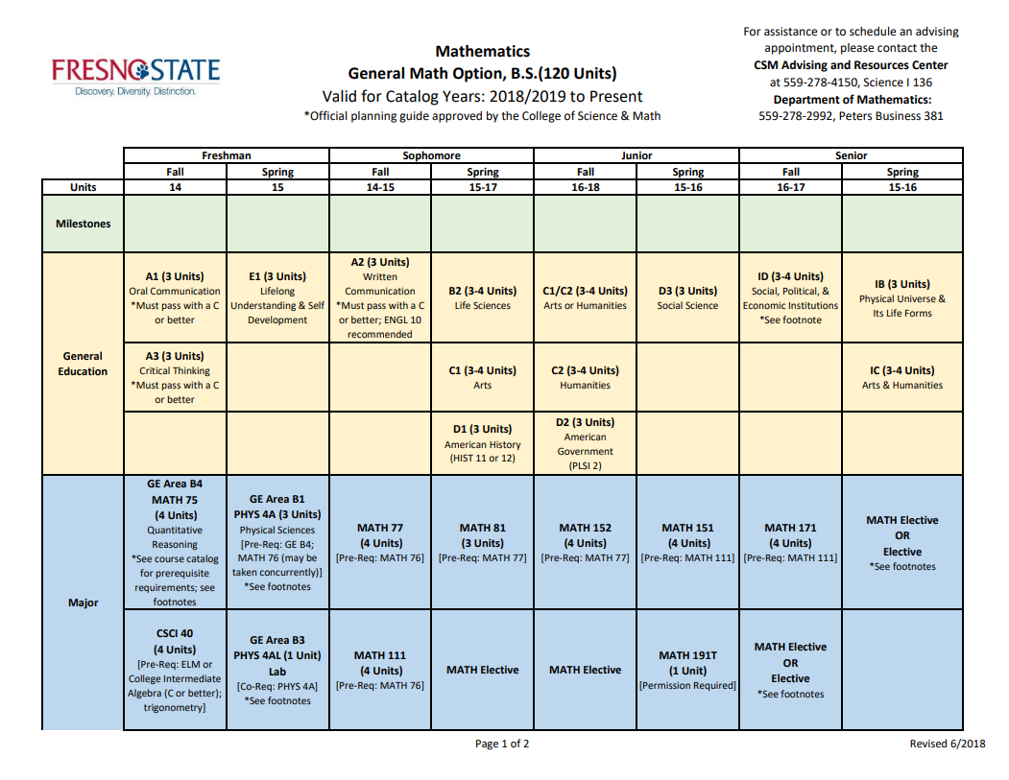
Easily switch from audit to roadmap
Roadmap title will appear
Notice order of courses align with current roadmaps published on Fresno State online catalog.

Slide 4
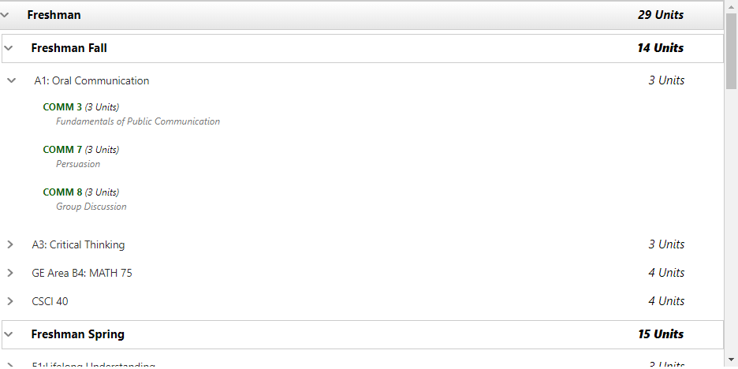
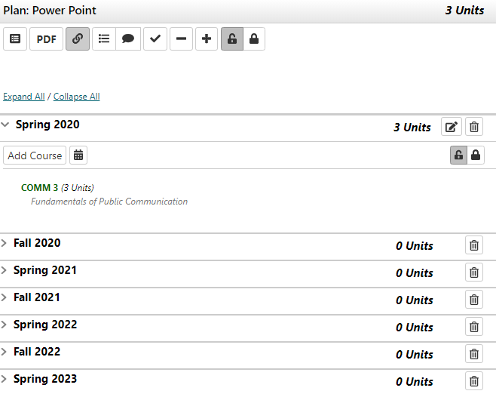
Drag and drop
open each requirement
Add course to plan
Note: Unit counts will adjust once course is moved to plan

Slide 5
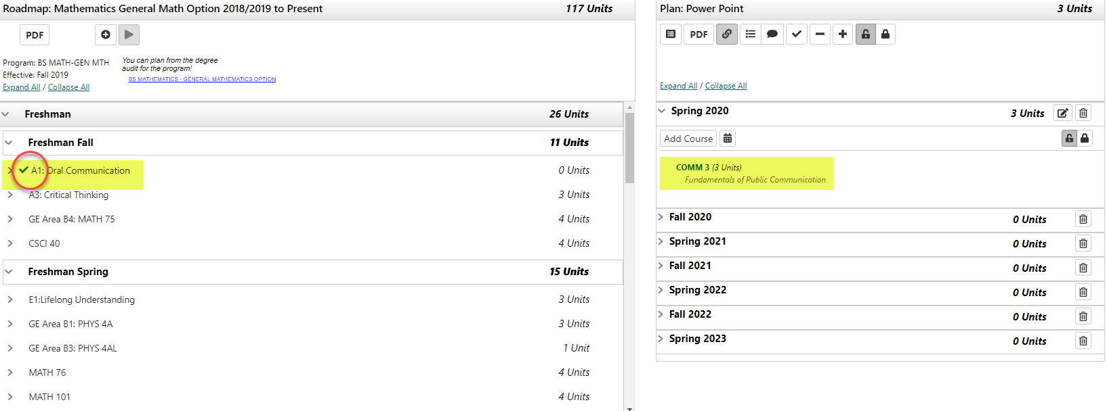
Course selection
Requirement gets checked. As noted unit counts adjust.

Slide 6
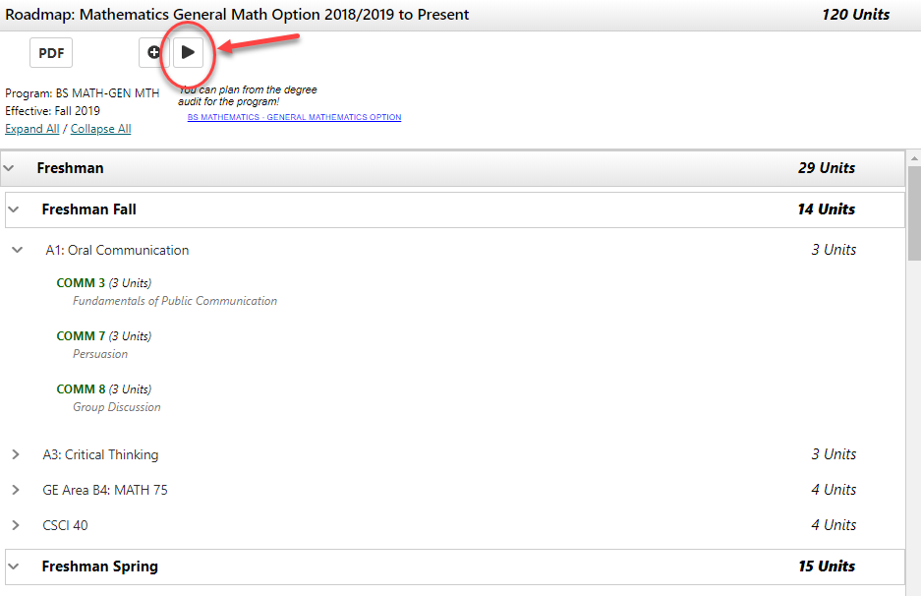
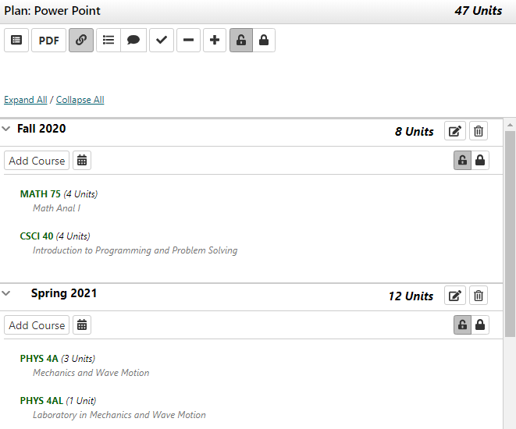
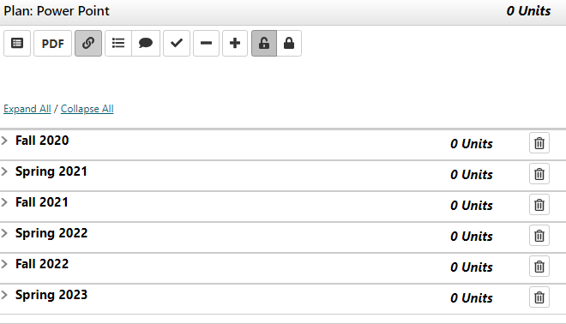
Moved preferred courses
Courses that have options do not move over and will require a selection.

Slide 7
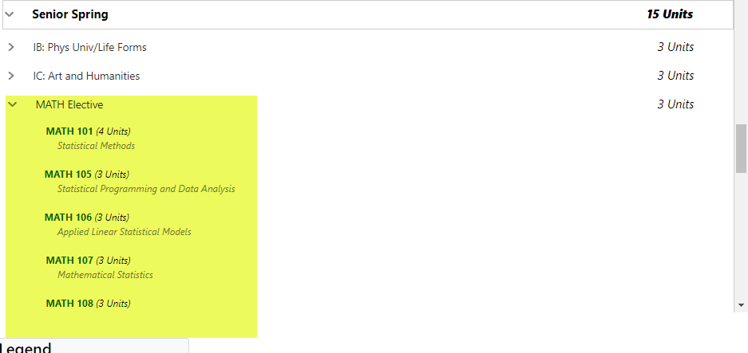
Specific Electives / open electives
Unspecified elective choices will have a wildcard holding place. Wildcards allow any course not specified in the roadmap to fulfill that requirement.

Slide 8
Questions?
Contact
Sam Porraz
sporraz@mail.fresnomail.edu

