Slide 1
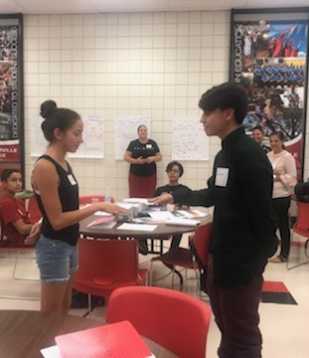
San Joaquin Valley Writing Project: Engaging with Teachers and Students Throughout the Region to Improve the Writing of All Students
Director: Dr. Juliet Wahleithner, Literacy, Early, Bilingual, & Special Education
Porterville Summer Writing Academy
A partnership with Porterville College serving Porterville-area teachers and students
July 23-Aug. 2, 2018 • Porterville College
Week One:
9 Porterville-area secondary teachers participated in a 4-day workshop led by SJVWP Teacher Leaders focused on developing their knowledge of argument writing and understanding of how to develop their students as writers
Week Two:
10 7th-12th grade students participated in a 4-morning workshop helping them to develop as writers led by the participating teachers with the SJVWP Teacher Leaders
Teachers and Teacher Leaders de-briefed together in the afternoons and made plans for the next day
•
“I loved the experience of seeing great Demo lessons and then actually applying them with students.”
“It was by far the best PD I've had.”
WHO WE ARE
Network of K-16 Teacher Leaders who support teaching and learning of writing in ALL disciplines
Local affiliate of California Writing Project and National Writing Project
Founded at Fresno State in 1979
WHAT WE DO
Develop teachers as writers, researchers, and instructional leaders
Provide professional development for teachers grounded in research and real-classroom experience, connected to the Common Core Standards
Provide writing programs for students and families
Serve over 350 local K-16 teachers annually

