Slide 1
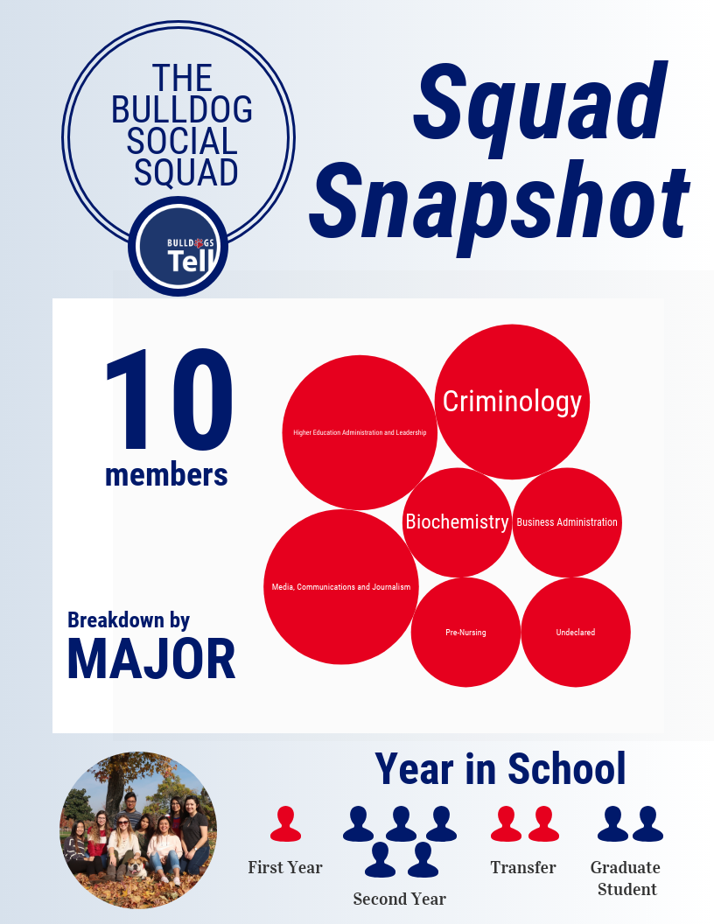
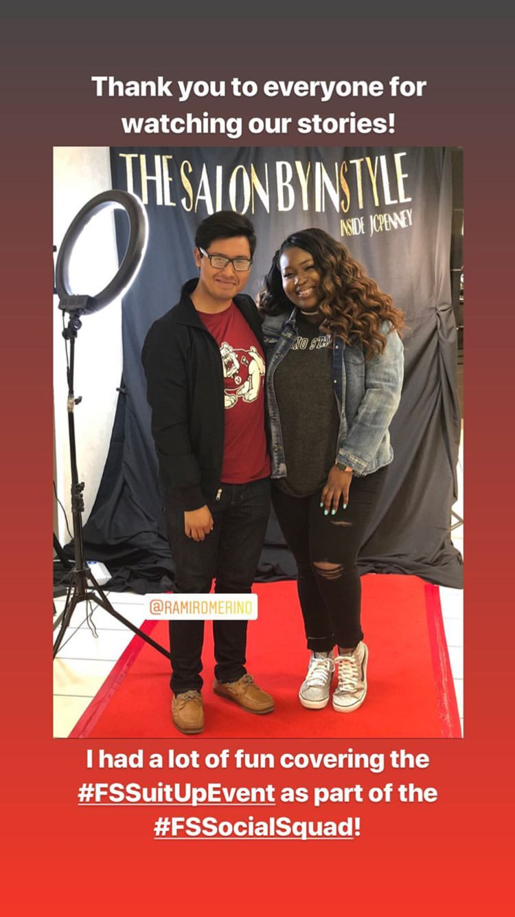
Bulldog Social Squad Division of Student Affairs and Enrollment Management
The Bulldog Social Squad (BSS), members are savvy student social-media influencers who are involved on campus and who offer creative and collaborative storytelling approaches. The squad promotes the division and the University through social media takeovers, primarily on @bulldogstell. The project was initiated in fall
Profile of the Squad
What’s Next
The squad has been working diligently this semester to think of innovative ways to engage with students and highlight our division’s resources. Upcoming projects include man-on-the-street interviews, promoting the Money Management Center, and a campus “map” locating important items for students.

Slide 2
Insert project title (and tag)

Slide 3
Insert project title (and tag)

