Slide 1
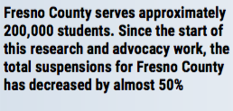
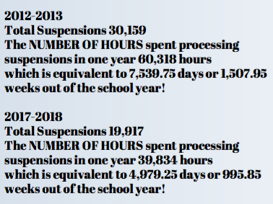
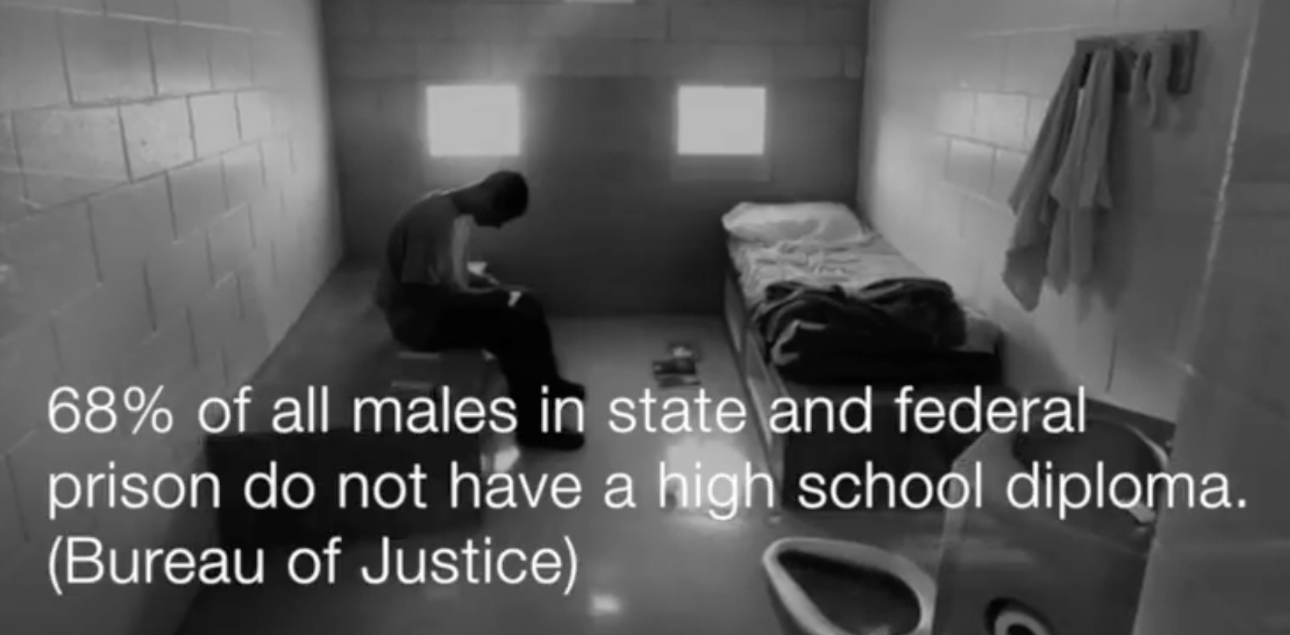
Equity in School Discipline: Scholarly Impact on Fresno County Schools Dr. Jessica Hannigan, Assistant Professor, Department of Educational Leadership, #dontsuspendme #equityinschooldiscipline
Strategic Theme: Grow and develop collaborative and engaged community partnerships to increase supports for students and the University.
Over twenty years of research on discipline approaches, researchers found that out-of-school suspension and zero-tolerance approaches do not reduce or prevent misbehavior and correlates with lower achievement.
Corporal punishment, zero tolerance, and use of exclusionary practices such as suspensions and expulsions have shifted toward creating positive school environments.
(Losen, 2011; Irvin, Tobin, Sprague, Sugai, & Vincent, 2004; Skiba & Peterson, 1999; Mayer, 1995; Skiba & Rausch, 2006)

