Slide 1
PHASE I AND PHASE II PROCESSES
Sources:
Office of Budget & Resource Planning
Notes:
This PowerPoint template is designed to assist you in creating your own university-branded presentation.
You may alter the text boxes or graphic elements in the template to accommodate your content. Please do not alter the background image.
If you need assistance with this template, please contact the Office of University Communications at 559.278.8595.

Slide 2
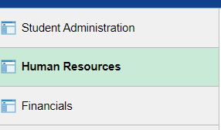
Phase I
To complete Phase I Budget process, a current Budget/Expenditure report will need to be run:
Go to my.fresnostate.edu
Select Reports Portfolio
Select Human Resources

Slide 3
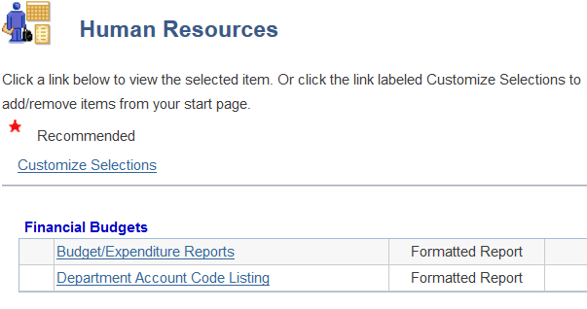
Phase I
Budget/Expenditure Reports

Slide 4
Phase I
Enter existing run control
2. Click either “Search” or “Add a New Value”

Slide 5
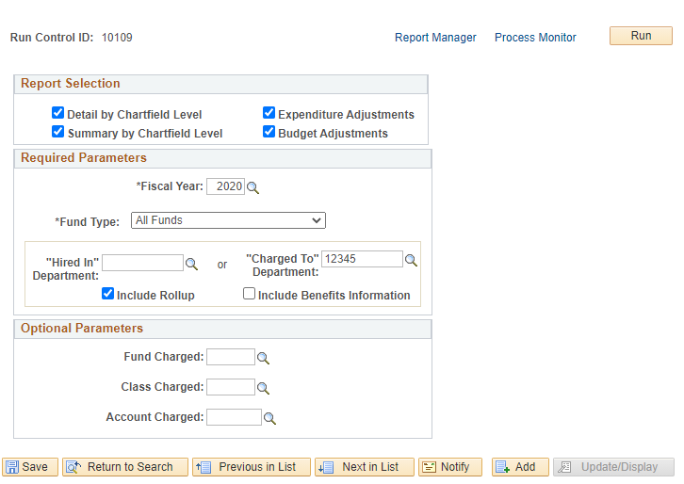
Phase I
Click Detail by Chartfield Level for Report Selection
Fill in all the Required Parameters
Click Run

Slide 6
Phase I
01369
Select Server Name from drop down
Press “OK”

Slide 7
Phase I
Click “Report Manager”

Slide 8
Phase I
789456
Click “Refresh”, when status is changed to “Posted” you are ready to view your report.
Click Details to view the report.
05/26/2021
11:01:31 AM
05/26/2021
11:01:31 AM

Slide 9
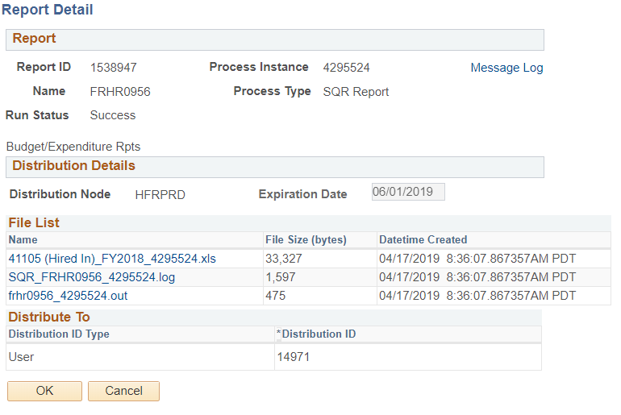
Phase I
Click the link to view the report on excel file format

Slide 10
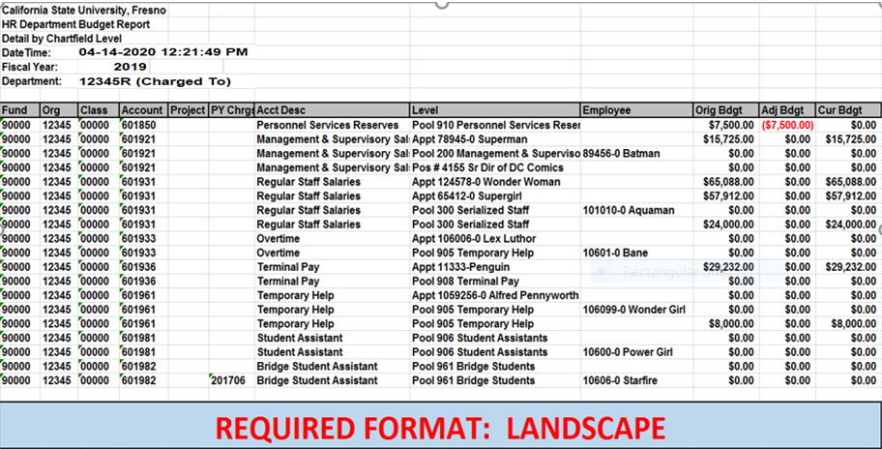
Phase I
Budget/Expenditure Report:
05-26-2021 12:24:49 PM
2020

Slide 11
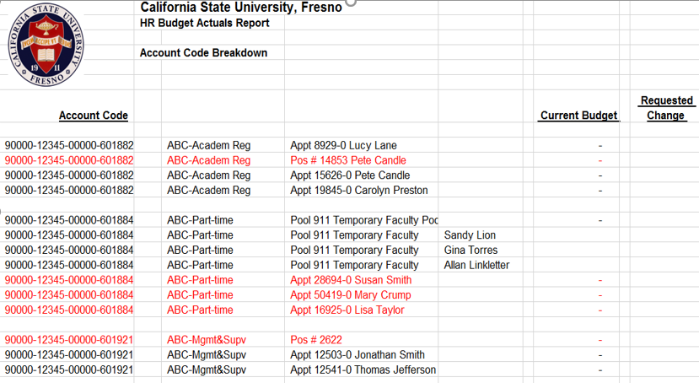
Phase I
Save your report, this will be your working copy to be used for final submission.
Insert a new column with the heading, “Requested Change” to the right of the “Current Budget” column.
Drop or hide all other columns and complete the “Requested Change” column.

Slide 12
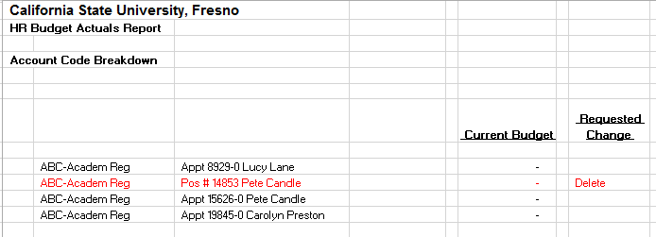
Phase I
Clean-up of FY2020-21 employee records for the Budget/Expenditure Reports:
Delete – Terminations, Resignations, transfers out of Department
Also delete positions if not in use

Slide 13
Phase I
Modify Chartstrings – for Fund, Department, Class, Account
Departmental Changes must also be made via ETR
Requested
Change
- new class

Slide 14
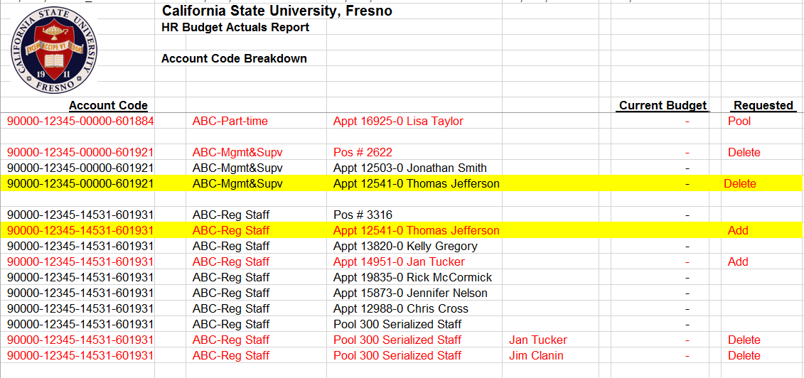
Phase I
Modify Chartstrings – for Fund, Department, Class, Account
Departmental Changes must also be made via ETR
Requested Change

Slide 15
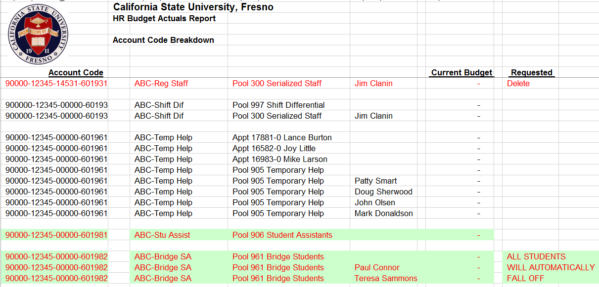
Phase I
All pool employees will be dropped or added automatically – according to the employment end date
Student Assistants will drop off the report automatically
Requested Change

Slide 16
Phase I
Add all new staff:
Transfers to your department
New employees to the campus
Requested Change

Slide 17
Phase I
Positions:
New Positions can be added – but only if the vacant position is budgeted
If you do not know the position number, a vacant position can be requested by using a job code or job classification
Requested
Change

Slide 18
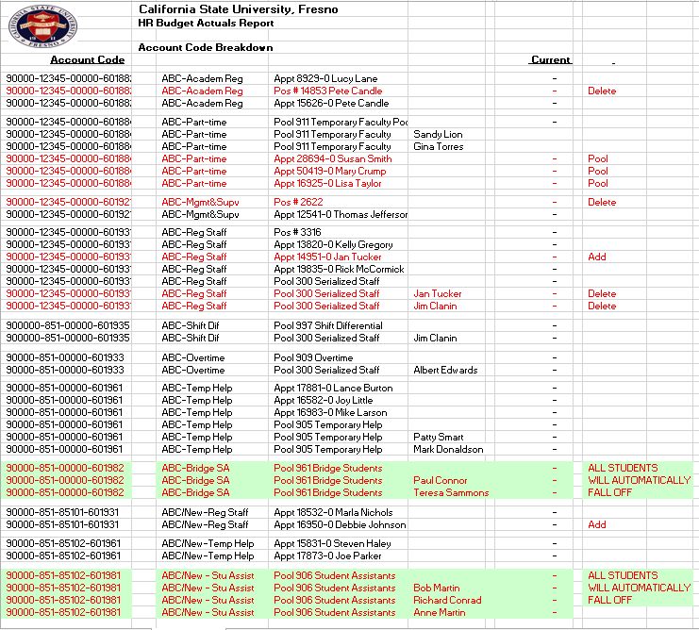
Completed Phase I
Requested Change

Slide 19
Budget submissions are not part of Phase I

Slide 20
Phase II Budget Submission
2021-22 Due date is determined by the date of the Governor signing the Budget for the State of California and the date that the Chancellor’s Office Allocates the CSU’s their Campus Budgets.

Slide 21
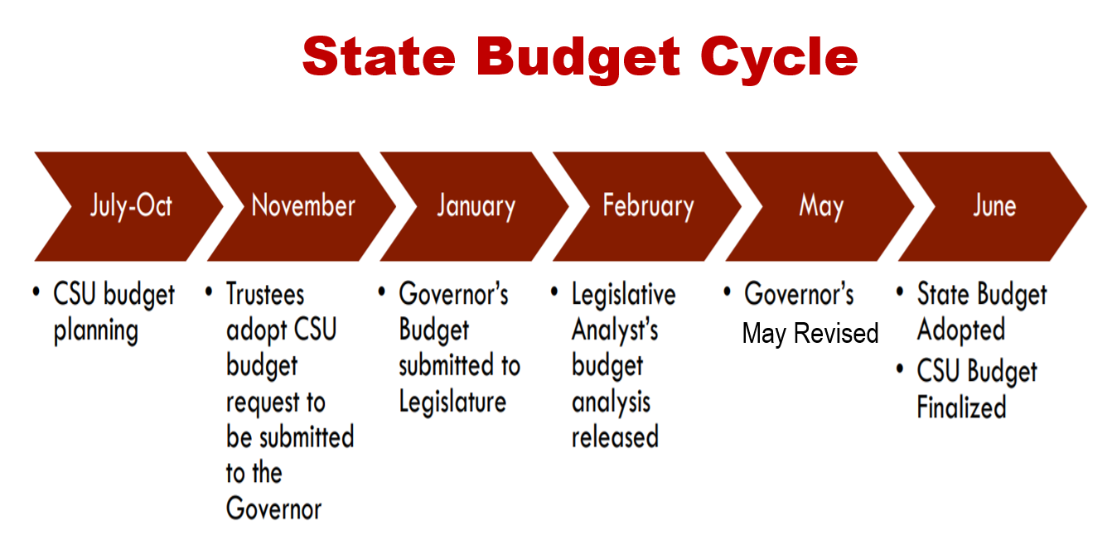

Slide 23
Phase II
Level A Processes:
Fresno receives their allocation via Memo B from the Chancellor Office
The cabinet approves the final CSU Fresno Budget
The cabinet members allocate budgets to their departments/divisions

Slide 24
Phase II

Slide 25
Phase II
Instructions will be sent from the University Budget Office for final submissions of Phase II Budgets (Provost will send a separate instructions/submission date for the Division of Academic Affairs).
Run a FY2021-22 Budget Expenditure Report, in PeopleSoft HR for the division(s) you are submitting original budgets.
Save the resulting report using the “Save as” option to your local drive, with the file name of “2021 Phase II”.
Using the saved report from Step 2, allocate your budget to the desired level, Appointment, Position (vacancies only), or Pool using the Original Budget column, (all other columns should be deleted/hide).

Slide 26
Phase II
All chartfield strings must be sub-totaled. For example 90000-XXXXX-00000-601931 would have a subtotal, as would 90000-XXXXX-12501-601931. Rows will need to be inserted as needed for these subtotals. Add formula in the Total line of the Original Budget column that adds together all the subtotals from the above entries.
PLEASE NOTE: All Budget entries for salaries need to be formatted as follows: $XX,XXX.00. Only whole dollar entries will be allowed – all digits following the decimal have to be zero “$XX,XXX.00” and they have to be displayed on the final submission.

Slide 27
Phase II HR
05-26-2021 12:21:49 PM
2020

Slide 28
Phase II Operations
The Budget Office has established a template to enter and submit your financial budgets, available at: http://www.fresnostate.edu/adminserv/budget/phases/index.html
Select the Initial Budget Form 21-22.xlsx and click it. This will bring up the budget entry form for the initial budgets for 2020 on an excel worksheets.
Please Note: Do not enter data onto the summary tab.

Slide 29
Phase II Operations
Notes:
This is the summary tab, you do not enter data on this sheet. The bottom part of this summary page has some blank rows to accommodate additional accounts that are not included in the form. You will only enter the account number on the Account column and account description on the Description column. Leave the Amount column alone.

Slide 30
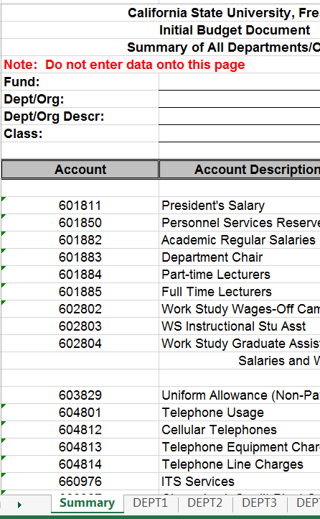
Phase II Operations
Create separate worksheets for each Department/Class combination.
Start a new sheets for each Dept/Class Combination
Notes:
This is the summary tab, you do not enter data on this sheet. The bottom part of this summary page has some blank spaces to accommodate additional accounts that are not included in the form. You will only enter the account number on the Account column and account description on the Description column. Leave the Amount column alone.

Slide 31
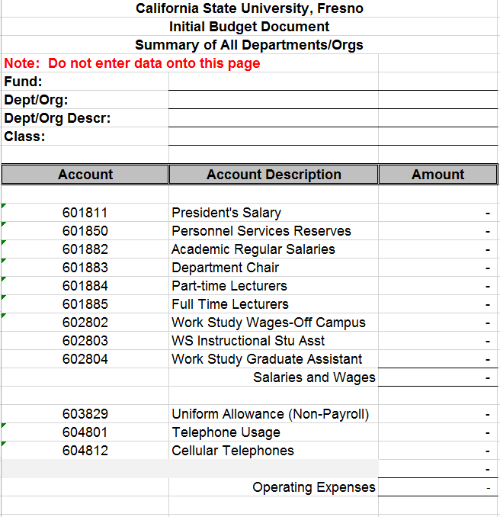
Phase II Operations
Below the heading information, various accounts are separated into two-sections – Salaries and Operations.
Salaries
Operations
Notes:
This is the summary tab, you do not enter data on this sheet. The bottom part of this summary page has some blank spaces to accommodate additional accounts that are not included in the form. You will only enter the account number on the Account column and account description on the Description column. Leave the Amount column alone.

Slide 32
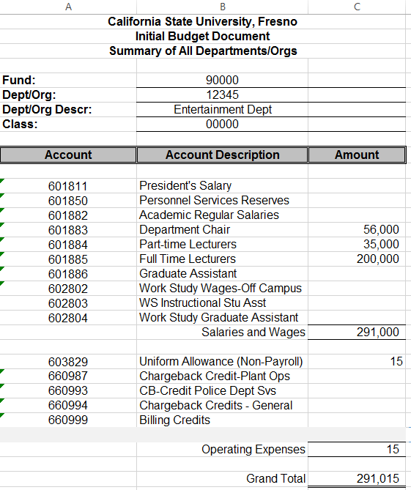
Phase II Operations
Budgets should be entered in column “C” (Amount Column) in whole dollars only (no decimal points, cents or zeros).
Salaries and Wages – MUST balance to the HR work sheets and be in whole dollars.
Notes:
This is the summary tab, you do not enter data on this sheet. The bottom part of this summary page has some blank spaces to accommodate additional accounts that are not included in the form. You will only enter the account number on the Account column and account description on the Description column. Leave the Amount column alone.

Slide 33
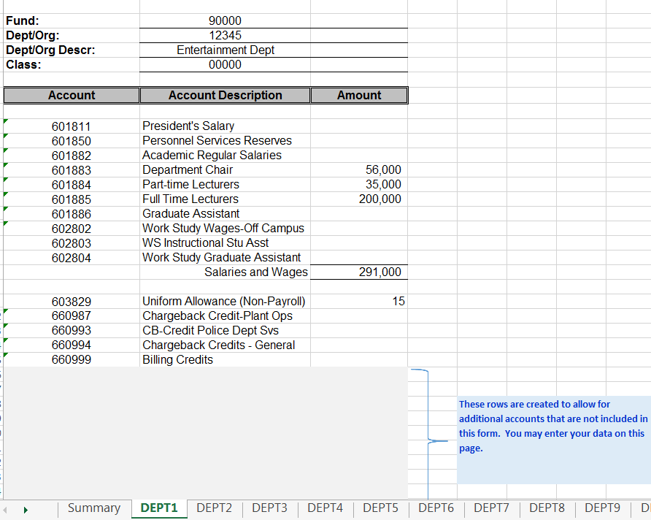
Phase II Operations
Adding Accounts – at the bottom of each tabs, rows are already added to accommodate additional accounts. If you need more rows, please insert a line, but do not insert at the top or bottom of a section, as it may not be included in the totals formula.
Notes:
This is the summary tab, you do not enter data on this sheet. The bottom part of this summary page has some blank spaces to accommodate additional accounts that are not included in the form. You will only enter the account number on the Account column and account description on the Description column. Leave the Amount column alone.

Slide 34
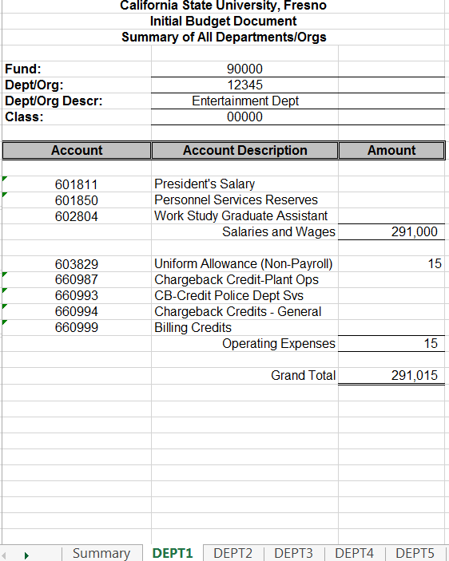
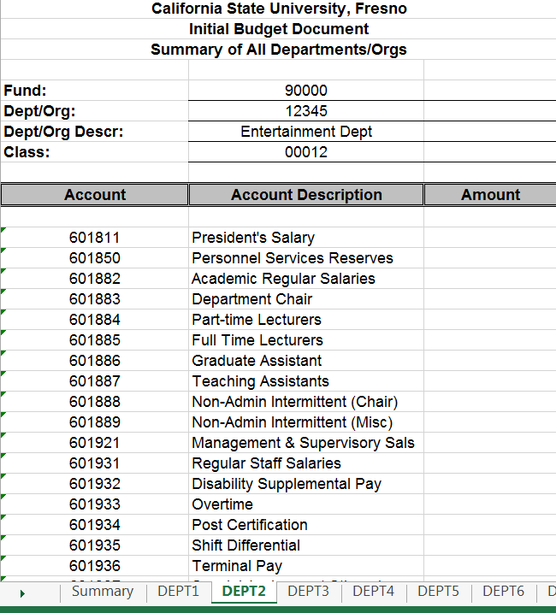
Phase II Operations
Again, for multiple Class Code Combinations, a new sheet should be used for each Department/Class code combination.
Notes:
This is the summary tab, you do not enter data on this sheet. The bottom part of this summary page has some blank spaces to accommodate additional accounts that are not included in the form. You will only enter the account number on the Account column and account description on the Description column. Leave the Amount column alone.

Slide 35
Phase II Operations
Check Balances – Once all the budget data is entered on the sheets, please perform a final review making sure budgets balance. Add up all Department/Class code worksheets to confirm they match your total departmental budget.
Again, instructions will be sent from the University Budget Office for final submissions of Phase II Budgets (Provost will send a separate instructions/submission date for the Division of Academic Affairs).
Notes:
This is the summary tab, you do not enter data on this sheet. The bottom part of this summary page has some blank spaces to accommodate additional accounts that are not included in the form. You will only enter the account number on the Account column and account description on the Description column. Leave the Amount column alone.

Slide 36
Phase I and Phase II
Notes:
This is the summary tab, you do not enter data on this sheet. The bottom part of this summary page has some blank spaces to accommodate additional accounts that are not included in the form. You will only enter the account number on the Account column and account description on the Description column. Leave the Amount column alone.

Slide 37
Time Administration Review

Slide 38
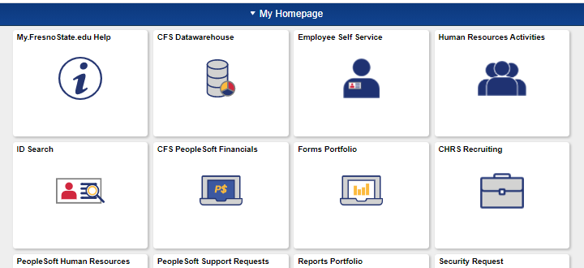
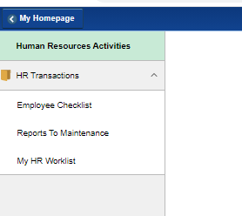
Time Administration: Reports to Maintenance
To access:
Go to https://my.fresnostate.edu
Select Human Resources Activities
Under HR Transactions, select Reports To Maintenance

Slide 39
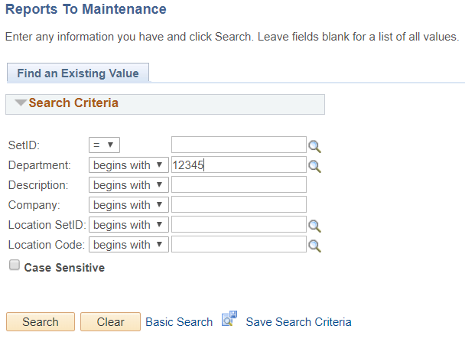
Time Administration: Reports to Maintenance
1. Type in the Dept ID
2. Click Search to retrieve the report

Slide 40
Time Administration: Reports to Maintenance
The Reports To section has to be a Manager or Department Chair
The Effective Date has to be when the MPP or Department Chair is hired or after being promoted to the a new position
Remember to save when you are done

Slide 41
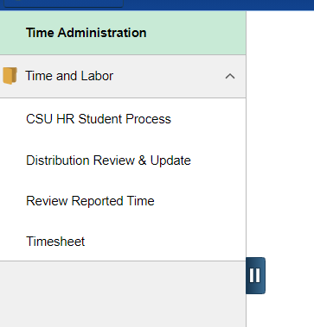
Time Administration: Distribution Review & Update -Check to make sure the hourly employee are paid from the correct chartfield
Go to Time Administration
Under Time and Labor, select Distribution Review & Update

Slide 42
Time Administration
Enter the Dept ID number you needed to do an update here, or use the magnifying glass to do a search.
12345

Slide 43
Time Administration
If the chartfield is not correct, or you need to change the chartfield, please make sure the following are fill in correctly:
1. Effective Date 2. Combo Code 3. Distribution %
Employee, A
Employee, B
Employee, C
Employee, D
4. Don’t forget to save your changes

Slide 44
Additional Notes….Adjustments
Notes:
This is the summary tab, you do not enter data on this sheet. The bottom part of this summary page has some blank spaces to accommodate additional accounts that are not included in the form. You will only enter the account number on the Account column and account description on the Description column. Leave the Amount column alone.

Slide 45
Additional Notes….Adjustments
ABJ – Adjusting Budget Journals are now submitted using DocuSign for signature approval and processing by the Budget Office.
For instructions on how to use DocuSign please click the link below:
https://www.fresnostate.edu/adminserv/purchasing/documents/ABJ%20DocuSign%20Process%20V1.2.pdf
Notes:
This is the summary tab, you do not enter data on this sheet. The bottom part of this summary page has some blank spaces to accommodate additional accounts that are not included in the form. You will only enter the account number on the Account column and account description on the Description column. Leave the Amount column alone.

Slide 46
Additional Notes….Adjustments
Notes:
This is the summary tab, you do not enter data on this sheet. The bottom part of this summary page has some blank spaces to accommodate additional accounts that are not included in the form. You will only enter the account number on the Account column and account description on the Description column. Leave the Amount column alone.

Slide 47
Additional Notes….Adjustments
Notes:
This is the summary tab, you do not enter data on this sheet. The bottom part of this summary page has some blank spaces to accommodate additional accounts that are not included in the form. You will only enter the account number on the Account column and account description on the Description column. Leave the Amount column alone.

Slide 48
Accounting Quick Reference Guide

Slide 49
Accounting Quick Reference Guide

Slide 50
Accounting Quick Reference Guide
http://www.fresnostate.edu/adminserv/accountingservices/documents/Accounting%20Quick%20Reference.pdf

Slide 51
Questions?
Contact Information
Office of Budget & Resource Planning
Jean Aguayo jaguayo@csufresno.edu 559-278-7224
Lisa Chavez lisachavez@csufresno.edu 559-278-5293
Pam Lewis paml@csufresno.edu 559-278-5295

