Slide 2
Profile and Delegates

Slide 3
From “My Homepage,” go to “Campus Systems” and select the SAP Concur tile.

Slide 4
The dashboard has important information for your reference

Slide 5
The dashboard provides links under “Travel Alert Information” and “High Hazard” for important information about international travel

Slide 6
Set up your profile settings to get started

Slide 7
Start with your personal information

Slide 8
All Required** fields must be completed

Slide 9
Customize your dashboard in System Settings, including email notifications and Appearance Settings

Slide 10
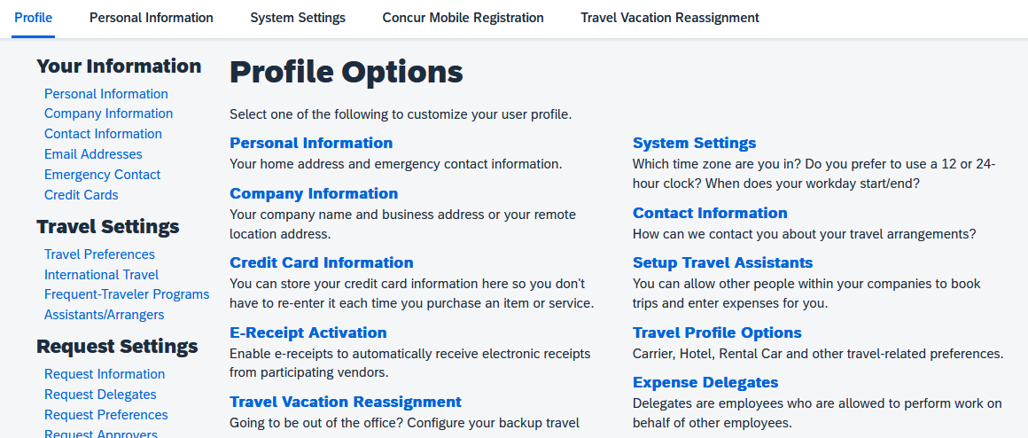
Establish your Travel Assistants and Expense Delegates in your Profile Options

Slide 11
To add a Travel Arranger, click “+ Add an Assistant.”

Slide 12
Search for the individual who will be your assistant. It’s important to click the permission button before you save. This permission allows the individual only to make travel reservations on your behalf.

Slide 13
To add an Expense Delegate, click the “Add” button and search for the individual who will be your delegate.

Slide 14
Don’t forget to click the permission buttons to give your delegate permission to prepare preapproval Requests or Expense reports.

Slide 15
Definitions
Concur is a travel and expense reimbursement and reporting system.
A Request is the same as a Travel Application and is used for preapproval purposes only.
An Expense Report is the same as a Travel Expense Claim and is used for reimbursements.
The Approver is the Manager/Supervisor/Chair who typically approves your travel.
The Cost Object Approver (COA) is the budget approver/analyst. This is the individual authorized to approve the use of department funds.
A Delegate can create and/or view travel requests or expense reports on behalf of another employee.
A Travel Arranger is an individual who can make travel reservations on behalf of another employee.

Slide 16
Things to Note
Verify your Fresno State email in your profile so you can email your receipts to receipts@concur.com.
Enable E-Receipt Activation in your Profile Settings to obtain e-receipts from participating suppliers.
Keep original receipts until reimbursement for travel expenses have been received.
Travel Approver has seven (7) business days to approve. After seven days, the report is automatically returned to the traveler to redirect for approval.

Slide 17
Need help?
Marie Cuningham | (559) 278-2911 | mariec@csufresno.edu
Virginia Nevarez | (559) 278-2877 | vnevarez@csufresno.edu

