Slide 1
Updates
President Saúl
Sept. 25, 2023

Slide 2
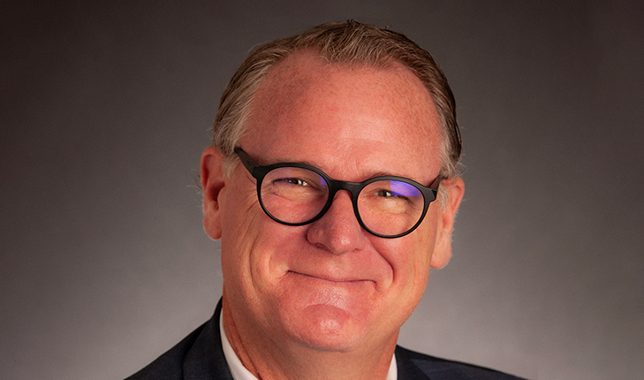
New Vice President of Advancement
Brady Crook

Slide 4
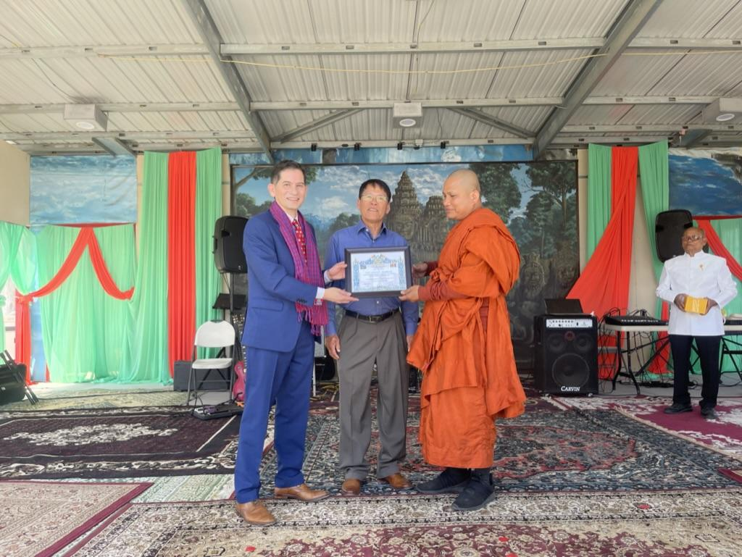
Cambodian New Year Celebration

Slide 5
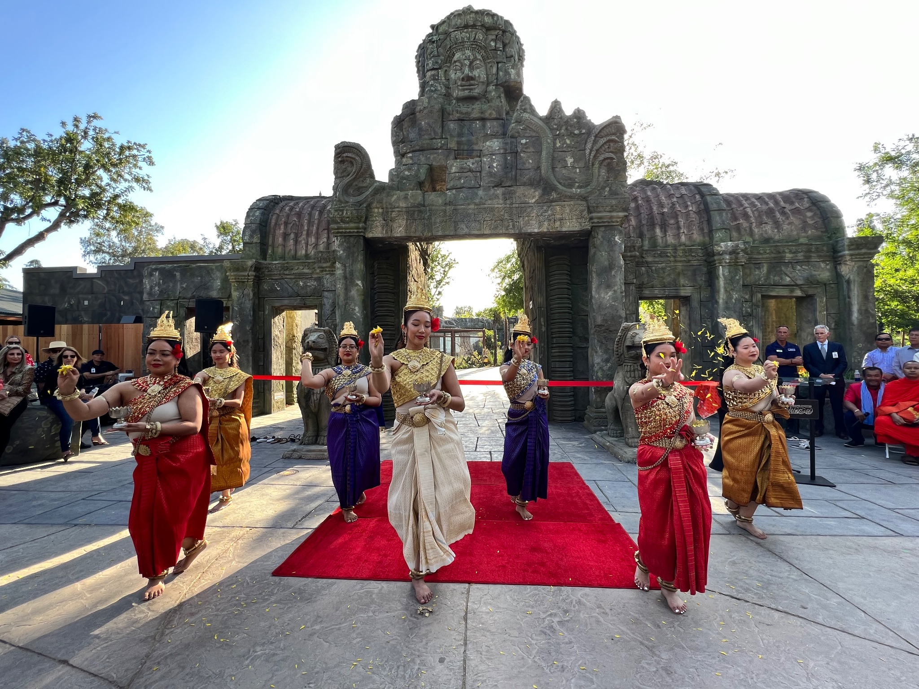
Kingdoms of Asia
And
Fresno State’s
Dr. Saam Noonsuk

Slide 6
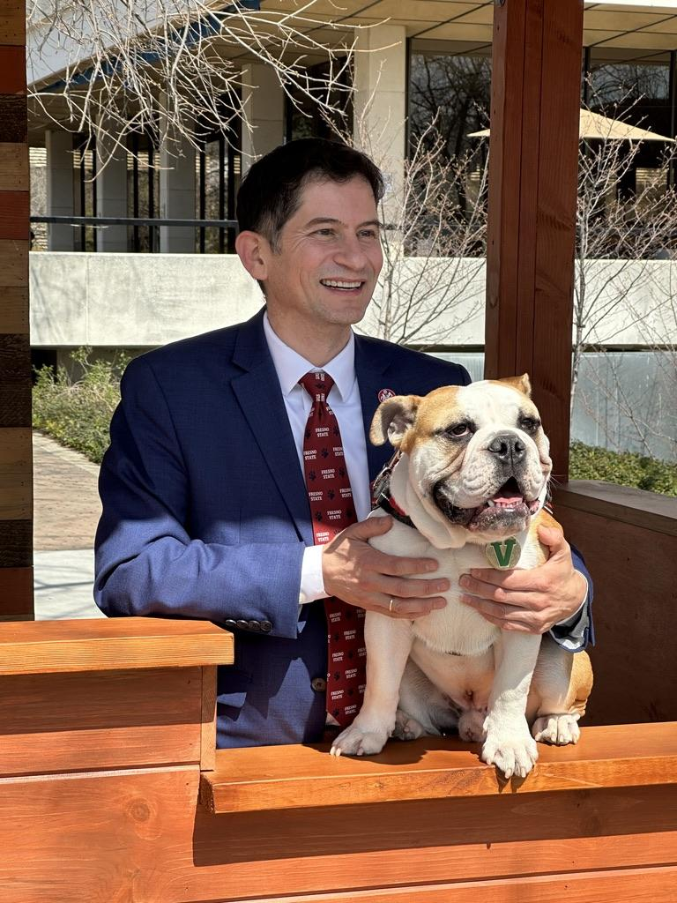
President’s Booth

Slide 7
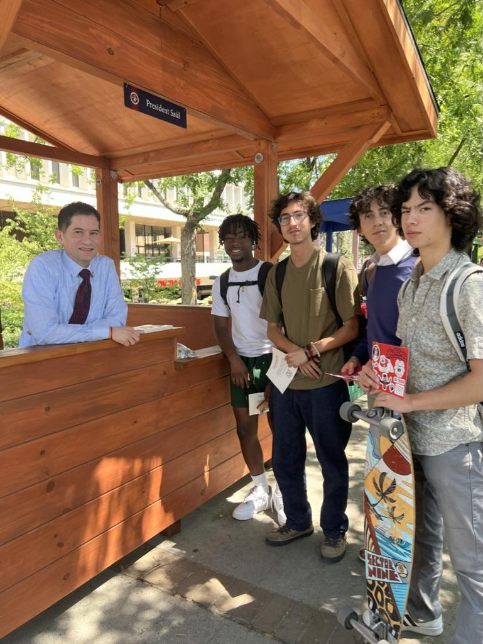
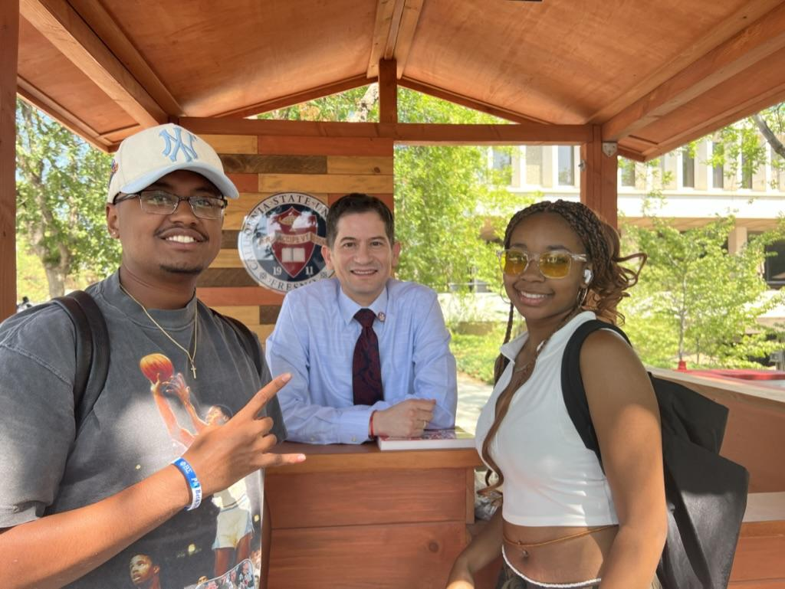

Slide 8
Special thanks to CSSA President Krishan Malhotra and ASI President Caroline Alvarez.
Awarded the Robert C. Maxon President of the Year, for a second consecutive year (May 7, 2023).

Slide 9
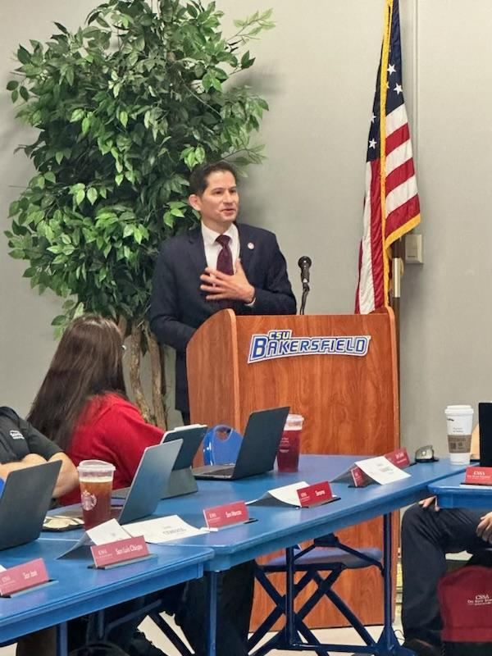
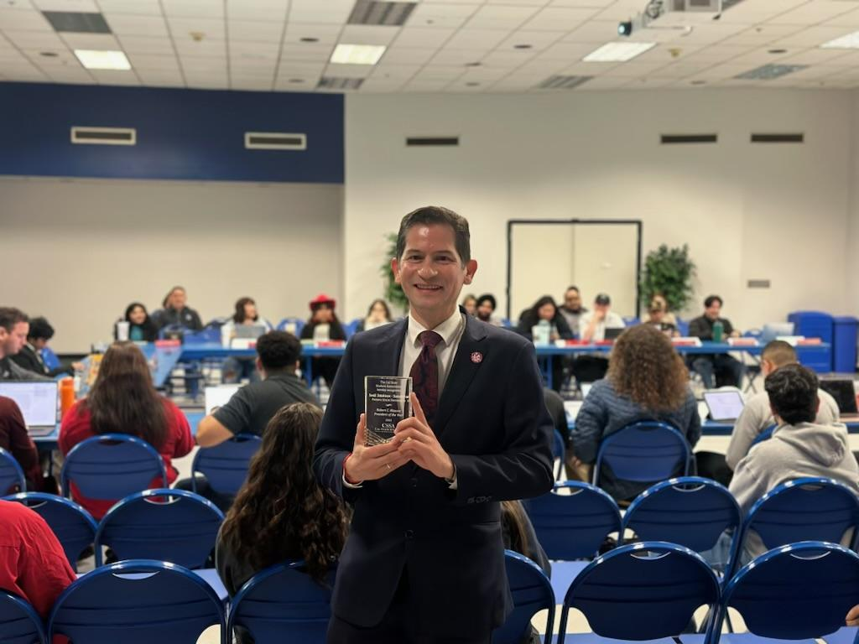

Slide 10
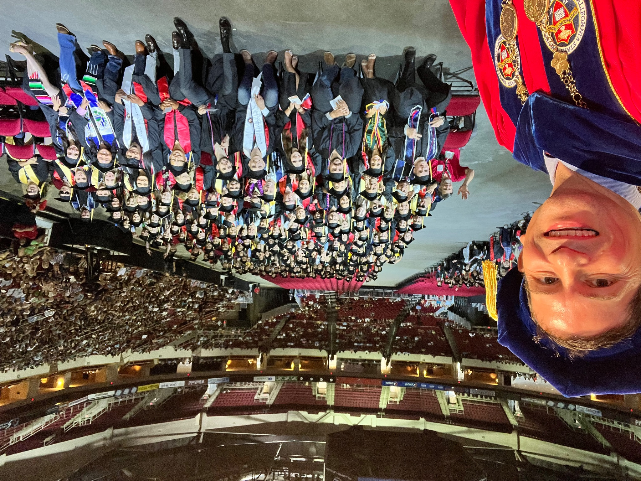

Slide 11
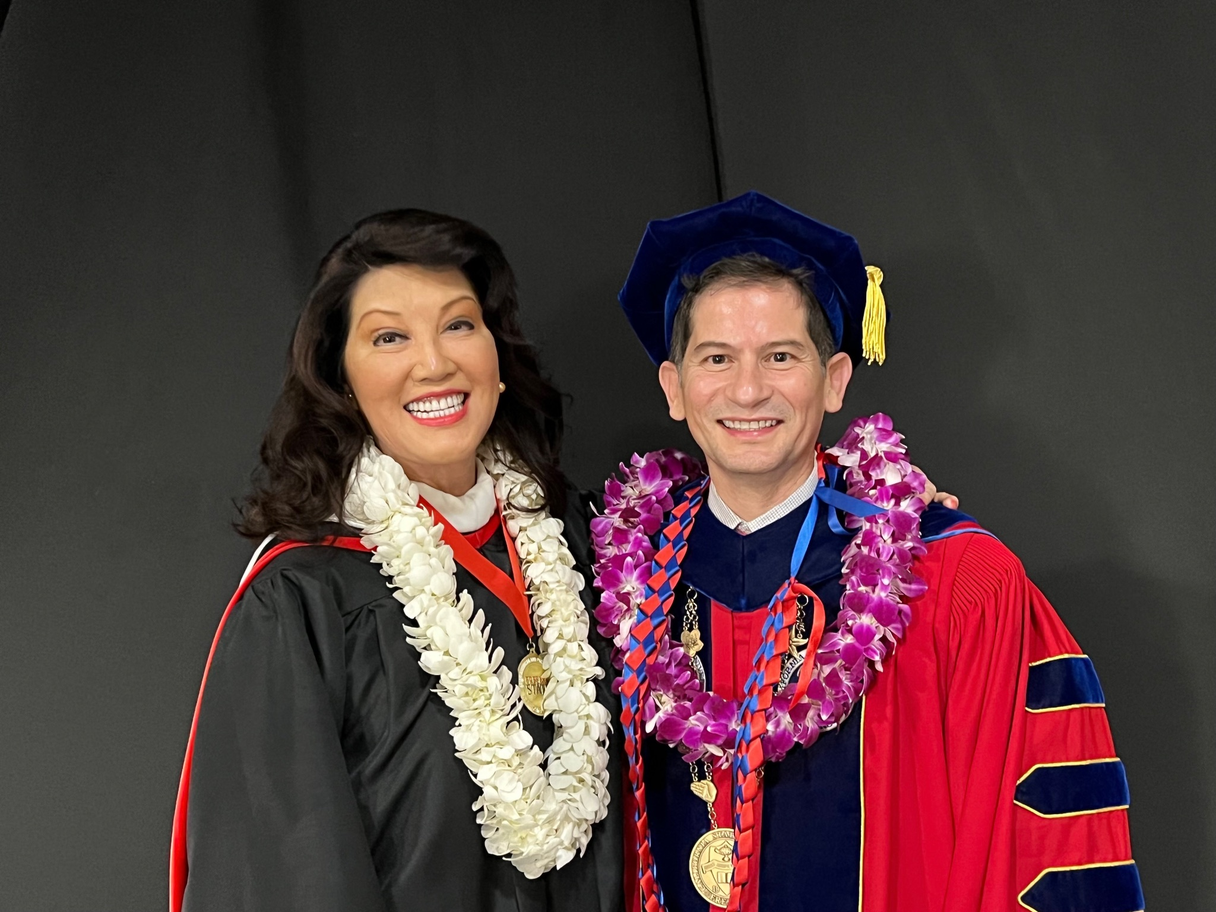

Slide 12
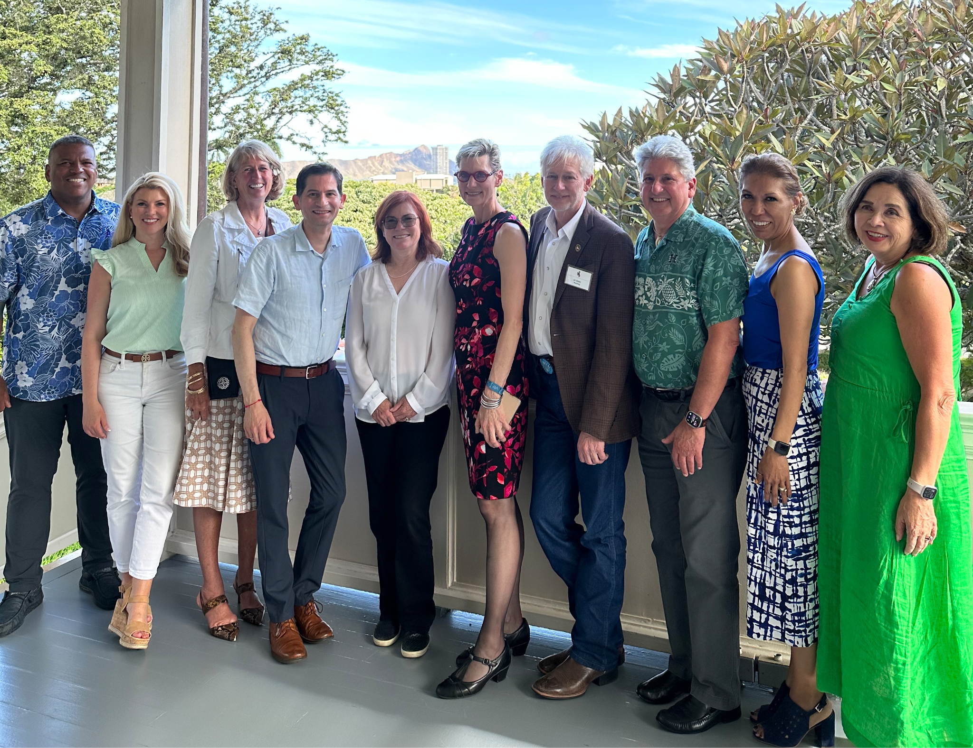
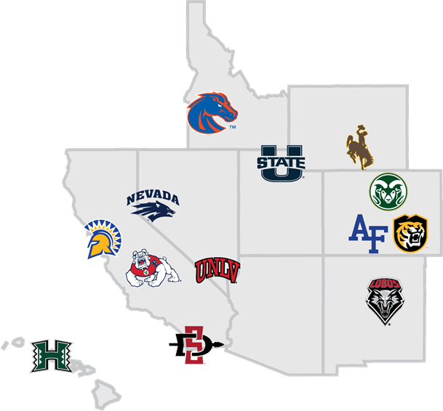

Slide 13
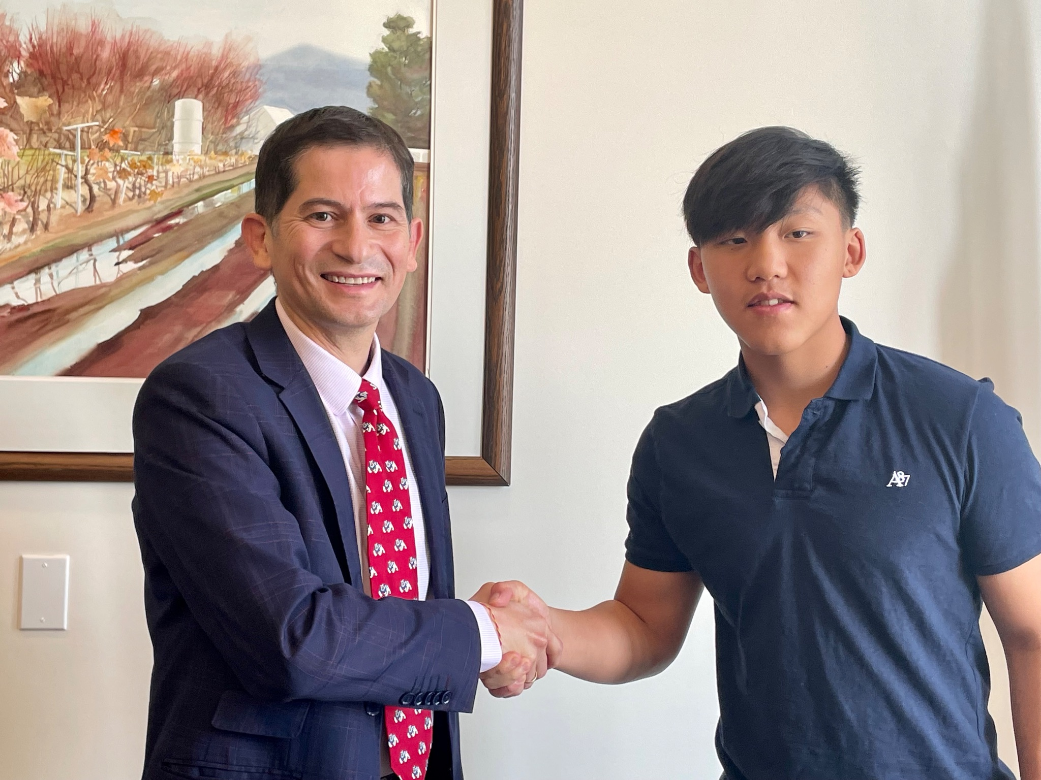

Slide 14
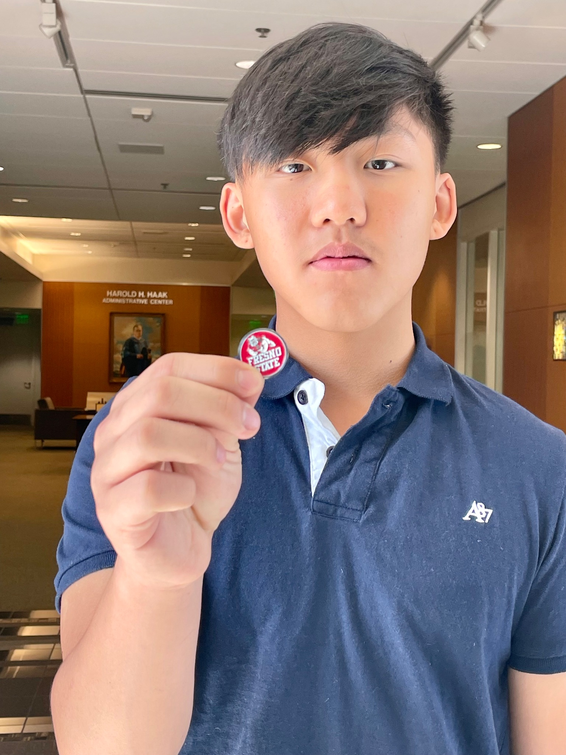
Contract:
Freshman
Summer: Overview of Disciplines at Fresno State
Sophomore
Summer: Deep dive on a specific discipline
Junior:
Hands-pn Experience within a major
Senior:
Accepted on the spot with their financial aid letter

Slide 15
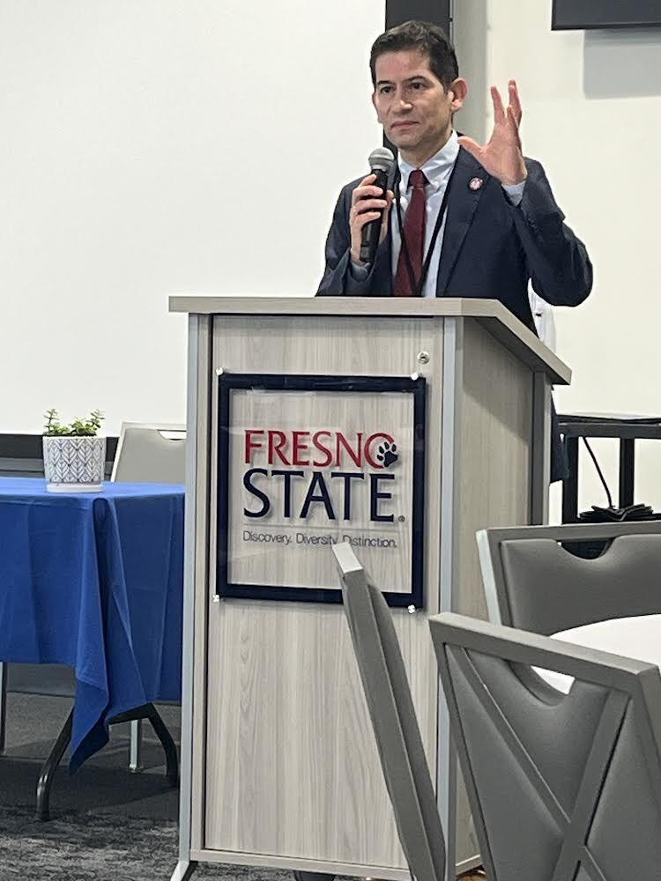
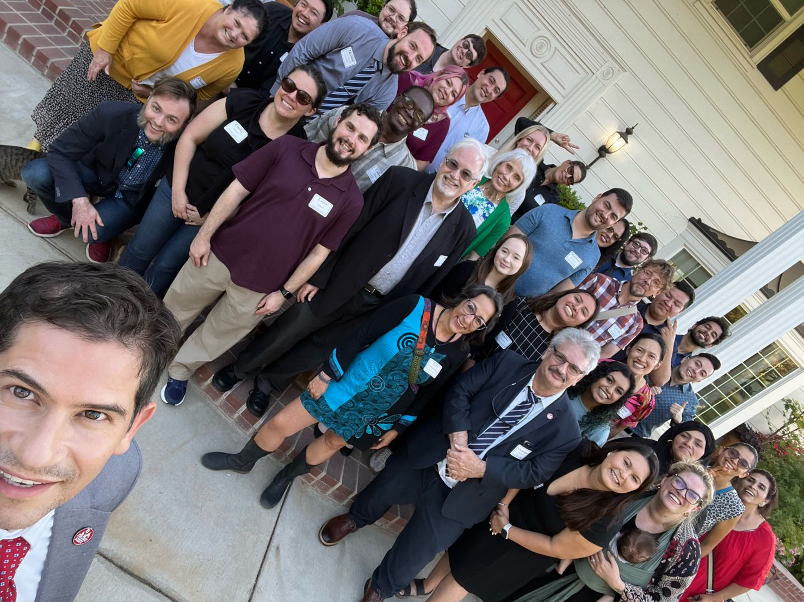
CV RISER Conference
June 23, 2023

Slide 16
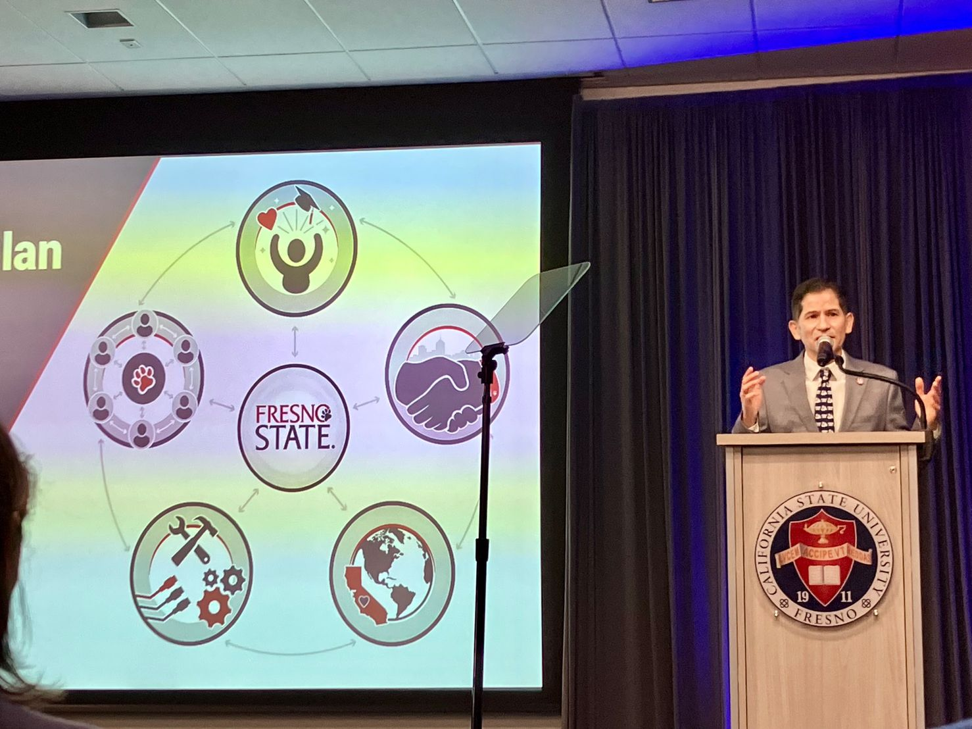
Faculty & Staff Assembly

Slide 17
Strategic Plan, 2023-2028
Mission
Our mission states: “Fresno State empowers students for success through a transformative education rooted in active service with diverse communities.”

Slide 18
Vision
“With its local focus and global impact, Fresno State will be recognized as a model for advancing social, economic and environmental progress regionally, nationally and globally by providing an accessible, transformative education; conducting research on critical issues; and producing a generation of diverse leaders.”

Slide 19
Goal One: Enhancing Students’, Staff and Faculty Personal Well-Being
Goal Two: Bridging Campus and Community
Goal Three: Cultivate Regional Progress and Global Impact by Enhancing Instruction and Research
Goal Four: Modernize Facilities, Infrastructure and Technology
Goal Five: Embody Full Inclusivity and Belongingness

Slide 20
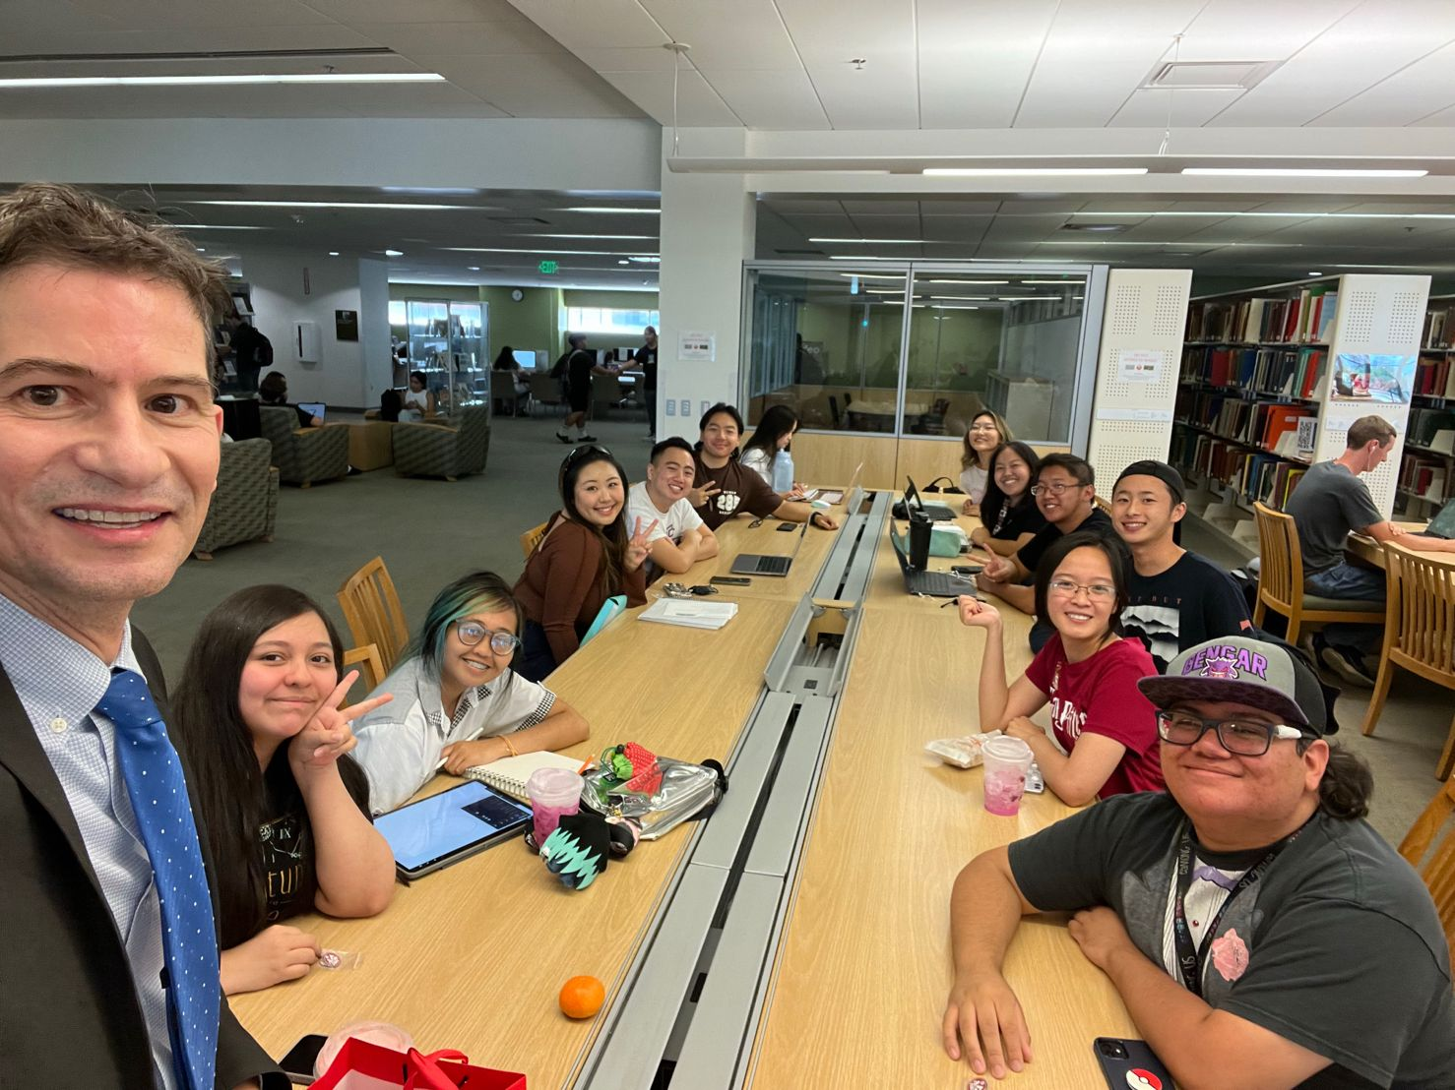
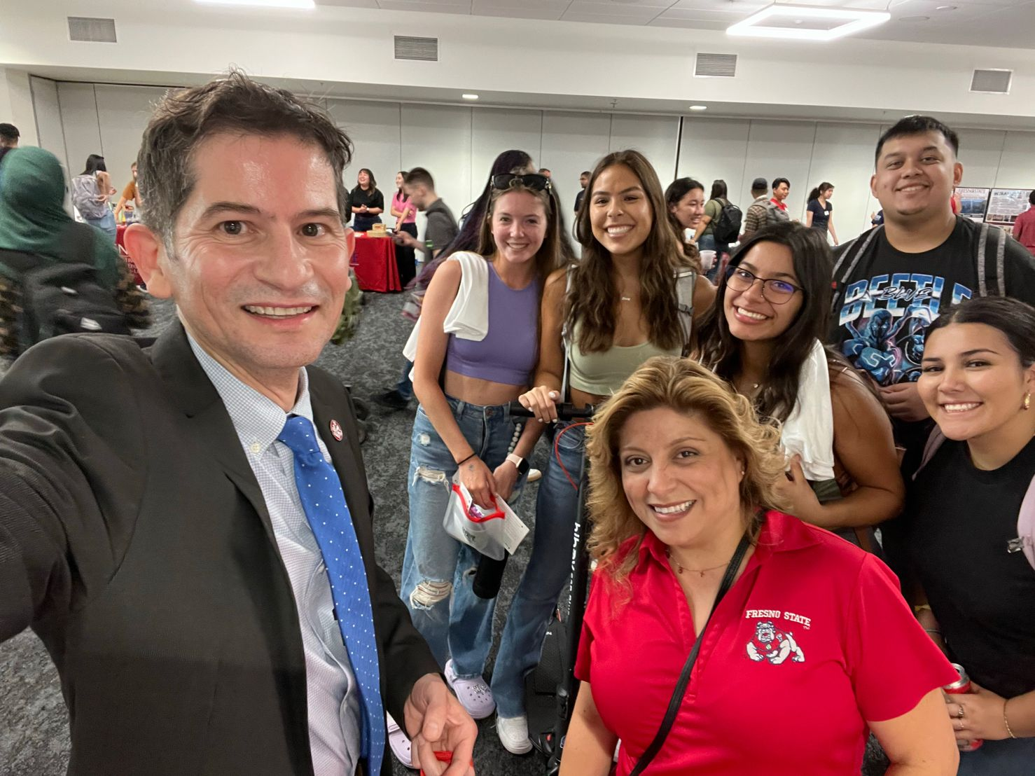
First Day of Classes

Slide 21
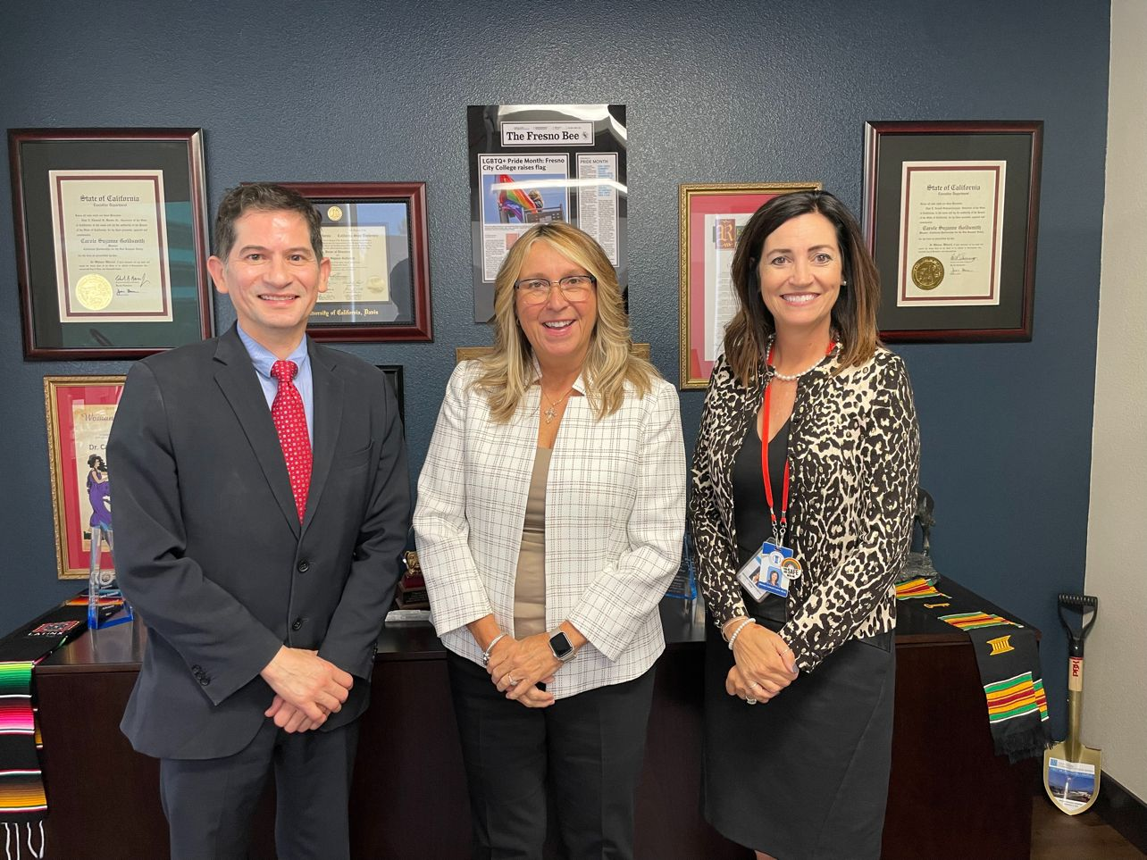
Quarterly meetings with
Dr. Goldsmith and Dr. Copher

Slide 22
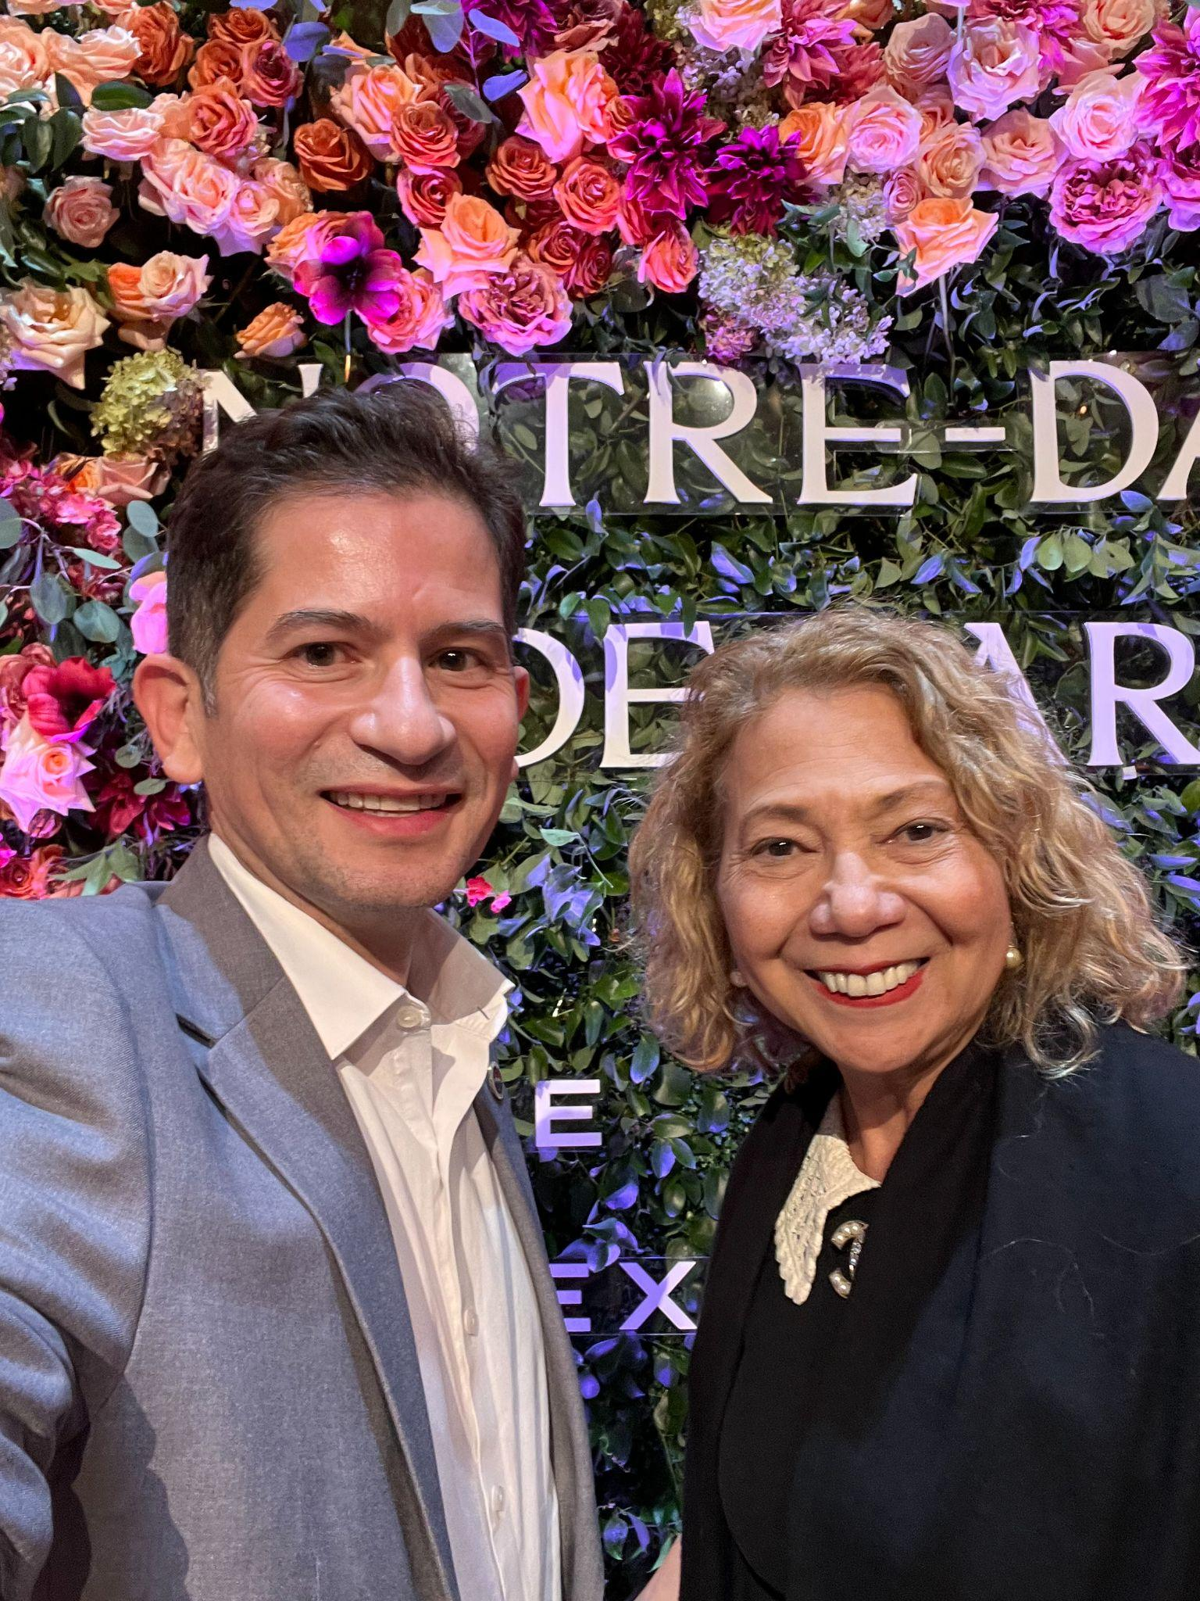
CSU Chancellor: Dr. Millie García

Slide 23
First exclusively Spanish-language TV broadcast in
FBS college football history!
Sept. 9, vs. Eastern Washington

Slide 24
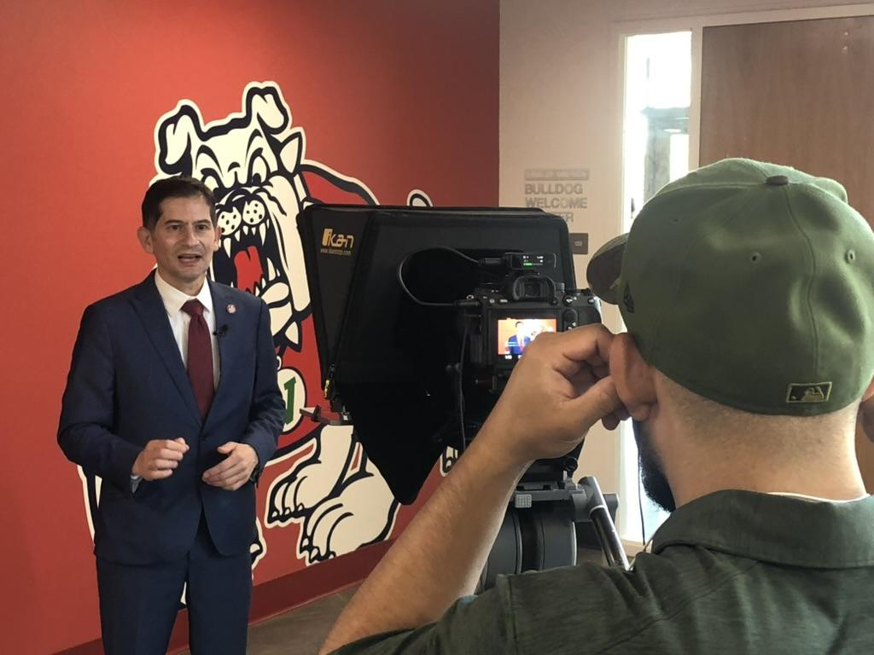

Slide 25
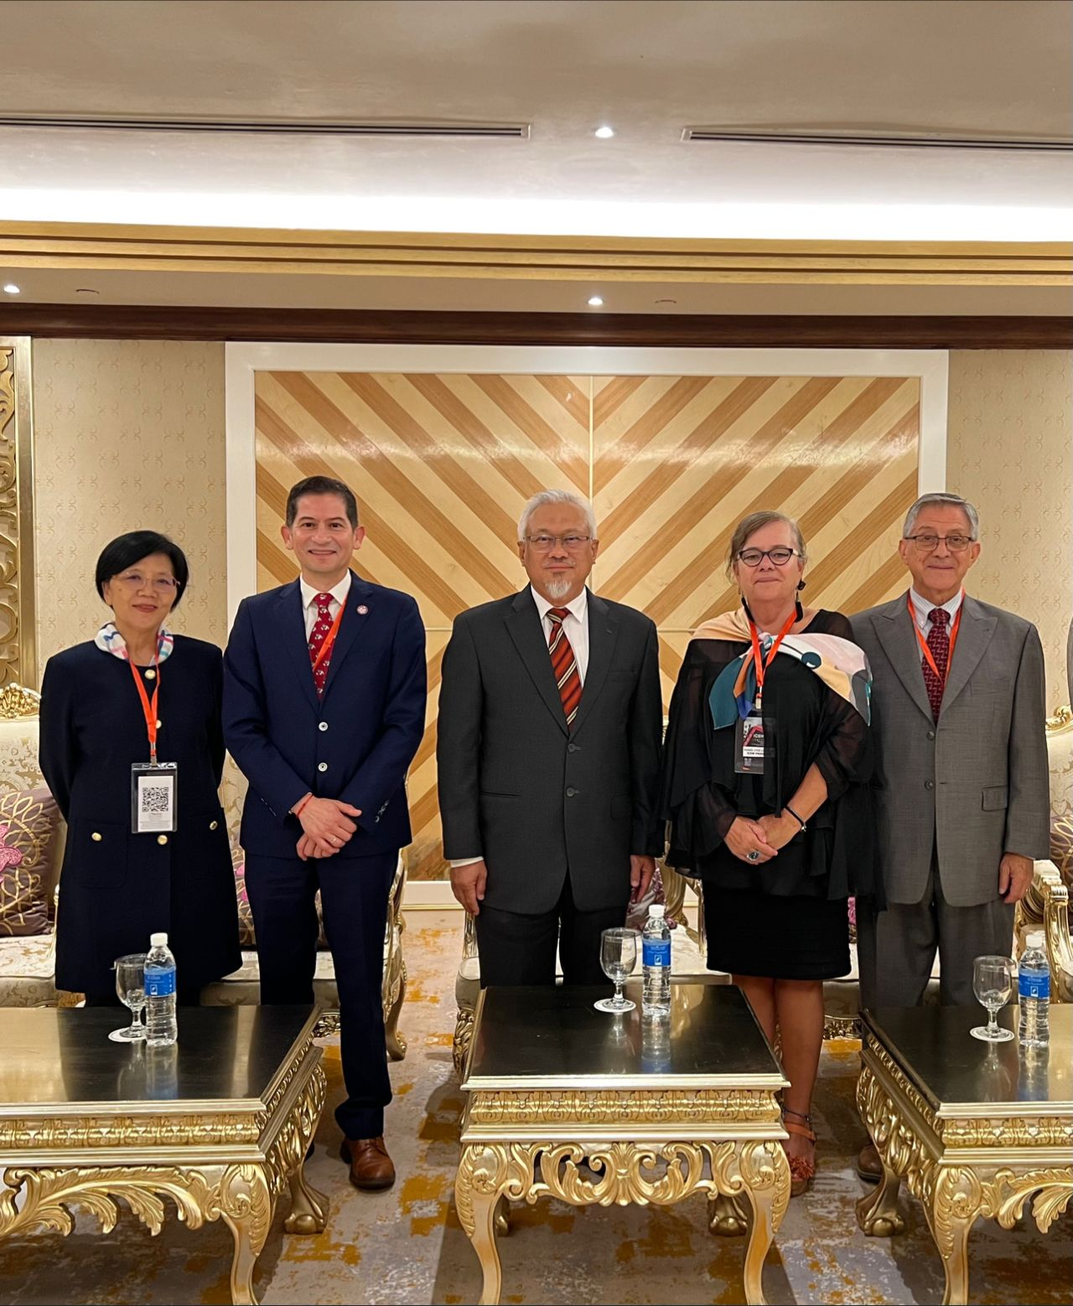
MOU with Universiti Teknologi MARA
Sept. 12, 2023

Slide 26
International Council for Educational Media in Kuching, Malaysia.
Sept. 13, 2023

Slide 27
RANKINGS
Third Way: 7th, Top School that Offers the Most Economic Mobility
Washington Monthly: 26th National Universities Category
Wall Street Journal: No. 6 in the nation for social mobility.
U.S. News: No. 8 in the nation for social mobility.

Slide 28
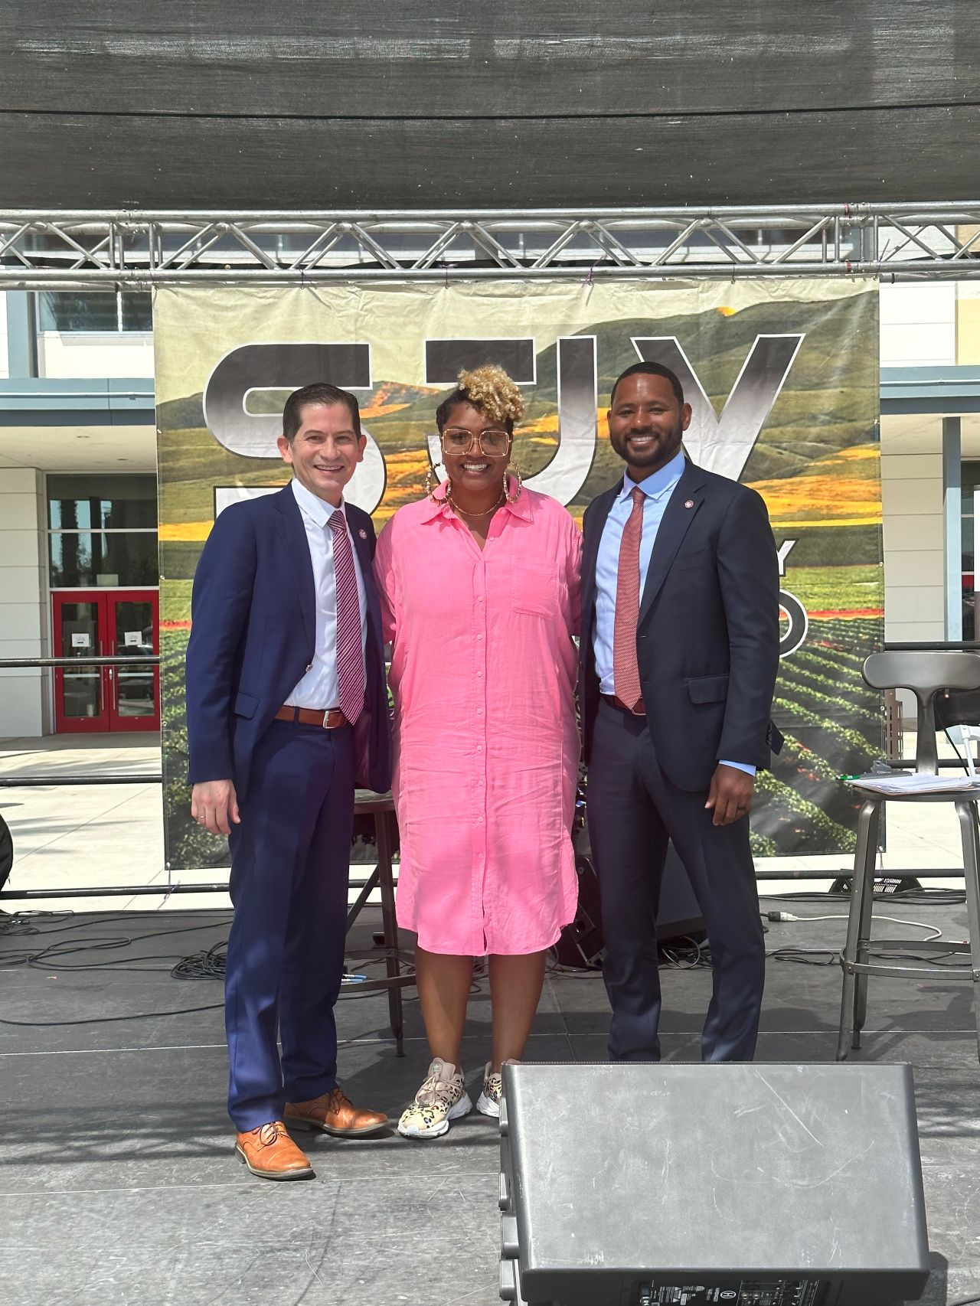
San Joaquin Black Expo
Sept. 17, 2023

Slide 29
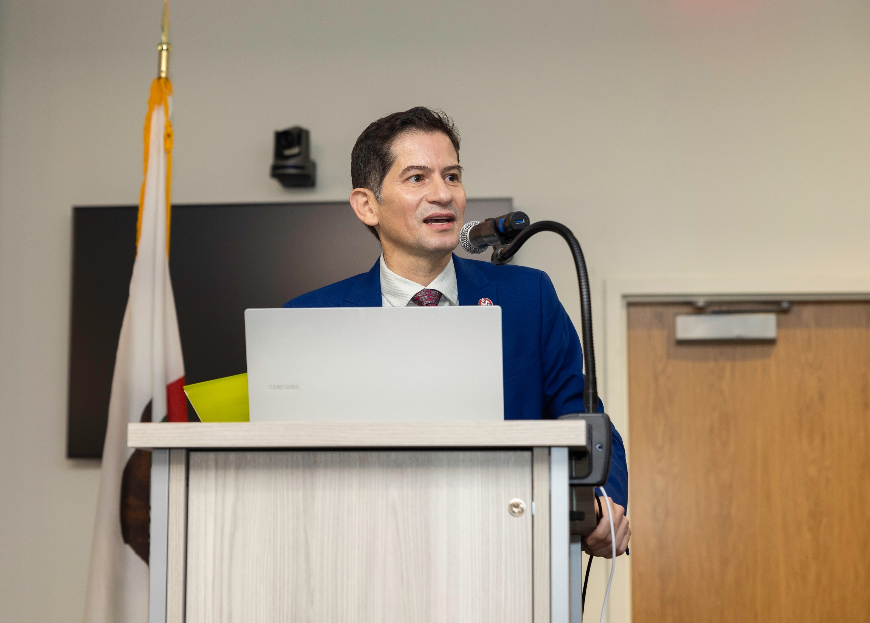
Managing Water and Farmland Transitions in the San Joaquin Valley conference
Sept. 21, 2023

Slide 30
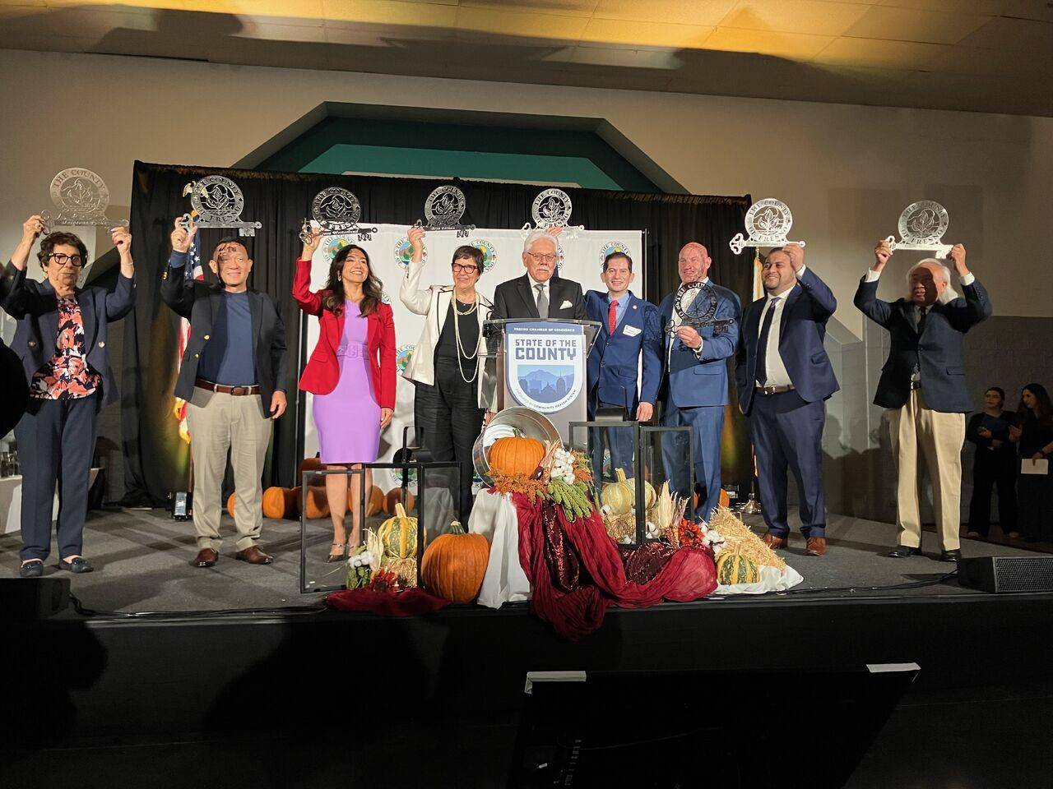
Key to the County of Fresno, Sept. 22, 2023

