Slide 1
Foundation Financial Services Post Award
Nancy Gomez
Post Award Analyst

Slide 2
Phase I
Pre Award
Phase II
Award Notification
Phase IV
Post Award Closeout
Phase III
Post Award Management

Slide 3
Award Responsibilities Overview
Various individuals work together throughout the life of an award to effectively manage sponsored awards. These individuals rely on each other for the successful fiscal management of the award.
The Principal Investigator (PI) and/or Project Director (PD) is/are the individual(s) in charge of a grant or sponsored project.
The Foundation is the entity that is legally and financially responsible to the sponsor for the performance of the project and the proper use of funds.

Slide 4
Post Award Management
Foundation Financial Services provides the Principal Investigator (PI)/Project Director with the following services for Post Award Management:
Offers new PIs training in post-award activities
Provide fiscal/accounting services and various monthly financial reports
Process purchase orders and accounts payable transactions
Facilitate payroll functions
Reviews expenditures for allowability, allocable, consistency and reasonableness

Slide 5
Post Award Management contd.
Prepares and submits invoices to funding agencies
Acts as liaison between Project Investigators/Project Directors and the funding agencies
Prepares and submits required fiscal reports to the sponsor
Assists with budget matters, contract interpretations, and resolving award discrepancies
Monitors the filing of technical reports required by the sponsor
Assists with closeout of award.

Slide 6
Post Award
Questions on Awarded Grants and Contracts
Set up of cost center
Cost Transfers
Compliance or policy questions
Creation of subcontracts and consultant agreements
Modifications to project budgets
Inquiries related to:
Billing
Payments
Financial Reporting
Allowable expenses
Project Closeout

Slide 7
Role of PI/Project Director
The primary responsibilities of the PI/Project Director include:
Ensure that programmatic responsibilities and deliverables involving sub-recipients and subcontractors are performed and completed in accordance with the award
Prepare accurate annual budgets
Designate signing authority to others as needed
Authorize expenditures that are reasonable and necessary to accomplish the project
Review and approve invoices for payment to vendors
Monitor monthly financial activity reports for accuracy
Communicate to your Post Award Analyst any necessary budget revisions

Slide 8
Role of PI/Project Director contd.
Comply with the Foundation’s procurement policy when making equipment purchases
Ensure each equipment purchase is pre-approved by the sponsor
Ensure agreements have the appropriate approvals and signatures. The Post Award Analyst will assist in obtaining appropriate approval for any type of agreement including space lease, copy machine leases, subcontractor, consultant, etc. Note: PIs/Project Directors do not have the authority to sign on behalf of the Foundation
Comply with Effort Reporting and Cost Share Policies
Contact the Post Award Analyst if a conflict of interest arises that requires special review
Submit programmatic reports to sponsors timely and provide copies to the Foundation as applicable
Request a No-Cost Extension from the sponsor, as needed

Slide 9
Role of Post Award Analyst
Establish new accounts and monitors funds
Review expenditures and timesheets to ensure compliance with the approved budget
Review expenditures and timesheets to ensure compliance with all terms and conditions of the award
Offer administrative support to the project and its personnel
Prepare and submit invoices to the sponsor
Assist PI/Project Director with reporting requirements
Ensure fiscal reports are submitted timely to the sponsor
Review HR transactions forms
Review Reimbursed Released Time (RRT) agreements
Review subcontracts for compliance
Provide assistance with interpretation of applicable sponsor regulations and Foundation/University policies and procedures
Ensure timely closeout of a sponsored program

Slide 10
Role of Post Award Assistant
Setup new cost centers
Review travel expense claims for compliance with Foundation Travel Policy and ensure Foreign Travel Insurance, if required.
Maintain Physical Inventory of Equipment over $5,000 and Sensitive Equipment
Process stipend paybacks

Slide 11
Human Resources
Human Resource functions are available from one of two organizations: the Auxiliary Human Resources Department and the University’s Human Resources/Faculty Affairs Department. Each department handles a different group of employees. The Auxiliary Human Resources Department is responsible for providing recruitment/selection, benefits, classification, employee relations, workers compensation/safety, training, and payroll services to all employees of the Foundation
The Foundation is the employer of record for all persons paid with funds generated from grants, contracts, revenue, and agency accounts where the Foundation is the recipient. Auxiliary Human Resources policies and procedures are designed to comply with the various federal and state regulations. It’s important to note the Foundation is a separate employer from the University

Slide 12
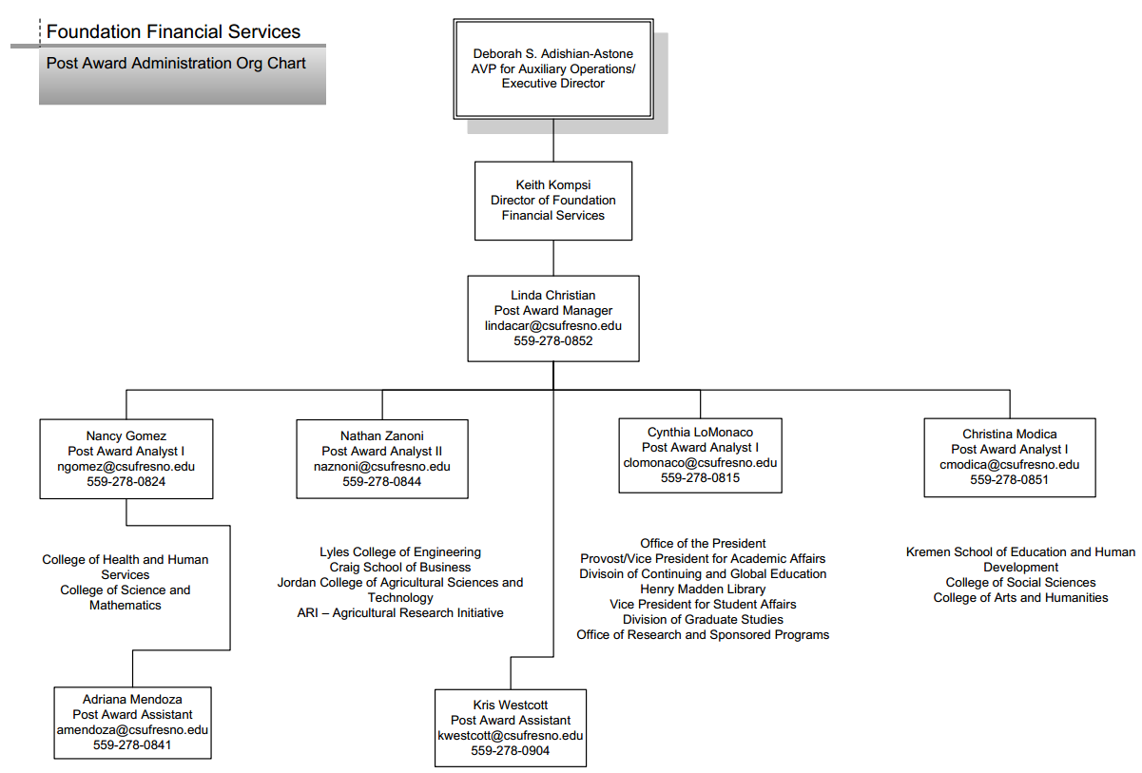

Slide 13
Contact Information
Foundation Financial Services
Department Phone | 559.278.0850
Department Fax | 559.278.0992
Location | 4910 N. Chestnut Ave. (93726-1852)
Campus Mail Stop | M/S OF123
Web Site | www.auxiliary.com

Slide 14
Questions?

