Slide 1
Speed Eleusis
Demonstrating the Scientific Process / Vocabulary
John Walkup, Roger Key
CSU Fresno

Slide 2
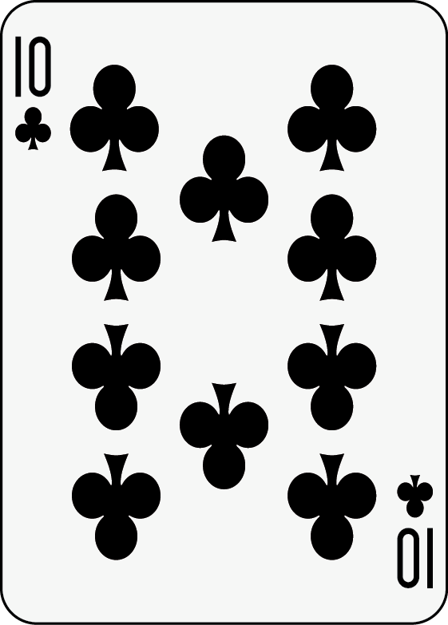
Rules
Cards are only defined according to:
Suit
Number
Color
First team offer a model (pattern) yells ‘Publish’
Those teams agreeing with model can yell `Replicate’
Those teams that have published or replicated can yell `Retract’
Scores are tallied at end of game.
If correct:
10 pts for Publishing + 2 pts for each subsequent round
5 points for Replication + 1 pt for each subsequent round
No points lost after retraction.
If incorrect: Points are same but negative.

Slide 3
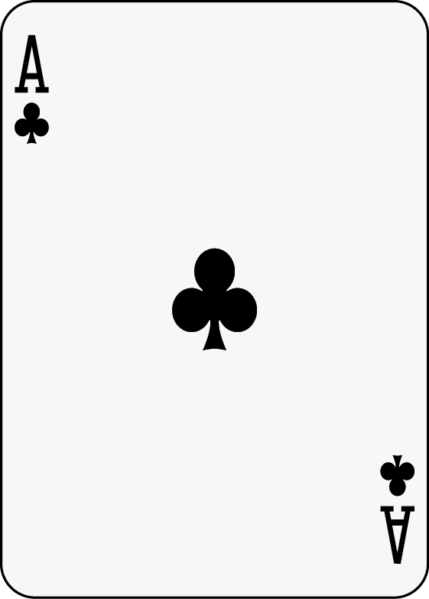
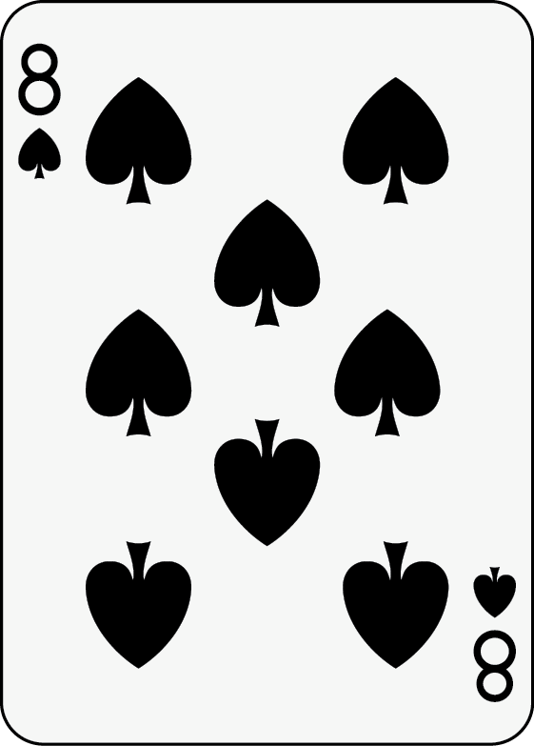
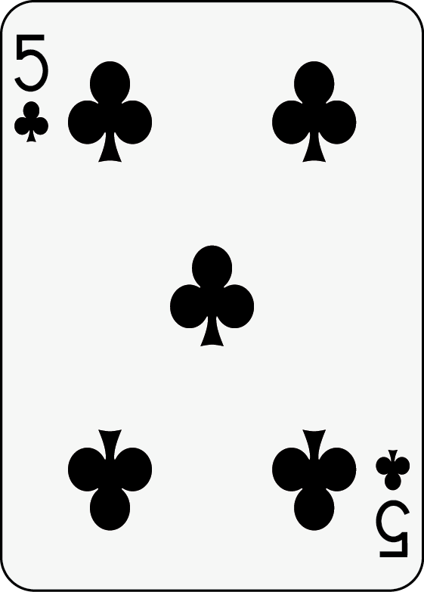
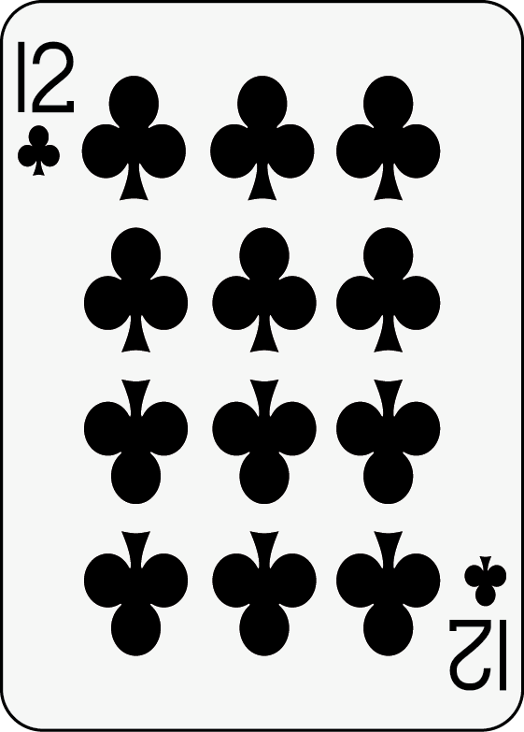
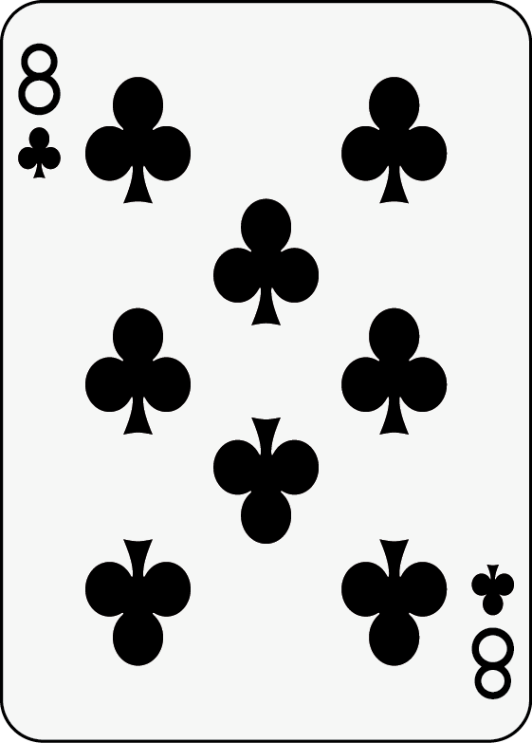
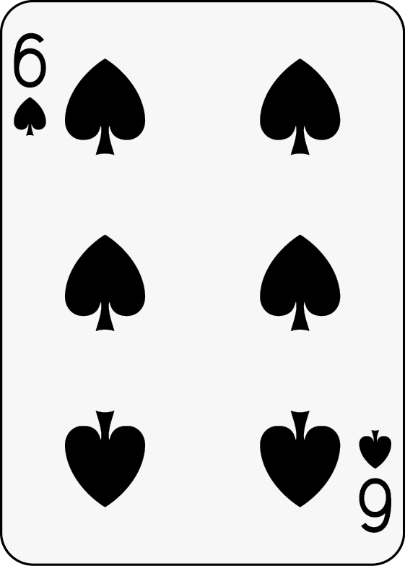
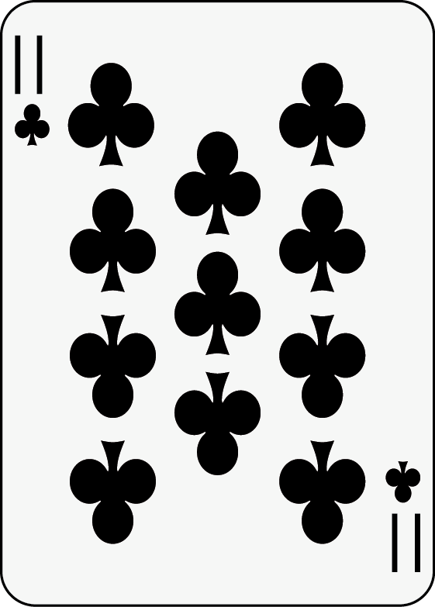
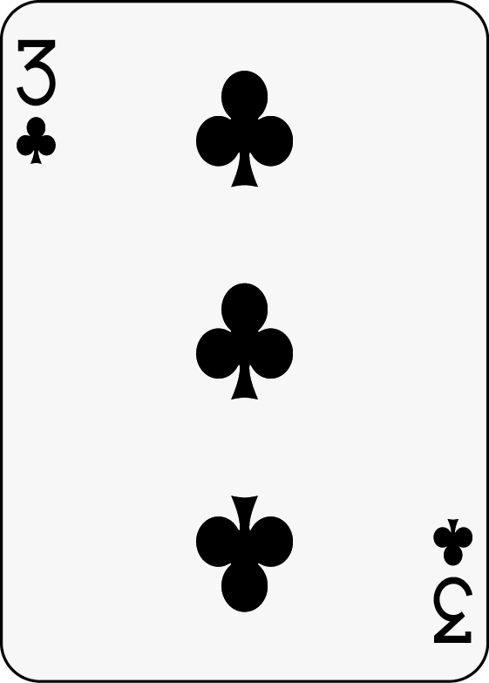
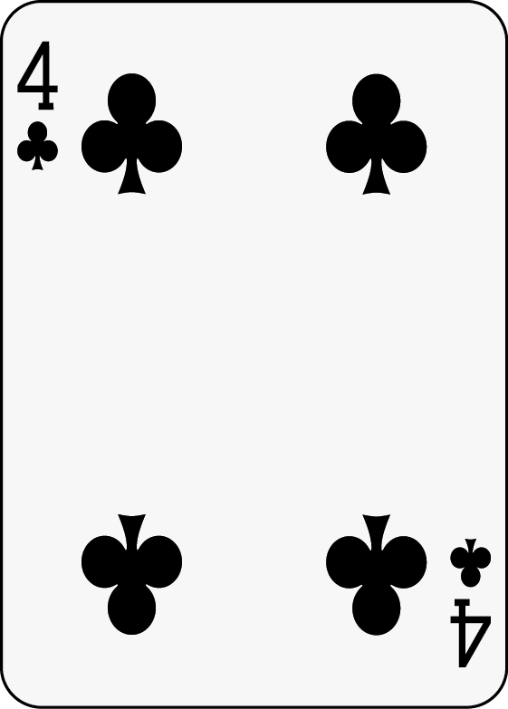
Sample Round
All black. No other pattern

Slide 4
Sample Scoring
Eleusis Scoring
Card | Team 1 | Team 2 | Team 3 | Team 4 | Team 5 | Team 6 | NOTES
1
2
3 |  | Dis! (-5) |  |  |  |  | T2: “Diamonds, increasing by 1.”
4 |  | (-1) | Rep! (-2) |  |  |  | T3: Replicates T2’s rule.
5 |  | (-1) | (-1) | Rep! (-2) |  |  | T4: Replicates T2’s rule.
6 |  | (-1) | (-1) | (-1)
7 |  | Ret! (-2) | Ret! (-2) | Ret! (-2) |  |  | T2, T3, T4: Retract rule
8 |  | 0 | 0 | 0 |  |  | T2, T3, T4 no longer lose points
9 |  | 0 | 0 | 0 | Dis! (+5) |  | T5: “Red, increasing by 1.”
10 | Rep! (+2) | Rep! (+2) | Rep! (+2) | Rep! (+2) | (+1) |  | T1, T2, T4, T4: Replicate T5’s rule
11 | (+1) | (+1) | (+1) | (+1) | (+1)
12 | (+1) | (+1) | (+1) | (+1) | (+1) | Rep! (+2) | T6: Replicate T5’s rule
Total | 54 | 44 | 48 | 49 | 58 | 52

Slide 5
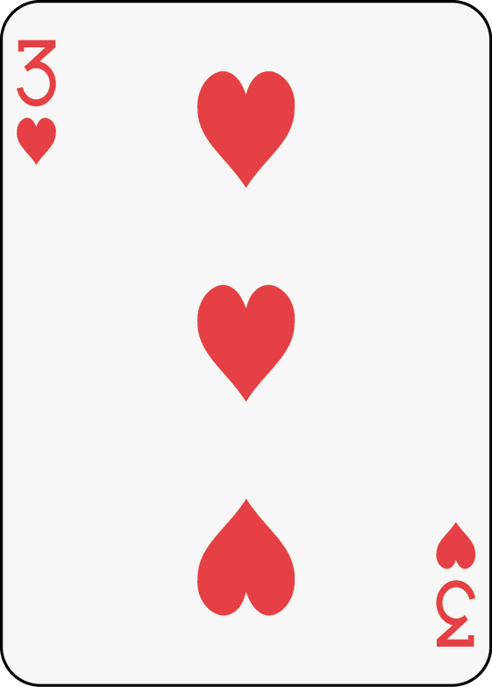
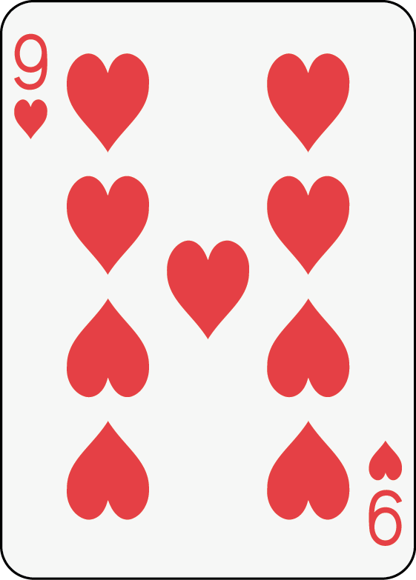
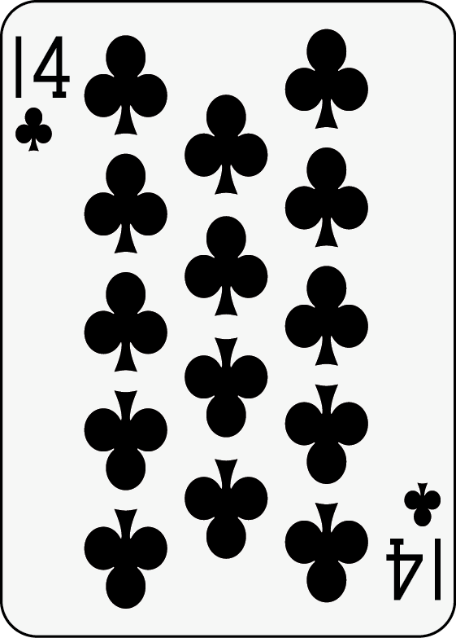
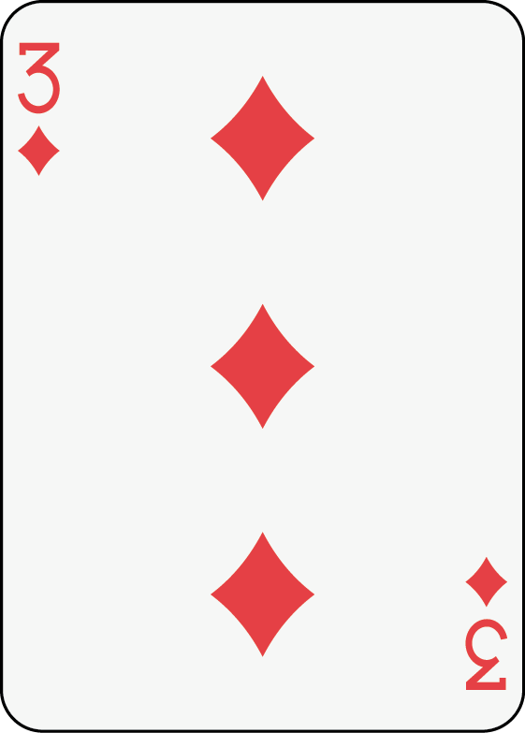
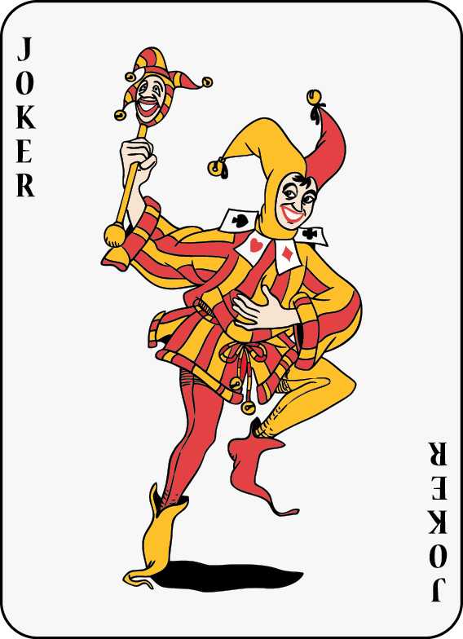
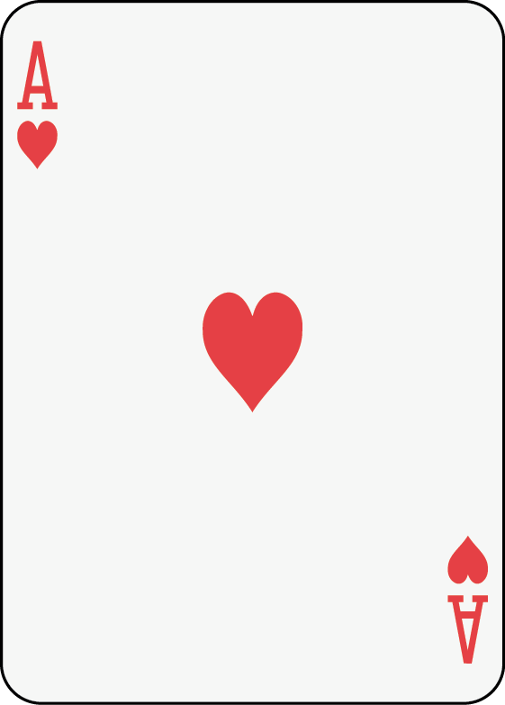
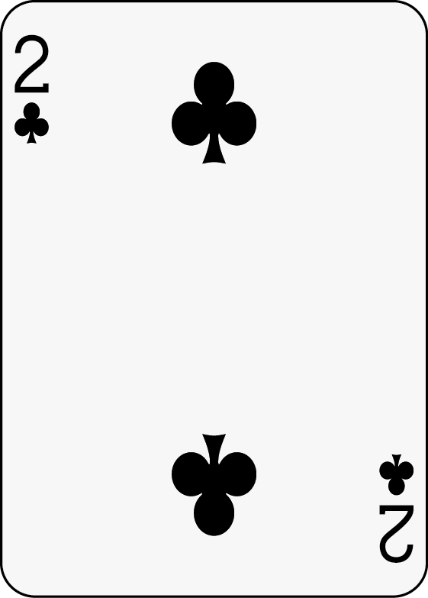
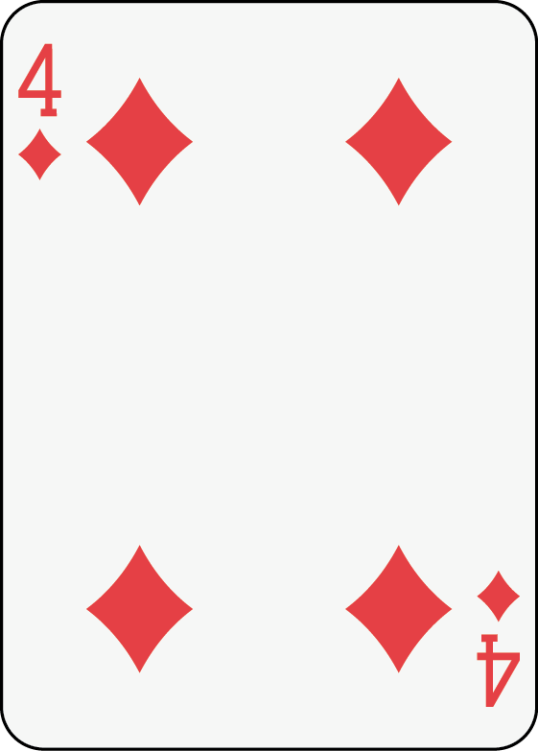
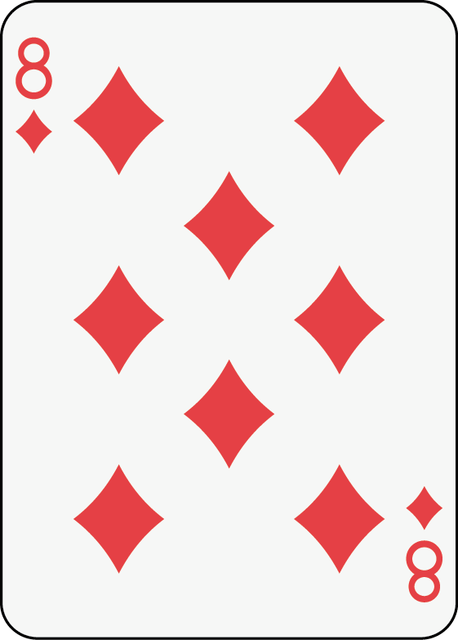
1 red, 2 blacks; blacks even.

Slide 6
Traditional Eleusis*
Models experimentation.
Demonstrates the scientific process of
Accumulating facts and data to form models
Formulating hypothesis and conducting experiments
Combining successes and failures to revise models
Enhances vocabulary (e.g., facts, models, hypotheses, laws, hypothesis, experiment, observation)
But…
Requires playing cards
* Invented by Robert Abbott (1956) and first published by Martin Gardner in his Mathematical Games column in Scientific American magazine (1959). A revised version appeared in Gardner's July 1977 column. The rules of Eleusis can be found using a simple Web search or by picking up a copy of the Bicycle Official Rules of Card Games. Bicycle Cards also hosts a Website that contains the complete rules of Eleusis (http://bit.ly/1lkhBS7). Another card game called Mao is remarkably similar.

Slide 7
Speed Eleusis
Models observation.
Does not require cards; can be driven by PowerPoint
Teaches concepts of replication and retraction
Allows instructors to insert Joker to demonstrate spurious experiments
Simplifies game management

Slide 8
Further Inquiries
To email John Walkup: jwalkup@csufresno.edu.

Slide 9
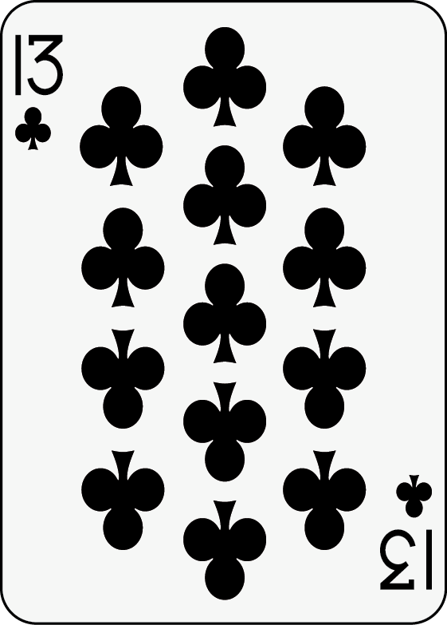
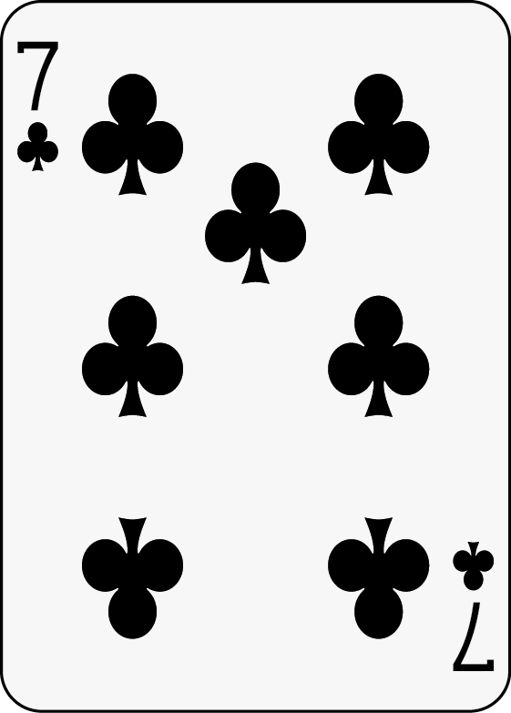
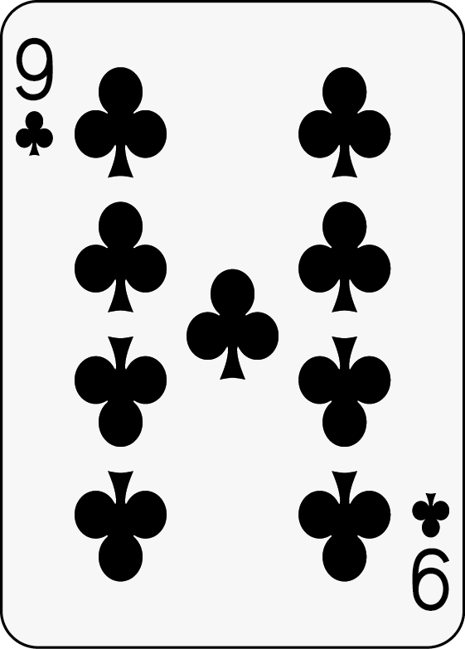
Round 2

