Slide 1
Data Warehouse Financial Reporting & Transaction Inquiry Overview
Sources:
Office of Budget & Resource Planning
Accounting Services
Chancellor’s Office
Notes:
This PowerPoint template is designed to assist you in creating your own university-branded presentation.
You may alter the text boxes or graphic elements in the template to accommodate your content. Please do not alter the background image.
If you need assistance with this template, please contact the Office of University Communications at 559.278.8595.

Slide 2
All campuses have access to the Data Warehouse.
Features include:
Summarized reports by ChartFields, with drill down capability.
Open PO’s, with drill down capability.
Transactions by “posted date”.
Department Hierarchy.
Report by Division, by College, by Department.
Can select by one and report at lower level.
NOTE: Data is one day old!

Slide 3
One of the main features of Finance Data Warehouse Phase 2 upgrade is the consolidation of three “Data Warehouse” dashboards – Manage My Budget, Operations, and Management Reporting – into two streamlined dashboards:
Financial Reporting – Manage My Budget, Management Reporting, and Operations report pages have been consolidated/relocated here with enhanced functionality.
Transaction Inquiry – all transaction inquiry pages are now located on this dashboard with a wider arrangement of filters and column selectors.
NOTE: Data is one day old!

Slide 4
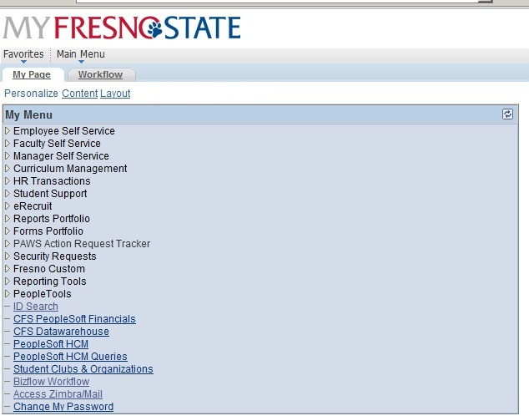
Log in to the Data Warehouse
Log into My Fresno State
At “My Menu” select “CFS Data Warehouse – Phase 2”
Notes:
When Phase 2 is set up, this is the normal route to access.

Slide 5
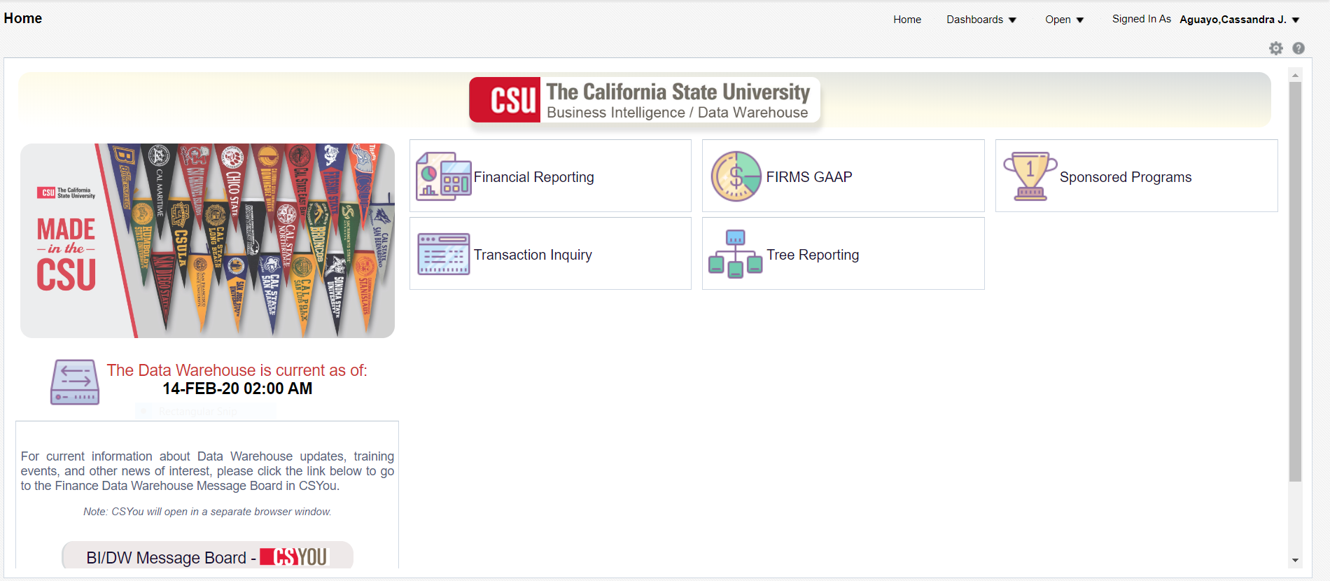
Log in to the Data Warehouse
Below is the default screen with Dashboard icons

Slide 6
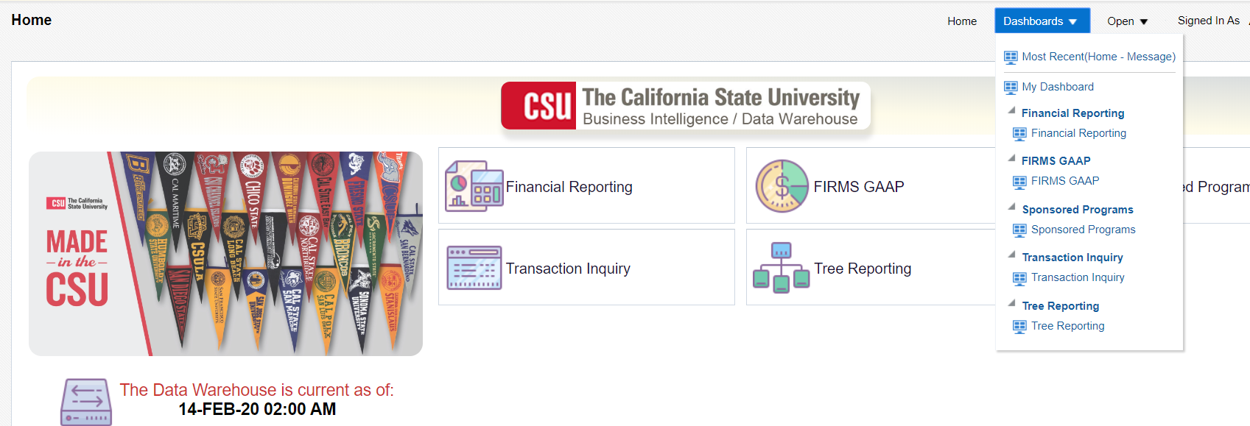
Or you can click the Dashboards drop down menu to display a list of available dashboards

Slide 7
Getting Started - Dashboards
Dashboard Choices:
Financial Reporting
Firms Gaap
Sponsored Programs
Transactions Inquiry
Tree Reporting

Slide 8
Your Primary Choices:
Financial Reporting
Transaction Inquiry
Your primary choices:
Financial Reporting
Transaction Inquiry

Slide 9
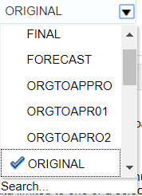
Getting Started – Establish Default Settings
Select Business Unit
Select Standard Budget
Click Apply

Slide 10
Click Options Dropdown
Save Current Customization

Slide 11
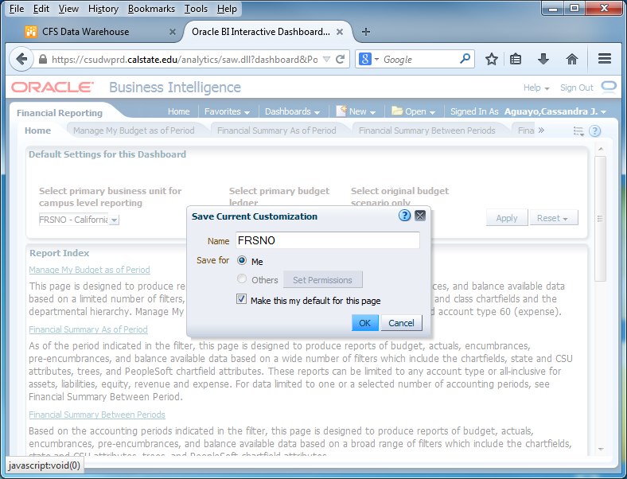
Save as “FRSNO”
Click the option “Me”
Check the box “Make this my default for this page”
Click “OK”

Slide 12
Five Steps to Report Results
After you establish your dashboard defaults, you are ready to generate a report.
There are five main activities involved with report production:
Select the report
Set the report filters
Set the report format
Drill through report data
Capture report results (print /download)

Slide 13
Getting Started – Manage My Budget as of Period
The Basics: one Dept, one Fund report
Set Filters:
Business Unit- FRSNO
Fiscal Year – accept default or make your selection
Period – accept default or make your selection
Account Type – normally defaults to 50 & 60
Budget Ledger – normally defaults to Standard Budget
Fund
Department

Slide 14
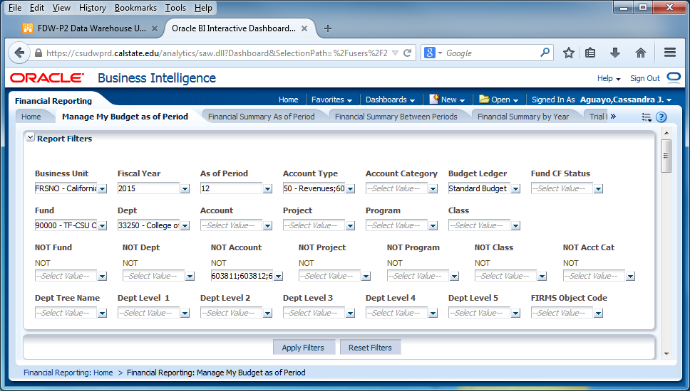
Manage My Budget as of Period
Set Business Unit, Fiscal Year, Period, Account Type, and Budget Ledger
Set Fund and Department
NOT filters: Fund, Dept, Prog, Class & Not Acct Cat – use these filters if you do not want certain items included on the report…603811-603819 benefits
Click Apply Filters

Slide 15
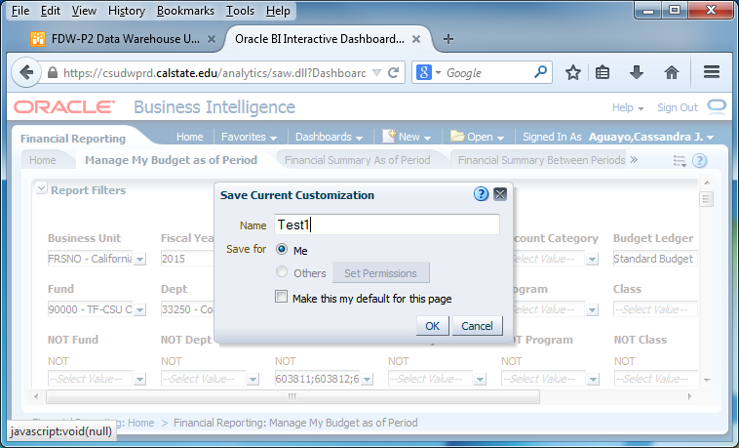
Manage My Budget as of Period
Save your file by clicking the drop down menu, select “Save Current Customizations”, name your file, and select “Me”
Click “OK”

Slide 16
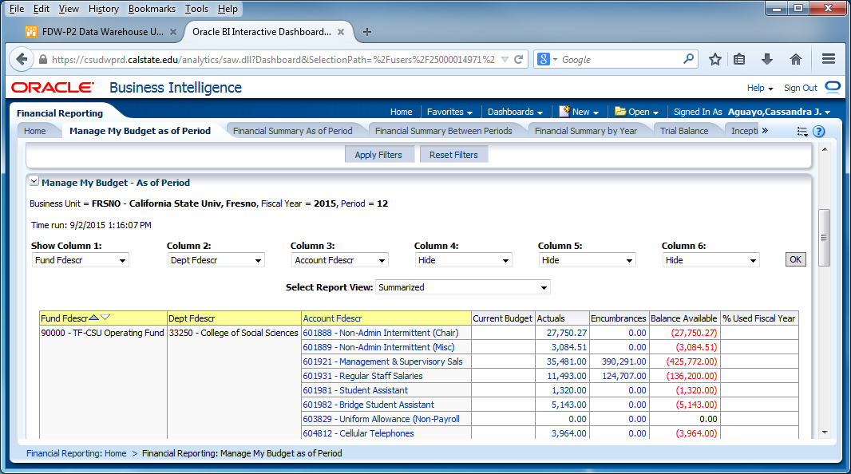
Manage My Budget as of Period
Report Results

Slide 17
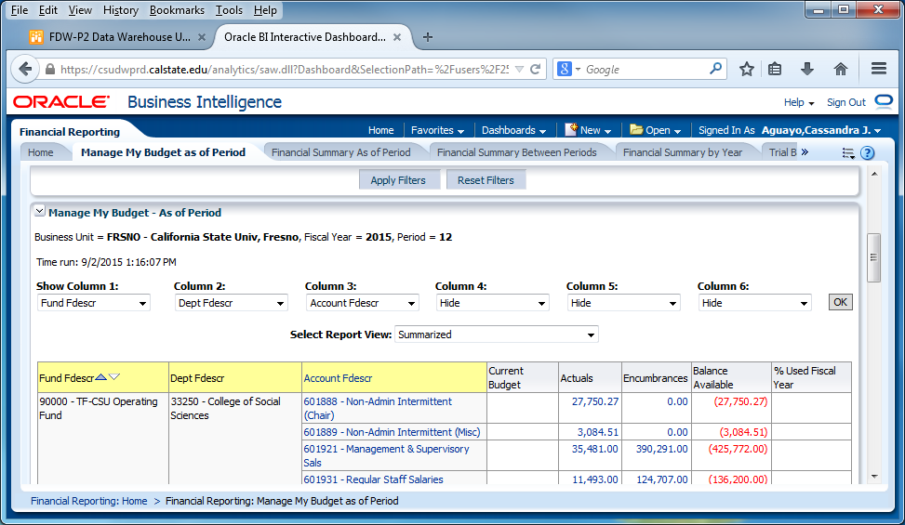
Enhanced Report Results Features:
Reports will default to three visible columns
Hide/unhide columns for up to as many as six columns
Add/remove subtotals to any and all columns, as needed.
Just as in the old version, results can be stored as a Saved Customization.

Slide 18
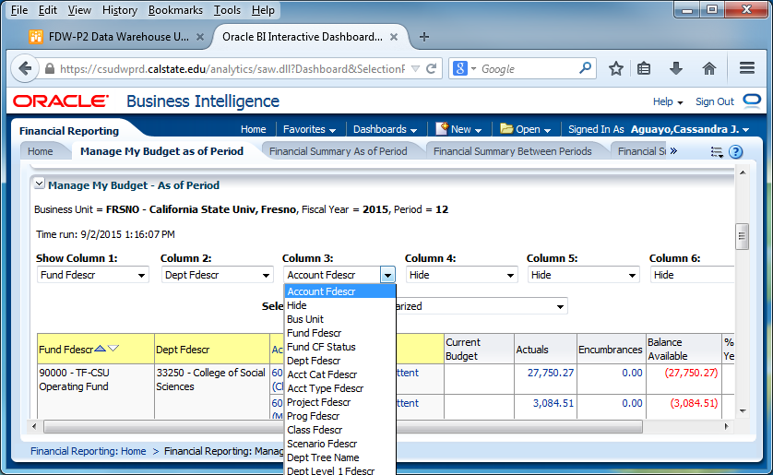
New Feature: Hide and Display Columns
To Hide – simply click the drop down menu on that column, click “Hide” and click “OK” for your selections to apply.
To Display/add column – simply click the drop down menu on the column you want to display and make your selections and click “OK” in order to apply the column values and generate the report.

Slide 19
New Feature: Add/Remove Subtotals
The first two columns in every report are formatted to display subtotals.
To add subtotals:
Place cursor at the top of column where you want to add subtotals to
Right click on yellow column heading to access the Columns shortcut menu.
Choose “Show Subtotal” and “> after values”
To remove subtotals:
Place cursor at the top of column where you want to remove subtotals from

Slide 20
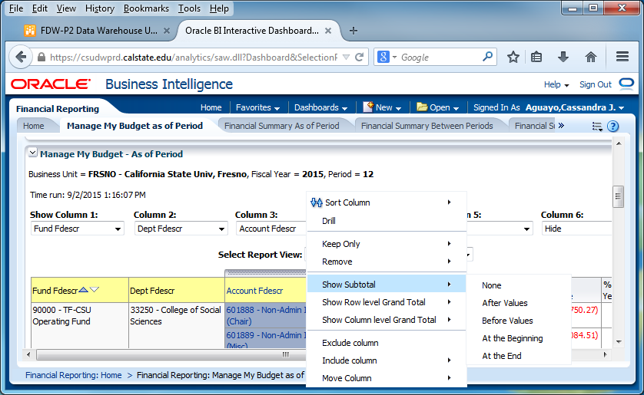
To remove subtotals:
Place cursor at the top of column where you want to remove subtotals from
Right click on yellow column heading to access the Columns shortcut menu.
Choose “Show Subtotal” or “None” to remove

Slide 21
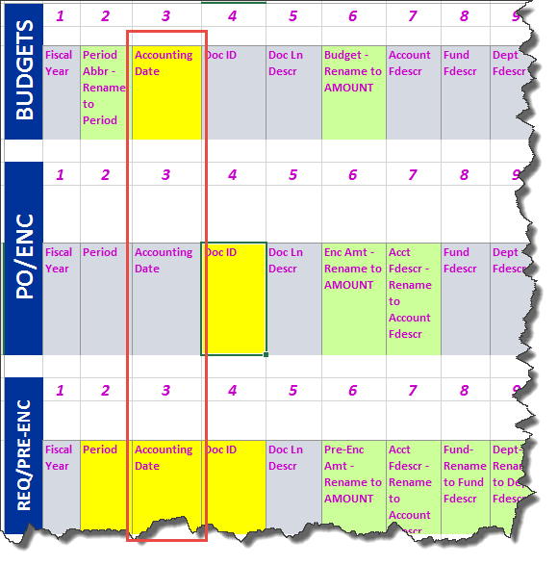
Drilldowns Improvement
Column order is now consistent on Actuals and Budget, PO, and Requisition drilldowns.

Slide 22
Drilldowns Improvement
Drill down columns have been reformatted to have priority columns on the left so they are easier to view.
Additional fields have been added for Actuals and Budget drilldowns.
Budget does not include PO or other Actuals specific columns
Drilldown columns align on the left to the extent possible.

Slide 23
Drilldowns Improvement
Actuals Drilldown Columns
Budget Drilldown Columns

Slide 24
Report Views
Report views available in the in the old version is also available in FDW-P2. Now it is user-friendly.
Rev Budget is now Current Budget
Enc is now Encumbrances
BBA is now Balance Available
MTD is now Month to Date
PY Per 0 is now Inception to Date Actuals

Slide 25
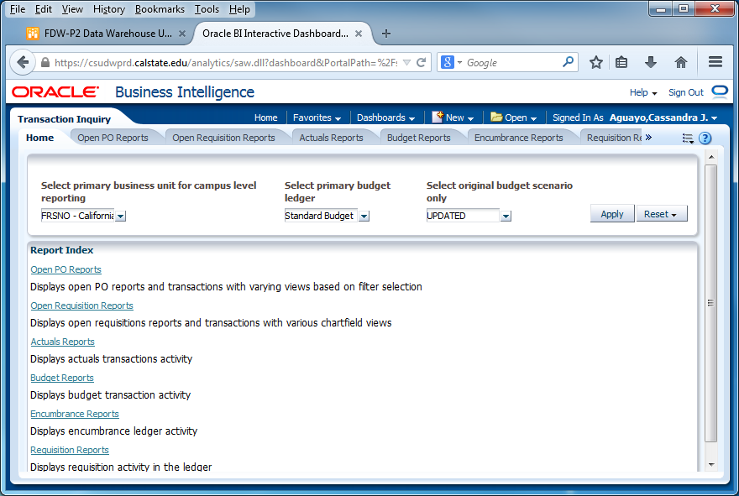
New Dashboard: Transaction Inquiry

Slide 26
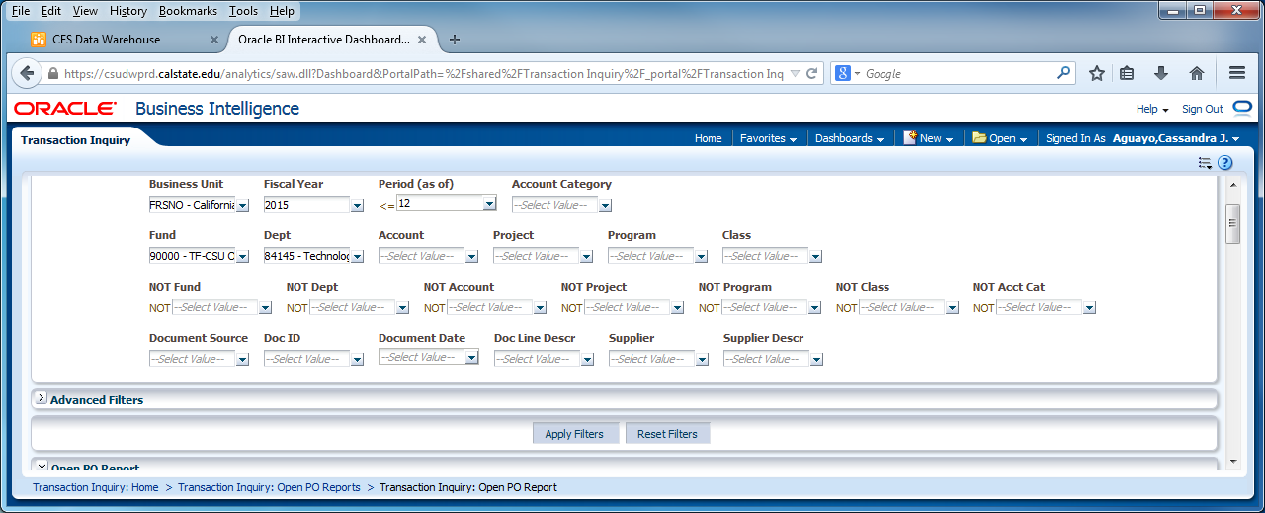
New Dashboard: Transaction Inquiry
Open PO Report: Set your filters and apply

Slide 27
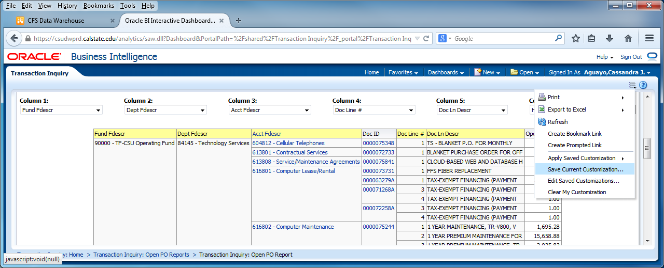
New Dashboard: Transaction Inquiry
Open PO Report: Results
Save

Slide 28
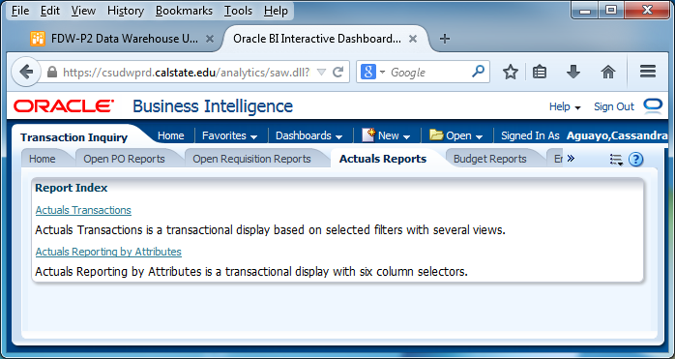
New Dashboard: Transaction Inquiry
Actuals Transactions
Actuals Reporting by Attributes

Slide 29
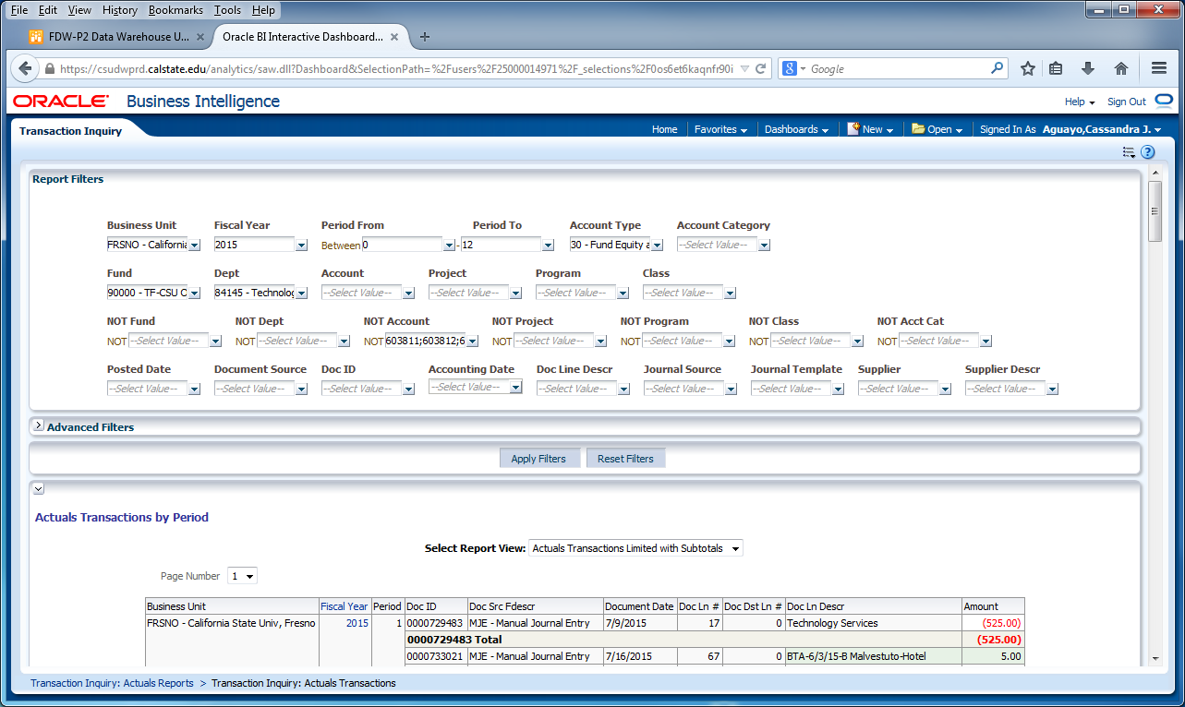
New Dashboard: Transaction Inquiry
Actuals by Period

Slide 30
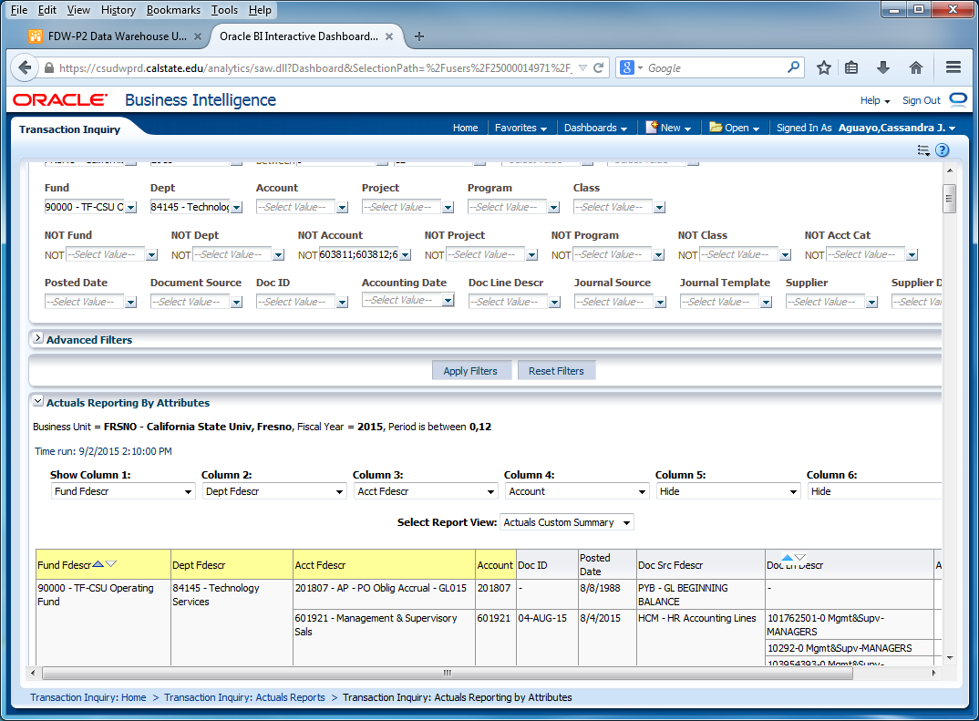
New Dashboard: Transaction Inquiry
Actuals Reporting by Attributes

Slide 31
New Dashboard: Transaction Inquiry
Budget Transactions
Budget Reporting by Attributes

Slide 32
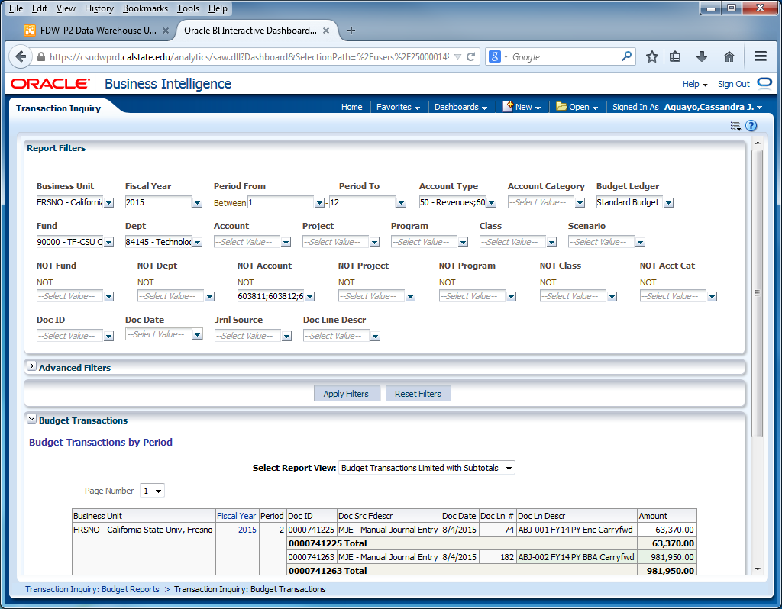
New Dashboard: Transaction Inquiry
Budget Transactions

Slide 33
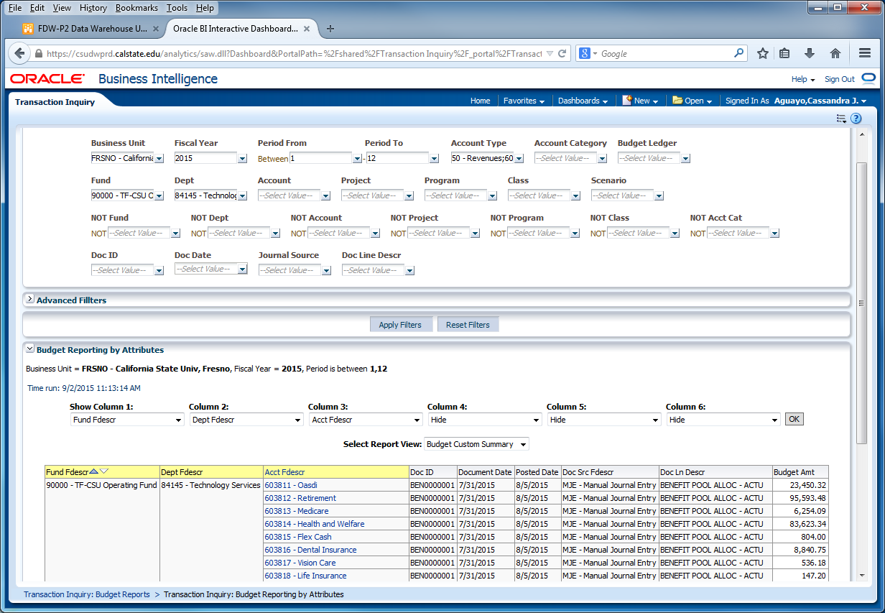
New Dashboard: Transaction Inquiry
Budget Reporting by Attributes

Slide 34
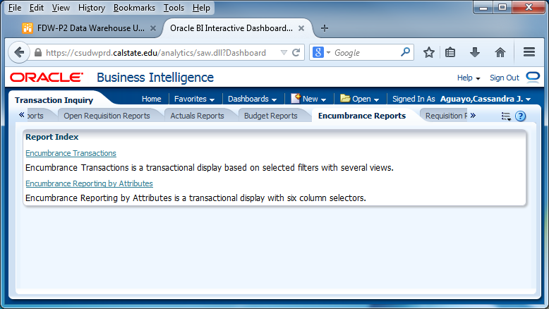
New Dashboard: Transaction Inquiry
Encumbrance Transactions
Encumbrance Reporting by Attributes

Slide 35
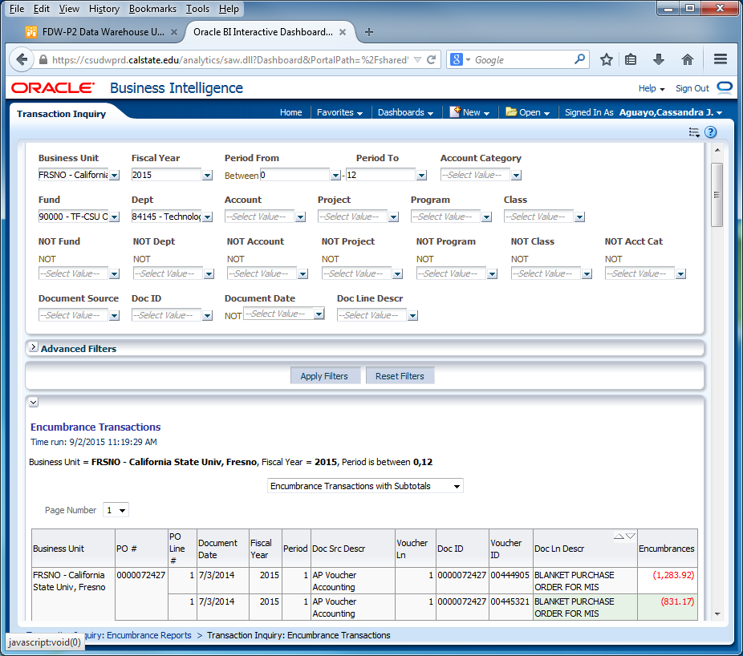
New Dashboard: Transaction Inquiry
Encumbrance Transactions

Slide 36
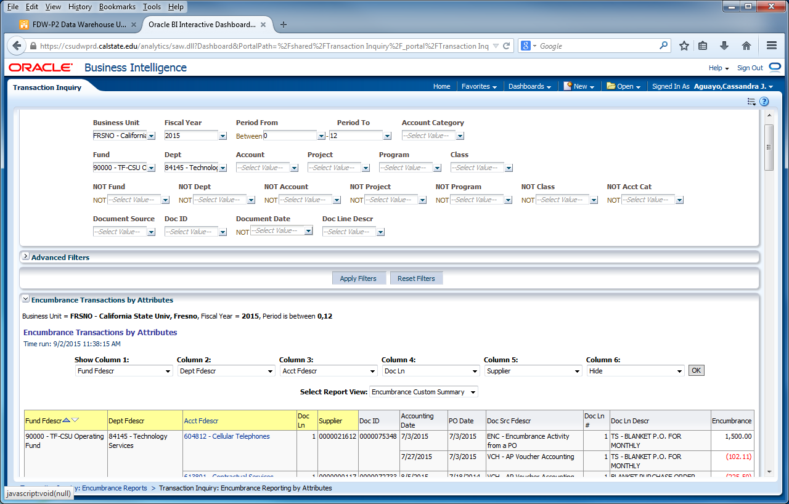
New Dashboard: Transaction Inquiry
Encumbrance Reporting by Attributes

Slide 37
PART II

Slide 38
Five Steps to Report Results
After you establish your dashboard defaults, you are ready to generate a report.
There are five main activities involved with report production:
Select the report
Set the report filters
Set the report format
Drill through report data
Capture report results (print /download)

Slide 39
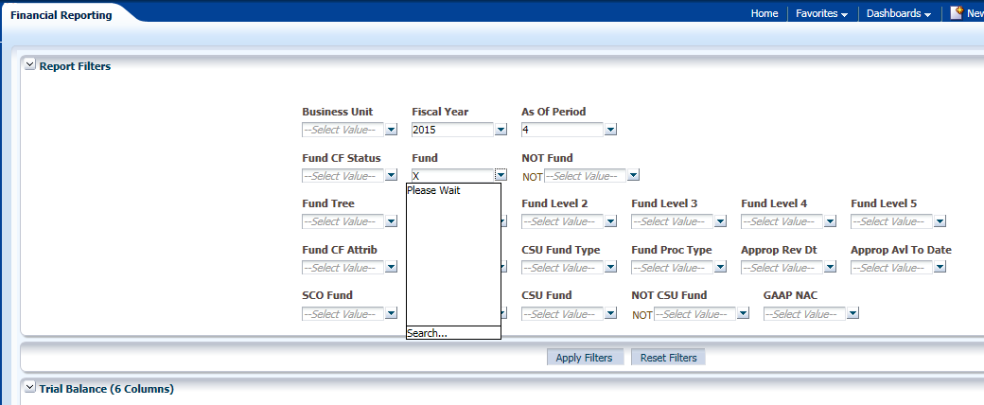
Trial Balance Selections
This report is best used for Fund only views
Prompt filter has down arrow. It will default to current period and year unless it is a save selection report. (Hint: Save as Period 12)
Multiple Funds can be selected for this report. (Departments cannot be filtered in this)
Click Apply Filters

Slide 40
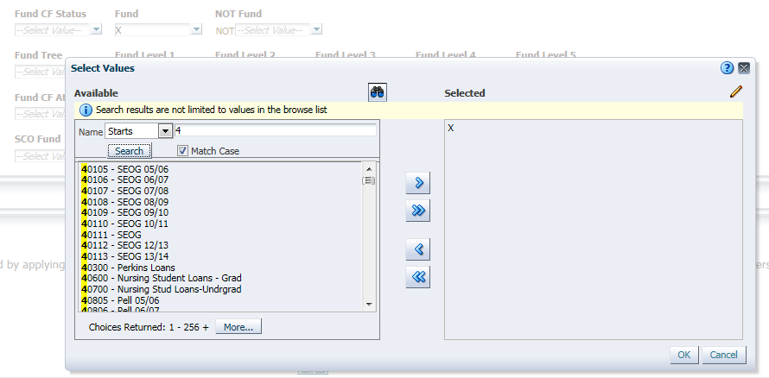
Report Filters – Fund Selection Criteria
Double-click on any value to move it into or out of the Selected box or use the arrow button.
Enter first number of Fund to list all with that beginning number.
Search is available in drop down box for ‘Starts’, ‘Contains’, ‘Ends’, and ‘Is Like’. Unselect Match Case for more options. It does not identify the description. There is limited criteria in the selection box. If your search contains more . Remember to select ‘Search’.
When more than 256 results, hit the “More” button to display the next 256 choices. Otherwise, you may not find your choice. It is easier to use the ‘Search’ than to scroll.
Click ‘Ok” to save.
Selection Buttons | Use the buttons below to move items into the Selected Box.
 | De-select all items.
 | De-select highlighted item(s)
 | Select all items listed
 | Select highlighted item(s)

Slide 41
Trial Balance (6 columns)
This report is good to view the available cash balance
In the 6 Column Trial Balance, various columns can be added to suit different reporting needs

Slide 42
Cash Balance Report
Choose your Fund Number

Slide 43
Cash Report
Balance will show in Cash column. Report will only show the Cash balance.

Slide 44
Financial Summary As of Period
You can drill down for detailed information, in any field that shows an underline when you scroll over it

Slide 45
Financial Summary Between Periods
Report is similar to Financial Summary As of Period, but it allows the user to choose periods to view

Slide 46
Financial Summary by Year
Compares fields year by year. Periods and Department field can also be filtered.
Select years and periods to compare
Select Column order for the report
Shows amounts posted from year to year and it allows the user to drill down

Slide 47
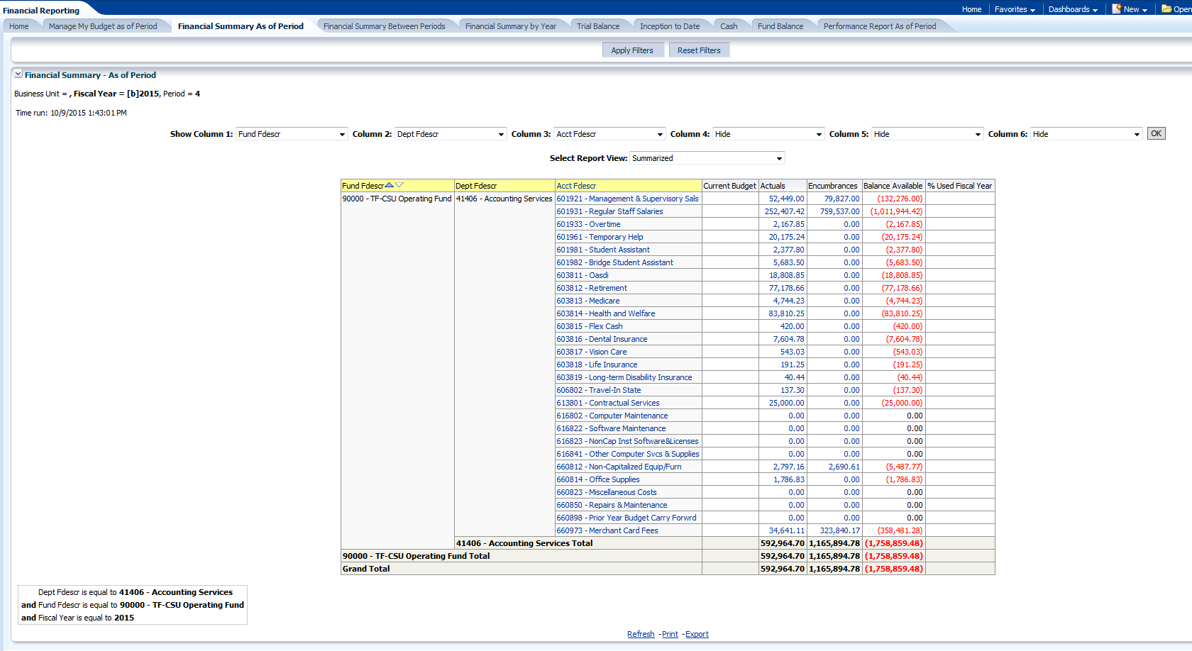
Export and Print
Example is from Financial Summary As of Period
Refresh, Print, and Export options are at the bottom of the page

Slide 48
Print to PDF
The Print hyperlink located beneath the report will print the individual report in either PDF or HTML formats. Both are similar

Slide 49
Print PDF Results
Printing to PDF provides a report similar to the results on the main screen

Slide 50
Print to HTML Results
Printing to HTML provides a printout screen similar to a screenshot. The result is a smaller output which can fit to one page

Slide 51
Exporting Data
Exports all data on the screen to a variety of file formats including PDF, Excel, & CSV.
Exporting to PDF results in a file similar to the print to PDF, but it can be saved as a file.
Exporting to Excel presents the data in Excel along with report formats. Formulas are not transferred to Excel. It is only hardcoded numbers.
Tab Delimited and CSV files will open in Excel without any formatting and can then be saved as an Excel file. Be sure to save as an Excel file. This export may include more data than shown on the screen.

Slide 52
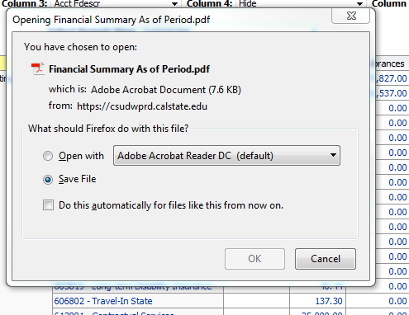
Example of Export to PDF
This is a good tool to send the report to a manager
Select PDF as Export file type
After selecting the PDF file, a box will pop up asking to either open or save the file. Either option will work.
Click OK

Slide 53
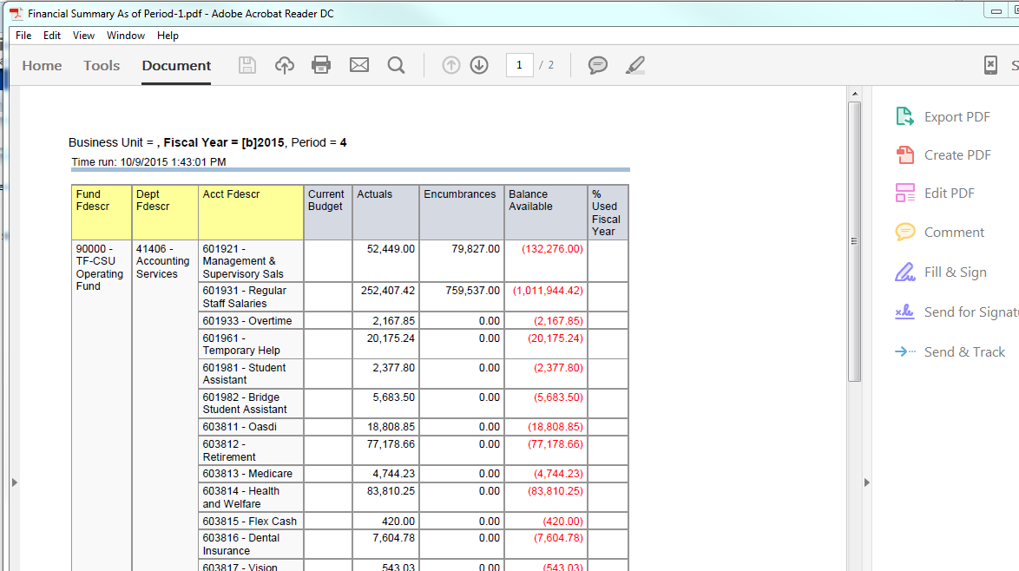
Example of Export to PDF Result
This is the result from the Open option
When choosing to Open the file, the file opens in Adobe Acrobat. The file can then be saved, printed, or sent based on your needs. The data cannot be changed in a PDF file.

Slide 54
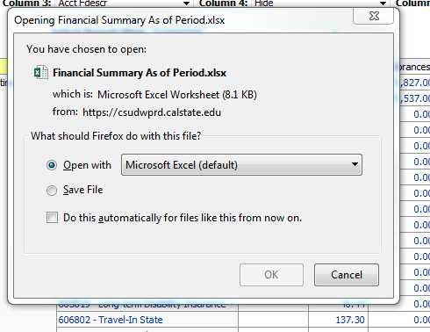
Example of Export to Excel
Select Export to Excel. Then select the Excel 2007+ format.
After selecting the Excel file as output, a box will either open or save to file. Either option will work.
Click OK

Slide 55
Example of Export to Excel Data Output
The data is downloaded into Excel. The formatting can be manipulated from this point and can be saved as an Excel file.
Formulas do not carry forward. Numbers are hardcoded.

Slide 56
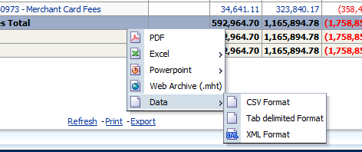
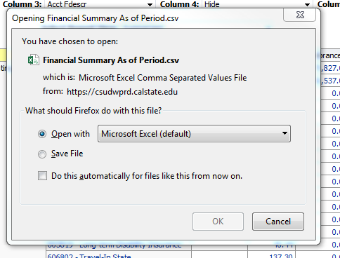
Example of Export to Data – CSV Format
Select Export to Data – CSV Format
Prompt will open the CSV file with Excel. There is also an option to save the file. Opening in Excel is recommended.

Slide 57
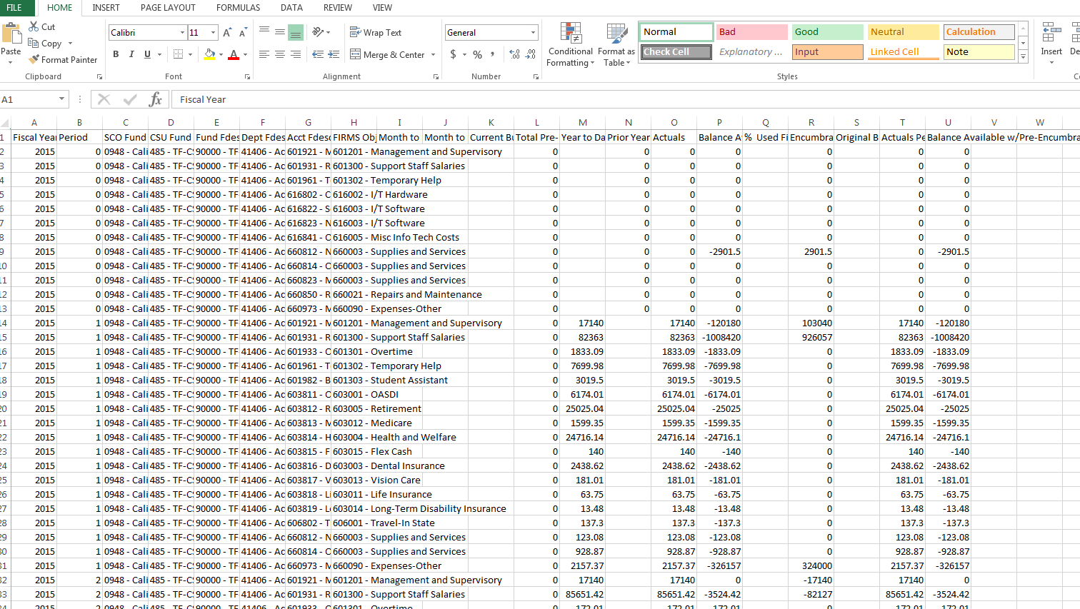
Example of Export to Data – CSV Format Output
The CSV file opens to Excel as unformatted data. It can be manipulated from this point. Data includes information such as additional fields which may not be seen on the original output screen.
Remember to save the file as an Excel file when finished formatting

Slide 58
Questions?
Contact Information
Accounting Services
P.J. Soligian pjsoligian@csufresno.edu 559-278-8133
Lora Kutka lkutka@csufresno.edu 559-278-4343
Office of Budget & Resource Planning
Jean Aguayo jaguayo@csufresno.edu 559-278-7224
Lisa Chavez lisachavez@csufresno.edu 559-278-5293
Pam Lewis paml@csufresno.edu 559-278-5295

