Slide 1
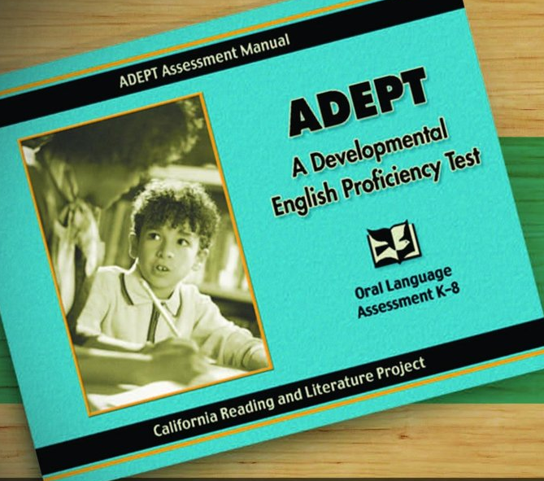
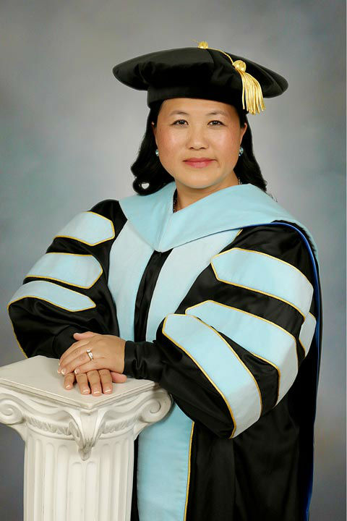
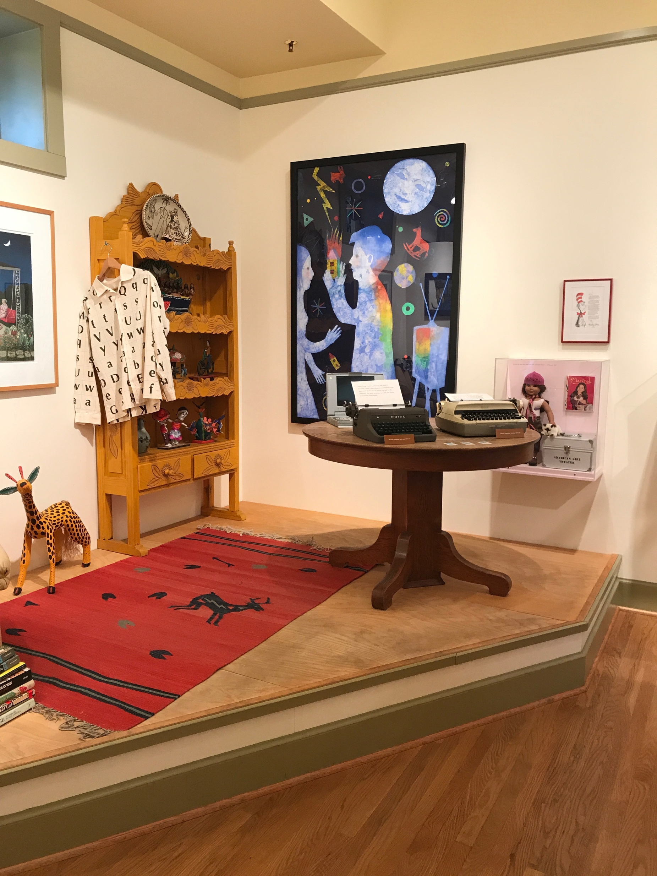
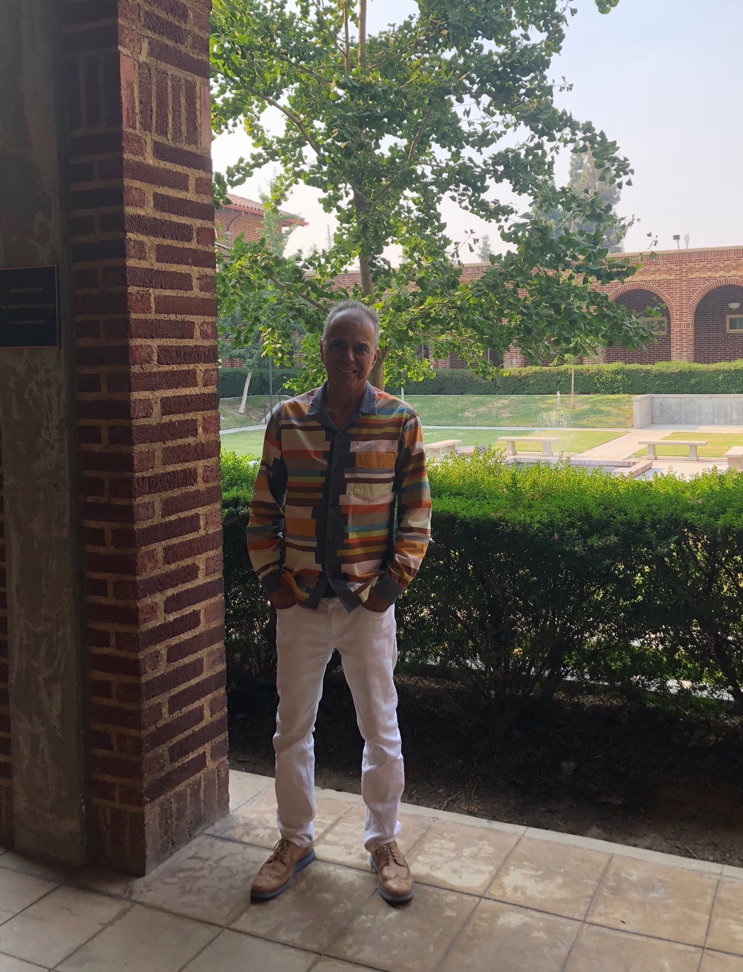
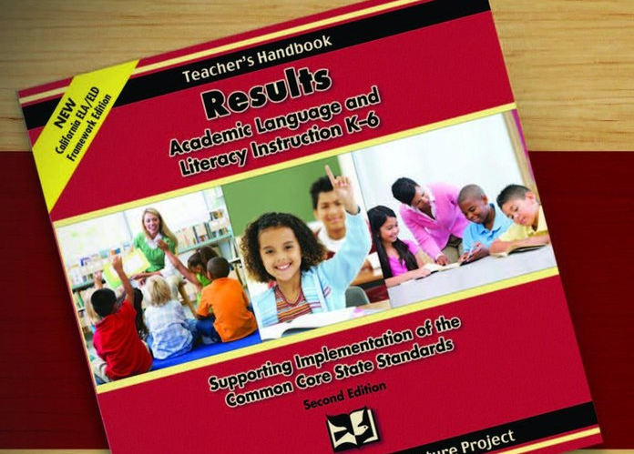
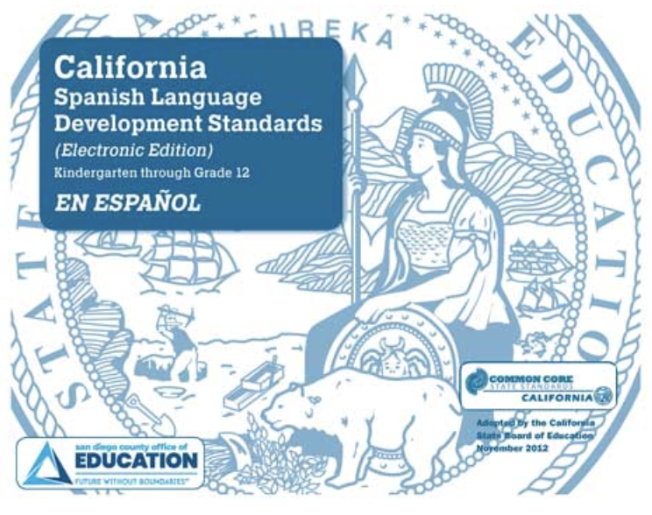
Collaborating with Local Educators on Dual Immersion, Foundational Reading, and Teacher Leadership Initiatives
Focus One: Provide Supports to Teachers and Leaders of EL Learners
Focus Two: Provide Academic & Disciplinary Literacy Supports to Partners
Focus Three: Develop Committed Teacher Leaders
Our work this year has included the recruitment of two primary elementary school teachers from Madera with expertise in foundational reading and high capacity to learn and implement RESULTS with an intent to train next year. An additional teacher leader recruit from Madera with expertise in DL/EL in grades 5-8 with training and implementation of SEBT at her school site recently agreed to commit to the work. We also have networked with faculty from the Department of Literacy, Early, Bilingual, Special Education (LEBSE) and Educational Leadership who have interest in the signature programs for course goals.
Our webinar series has highlighted work from one faculty member from KSOEHD around literacy supports. Additionally, we are working with other CRLP Regions and faculty to open conversation around academic and disciplinary literacy.
From our work with developing an EL partnership with Parlier, we are providing a RESULTS refresher training for those who have been trained under older materials and currently offering a full initial RESULTS training for those who are new to the program. These Open Institutes are available for other districts, and Bishop Unified has sent teacher leaders as well. Through intentional Open Institutes we can meet the needs of the rural partners while also allowing for more participants. The new co-director has also offered the CRLP program developed in partnership with SDCOE to outline the Spanish Language Development Standards (SLD) to support Dual Language Initiatives.
As we worked to develop new partnerships with districts beginning in Fresno, Madera, and Kings/Tulare Counties for professional learning and support SEBT and ADEPT Signature Programs, 21 participants across two district partnerships and one network have been impacted in this focal area for the project.
This included a continued district partnership with Exeter Unified in Tulare County for ADEPT training and established a renewed partnership with Parlier Unified in Fresno County for SEBT training and technical assistance in the form of follow up classroom walkthroughs and principal coaching feedback. Regarding Madera, a Teacher on Special Assignment at the new Dual Language elementary school attended SEBT training which has initiated work to develop partnership in SEBT for teacher leaders.
The 2018 Fall MARC Literacy Institute held at Martin Luther King Middle School in Madera Unified and CRLP sessions offered by Co-Directors during breakouts. The Region 7 John Shefelbine Leadership in Literacy Award was also presented during this event to Dr. Vicky Xiog-Lor. In addition, author Gary Soto presented the keynote address supporting his newest release [Gabe], set in downtown Fresno. We have also supported the opening of his new museum at Fresno City College.

