Slide 1
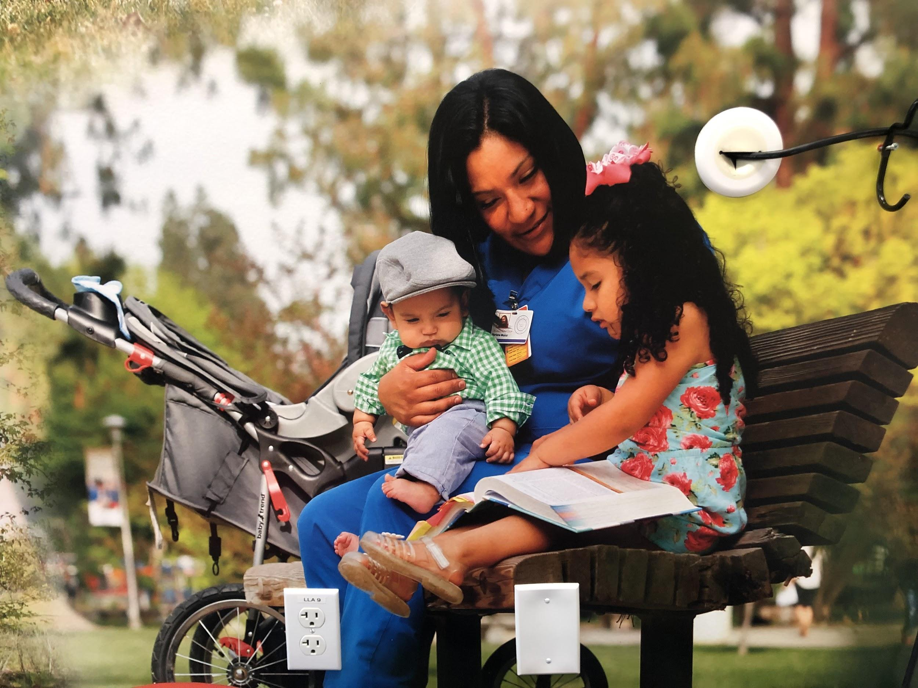
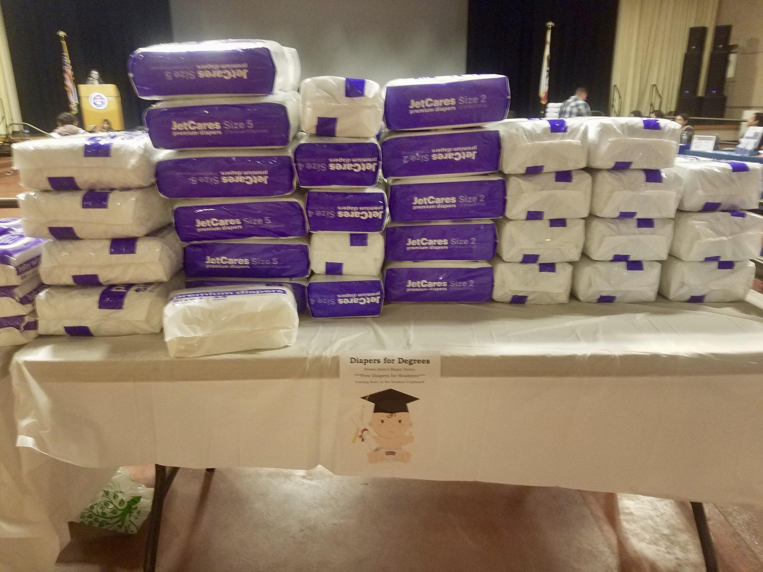
CAIFE: Supporting Student Parent Success through
Diapers for Degrees and a Children's Clothing Closet
Did you know that…?
1 in 5 CSU students is parenting a dependent 18 years and younger
1 in 3 mothers report diaper need
Student parents graduate with nearly 2x’s as much debt as non-parenting students
Student parents are 10 times less likely to complete a bachelor’s degree within 5 years than students without children
Student parents are more likely to graduate with higher GPA’s than non-parenting students
Coming Fall 2019!
Diapers for Degrees Launch
Approx. September
Location: Student Cupboard
Children’s Clothing Closet Launch
Approx. October
Location: ED 59
Our Projects
The children’s clothing closet (Dr. Susan Schlievert, KSOEHD) was proposed as a “bring-and-take space for families” for students to donate and receive clothing for their dependents.
The diaper bank, submitted by (Dr. Jennifer Randles, COSS), was proposed as a resource for parenting students to access free diapers to alleviate financial stress and support student success. The bank has since been designated by the Fresno County Food Bank as an official distribution hub and will have access to diapers through a $2.5 million grant.
Fresno State is actively working to support this highly ambitious yet vulnerable population.
Diapers for Degrees debuted its logo and distributed diapers at the first annual Student Parent Resources Fair on March 5, 2019
Dr. Larissa Mercado-López, Women’s Studies
Brittney Randolph, Programs for Children
Dr. Amber Crowell, Sociology
Alicia Nelson, Student Health and Counseling Center
Cecilia Ruesta, Student Representative
Executive Sponsor: Dr. Joseph Castro

