Slide 1
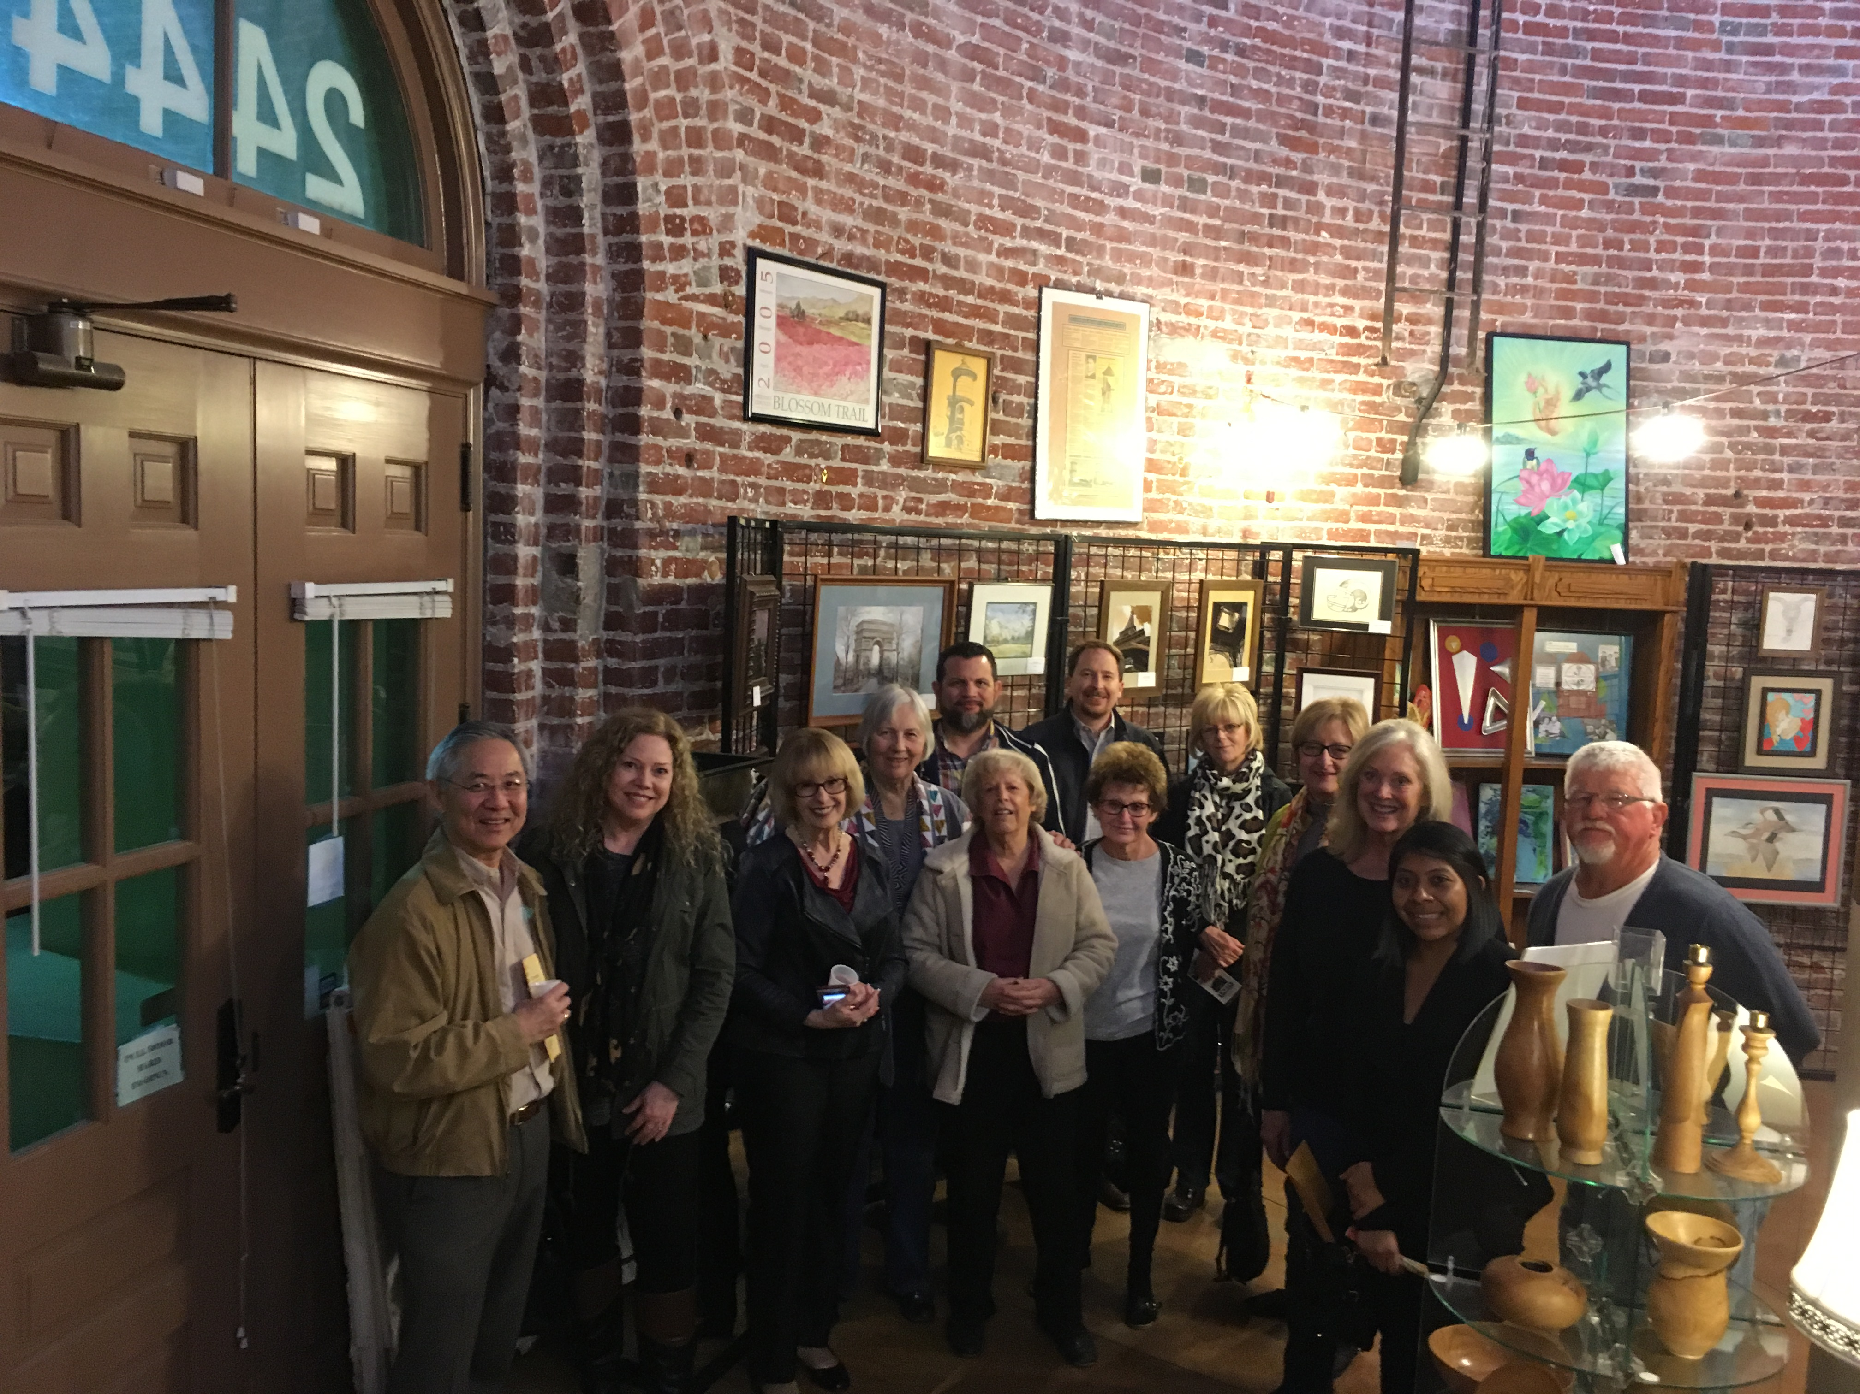
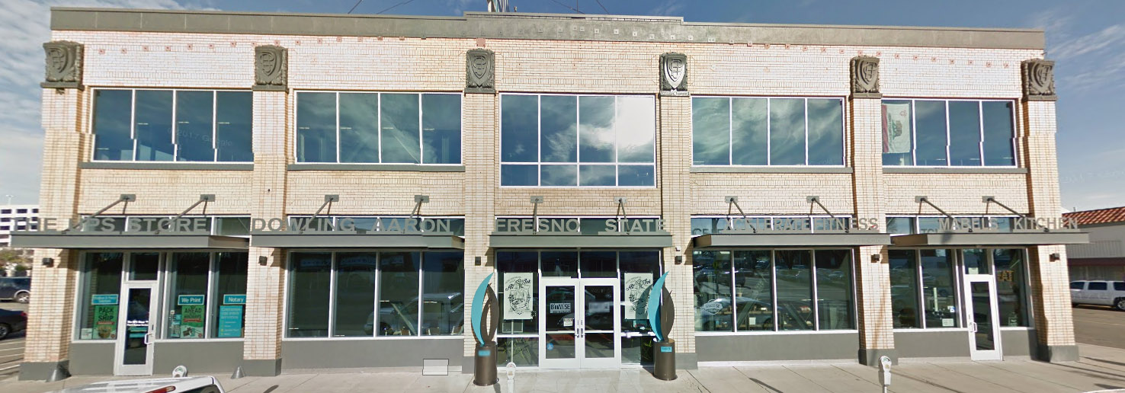
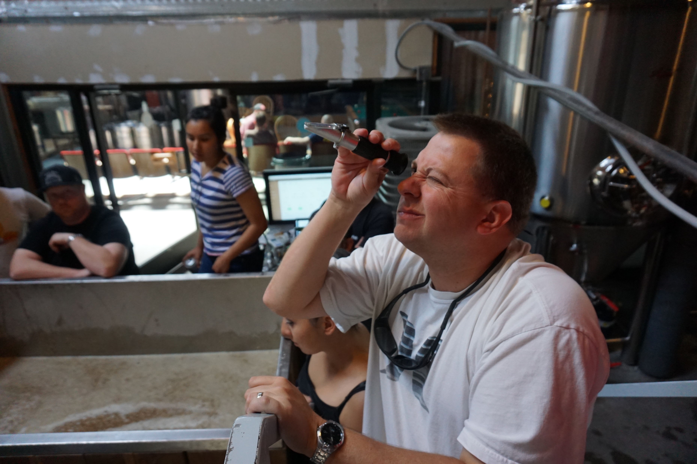
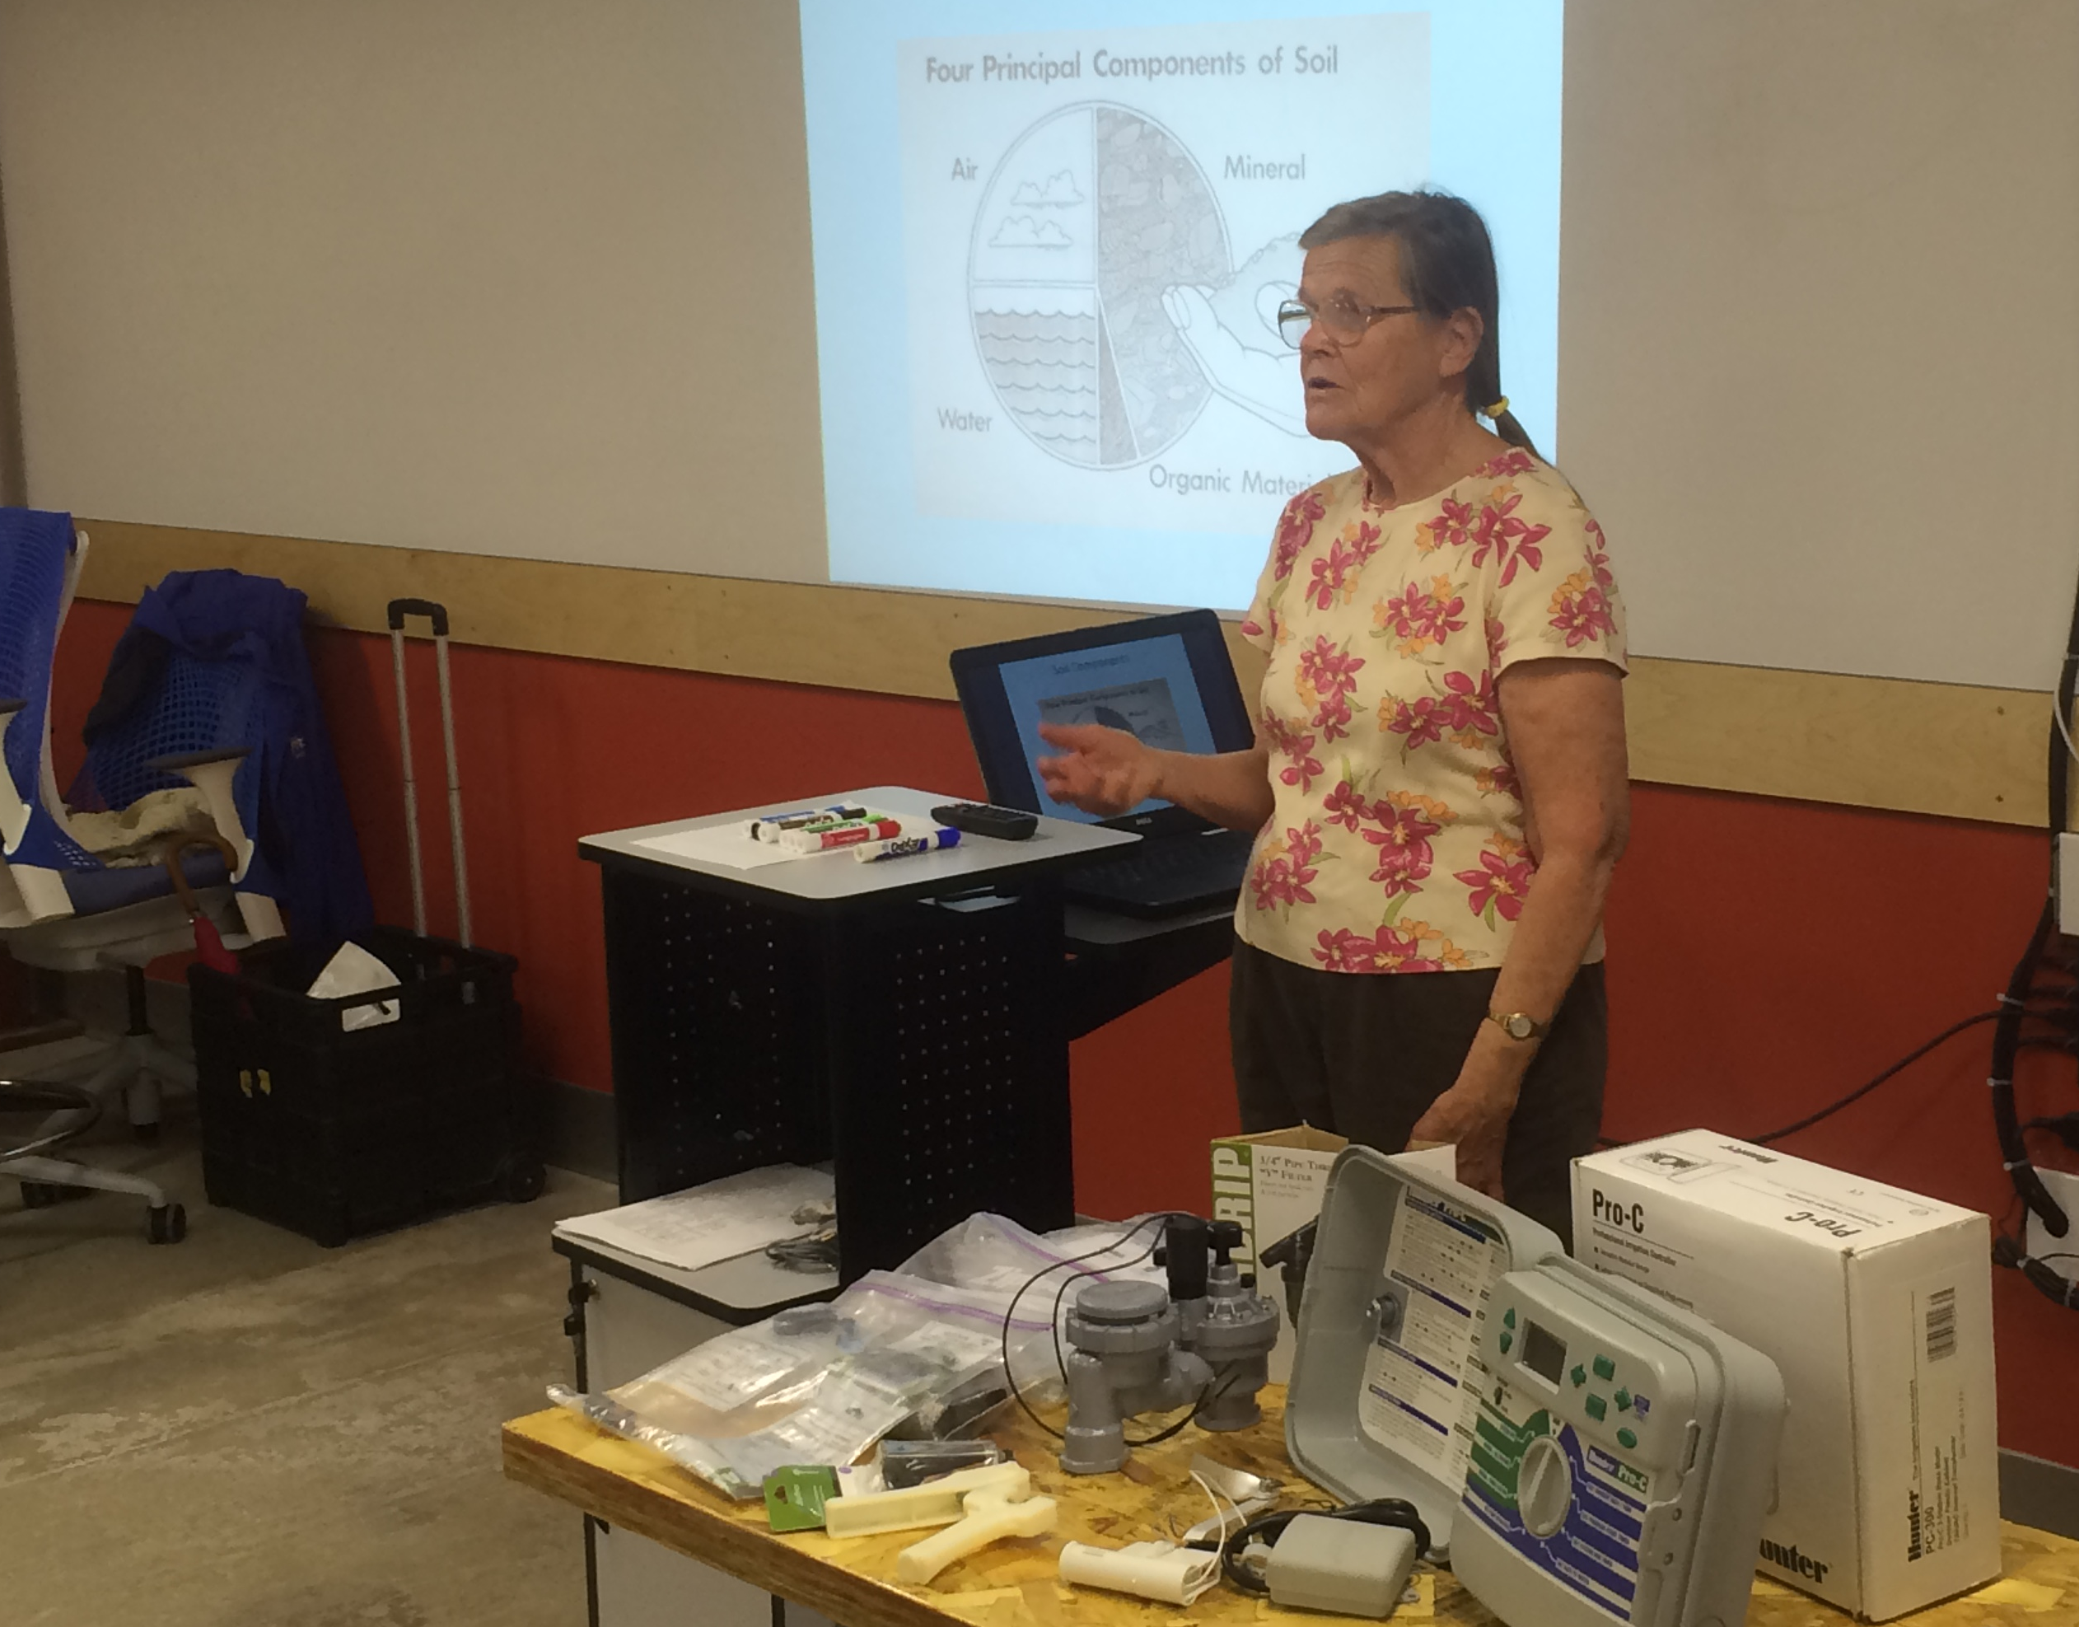
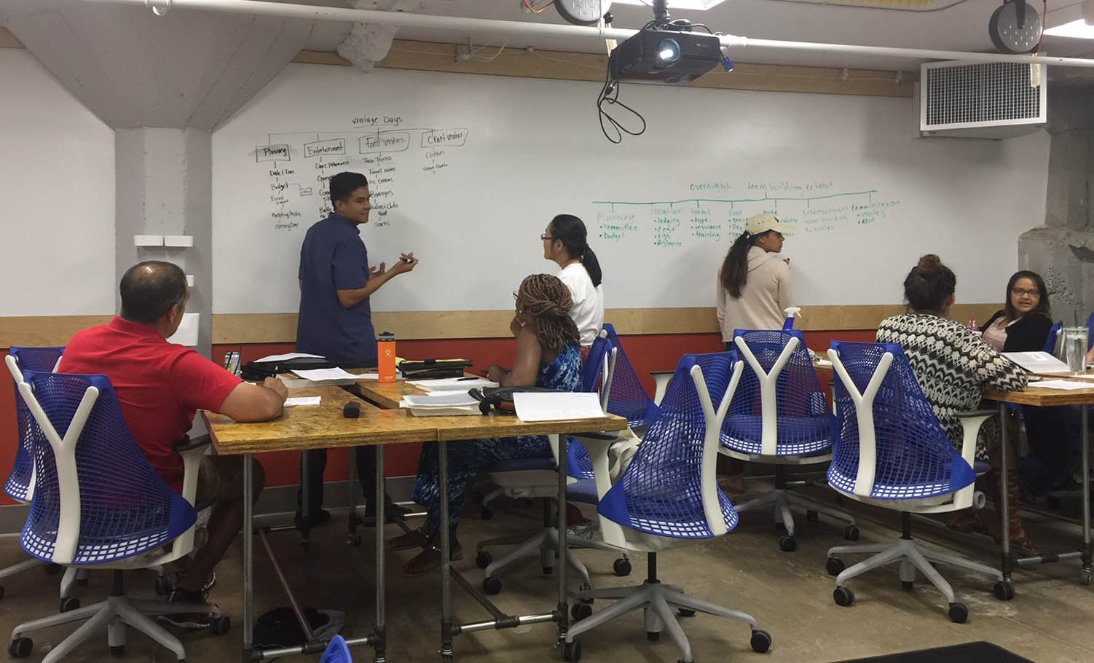
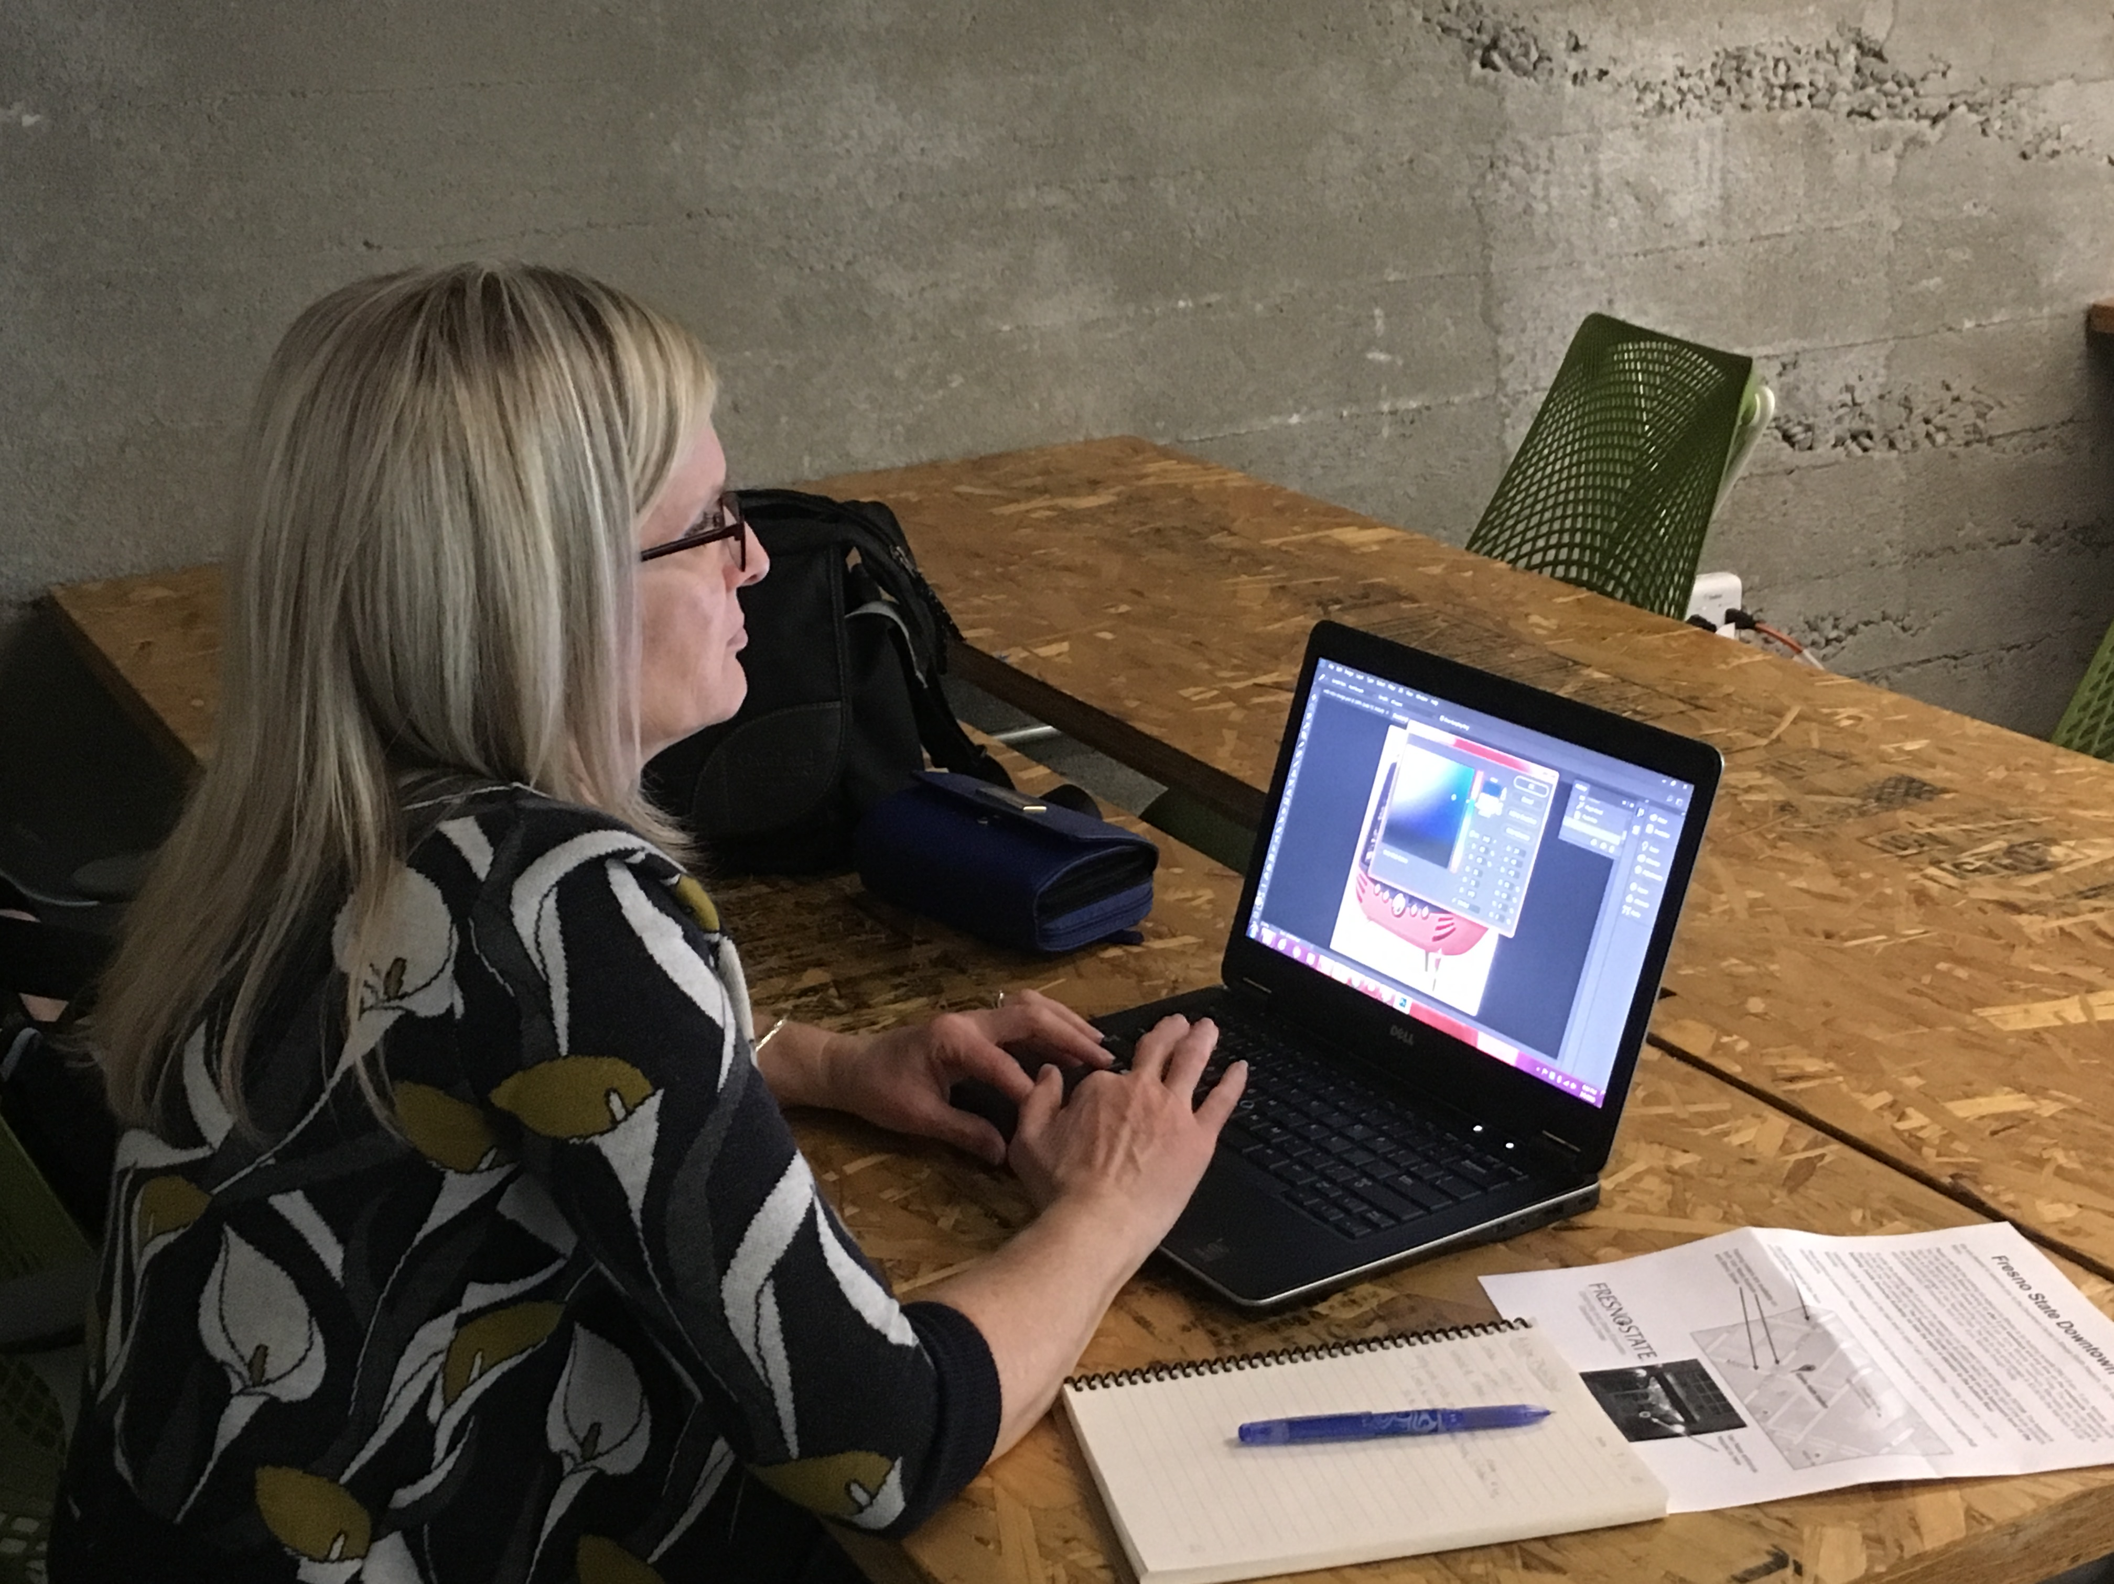
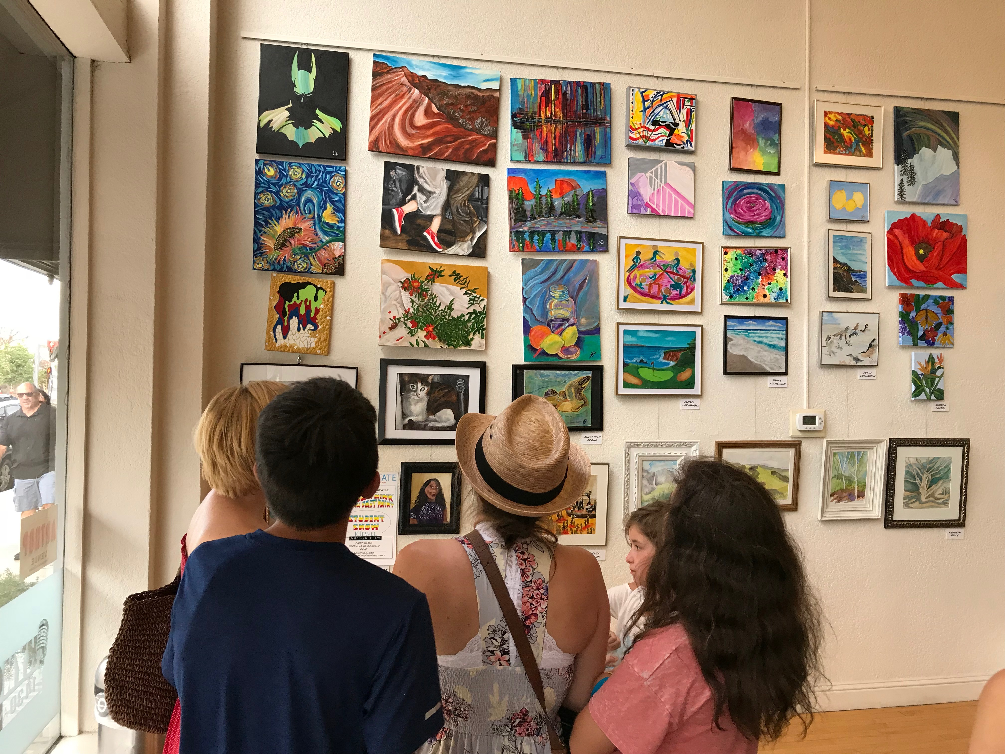
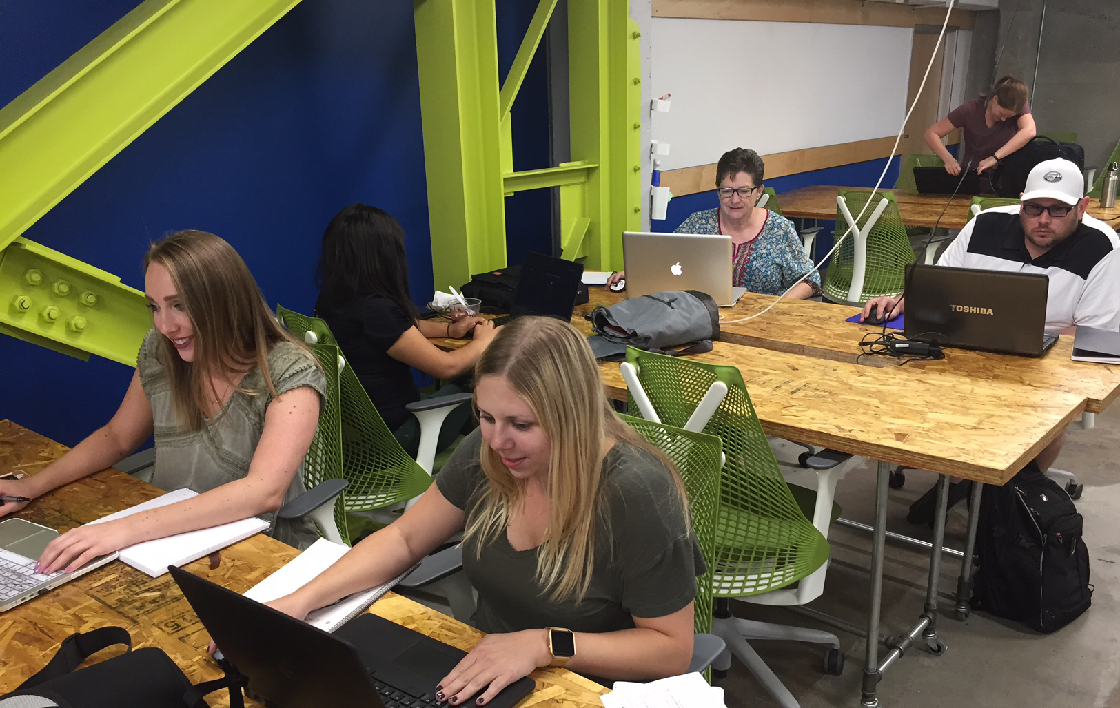
Expanding Educational Access
Fresno State Downtown Center
Architectural history
Brew U
Since 2015, the Downtown Center has provided non-credit professional development opportunities for the community at Bitwise South Stadium. All classes are open to the public and most short-term classes are offered at night and on weekends. Visit FresnoStateDowntown.com for details!
Career skills
Waterwise gardening
Project management
Adobe design software
Fine art painting
Grant writing

