Slide 1
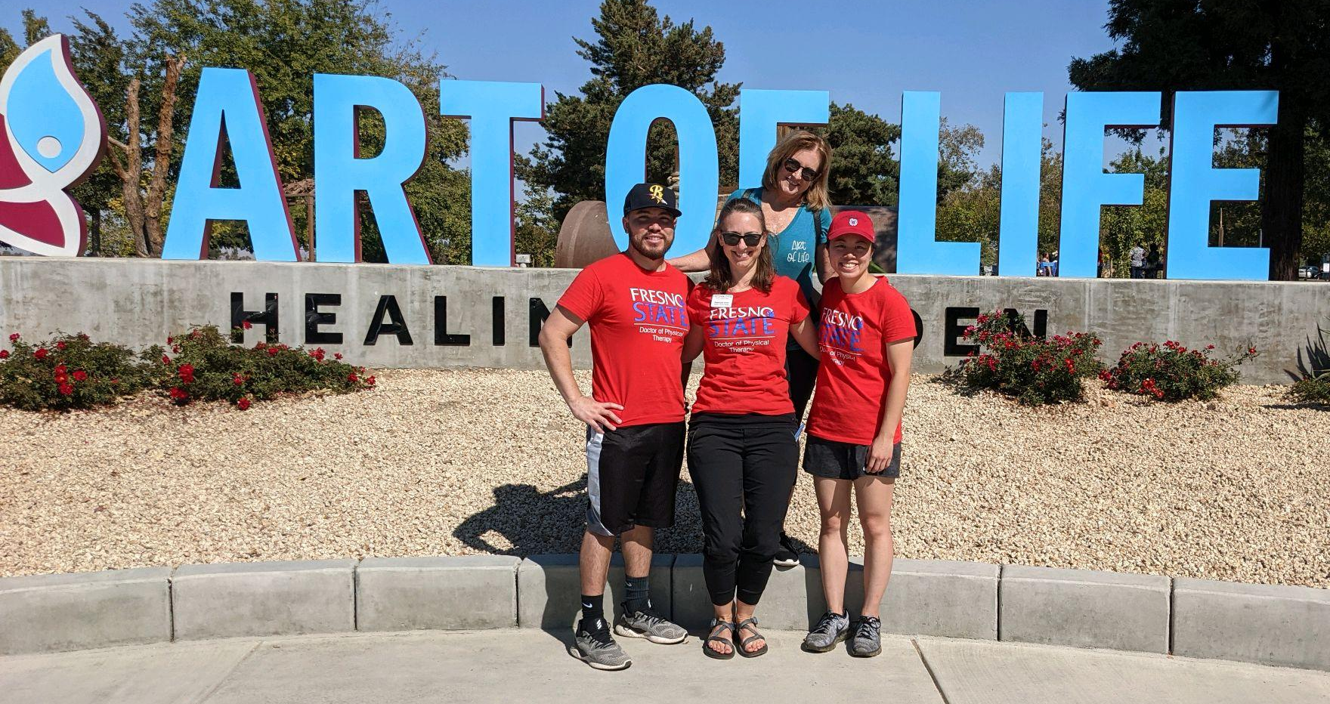
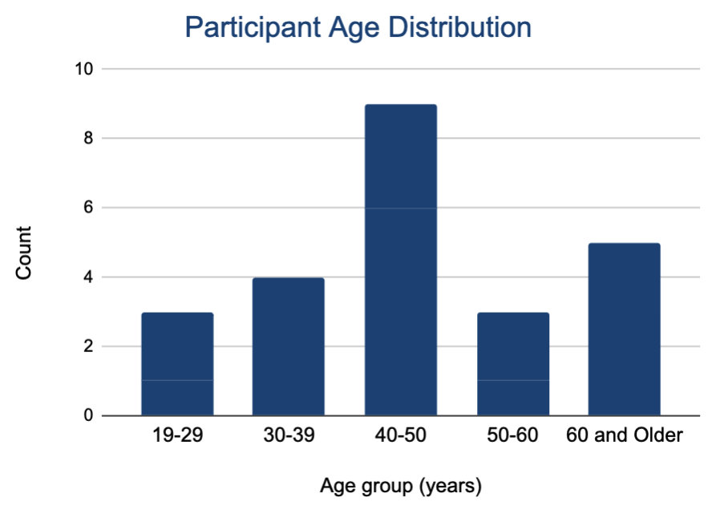
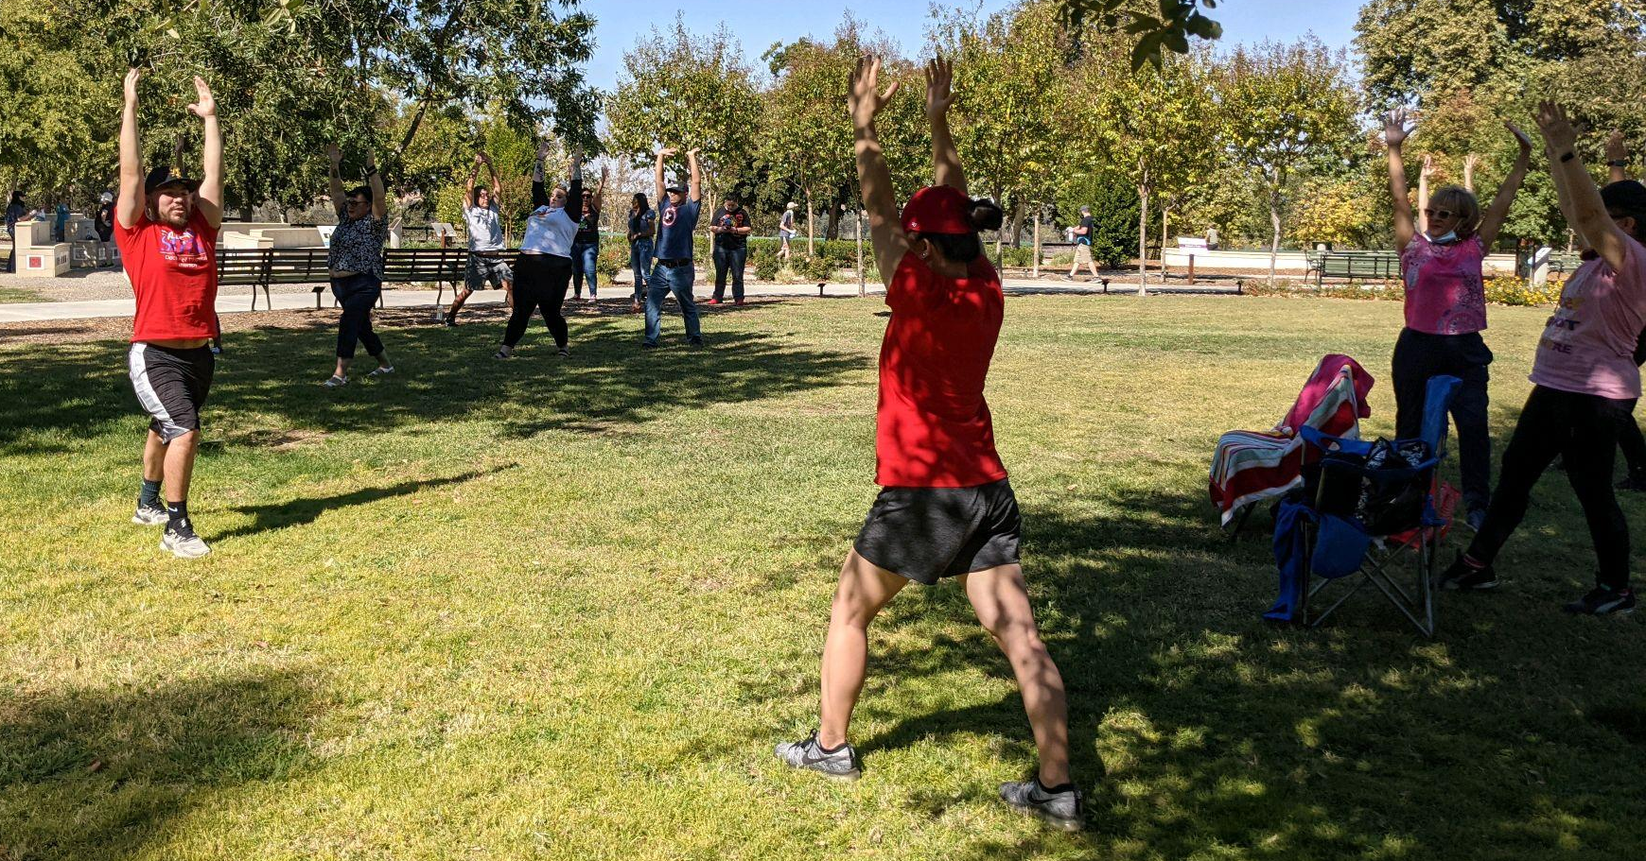
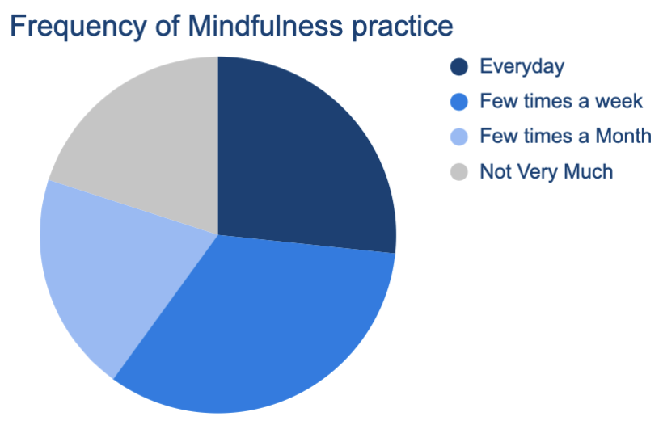
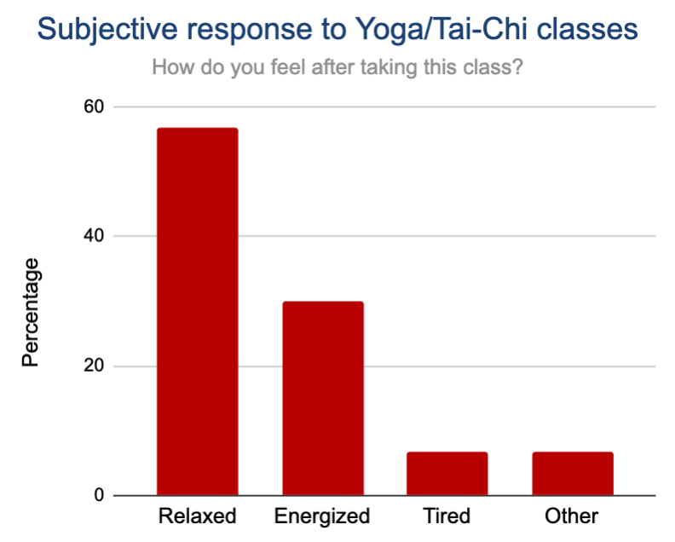
YOGA & TAI CHI FOR CANCER
For questions or additional information please contact:
Stephanie Soleil, SPT
ssoleil@mail.fresnostate.edu
Ernesto Rivera, SPT
erivera1995@mail.fresnostate.edu
Laura Louie, SPT
lauraalouie@mail.fresnostate.edu
References provided upon request.
Stephanie Soleil, SPT, Ernesto Rivera, SPT, Laura Louie, SPT & Jennifer Roos, PT, DPT, GCS
Art of Life
Department of Physical Therapy
California State University, Fresno
Background¹⁻³
About 39.5% of men and women will be diagnosed with cancer and as of 2019 there are 16.9 million cancer survivors in the U.S with an expectancy of increasing by 2030. All though cancer survival rates are improving, the effect of cancer has long term implications of psychological stress, pain, and fatigue that affect quality of life in its survivors. Cancer not only affects the patient, but as well as family and friends causing a variety of feelings such as anger, fear, anxiety, and worry having to also adjust to an unfortunate circumstance as well.
Benefits of Tai Chi & Yoga^{1,4-6}
Tai Chi Improved aerobic capacity, Improved balance control & flexibility aiding in reduced fall risk Reduced body stiffness, fatigue & depression Reduced inflammation to aid in improved sleep Gentle, low impact Mindfulness & psychological well-being Yoga Improved appetite & quality of life Reduced anxiety, headaches & myofascial pain in the upper and/or lower extremities
Our Mission
For DPT students, in conjunction with Art Of Life, to provide meditation, yoga, and dynamic mobility education to cancer survivors and their support system and reduce feelings of stress as well as promote body and mind wellness over the duration of two different classes.
Data & Demographics
Demographics
Total Participants: 24
History of Cancer: 17%
Cancer survivor supporter: 83%
Level of weekly physical activity (Days/Week):
0: 25% 1-2: 21%
3-5: 38% 6-7: 17%
Intervention
Focus: Mindfulness, mobility, yoga, and tai chi Duration: 2x 45-minute sessions Intensity: Low/moderate
Experience with mindfulness:
66% practice mindfulness regularly, 33% novice.
91% Interested in learning more about mindfulness.
Class 1 | Class 2
Warm-up: 5 minutes Body check-in in mountain pose, shoulder rolls, spine mobility (cat/cow), weight shifts, wide stance breathing Yoga poses: 8 exercises each held for 3 breaths Mobility - wide stance flow #1 (spinal wave), ragged doll, wide stance flow #2 (W2, side angle, peaceful warrior), narrow stance flow (high lunge, open book, chair pose) Balance - tree pose, W3 Cool down: 3 minutes Mountain pose body scan | Warm-up: 5 minutes Shoulder & head rolls Tai Chi poses: 7 exercises each held for 4 breaths Heaven, water, thunder, lake, push/pull, front recoil pushes, SL fighting stance Yoga poses: 5 exercises each held for 4 breathes Wide stance flow, prayer squat, tree post, front lunge, sun salutations Cool down: 3 minutes Goddess pose, mountain pose body scan
Key: W2 = Warrior 2; W3 = Warrior 3; SL = single leg
Reflection
Throughout the process of this project, we learned the importance of community outreach and how we can use our knowledge of exercise and mobility to better promote body and mind wellness in communities that have endured high levels of stress.
Perceived Class Intensity
Easy: 42%
Moderate: 58%
Most felt either relaxed or energized after class.
Notes:
References:
Background
Cramer H, Lauche R, Klose P, Lange S, Langhorst J, Dobos GJ. Yoga for improving health‐related quality of life, mental health and cancer‐related symptoms in women diagnosed with breast cancer. Cochrane Database of Systematic Reviews 2017, Issue 1. Art. No.: CD010802. DOI: 10.1002/14651858.CD010802.pub2. Accessed 09 November 2021.
Cancer.gov. Accessed November 9, 2021. https://www.cancer.gov/about-cancer/understanding/statistics
Coping – changes for the family. National Cancer Institute. https://www.cancer.gov/about-cancer/coping/adjusting-to-cancer/changes-for-family. Accessed November 9, 2021.
Benefits of Tai Chi - Taichifoundation.org. Accessed November 8, 2021. https://taichifoundation.org/blog-posts/what-are-benefits-tai-chi-joseph-nordqvist-jul-2019?gclid=Cj0KCQiAsqOMBhDFARIsAFBTN3fhMr2oQLLaacHUS8dE2kVmAaJxj4ds2nyV1R2s9Gyx-SV_P8jAFFEaAiS_EALw_wcB
Purposes of tai chi for pts w/ cancer - https://www.mskcc.org/cancer-care/integrative-medicine/therapies/tai-chi
Benefits of yoga for cancer pts -
Cramer H, Lauche R, Klose P, Lange S, Langhorst J, Dobos GJ. Yoga for improving health-related quality of life, mental health and cancer-related symptoms in women diagnosed with breast cancer. Cochrane Database Syst Rev. 2017;1(1):CD010802. Published 2017 Jan 3.
Rao RM, Amritanshu RR., Vinutha et al. Role of Yoga in Cancer Patients: Expectations, Benefits, and Risks: A Review. Indian Journal of Palliative Care. 2017; 23:225-230.
Poster considerations:
Colors can be changed but should be appropriate combination of Fresno State colors only (red, blue, gray, white – per website)
Use of the school logo – ONLY 1 logo can be placed on a presentation. You can choose the Fresno State “color” or all “white” version seen in this template. Please DELETE the other one!
You can change the background colors, move them around, change their size, add more boxes – this is only here as a GUIDE for you. Get creative – we don’t want all of our projects looking exactly the same!
Include pictures, charts, graphs, pics of you and your zoom meeting supervisor/student team or pic of a zoom presentation. If you attended a location or met with any members of your team in person and you use a pic – think A) is it appropriate? Am I following socially distant guidelines? B) do the people in the picture consent for sharing?
Request use of logo from your community partner – you just need to let them know you are using a representation of their business logo, website/social media picture/title, etc to share on your poster (for example if you worked with a school district – you’d like to share their school logo from website, etc)
If you are working with another course on F.S. campus – you cannot use another F.S. Logo – but you can have a pic with members of the team socially distanced, or via zoom, and list name of class somewhere in your write up sections
Acknowledgement/Thank You section – it goes a long way to thank your community business partner for taking time to share information or expose you to an event, etc… for the purpose of completing this project!
Don’t forget to submit poster through canvas or during group advising for review before you submit it for the symposium!

