Slide 1
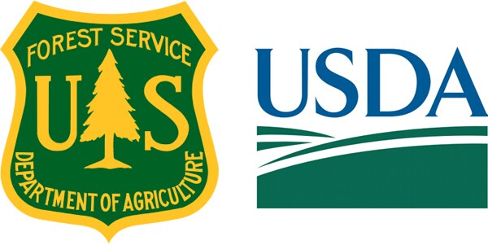
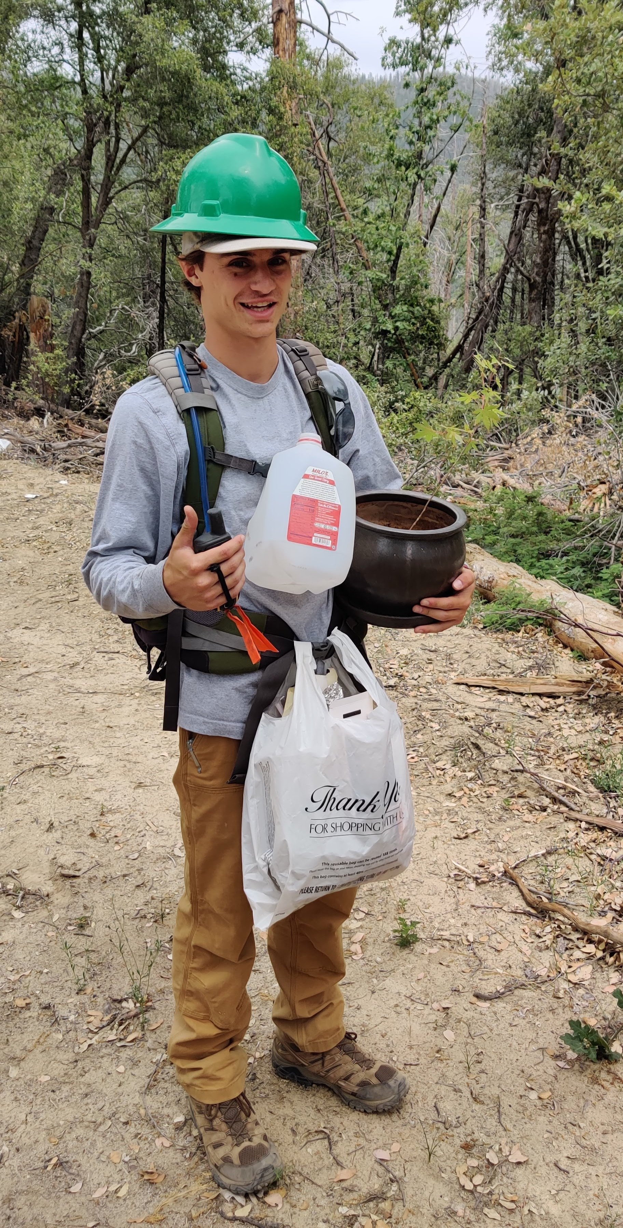
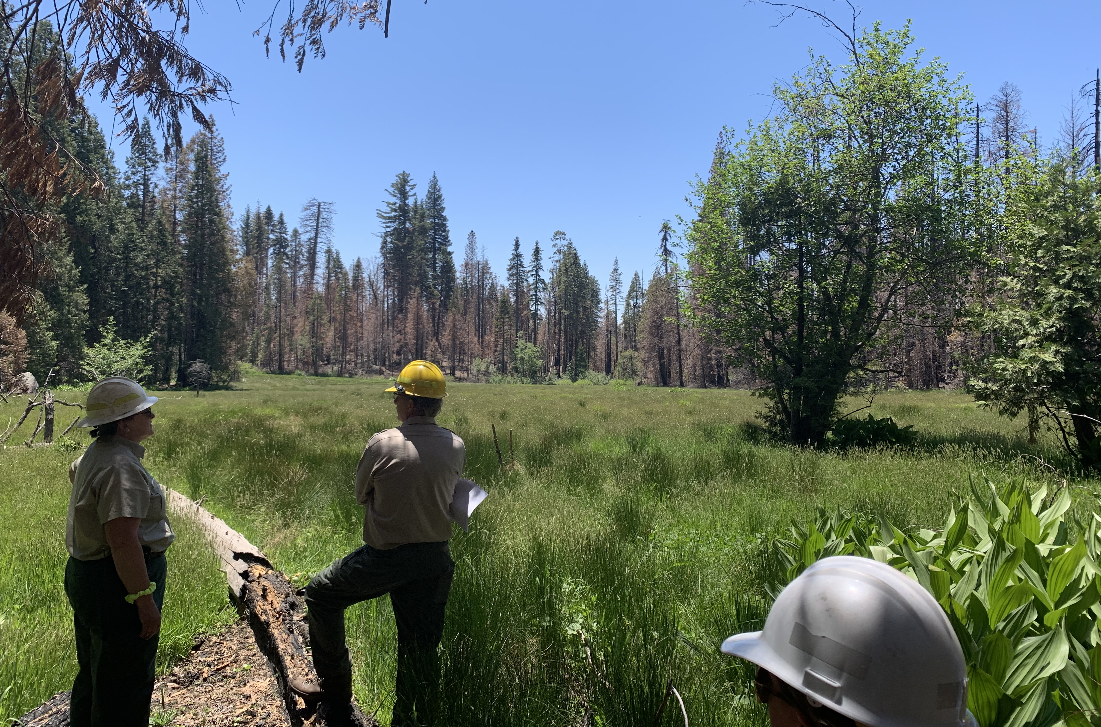
Forest Service Internship
Samuel Willis, COMS 101, Prof. Fiorentino
Community Service Project: Rangeland Management Trainee with USFS Bass Lake Ranger District (North Fork, CA)
150 hours of service recorded
Abstract
This summer I was given the opportunity to work in the US Forest Service as a Rangeland Management Intern as well as enrolling in COMS 101. During this I was able to serve my community and gain new knowledge and experience that I can take into my future career. My service took place across the Sierra National Forest, just south of Yosemite. I was stationed at the Bass Lake Ranger District located In North Fork, CA. During my time with the forest service, I not only got to work with the Rangeland Management Specialist but also the Botany, Wildlife, Recreation, and OHV Specialists and their teams. I had many different duties during my internship. Some of my main jobs were performing rangeland readiness surveys, repairing fences around meadows, clearing roads of debris from fallen trees, performing Goshawk surveys, Dozer Line inspections of native and noxious plants, noxious weed removal, campground inspections, and OHV trail repair. My services as a rangeland management intern directly helped with the problem of overuse in the forest. Building and repairing fences around meadows with threatened species of animals helps to decrease destruction of the meadow by keeping the cattle out. Performing meadow readiness surveys helps the rangeland specialist determine if a meadow is ready to be grazed and how healthy the meadow is compared to previous years. Working with botanists I got to locate and flag areas with invasive or noxious weeds to be removed in the future. This allows the native plants to thrive, which improves the diversity of the forest. Working with wildlife crew performing Goshawk surveys helps the wildlife specialist determine if a project can take place in an area without harming present and future Goshawks, also helping to keep the diversity of the forest. One of the biggest things I learned about the Forest Service is that as an employee, your job is to serve the community you are working with. This happens by keeping the forest and surrounding areas clean and healthy so that the present and future public may enjoy it for many years to come.
Myself during a dozer line inspection (Bass Lake, CA)
Meadow inspection with Cal Fish and Wildlife, USFS Wildlife Specialist and Rangeland Management Specialist (Whiskey Falls, CA)

