Slide 1
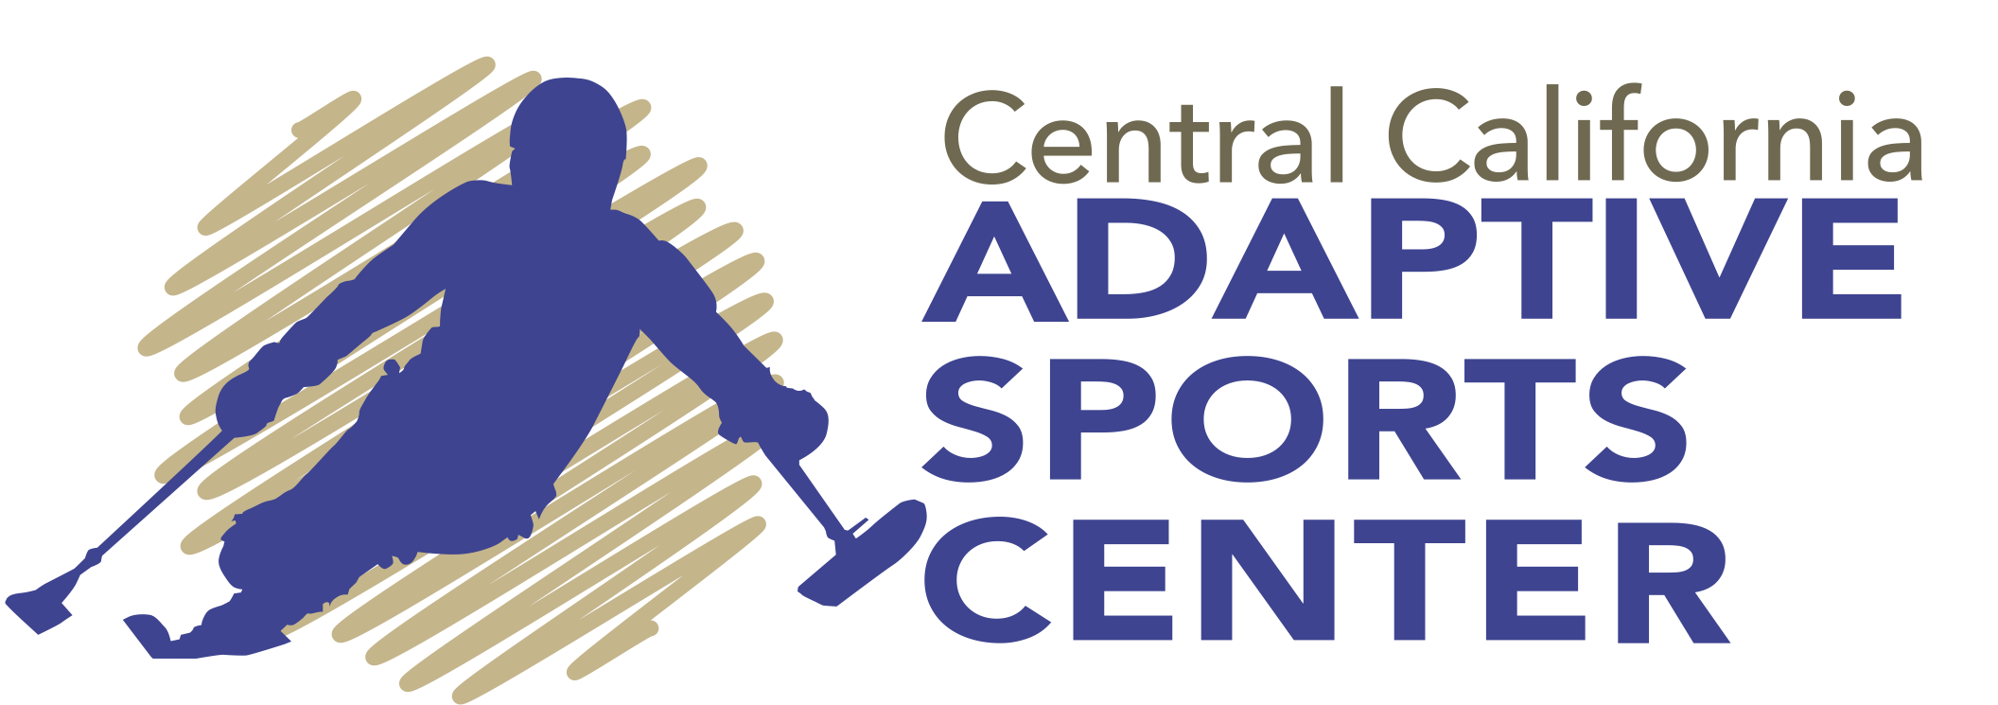
Central California Adaptive Sports Center in Shaver Lake
Kyra Gonzalez
RA 73S, Professor Ruiz , 32 hours
Abstract: CCASC serves disabled individuals with the goal of making outdoors adventures accessible for those with disabilities. I was able to take part in adventure summer program for a camping weekend where I helped participants rock climb, kayak, paddle board, and do yoga with modified technology.
Real World Application: In having the honor to participate in this program, I was able to see through my experience how life-changing this was to participants. One unique experience I had was working alongside an individual who was blind. One day we went paddle boarding and by communicating with him on what was up ahead, where I was, and what direction to go he was able to go to a destination spot we have in Shaver Lake (a tiny cove away from all the boats). He stood up on the paddle board the whole way and back and paddle boarded faster than me! A skill I developed was confidence as this helps with a positive mindset and especially in leading others. I never pictured myself doing this, and I've learned that nothing is ever impossible!
Community Impact
In helping individuals safely kayak and even paddle board across Shaver Lake, I noticed it helped boost their confidence and well-being, both physically and emotionally. "If it weren't for this program, I don't know where I would be now, it's helped me go out as I would always want to stay in", says a veteran from the camping weekend.

