Slide 1
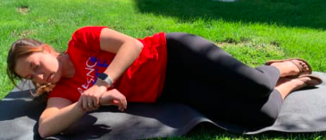
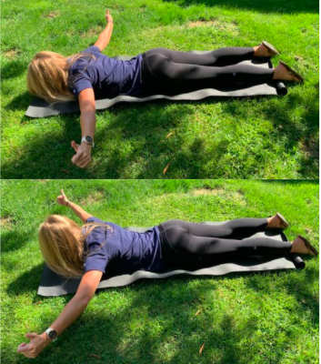
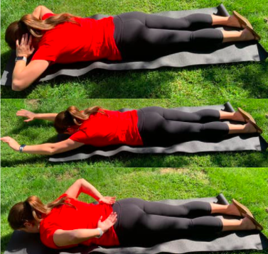
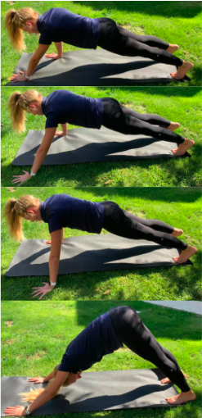
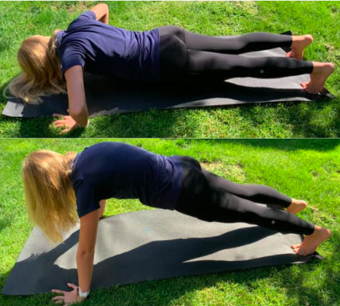
Prevention of Shoulder Injuries in
High School Baseball Athletes
1.
Emma Gabriano SPT, Kristiana Wood SPT, Marisa Burns SPT, Alexa Gonzalez SPT
Kevin Patrick kevinpatrick@clovisusd.k12.ca.us Dr. Jennifer Roos PT, DPT, GCS jroos@csufresno.edu
PHTH 565S Community Wellness Department of Physical Therapy California State University, Fresno
Purpose
To discuss how the impact of glenohumeral internal-rotation deficit, rotator cuff strength imbalance, scapular dyskinesis, thoracic spine hypomobilty, and core weakness increases the risk of shoulder injuries with the Clovis West High School baseball team, which included a consolidated practical prehab program supported by current literature.
Background
Risk factors¹⁻³
Rotator cuff and global shoulder weakness
Limited shoulder mobility in multiple directions
Pitching > 100 innings per year, > 75 pitches per game
Previous shoulder injury and/or pain
Prevalence^{4,5}
Most common in pitchers, and more common in players who are on multiple teams or play year round
½ of youth pitchers experience throwing arm pain at some point during their season
5% of youth pitchers sustain injuries severe enough to require surgery
Reflection
This project taught us the importance of bringing awareness to the community in order to prevent injury. We realized that this population did not have an understanding of their susceptibility for shoulder injuries, let alone how to prevent them to prolong a healthy career.
Participant Demographics:
82% have played baseball for >10 years
82% are pitchers
9% know the recommended pitch count
91% play on multiple teams
77% have had a shoulder injury or pain
Mobility Exercises:
Shoulder + thoracic spine mobility
Sleeper stretch
Strength Exercises:
Prone Ts + Ys
Prone swimmers
Push up plus
3 point tap + downward dog
Thank you Clovis West High School for taking the time to listen to our presentation and actively participate!
1
2
3
4
5
6
For questions or additional information please contact:
Kristiana Wood, SPT kristianacwood@mail.fresnostate.edu
References available upon request
Notes:
Poster considerations:
Colors can be changed but should be appropriate combination of Fresno State colors only (red, blue, gray, white – per website)
Use of the school logo – ONLY 1 logo can be placed on a presentation. You can choose the Fresno State “color” or all “white” version seen in this template. Please DELETE the other one!
You can change the background colors, move them around, change their size, add more boxes – this is only here as a GUIDE for you. Get creative – we don’t want all of our projects looking exactly the same!
Include pictures, charts, graphs, pics of you and your zoom meeting supervisor/student team or pic of a zoom presentation. If you attended a location or met with any members of your team in person and you use a pic – think A) is it appropriate? Am I following socially distant guidelines? B) do the people in the picture consent for sharing?
Request use of logo from your community partner – you just need to let them know you are using a representation of their business logo, website/social media picture/title, etc to share on your poster (for example if you worked with a school district – you’d like to share their school logo from website, etc)
If you are working with another course on F.S. campus – you cannot use another F.S. Logo – but you can have a pic with members of the team socially distanced, or via zoom, and list name of class somewhere in your write up sections
Acknowledgement/Thank You section – it goes a long way to thank your community business partner for taking time to share information or expose you to an event, etc… for the purpose of completing this project!
Don’t forget to submit poster through canvas or during group advising for review before you submit it for the symposium!

