Slide 1
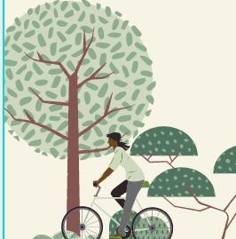
Through this service-learning project, I have come to the realization that I love working in schools. I enjoy the environment of a classroom and how each day is different. The young students come from different backgrounds, but all have the desire to be heard and want to learn. While in college I forgot how impactful school can be for young children. With this, it is necessary for them to have people there each day who really care about their long term growth in life. Because of this service project and the opportunity to work directly with children, I have started a new job where I will be working for a school as an assistant in a classroom. This service project has also led me to start earning my teaching certification in order to teach abroad, which will allow me to continue working in a classroom. I am extremely grateful for the opportunity to experience what it is like to be around younger students again, and find a passion to not only help out in the classroom but also long term by teaching them about their lifestyle choices. It is my hope that my participation in this program will have a positive long term impact on these students.
Cruising to Healthy Living
Jenna Perez
Coms 101
45 Hours
Mission:
This semester I had the privilege of working with Off the Front, a community based organization that works with schools to teach students about health and nutrition. Volunteers go into classes and teach different sessions on nutrition, and then students take quizzes to demonstrate their learning. Students who complete these are awarded bikes. The program’s overall goal is to provide kids with the knowledge of how to live a healthy lifestyle and provide them with a bike to start implementing it.
Community:
While the impact of this service-learning project might not be seen immediately, I have taught many young students the importance of implementing and maintaining a healthy lifestyle. It might seem like common knowledge that a fruit flavored gummy snack does not usually have the same nutritional value as an actual piece of fruit. However, in the sessions I taught, numerous students did not know this. Learning how to make a simple substitution like this in their day to day life is important. Through explanation and numerous class discussions, many of the students grew their knowledge about what is or is not beneficial to their body long term. These revelations are important not only for the students but the community in general. The more students we have choosing fruits and vegetables, and encouraging their parents to do so as well, the healthier our community will be. While not every student is going to choose an apple over chips, at least now they know that the apple would benefit their body more and have the knowledge of what is or is not healthy for their body.
Learned:

